Slide 1
COVID Project
Emily Rhodes
March 3rd, 2021

Slide 2
Simulation Update:
Mutant/Control | 12-1 | 12-3 | ACE2 | 12-1 gg | b38
Control | 100 ns | 100 ns | 33.054 ns | npt_prod | npt_prod
Control Whole Spike | 17.430 ns | 15.220 ns
D420E | 99.642 ns | 91.926 ns |  | npt_prod
D420K | 60.654 ns | 58.040 ns | 21.570 ns | npt_prod | npt_prod
E484K | 54.196 ns | 66.744 ns |  | npt_prod
E484N | 54.962 ns | 77.696 ns |  | npt_prod
I358F | 100 ns | 100 ns |  | npt_prod
K417D | Kayla | 67.972 ns |  | npt_prod
K417I | Kayla | Kayla |  | npt_prod
K417M | Kayla | 90.512 ns |  | npt_prod
K417N | Kayla | Kayla |  | npt_prod
K417P | 69.580 ns | Kayla | 30.234 ns | npt_prod | npt_prod
N501Y | 95.300 ns | 92.578 ns |  | npt_prod
Y421H | 100 ns | 100 ns | 41.840 ns | npt_prod | npt_prod
Y421N | 45.486 ns | 37.854 ns |  | npt_prod
Notes:
Blue = Finished last run, need to start next step
Red = failed
Yellow = waiting
Green = running
Send updated table to Kayla
- Keep track of job time

Slide 3
Methods
MD Simulation
GROMACS108.3 was used for all MD simulations along with the TIP3P (TIP 3-point) water model and AMBER99SB-ILDN force field (AMBER94) to model the receptor binding domain (RBD), antibodies (12.1 and 12.3), angiotensin-converting enzyme 2 (ace2) and spike protein (S protein). This force field “maintains a lattice structure nearest that seen in the X-ray data” according to Cerutti et al. [1] Simulations containing the RBD and an antibody (either 12.1 or 12.3) had approximately 191952 atoms (approximately 182541 of which were water atoms). All models contained a positive charge were neutralized by the addition of Cl- ions also modeled with the AMBER99SB-ILDN force field. A steepest descent energy minimization of the initial coordinates for each system was run for 5000 steps. NVT equilibration was run for 0.5 ns at 310 K with velocity rescaling temperature coupling. NPT equilibration was run for 1 ns at 310 K and 1.0 bar also with velocity rescaling temperature coupling. The time constant for coupling in both the NVT and NPT steps was 0.1 ps. Production simulations in the NPT ensemble were then carried out at 310 K and 1.0 bar with velocity rescaling temperature coupling and the Parrinello–Rahman barostat. Long-range electrostatic interactions were calculated with particle mesh Ewald summations using a cutoff of 1.0 nm. At a distance beyond 1.0 nm interactions were assigned a value of 0. Neighbor lists were updated every 10 steps with a cutoff of 1.0 nm. Furthermore, periodic boundary conditions were used in all simulations. Simulations ran for a total of 100 ns.

Slide 4
Proposed Mechanisms
Mutant/Control | Idea
Control
Control Whole Spike
D420E | acid to acid: one extra carbon = sterics?
D420K | neg to positive: charge = electrostatics?
E484K | neg to positive: charge = electrostatics?
E484N | N has one less carbon and an amine group instead of oygen - is Q just as good of an escape mutant (if it isn't the carbon has a role)
I358F | carbon chain to ring = sterics?
K417D | positive to neg: charge = electrostatics?
K417I | charge to hydrophobic: interaction with water?
K417M | charge to hydrophobic: interaction with water?
K417N | added oxygen and shorter chain - not interacting with water the same way
K417P | now a ring and much different nitrogen configuration - water
N501Y | polar to hydrophobic - water
Y421H | both rings oxygen to nitrogen? Charge? *Can’t make H20+ (electrostatic driving force)
Y421N | oxygen to nitrogen - similar to H minus ring?

Slide 5
Mechanisms From Watching
Mutant/Control | 12-1 | 12-3
Control | There is some space between the antibody and RBD. Resid 417 is more central while 420 and 421 are off to the side. The centrality of 417 in addition to the strong influence for polar/apolar groups depending on the antibody suggests that the water location and strength of interaction is key in influencing the way the antibody interacts with the antigen. | whole
Control Whole Spike
D420E | whole | whole
D420K | The negatively charged acid tail interacted with resid 56 (SER). This residue was searching for a point of contact on the RBD when the mutation occured. The lysine is unable to form this connection due to it's nitrogren group and therefore, there is no point of contact between the antibody and antigen at this location. | whole
E484K | whole | whole
E484N | whole | whole
I358F | whole | whole
K417D
K417I
K417M
K417N
K417P | The proline forms a ring that is bound to itself. The lack of flexibility prevents the residue from rotating and binding with resid 841 (ASP). It is stiff and short and this space changes the way the antibody interacts with the RBD. | whole
N501Y | whole | whole
Y421H | The histodine has several nitrogens and a positive charge as opposed to a negative charge. It iteracts with the loop formed by resid 794 to 796. This prevents the residue from sitting nicely in the pocket formed by this loop and instead, twists and turns pulling back intoself rather than interacting strongly with the antibody. | whole
Y421N | whole | whole

Slide 6
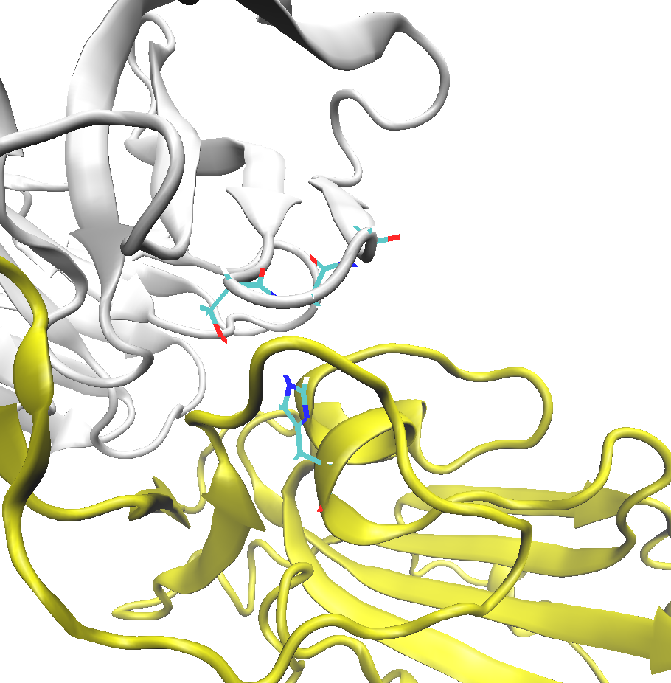
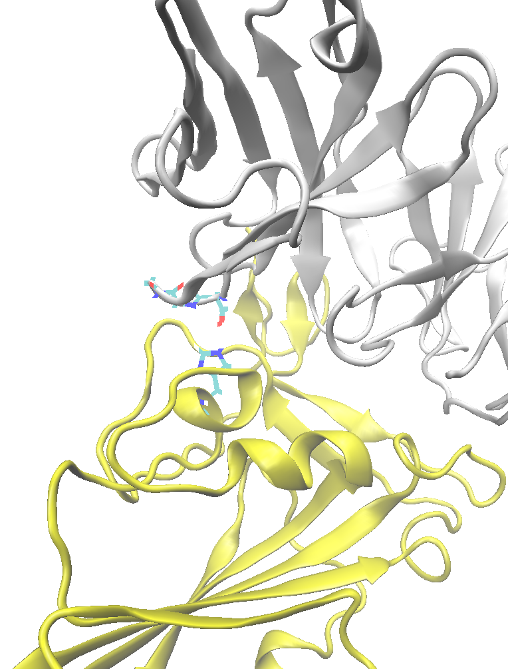
Snapshot - 421

Slide 7
Additional Sims
Extending finished sims – 100 ns
RBD in water (alone, no antibody)
Other antibodies

