Slide 1
Engineering antibody-based molecules for HIV treatment and cure
By: Marina Tuyishimea and Guido Ferraria

Slide 2
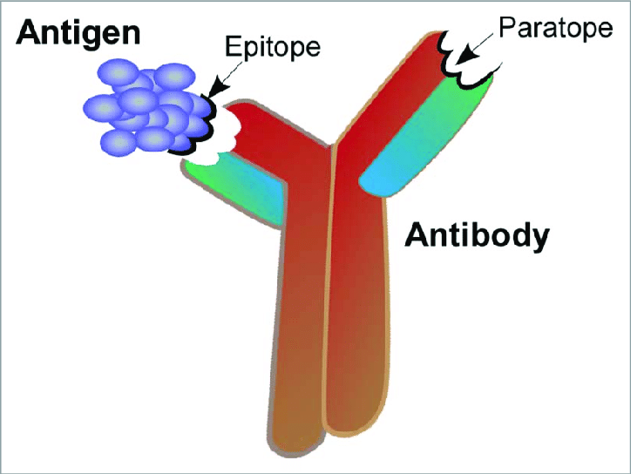

My Project and Why This Paper is Relevant
My project:
Affinity Maturation understand composition matching of antibody/antigen complex at various epitopes/paratopes
Relevance:
Which antibodies are currently effective and why?
Can this guide our insight into composition matching of antibody/antigen complexes?
Do the complexes described also employ composition matching?
$$→$$
https://i.stack.imgur.com/PtNdP.png
Notes:
A paratope, also called an antigen-binding site, is a part of an antibody which recognizes and binds to an antigen.
An epitope, also known as antigenic determinant, is the part of an antigen that is recognized by the immune system, specifically by antibodies, B cells, or T cells.
In short, we found that as some antibodies evolve through affinity maturation against a binding region ("epitope") on the surface of HIV called the CD4 binding site, they make mutations that result in the antibodies having a much closer amino acid composition and electrostatic pattern at the antibody/antigen interface to that of the antigen itself (e.g., see the attached screenshot of a figure from our unpublished paper for reference - note that acidic fractions evolve to match basic fractions, and vice versa). This is surprising because it says that these antibodies do not just make a small subset of key mutations that increase the binding energy against the antigen, as was perhaps thought to be the case, but instead first employ this "composition matching" scheme as a general means of binding, followed by specific mutations, almost like the lock-and-key mechanism of enzyme/ligand binding. As you can see in the figure, we only studied this for a small handful of antibodies, and only to a single epitope on HIV. I would like to understand how widely this finding applies to other antibodies against other epitopes on the surface of HIV, and potentially also epitopes on the surface of influenza. So, this project would entail large-scale analysis of existing PDBs of antigen/antibody complexes. Potentially, then, we could run affinity maturation simulations with antibodies with different initial degrees of composition matching, and see how that influences the process, comparing again to my past work with one specific antibody (VRC01, as in the figure).

Slide 3
Current Treatment
ART (Antiretroviral therapy)
Consists of multiple (3+) Antiretroviral drugs to suppress the virus
Benefits:
reduce viral load
immune system can recover
Drawbacks:
toxicity over time
allergic reactions
bleeding
bone loss
heart disease
etc.
https://www.who.int/health-topics/hiv-aids/#tab=tab_1
www.medicalnewstoday.com
www.healthline.com
Notes:
Add more info about current treatment
onsists of the combination of at least three antiretroviral (ARV) drugs to maximally suppress the HIV virus and stop the progression of HIV disease.

Slide 4
Proposed Solution
Instead use bNAbs (broadly neutralizing antibodies) that target epitopes on the HIV-1 envelope (Env)
Decreased toxicity
Improved pharmacokinetics
Able to interact/recruit immune cells
Other options for people who ART doesn’t work for

Slide 5
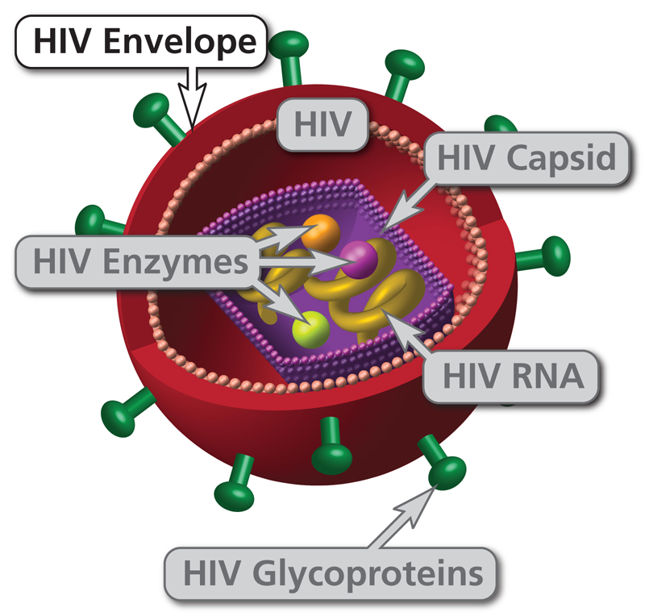
HIV Envelope
“The outer coat of HIV, made up of two layers of lipids (fatty molecules). HIV uses protein "spikes" embedded in its envelope to enter host cells.”
aidsinfo.nih.gov,

Slide 6
Adjusted Solution
With just 1 or 2 bNAbs: resistance develops
Instead bispecific or trispecific bNAbs
bsNAbs (bispecific broadly neutralizing antibodies)
tsNAbs (trispecific broadly neutralizing antibodies)
Increased breadth – overcome diversity of HIV
Overcome natural resistance
Less need to administer multiple antibodies

Slide 7
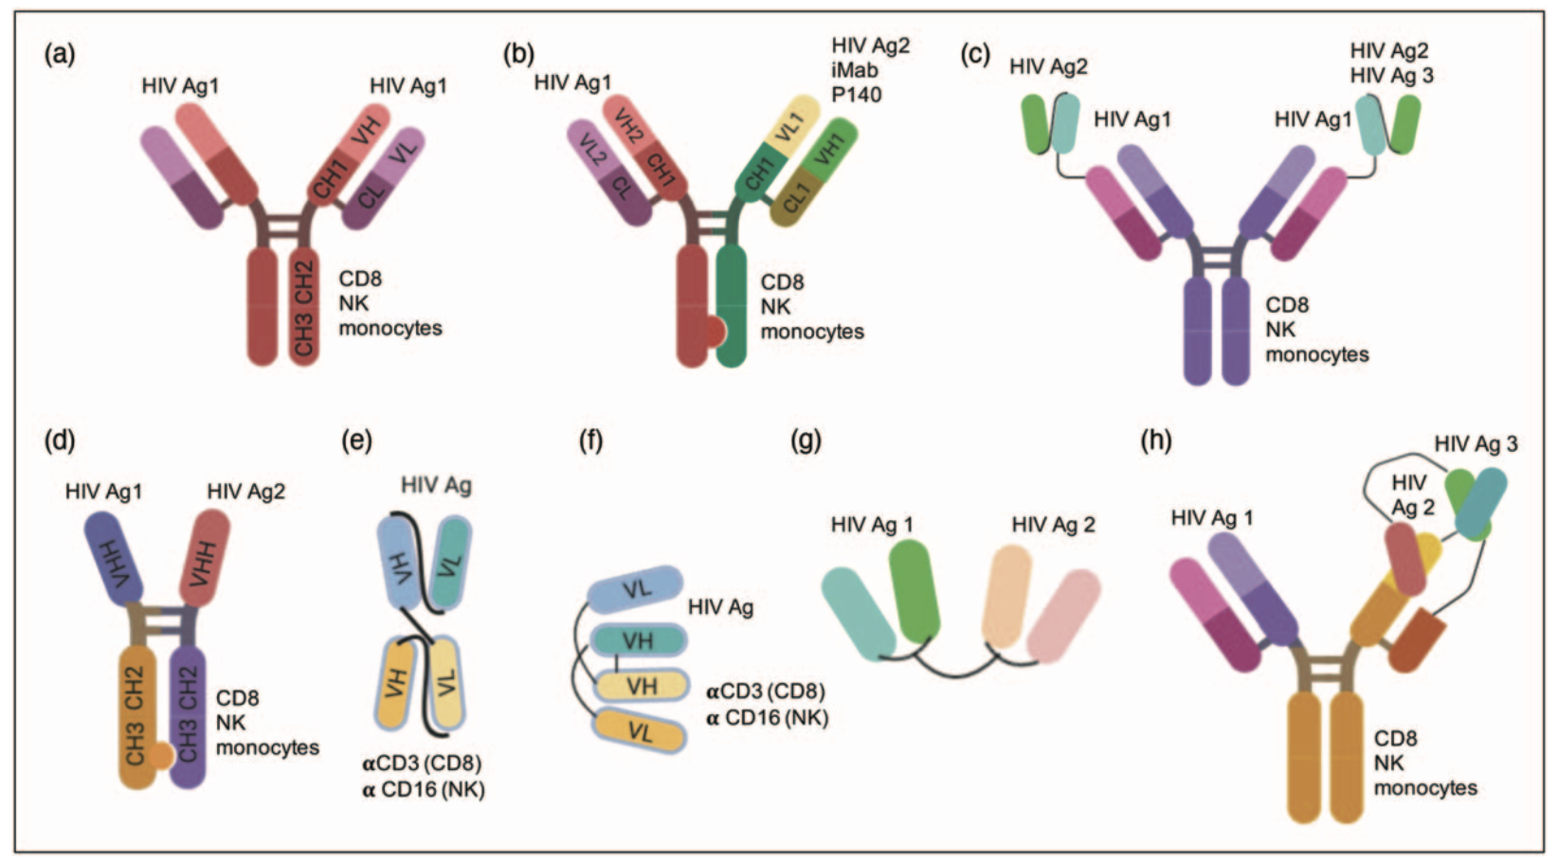
IgG-like bispecific-antibodies
Either:
Identify 2 epitopes on HIV
Identify 1 epitope on HIV + cellular receptor
Were able to:
“effectively concentrate inhibitory molecules at the cell surface and to better engage the Env epitopes during virus – cell interaction”
Notes:
Llama:
The small size of VHH (13 – 15kDa) allows them to bind the cavities that are difficult to reach for traditional antibodies (150 kDa), and for the CDR3 loop to protrude further within the cavity to reach neutralizing epitopes on the Env.
demonstrated increased breadth but not potency
Cellular receptor

Slide 8
Non-IgG-like bispecific-antibodies
Bispecific T-cell engagers bind to CD3 or CD16 with one arm and to HIV-1 Env with another
higher K_{D} with CD3
improved stability
improved half-life of the molecule
retained the neutralization breadth and potency of the antibody component
smaller in size compared with traditional antibodies
reduced production cost
able to penetrate tissue more easily
limited in vivo pharmacokinetics

Slide 9
Trispecific Antibodies
Three Parts:
tsAb targeting membrane-
proximal external region (MPER)
V3 glycan
V2 apex
Benefits:
improved strength of binding between antibody and antigen
simultaneous epitope engagement on the same envelope
Notes:
the overall strength of binding between an antibody and an antigen.
highly conserved region of the envelope glycoprotein (Env) gp41 subunit near the viral envelope surface

Slide 10
Key Design Constraints
If antibody is targeting envelope trimer, it could have limited efficacy based on the expression of this protein
There could be steric inhibition if two envelopes never get close enough to be engaged by one bsAbs or tsAbs molecule at the same time
Linker must be:
Flexible to bind allow binding to each epitope
Not hinder folding and assembly
Not to be cut off during manufacturing or by proteases
Notes:
“The HIV-1 envelope (Env) spike protein mediates entry into cells. Since the Env trimer is the only viral protein on the surface of HIV-1, understanding its structure and activation by the CD4 receptor and coreceptor is vital for the design of vaccines and antiviral therapies.”
“Proteases: an enzyme which breaks down proteins and peptides”

Slide 11
Summary
Bispecific and trispecific broadly neutralizing antibodies target 2+ independent epitopes on the HIV-1 envelope
Benefits:
improved strength of binding between antibody and antigen
simultaneous epitope engagement on the same envelope
improved neutralization potency and breadth compared with single parental antibodies
If engaging cellular receptors with one arm: help concentrate inhibitory molecules and effector cells to the sites of potential infection
Notes:
targeting the cell receptor with one arm could potentially block cell-mediated spreading of infection

Slide 12
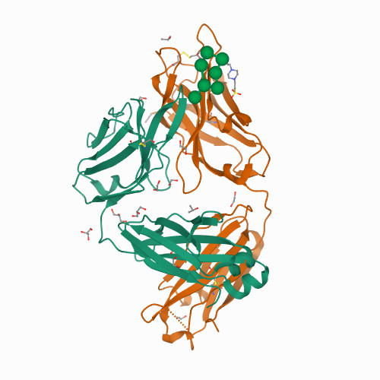
Questions?
I started looking up some PDB structures…
https://www.rcsb.org/structure/6B3D
Notes:
Crystal structure of anti-HIV antibody PGT128 in complex with a bacterially derived synthetic mimetic of Man9.

Slide 13
Discussion Questions
What are the key components of antibodies that make them successful and what would the corresponding ”weight” of each feature be?
Binding strength
Specific epitope engagement
Etc.
Hypothetical: If you were a HIV virus what would annoy you the most if someone was attacking/labeling you?

Slide 14
Types of Antibodies Described:
Notes:
Label each antibody with its type
https://www.rcsb.org/structure/6B3D
Normal antibody
Bi specific – IG-like
b. scFvs with a single Fc chain from two distinct antibodies to form a traditional Y-shaped antibody structure
iMab is a mAb that binds to domain 2 of human cellular receptor CD4
c. Exchange the scFv of one bNAb with the scFv of another bNAb or fuse it to a full length bNAb via a flexible linker in a scFv tandem format
d. Using cova- lently linked VHH CrossMabs with ‘knob-in-hole’ technology also increases potency due to an increase in avidity
Bi specific – non-IG like
e. bind to CD3 or CD16 with one arm and to HIV-1 Env with another
f. disulfide linking of two arms and, there- fore,
g. Another format of bsAbs is a tandem single chain variable fragment (scFv1-scFv2). These bsAbs are similar in structure to BiTE or DART molecules but target two distinct HIV-1 antigens with each arm
Trispecific
h. This tsAb was designed as a PGDM1400 antibody with one Fab was switched to the VRC01 Fab, and the scFv of the other PGDM1400 Fab was linked to the scFv of 10E8.4 in a reverse-order tandem-forming cross-over dual variable Ig

Slide 15
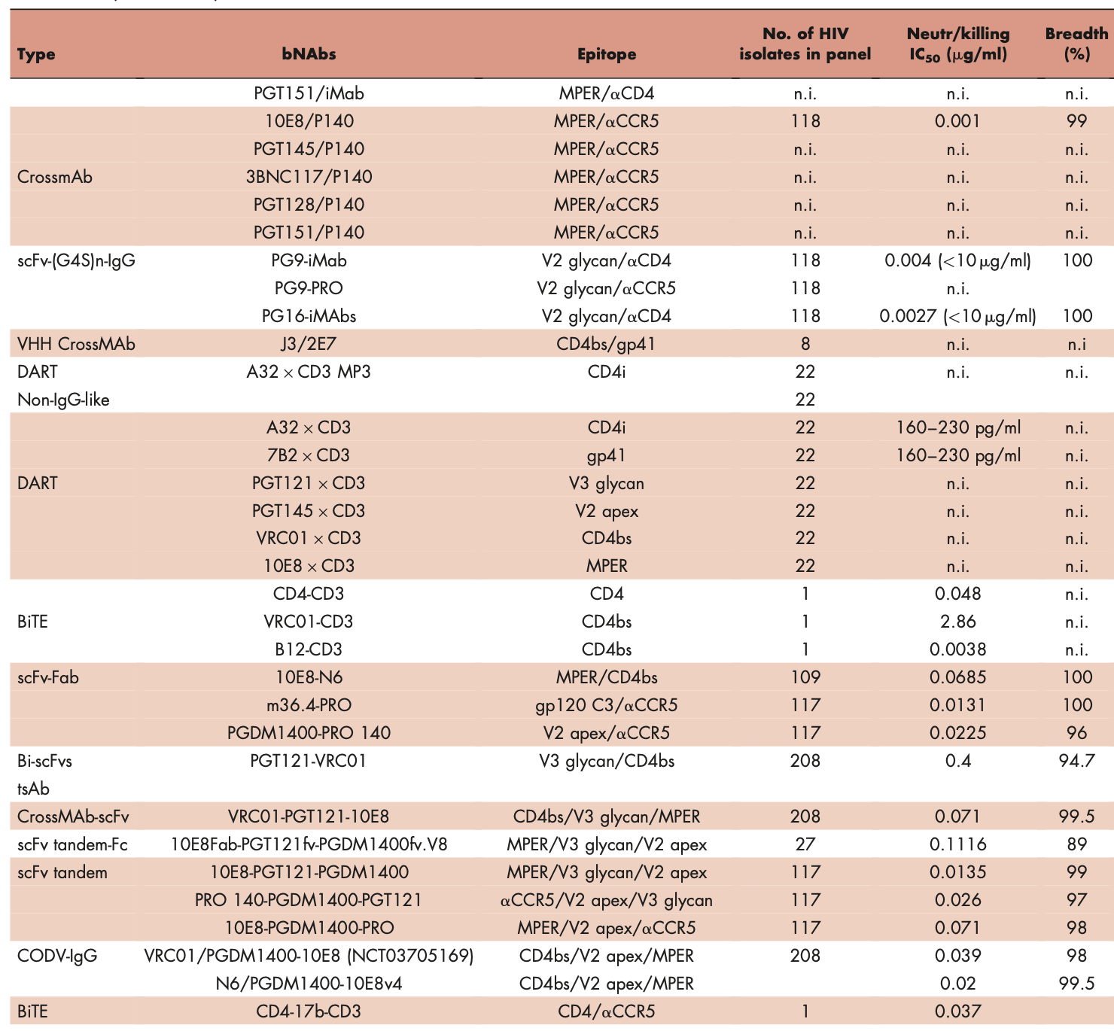
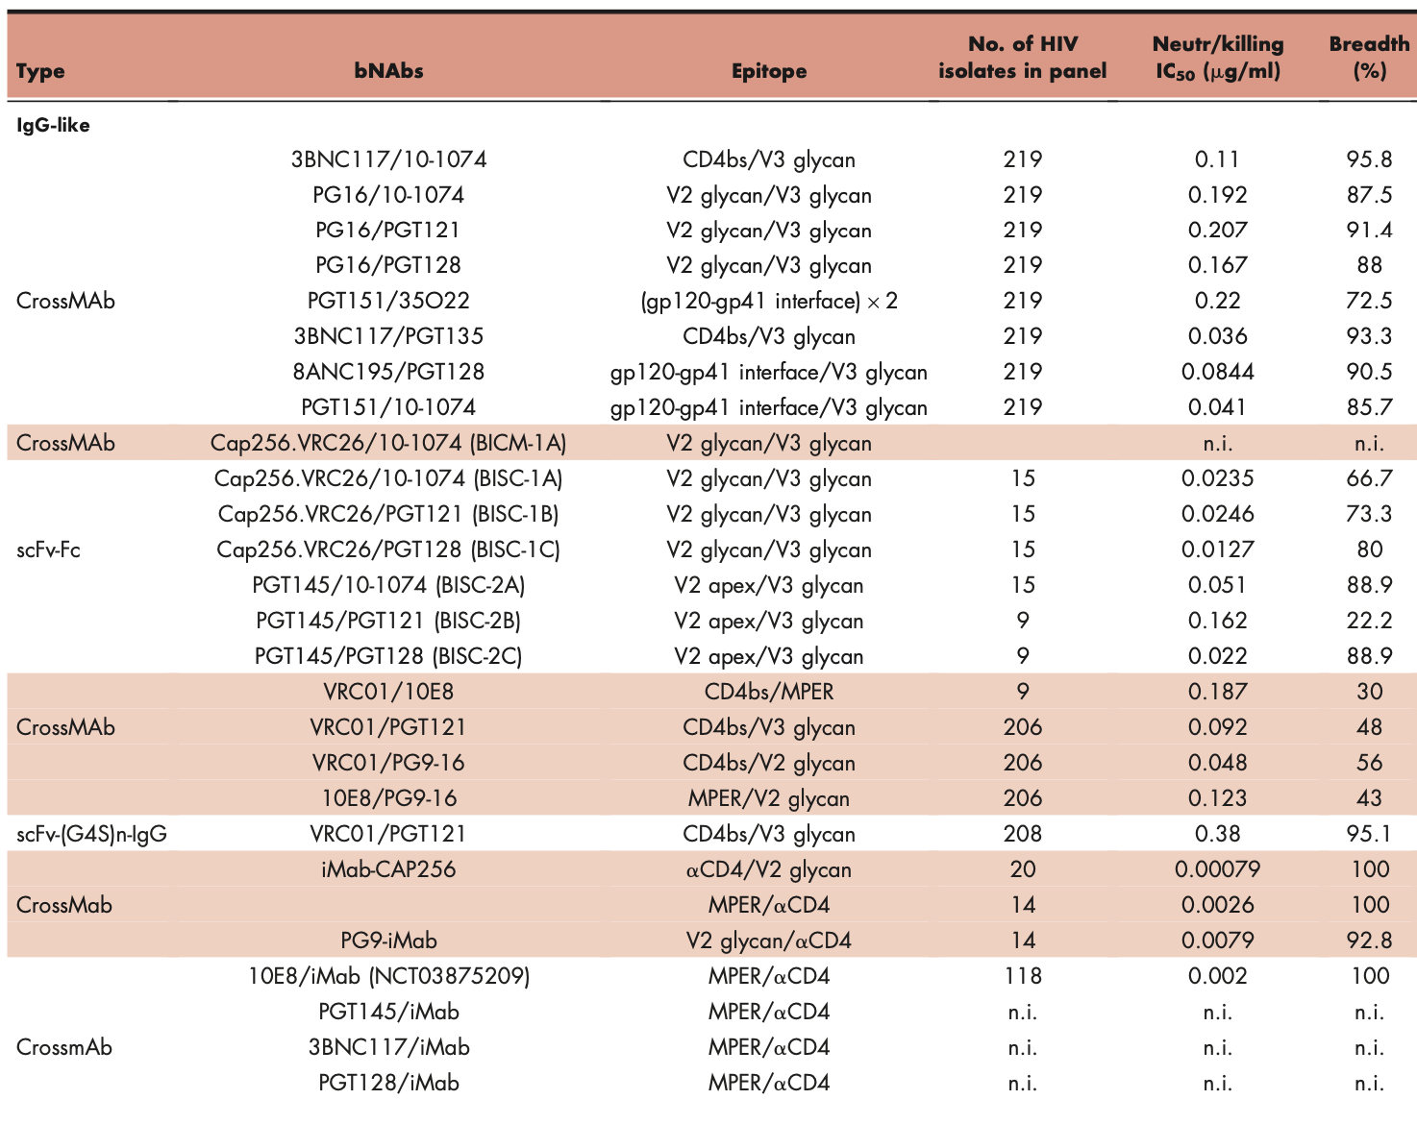
Antibodies + Epitopes
Helped me aggregate a nice list of antibodies/antigen complexes to analyze for composition matching!
Notes:
Helped me aggregate a nice list of antibodies/antigen complexes to analyze for composition matching

Slide 16
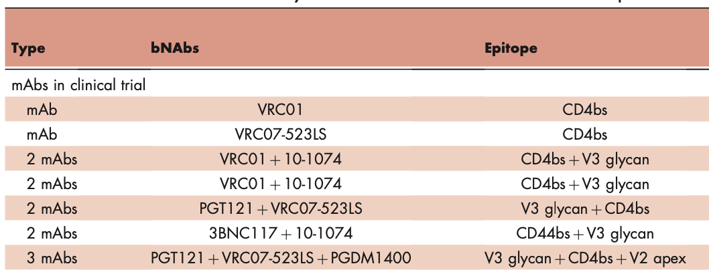
Antibodies in Clinical Trials

