Slide 1
Mechanisms & Biology behind Influenza and HIV
Emily Rhodes
Sprenger Lab Group Meeting
September 18th, 2020

Slide 2
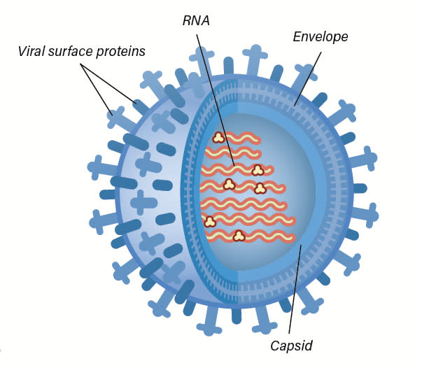
What is a virus?
“A virus is genetic material contained within an organic particle that invades living cells and uses their host's metabolic processes to produce a new generation of viral particles.” - https://www.sciencealert.com/virus
Notes:
Single strand RNA and single strand DNA
Just a package of molecules

Slide 3
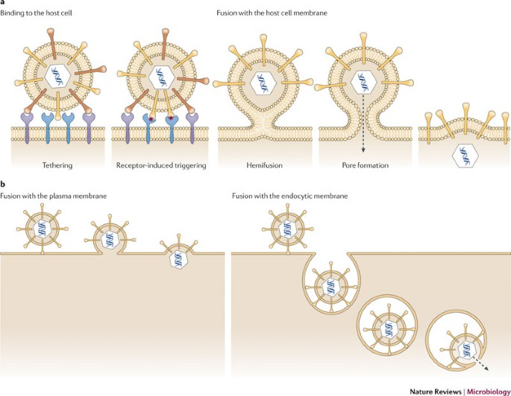
How do viruses attack cells?
Attached itself to cell
Fuse with cell + release capsid
Receptor fusion
Endocytosis
Inject material into bacterium

Slide 4
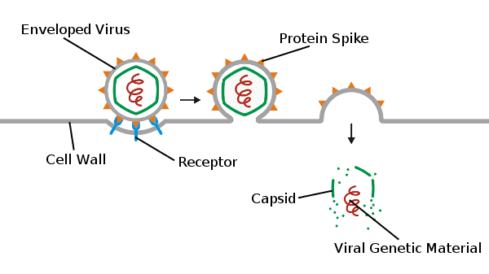
Genetic Material Released
Notes:
Genetic material
Hijack ribosomes to replicate themselves
Make proteins – kill native proteins

Slide 5
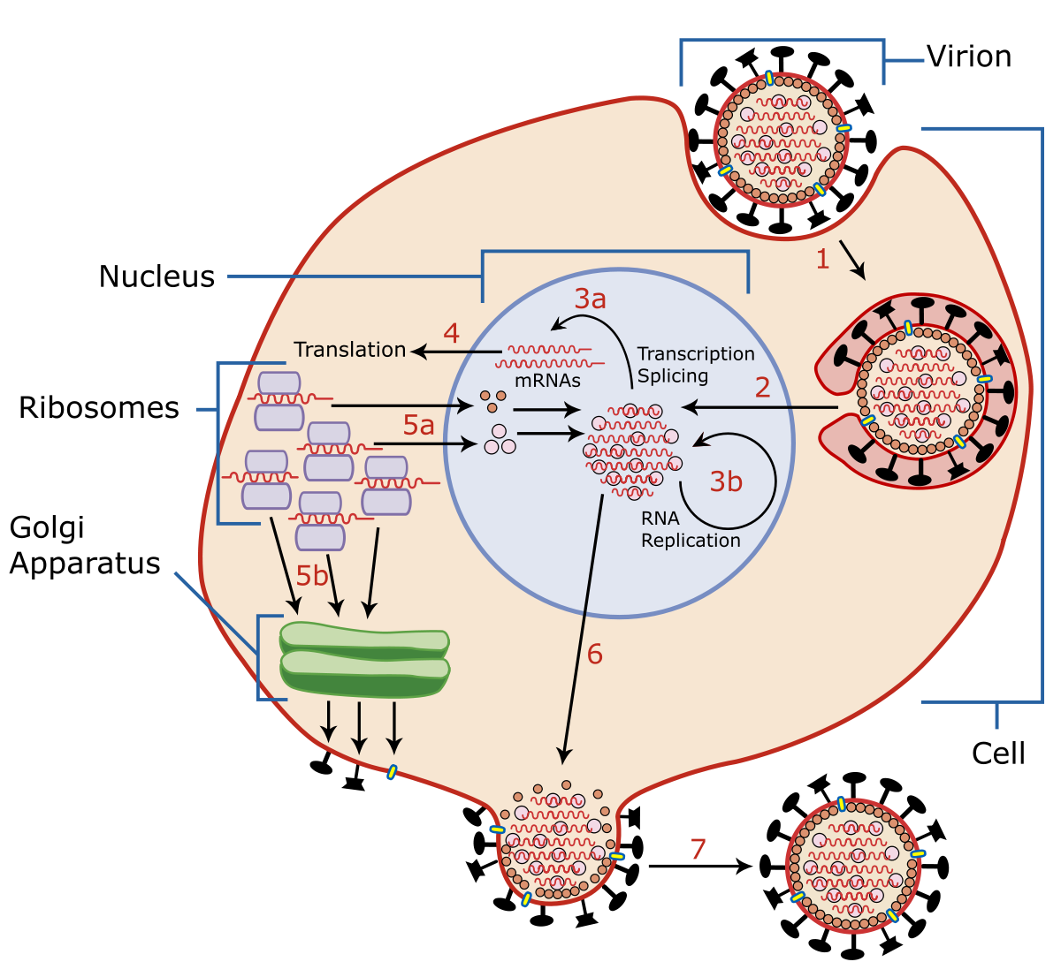
Viruses Use Cells’ Machinery

Slide 6
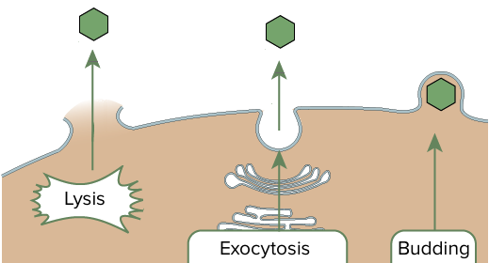
Virus Exits the Cell
Notes:
Exit cell
Lyse cell or bud off of cell (Lytic)
Release a bunch of viruses

Slide 7
Influenza (Illness)
Key traits:
Starts abruptly
Lasts 3-7 days
Can contract influenza for 4 days and be asymptomatic
Both respiratory and constitutional symptoms
Definition: (CDC) sore throat or cough and fever
Influenza-like Illness (ILI)
Respiratory | Constitutional
Air going through respiratory track Stuff nose Sore throat Cough | Whole body Fever/chills Body aches Fatigue

Slide 8
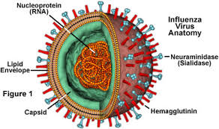
Influenza (Viruses)
Surface proteins: H & N proteins
H = hemagglutinin
Holds sialic acid on the cell membrane (enter)
N = neuraminidase
Cuts sialic acid (exit)
Capsid inside the virus
RNA inside the capsid
Notes:
Copy cat viruses: rhino virus (nose), RSV (respiratory syncytial virus)
Think you are dealing with influenza

Slide 9
Types of Influenza
Type A:
1
Highest mutation rate (genetic drift)
Genetic shift
Type B:
2
Middle mutation rate (genetic drift)
No genetic shift
Type C:
3
Slowest mutation rate (genetic drift)
No genetic shift
Only respiratory symptoms
Notes:
Type A flu: (almost all in birds, except H17N10 which is in bats)
Mixing of RNA – mix protein that is displayed on the surface
Genetic shift: a dominant virus is able to affect a bunch of people
Named by the type of proteins on their surface
H1N1 and H3N2 (most common right now)
- Good job transmitting from person to person

Slide 10
Genetic Change of Virus
Mutations over time in genetic material
Genetic drift
Make mistakes on replication
Genetic shift
Replace entire sections of RNA

Slide 11
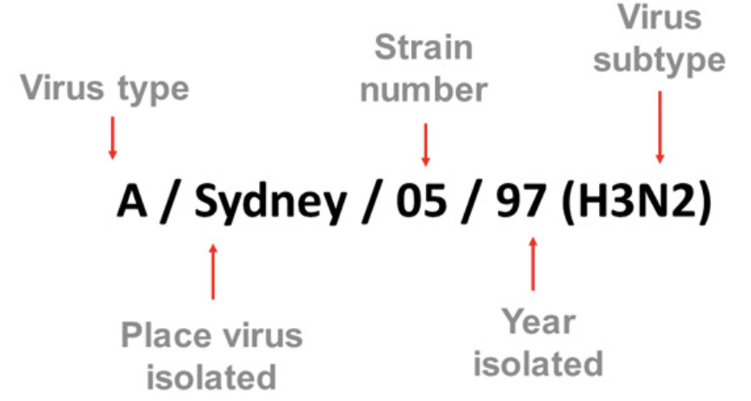
Naming Viruses

Slide 12
Antiretroviral Drugs
Amantadine
Rimantadine
Block M2
Resistance developed
OseHamivir (Pill)
Zanamivir (Powder)
Block N = neuraminidase
Age restriction

Slide 13
HIV (Illness)
Feels like flu
Muscle pain
Joint pain
Blood test
Antibodies (Form after ~1 month)
Rise 1 month after infection, fall, rise again
Detect immediately when we start making it
P24 (protein in HIV)
Two weeks – 1 month after infection
Tests
ELISA (Enzyme linked immunosorbent assay)
Western blot: look for specific proteins
+ ELISA, + Western blot = Have HIV

Slide 14

Can’t get HIV by:
Salvia
Tears
Sweat
Urine
Feces
Hugging someone who is HIV Positive
Air/Water
Mosquitoes

Slide 15
HIV (Virus)
Gets in your body and crosses into the bloodstream
Infects Cells
Hijacks T cells
Cell Death

Slide 16


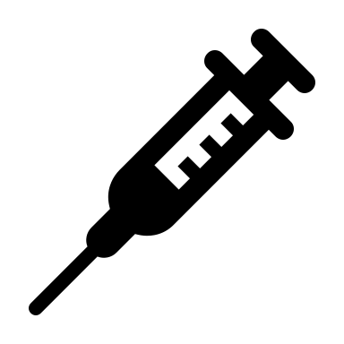
Step 1. HIV gets into the Body
Cross a mucous membrane
Injected directly into bloodstream for you to get infected
Common Methods:
Unprotected sex
Contaminated Blood
Childbirth
Breastfeeding
Notes:
https://www.avert.org/hiv-transmission-prevention/how-you-get-hiv#:~:text=For%20you%20to%20get%20HIV,or%20tears%20around%20the%20anus).
Unprotected sex
1. unprotected anal sex = 1st highest risk
2. unprotected vaginal sex = 2nd highest risk (most common)
3. oral sex = exposed to blood, sexual fluids and mucous membranes
Contaminated Blood
1. Sharing Needles (IV drug use)
2. Donated Blood
Childbirth
1. During birth
Breastfeeding
1. Small particles get into breast milk

Slide 17
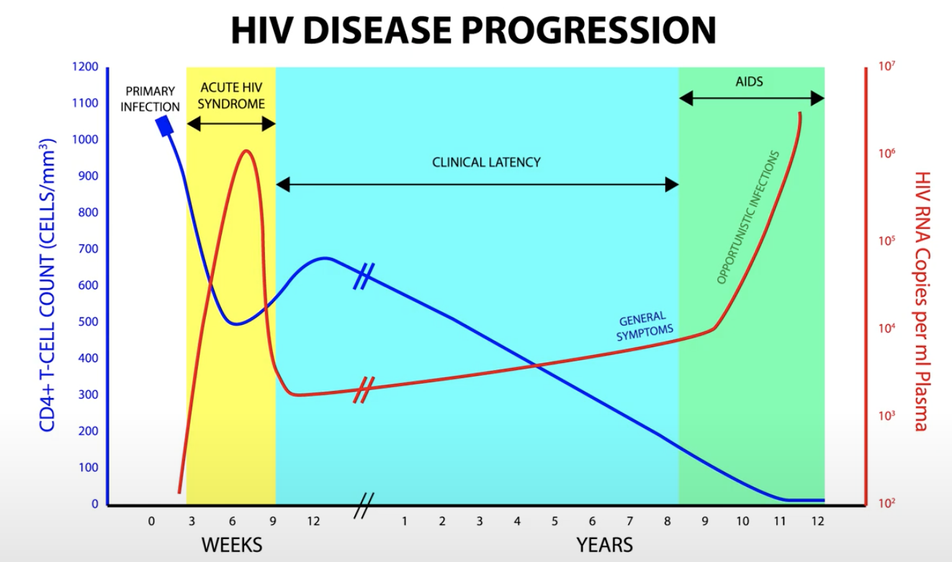
Viral Load and CD4 Cells
CD4 Cell Count
Viral Load
Time
Notes:
Intestinal mucosa (lymphocytes, CCR5 receptor)
Most DC4 Cell loss in the first few weeks
Big spike in HIV replication (several million/mL blood)
Acute virema – CD8+ Cytotoxis T Cells (kill cells) and B Cells (antibodies)
Chronic Stage
Little virus is detected
Slow decline

Slide 18
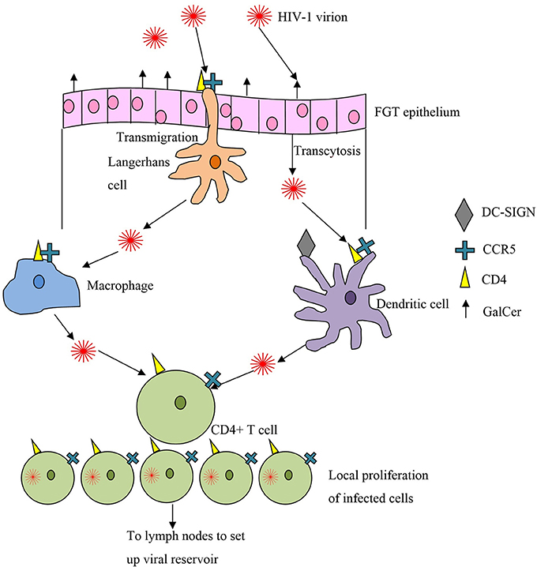
Step 2. (Part A) HIV Infection Process
Get into dendritic cells which are monitoring for invaders
Pull in molecules and determine if they are a threat
Gp120 sticks to DC-Sign on dendritic cells and dendritic cell brings it into blood stream
Infectious synapse
Endocytosed HIV
Infected dendritic cell
Other immune cells get infected
Notes:
10.3389/fmicb.2014.00572

Slide 19
Step 2. (Part B) Hijack T Helper Cell
If you have a mutation in CCR5, then you are immune (heterozygous mutations – slow progression)
HIV attached to the:
CD4 receptor
and
CCR5 receptor (M-tropic) or CXCR4 receptor (T-tropic)
The gp120 protein (attaches) + gp41 protein (inserts)
Membranes are pulled close together
HIV merges with cell and capsid is released
Notes:
Binding to CD4
Conformational change to CD4
Binding to CCR5 (M-tropic) receptor or CXCR4 (T-tropic) receptor
Pulls membranes close together
Further conformational changes – gp41
Fusion peptides inserted into host cell membrane
HIV merges with the cell and merges
HIV capsid releasees

Slide 20
Step 2. (Part C) Insertion of Viral DNA and Exit of Cell
Viral RNA is inserted into cell as capsid breaks down
Reverse transcriptase makes DNA out of RNA
Makes many mistakes!
Mutate quickly
Integrase
Brings DNA into nucleus
Integrates it into your DNA
DNA transcriptase
Make proteins
Make new envelope proteins for HIV
Viral polyproteins
Brought to surface
New immature HIV
Protease cuts up polyproteins
HIV buds up and branches off to form a new HIV virus
Notes:
Originally: single strand positive sense RNA
Makes viral DNA (double-stranded)
“retrovirus”: goes backwards

Slide 21
Step 3. Disease Progress – Cell Death
Only 5-10% of dead cells were infected, others die as a part of a cascade
Infected T cell: die because of virus activity or because of our immune response
IFI16 – looks out for rouge DNA and inflames the cell to cause pyroptosis
DNApK – sense break in DNA and self destructs (apoptosis)
HIV protease – accidentally cleaves caspase 8 and self destructs (apoptosis)
Other CD4 T Cells
Kill off infected cell
Antibodies displayed on surface = get killed
Uninfected T cell: exposed to HIV – travel to lymph nodes
Pyroptosis – driven by inflammation
Notes:
More HIV = more CD4 cells get infected = self destruct sequence (destroy nearby immune cells)
Caspase 1 -> Interleukin 1- beta -> inflammation -> grenade -> other cells showered in interleukin 1 – beta *CHAIN REACTION*
Chronic inflammation
Keep activating immune system – more cells die off
Wear down immune system

Slide 22
Progressed to AIDS
Opportunistic infections
<200 CD4 Cells/uL
Notes:
Eventually Kaposi’s sarcoma
Tumors caused by Herpes 8
Purple patches on mouth
PCP
Lung infections
Histoplasmosis
Coccidioidomycosis
100 – 50 CD4 T cell count
Texoplasmosis
Crypotococcosis
50 CD4 T Cell
MAC

Slide 23
Retroviruses
5-8% of human genome is used to encode genetic material from retroviruses
Notes:
(Genetic information jumping from one species to another )

Slide 24
Treatments
Treatment
ARVS (2-3 types): HIV can’t mutate fast enough to avoid all these drugs
Reduce HIV in someone’s body (viral levels are low)
1. Fusion inhibitors
2. CCR5 antagonists
3. Nucleoside reverse transcriptase inhibitor
Decoy nucleoside (can’t build DNA)
Reverse transcriptase can mutate to reject decoys (prevent binding)
Reverse transcriptase can remove decoy
4. Non-nucleoside reverse transcriptase inhibitor
Binds to reverse transcriptase
Reverse transcriptase can mutate to prevent binding of inhibitor
5. Integrase Inhibitors
Can’t bring dsDNA into nucleus
6. Protease inhibitor
Binds to protease enzyme
Can’t chop up viral polyproteins
Can mutate to prevent binding of inhibit
Notes:
Highly active antiretroviral therapy
HIV a few billion new viral particles per day
1/10,000 nucleotides is wrong
Isn’t repaired correctly
1/10^12 chance is that is resistant to 3 types of drugs
Can’t stop ARVs
Every day of your life
Right time to start treatment
Start HAART
CD4 T cell count <= 350-500
Viral load >= 100,000
Child, Pregnant

Slide 25
HAART Cascade
HAART results in HIV going down
CD4 cells come back
CD4 cells see all bugs or reminants of bugs
Immune Reconstitution Inflammatory Syndrome (IRIS)

Slide 26
Prevent Transmission
Pre-exposure prophylaxis (PrEP)
Post-exposure prophylaxis (PEP)
1 hour – 3 days after exposure
What is in them?
ARVs: stop infection before it truly has a hold on your system

Slide 27
Videos to Watch
Khan Academy: https://www.youtube.com/playlist?list=PLbKSbFnKYVY1snZiZrtsoKaf8YRkIM_he
Neural Academy: https://www.youtube.com/watch?v=AuWaX9HOiHI
https://www.youtube.com/watch?v=5g1ijpBI6Dk
https://www.youtube.com/watch?v=ng22Ucr33aw
https://www.youtube.com/watch?v=kdNljZkGqu8&list=PLMO1589WRspykVPiy6SgKi3OPKbe9b0El&index=3
Animated HIV Science: https://www.youtube.com/user/animatedhivscience/playlists
https://www.youtube.com/watch?v=E2Hfz45e17w&feature=youtu.be
https://www.sciencealert.com/watch-here-s-what-we-know-about-hiv-and-aids

Slide 28
“Resources for Researchers” by NIH
Division of AIDS
https://www.niaid.nih.gov/research/resources?f%5B0%5D=division%3A10

Slide 29
Other Sources
https://www.avert.org/hiv-transmission-prevention/how-you-get-hiv#:~:text=For%20you%20to%20get%20HIV,or%20tears%20around%20the%20anus
10.3389/fmicb.2014.00572
Zhang, Z., Schuler, T., Zupancic, M., Wietgrefe, S., Staskus, K. A., Reimann, K.A., et al. (1999). Sexual transmission and propagation of SIV and HIV inresting and activated CD4+T cells.Science286, 1353–1357. doi: 10.1126/sci-ence.286.5443.1353
http://hivinsite.ucsf.edu/InSite?page=kb-02-01-01
https://apps-webofknowledge-com.colorado.idm.oclc.org/Search.do?product=WOS&SID=6CdZX4fA4fknKuQbK37&search_mode=GeneralSearch&prID=0ed6d8be-e001-48cb-9fa0-184884decda5
https://apps-webofknowledge-com.colorado.idm.oclc.org/full_record.do?product=WOS&search_mode=GeneralSearch&qid=2&SID=6CdZX4fA4fknKuQbK37&page=1&doc=8&cacheurlFromRightClick=no
https://apps-webofknowledge-com.colorado.idm.oclc.org/full_record.do?product=WOS&search_mode=GeneralSearch&qid=12&SID=6CdZX4fA4fknKuQbK37&page=1&doc=6&cacheurlFromRightClick=no
https://apps-webofknowledge-com.colorado.idm.oclc.org/full_record.do?product=WOS&search_mode=GeneralSearch&qid=11&SID=6CdZX4fA4fknKuQbK37&page=1&doc=2&cacheurlFromRightClick=no

Slide 30
Ideas
Could we make highly mutable cells
Not able to correct mutations like HIV
Incubate cells (mutate DNA to have no repair mechanism) with HIV
Able to find cells that can survive

