Slide 1
Mechanisms & Biology behind HIV and Influenza
Emily Rhodes
Sprenger Lab Group Meeting
September 18th, 2020

Slide 2
Overview
HIV
How does HIV get into the body?
What does it do once it gets into the body?
Current treatments and their targets
Influenza
How does Influenza get into the body?
What does it do once it gets into the body?
Current treatments and their targets

Slide 3
Progression
Gets in your body and crossing into the bloodstream
Hijacks T cells
Infection increases rapidly 2-3 weeks
Around a month: antibodies are formed
Start to feel really sick
When cells die off/get infected: inflammatory response (feel sick)
Latency period (no clinical signs)
HIV cells are replicating and duplicating slightly faster than immune response (low energy and weight loss)
Development of AIDS
overwhelmed immune system: get infections that you could normally fight off
Less than 200 CD4 cells/uL
AIDS defining illnesses

Slide 4
Step 1. HIV gets into the Body
HIV is found in several bodily fluids, including: [1]
Blood
Semin and Pre-Seminal Fluid
Rectal Fluids
Vaginal Fluids
Breastmilk
HIV needs to get into your blood through a mucous membrane or injected directly into bloodstream for you to get infected
High levels in beginning of infection
Common Methods:
Unprotected sex
1. unprotected anal sex = 1st highest risk
2. unprotected vaginal sex = 2nd highest risk (most common)
3. oral sex = exposed to blood, sexual fluids and mucous membranes
Contaminated Blood
1. Sharing Needles (IV drug use)
2. Donated Blood
Childbirth
1. During birth
Breastfeeding
1. Small particles get into breast milk
Notes:
https://www.avert.org/hiv-transmission-prevention/how-you-get-hiv#:~:text=For%20you%20to%20get%20HIV,or%20tears%20around%20the%20anus).

Slide 5
Can’t get HIV by:
Salvia
Tears
Sweat
Urine
Feces
Hugging someone who is HIV Positive
Air/Water
Mosquitoes

Slide 6
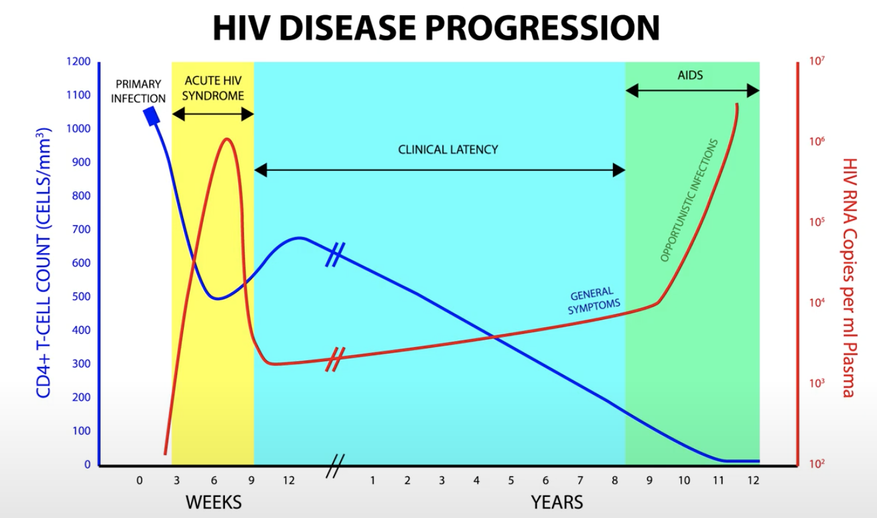
Viral Load and CD4 Cells
CD4 Cell Count
Viral Load
Time
Notes:
Intestinal mucosa (lymphocytes, CCR5 receptor)
Most DC4 Cell loss in the first few weeks
Big spike in HIV replication (several million/mL blood)
Acute virema – CD8+ Cytotoxis T Cells (kill cells) and B Cells (antibodies)
Chronic Stage
Little virus is detected
Slow decline

Slide 7
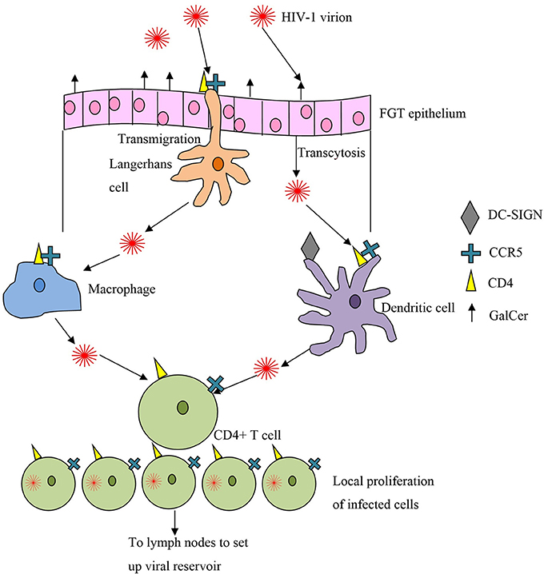
Step 2. HIV Infection Process
First infected cell:
endocervical intraepithelial resting CD4+ T Cell [3]
Limited founder population of infected cells
There is a key window here where the infection has not spread to the whole body and could be stopped.
Dendritic cells live in mucous membrane
Pull in molecules and determine if they are a threat
Gp120 sticks to DC-Sign
Break down and display antigen
Move to lymph nodes
Bring intact HIV to lymph nodes
Infectious synapse
Hands it off to t-cell
Endocytosed HIV
Infected dendritic cell
Notes:
10.3389/fmicb.2014.00572

Slide 8
Step 2. (Part A) Hijack T Helper Cell
If you have a mutation in CCR5, then you are immune (heterozygous mutations – slow progression)
CD4 receptor
CCR5 receptor or CXCR4 receptor
gp120 protein (attach) + gp41 protein (insert)
Binding to CD4
Conformational change to CD4
Binding to CCR5 (M-tropic) receptor or CXCR4 (T-tropic) receptor
Pulls membranes close together
Further conformational changes – gp41
Fusion peptides inserted into host cell membrane
HIV merges with the cell and merges
HIV capsid releasees

Slide 9
Step 2. (Part B) Insertion of Viral DNA
Viral RNA
Reverse transcriptase
Originally: single strand positive sense RNA
Makes viral DNA (double-stranded)
“retrovirus”: goes backwards
Transcriptase
Makes many mistakes!
Mutate quickly
Integrase
Brings DNA into nucleus
Integrates it into your DNA
DNA transcriptase
Make proteins
Make new envelope proteins for HIV
Viral polyproteins
Brought to surface
New immature HIV
Protease cuts up polyproteins
HIV buds up and branches off to form a new HIV virus

Slide 10
Step 3. Disease Progress – Cell Death
CD4 T-lymphocytes Count
Super important in propagation of HIV to AIDS
5-10% of dead cells = infected, others don’t die after being infected
Infected T cell: die because of virus activity or because of our immune response
IFI16 – looks out for rouge DNA and inflames the cell to cause pyroptosis
DNApK – sense break in DNA and self destructs (apoptosis)
HIV protease – accidentally cleaves caspase 8 and self destructs (apoptosis)
CD4 T Cells
Kill off infected cell
Antibodies displayed on surface = get killed
Uninfected T cell: exposed to HIV – travel to lymph nodes
Pyroptosis – driven by inflammation
Caspase 1 -> Interleukin 1- beta -> inflammation -> grenade -> other cells showered in interleukin 1 – beta *CHAIN REACTION*
Chronic inflammation
Keep activating immune system – more cells die off
Wear down immune system
Notes:
More HIV = more CD4 cells get infected = self destruct sequence (destroy nearby immune cells)

Slide 11
Diagnosis HIV
Feels like flu
Muscle pain
Joint pain
Blood test
Antibodies (~1 month)
Rise 1 month after infection, fall, rise again
Detect immediately when we start making it
P24 (protein in HIV)
Two week – 1 month
Tests
ELISA: Enzyme linked immunosorbent assay
Western blot: look for specific proteins
+ ELISA, + Western blot = Have HIV

Slide 12
Types of HIV
Type 1
Standard
Look at RNA
Nucleic acid
Duplicate RNA
Type 2
Rapid test
Screening test: good for getting a positive

Slide 13
Treatments
Treatment
ARVS (2-3 types): HIV can’t mutate fast enough to avoid all these drugs
Reduce HIV in someone’s body (viral levels are low)
1. Fusion inhibitors
2. CCR5 antagonists
3. Nucleoside reverse transcriptase inhibitor
Decoy nucleoside (can’t build DNA)
Reverse transcriptase can mutate to reject decoys (prevent binding)
Reverse transcriptase can remove decoy
4. Non-nucleoside reverse transcriptase inhibitor
Binds to reverse transcriptase
Reverse transcriptase can mutate to prevent binding of inhibitor
5. Integrase Inhibitors
Can’t bring dsDNA into nucleus
6. Protease inhibitor
Binds to protease enzyme
Can’t chop up viral polyproteins
Can mutate to prevent binding of inhibitor
Low level CD4 cells -

Slide 14
HAART
Highly active antiretroviral therapy
HIV a few billion new viral particles per day
1/10,000 nucleotides is wrong
Isn’t repaired correctly
1/10^12 chance is that is resistant to 3 types of drugs
Can’t stop ARVs
Every day of your life
Right time to start treatment
Start HAART
CD4 T cell count <= 350-500
Viral load >= 100,000
Child, Pregnant

Slide 15
Progressed to AIDS
Opportunistic infections
Eventually Kaposi’s sarcoma
Tumors caused by Herpes 8
Purple patches on mouth
PCP
Lung infections
Histoplasmosis
Coccidioidomycosis
100 – 50 CD4 T cell count
Texoplasmosis
Crypotococcosis
50 CD4 T Cell
MAC

Slide 16
HAART Cascade
HAART results in HIV going down
CD4 cells come back
CD4 cells see all bugs or reminants of bugs
Immune Reconstitution Inflammatory Syndrome (IRIS)

Slide 17
Prevent Transmission
Pre-exposure prophylaxis (PrEP)
Post-exposure prophylaxis (PEP)
1 hour – 3 days after exposure
What is in them?
ARVs: stop infection before it truly has a hold on your system

Slide 18
What is a virus?
Single strand RNA and single strand DNA
Just a package of molecules
Attached itself to cell
Fuse with cell + release capsid
Receptor fusion
Endocytosis
Inject material into bacterium
Genetic material
Hijack ribosomes to replicate themselves
Make proteins – kill native proteins
Exit cell
Lyse cell or bud off of cell (Lytic)
Release a bunch of viruses
5-8% of human genome is encoding retrovirus
Biohorizonal transfer
Genetic information jumping from one species to another
Notes:
Capsule containing nucleic acids

Slide 19
Flu (Influenza)
Illness
Is it abrupt?
Lasts 3-7 days
4 days asymptomatic
Both respiratory and constitutional setting
Definition: (CDC) sore throat or cough and fever
Influenza-like Illness (ILI)
Respiratory | Constitutional
Air going through respiratory track Stuff nose Sore throat Cough | Whole body Fever/chills Body aches Fatigue

Slide 20
Influenza Virus
RNA: inside
Surface proteins: H & N proteins
Copy cat viruses: rhino virus (nose), RSV (respiratory syncytial virus)
Think you are dealing with influenza

Slide 21
Hemaglutinin (on surface of virus)
Holds sialic acid (on cell membrane) (enter)
Neuraminidase (on surface of virus)
Cuts sialic acid (exit)
Inflammation
Runny nose, sore throat, cough
Constitutional Symptoms:
Fever/chills, fatigue

Slide 22
Families of Influenza
Type:
A - M2 proteins
Resp/Constitutional
Epidemic (elevate cases in some months of the year)
Vaccine
Highest mutation rate (genetic drift)
Genetic shift
Pandemic
Animals
B
Resp/Constitutional
Epidemic (elevate cases in some months of the year)
Vaccine
Middle mutation rate (genetic drift)
No genetic shift
No Pandemic
C
Usually Resp
No epidemic
Vaccine
Lowest mutation rate (genetic drift)
No genetic shift
No Pandemic
Type A flu: (almost all in birds, except H17N10 which is in bats)
Proteins:
H – 17 types
N – 10 types
Named by the type of proteins on their surface
H1N1 and H3N2 (most common right now)
- Good job transmitting from person to person

Slide 23
Two Viruses Attack
Mixing of RNA – mix protein that is displayed on the surface
Genetic shift: a dominant virus is able to affect a bunch of people

Slide 24
Genetic Change of Virus
Mutations over time in genetic material
Genetic drift
Make mistakes on replication
Genetic shift
Replace sections of RNA
Many people can get sick

Slide 25
Antiretroviral Drugs
Amantadine
Rimantadine
Block M2
Resistance developed
OseHamivir (Pill)
Zanamivir (Powder)
Block N
Age restriction

Slide 26
Doesn’t exist well in the environment
Usually get it from people
Spread the flu
1 day before symptoms – 7 days after you start symptoms
Bronchitis
Big infection in bronchioles
Pneumonia
Asthma Attack

Slide 27
Videos to Watch
Khan Academy: https://www.youtube.com/playlist?list=PLbKSbFnKYVY1snZiZrtsoKaf8YRkIM_he
Neural Academy: https://www.youtube.com/watch?v=AuWaX9HOiHI
https://www.youtube.com/watch?v=5g1ijpBI6Dk
https://www.youtube.com/watch?v=ng22Ucr33aw
https://www.youtube.com/watch?v=kdNljZkGqu8&list=PLMO1589WRspykVPiy6SgKi3OPKbe9b0El&index=3
Animated HIV Science: https://www.youtube.com/user/animatedhivscience/playlists
https://www.youtube.com/watch?v=E2Hfz45e17w&feature=youtu.be
https://www.sciencealert.com/watch-here-s-what-we-know-about-hiv-and-aids

Slide 28
“Resources for Researchers” by NIH
Division of AIDS
https://www.niaid.nih.gov/research/resources?f%5B0%5D=division%3A10

Slide 29
Bibliography
[1] https://www.avert.org/hiv-transmission-prevention/how-you-get-hiv#:~:text=For%20you%20to%20get%20HIV,or%20tears%20around%20the%20anus
[2] 10.3389/fmicb.2014.00572
[3] Zhang, Z., Schuler, T., Zupancic, M., Wietgrefe, S., Staskus, K. A., Reimann, K.A., et al. (1999). Sexual transmission and propagation of SIV and HIV inresting and activated CD4+T cells.Science286, 1353–1357. doi: 10.1126/sci-ence.286.5443.1353
[4] http://hivinsite.ucsf.edu/InSite?page=kb-02-01-01

Slide 30
Ideas
Could we make highly mutable cells
Not able to correct mutations like HIV
Incubate cells (mutate DNA to have no repair mechanism) with HIV
Able to find cells that can survive

