Slide 1
Research Updates
Emily Rhodes
Group Meeting
October 23rd, 2020

Slide 2
Outline
Background
What are viruses?
What is HIV and why do we care about it?
Mission
What is ICM?
Goals
What have I done so far?
Can I get some help/advice?
Future Work

Slide 3
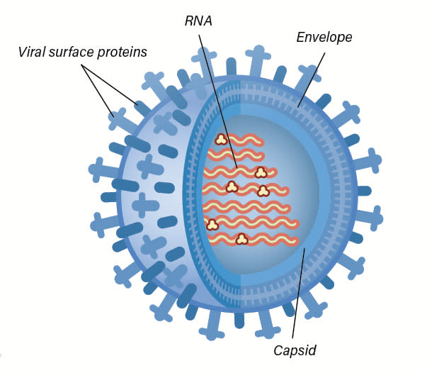
What is a virus?
“A virus is genetic material contained within an organic particle that invades living cells and uses their host's metabolic processes to produce a new generation of viral particles.” - https://www.sciencealert.com/virus
Notes:
Single strand RNA and single strand DNA
Just a package of molecules

Slide 4
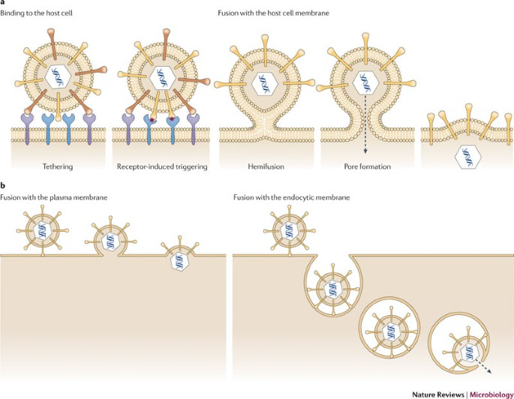
How do viruses attack cells?
Attached itself to cell
Fuse with cell + release capsid
Receptor fusion
Endocytosis
Inject material into bacterium

Slide 5
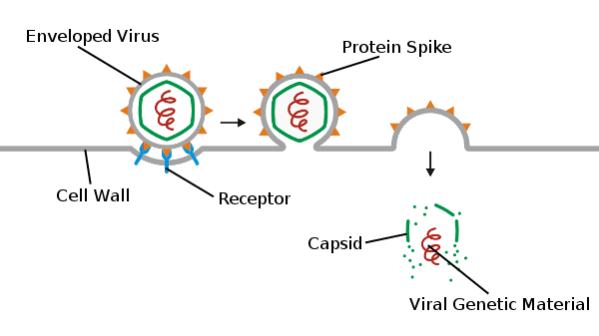
Genetic Material Released
Notes:
Genetic material
Hijack ribosomes to replicate themselves
Make proteins – kill native proteins

Slide 6
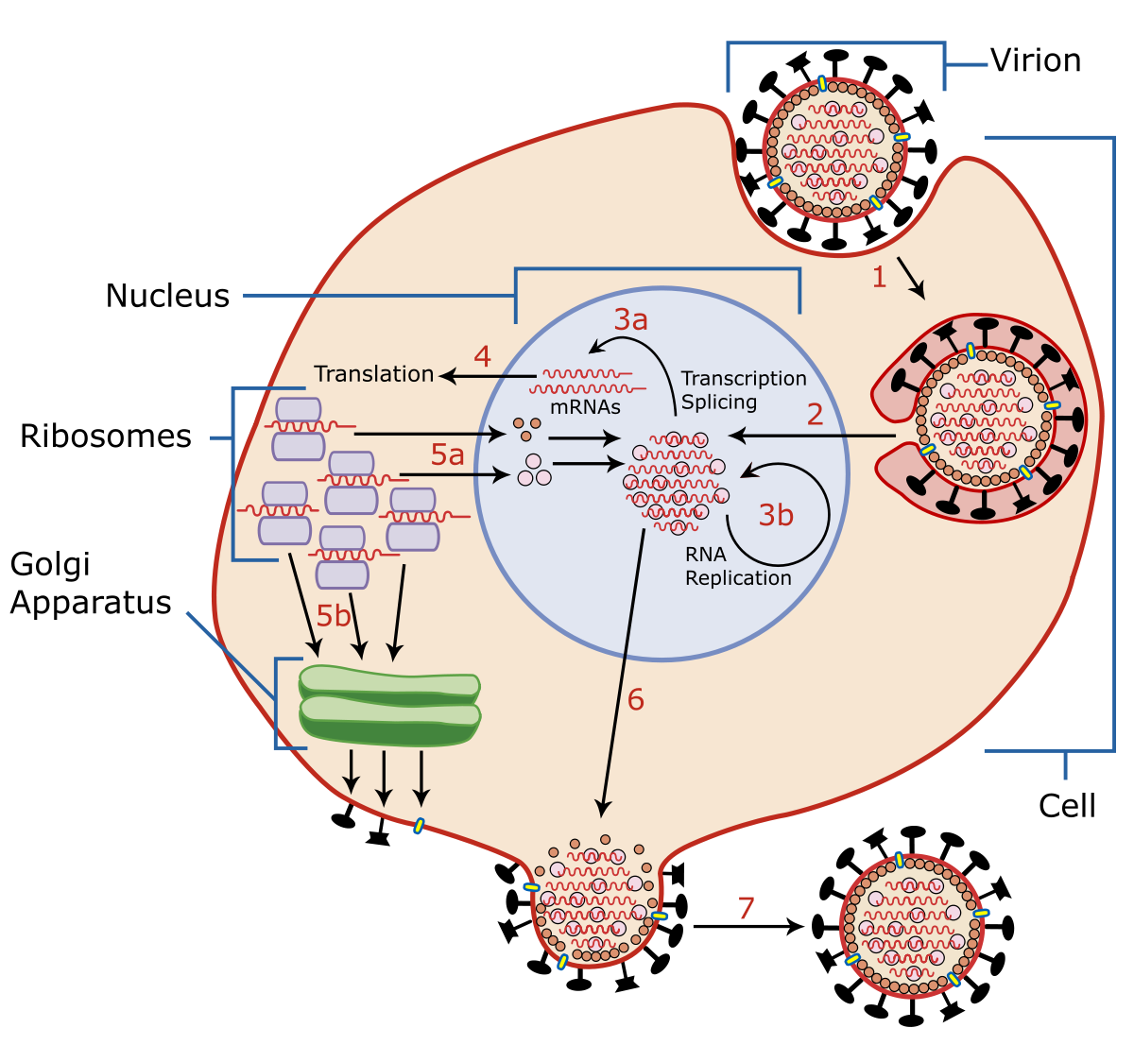
Viruses Use Cells’ Machinery

Slide 7
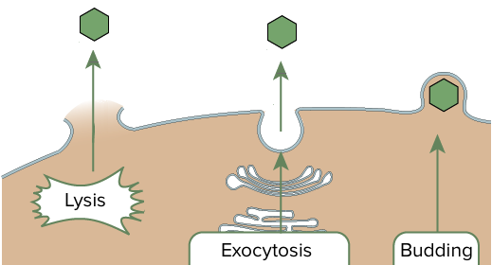
Virus Exits the Cell
Notes:
Exit cell
Lyse cell or bud off of cell (Lytic)
Release a bunch of viruses

Slide 8
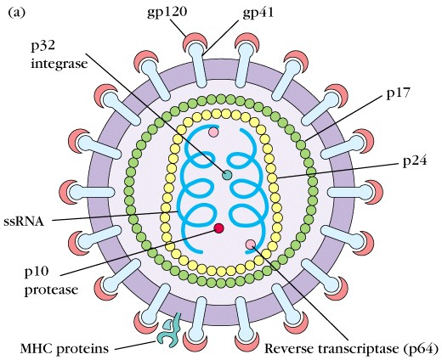
HIV
https://www.google.com/url?sa=i&url=https%3A%2F%2Fbiosci.mcdb.ucsb.edu%2Fimmunology%2FImmunodeficiencies%2FHIV-structure.htm&psig=AOvVaw0sKvuP82NwhwRB9s1BdRQU&ust=1603561703542000&source=images&cd=vfe&ved=0CAMQjB1qFwoTCNi9h4Cjy-wCFQAAAAAdAAAAABAD
Notes:
HIV (human immunodeficiency virus) is a virus that attacks cells that help the body fight infection, making a person more vulnerable to other infections and diseases.

Slide 9
Mission
Create a high-throughput pipeline for rationally designing vaccine-candidate, HIV-based proteins (or “antigens”) that will lead to the efficient elicitation of high titers of broadly neutralizing antibodies against diverse HIV epitopes

Slide 10

In other words...
Antigen (Vaccine-candidate)
Broadly Neutralizing Antibody
Diverse HIV Epitopes
We want to understand this process.

Slide 11
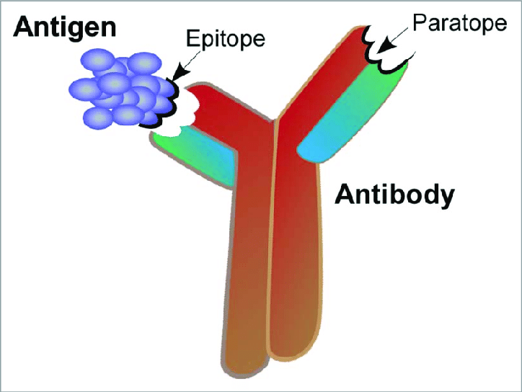
Theory - ICM

Slide 12
Goal 1
Broadly Neutralizing Antibody | Epitope
10-1074 | V3 glycan
10E8 | MPER
10E8 Fab | MPER
10E8 x CD3 | MPER
10E8v4 | MPER
17b x CD3 | alphaCCR5
2E7 | gp41
35O22 | gp120-gp41
3BNC117 | CD4bs
3BNC117 | MPER
7B2 x CD3 | gp41
8ANC195 | gp120-gp41
A32 x CD3 | CD4i
A32 x CD3 MP3 | CD4i
B12 x CD3 | CD4bs
Cap256.VRC26 | V2 glycan
CD4 | CD4
CD4 x CD3 | CD4
I3 | CD4bs
iMab | alphaCD4
m36.4 | gp120 C3
N6 | CD4bs
P140 | alphaCCR5
PG9 | V2 glycan
PG9-16 | V2 glycan
PGDM1400 | V2 apex
PGDM1400fv.V8 | V2 apex
PGT121 | V3 glycan
PGT121 x CD3 | V3 glycan
PGT128 | V3 glycan
PGT128 | MPER
PGT135 | V3 glycan
PGT145 | V2 apex
PGT145 | MPER
PGT145 x CD3 | V2 apex
PGT151 | gp120-gp41
PGT151 | MPER
PRO | alphaCCR5
PRO 140 | alphaCCR5
VCR01 | CD4bs
VRC01 x CD3 | CD4bs
VRC07-523LS | CD4bs
Carry out a literature review to identify all relevant antibody (Ab)/antigen (Ag) complexes for HIV.
Notes:
Lots of repeats – still trying to figure out what they all are.

Slide 13
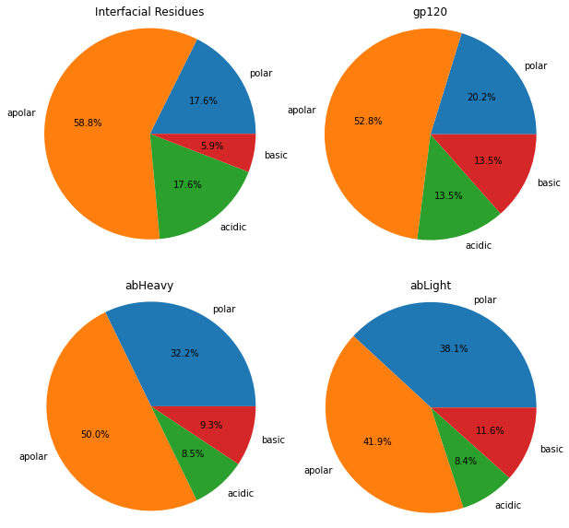
Goal 2
10E8 Fab
Carry out an analysis to determine the degree of interfacial composition matching (ICM) of Abs bound to different binding sites on HIV, comparing the results for the germline/mature versions of each Ab.

Slide 14
Goal 2
10E8 Fab
Carry out an analysis to determine the degree of interfacial composition matching (ICM) of Abs bound to different binding sites on HIV, comparing the results for the germline/mature versions of each Ab.

Slide 15
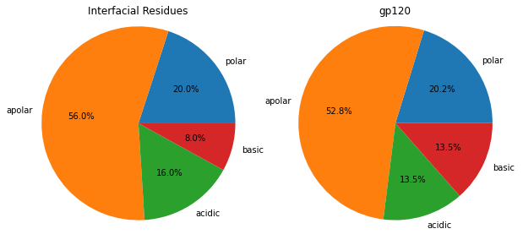

How to Determine the Interfacial Residues?
4 Angstroms
5 Angstroms
6 Angstroms
Notes:
Key – add germline part

Slide 16
Thoughts
Look not only at residues which may be including more than is actually relevant – really we want interacting atoms, correct?
Would it make more sense to look at a distance cutoff or something like a force calculation threshold? Which residues have the most force impact?

Slide 17
Goal 3
Use results from (2) to determine: (a) how prevalently employed ICM is for anti-HIV Abs, (b) how ICM varies for neut. vs. non-neut. Abs, (c) how ICM varies for different HIV binding sites, and (d) the effect of glycans on ICM.
Need to put data in chart form – find a better way to display or compare the ICM.

Slide 18
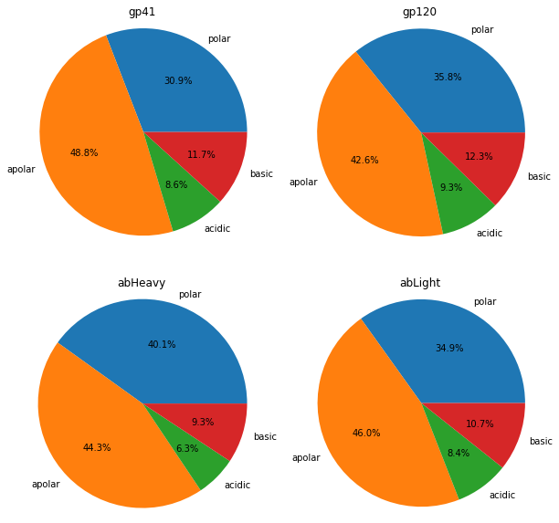
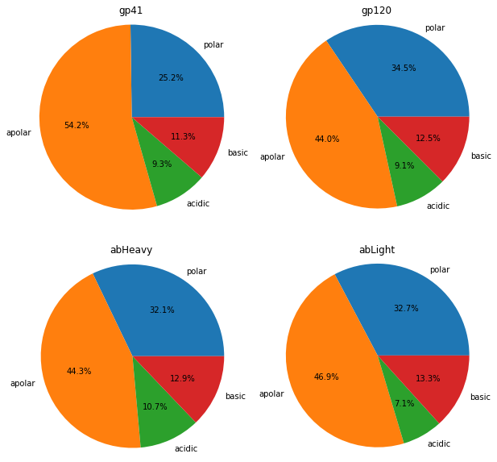
Data
Interfacial residue comparison *need to add*
10-1074
pgt145
Could the antibodies and antigens simply have a similar composition most of the time?
What is the degree of sensitivity?
Would it change if I compared position to position?

Slide 19
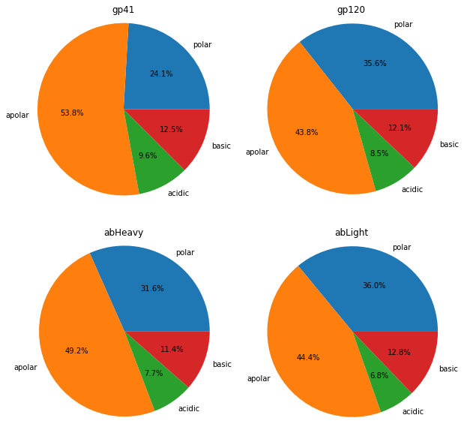
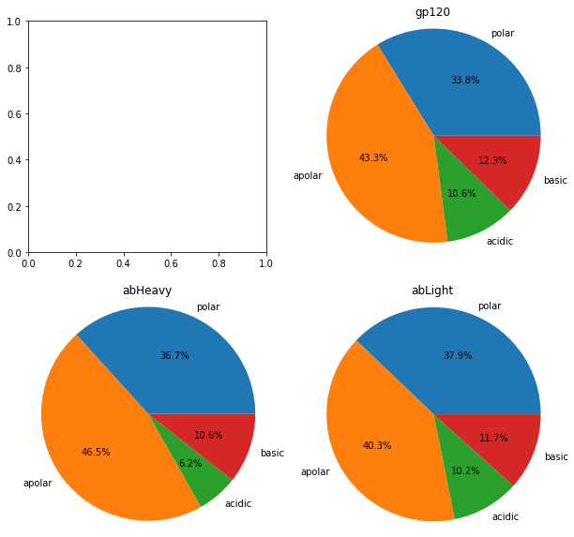
10-1074
pgt145
pg16
3BNC117

Slide 20
Goal 4
Carry out affinity maturation simulations with different initial ICM values by changing the Ab, Ag sequences.
Status: Ran one simulation.
Next step: View the data and determine how to do this with other antibodies.

