Slide 1
Research Updates
Emily Rhodes
Group Meeting
November 20th, 2020

Slide 2
Outline
Background
What are viruses?
What is HIV and why do we care about it?
Mission
What is ICM?
Goals
What have I done so far?
Can I get some help/advice?
Future Work

Slide 3
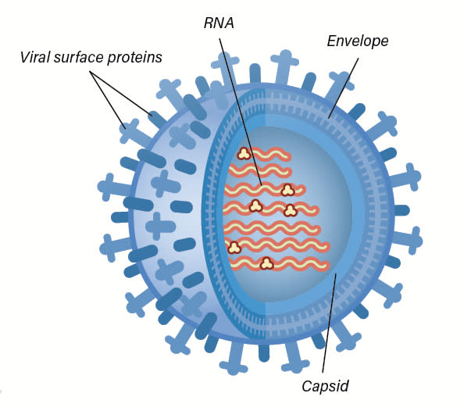
What is a virus?
“A virus is genetic material contained within an organic particle that invades living cells and uses their host's metabolic processes to produce a new generation of viral particles.” - https://www.sciencealert.com/virus
Notes:
Single strand RNA and single strand DNA
Just a package of molecules

Slide 4
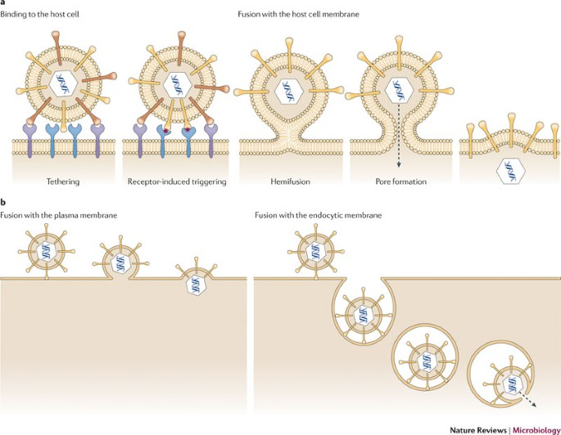
How do viruses attack cells?
Attached itself to cell
Fuse with cell + release capsid
Receptor fusion
Endocytosis
Inject material into bacterium

Slide 5
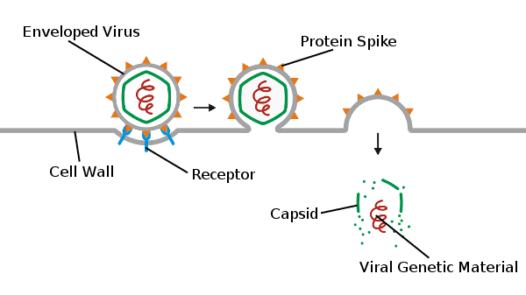
Genetic Material Released
Notes:
Genetic material
Hijack ribosomes to replicate themselves
Make proteins – kill native proteins

Slide 6
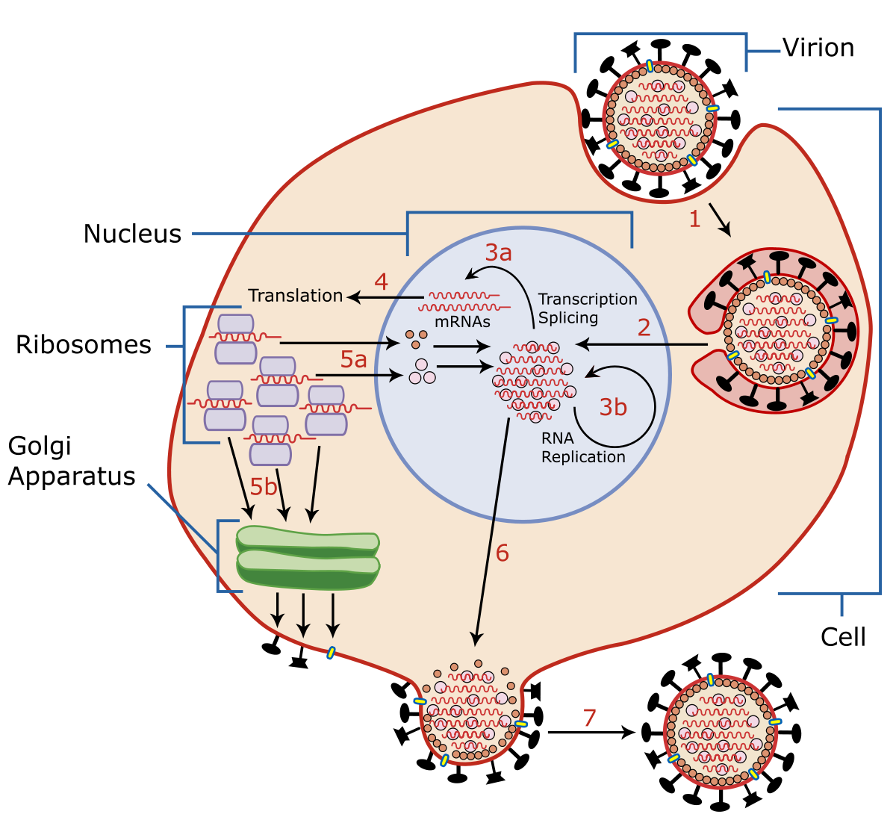
Viruses Use Cells’ Machinery

Slide 7
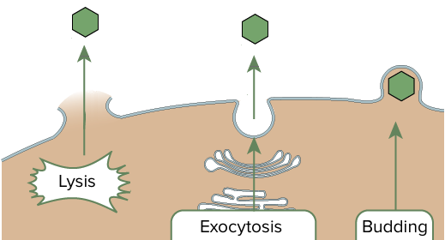
Virus Exits the Cell
Notes:
Exit cell
Lyse cell or bud off of cell (Lytic)
Release a bunch of viruses

Slide 8
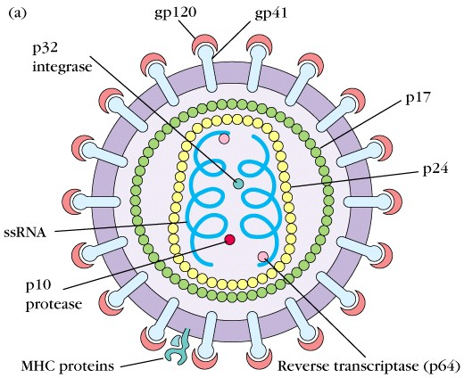
HIV
https://www.google.com/url?sa=i&url=https%3A%2F%2Fbiosci.mcdb.ucsb.edu%2Fimmunology%2FImmunodeficiencies%2FHIV-structure.htm&psig=AOvVaw0sKvuP82NwhwRB9s1BdRQU&ust=1603561703542000&source=images&cd=vfe&ved=0CAMQjB1qFwoTCNi9h4Cjy-wCFQAAAAAdAAAAABAD
Notes:
HIV (human immunodeficiency virus) is a virus that attacks cells that help the body fight infection, making a person more vulnerable to other infections and diseases.

Slide 9
Mission
Create a high-throughput pipeline for rationally designing vaccine-candidate, HIV-based proteins (or “antigens”) that will lead to the efficient elicitation of high titers of broadly neutralizing antibodies against diverse HIV epitopes

Slide 10

In other words...
Antigen (Vaccine-candidate)
Broadly Neutralizing Antibody
Diverse HIV Epitopes
We want to understand this process.

Slide 11
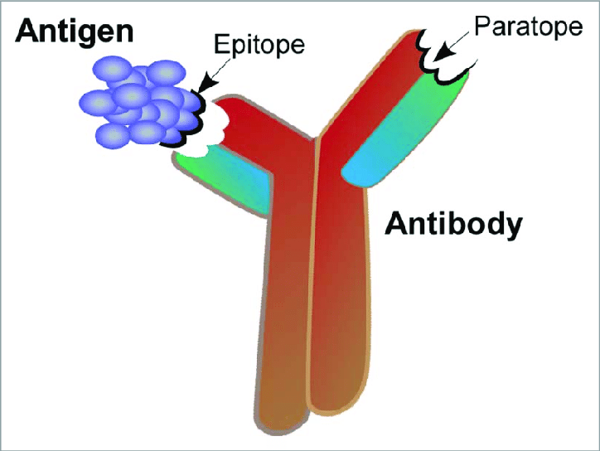
Theory - ICM

Slide 12
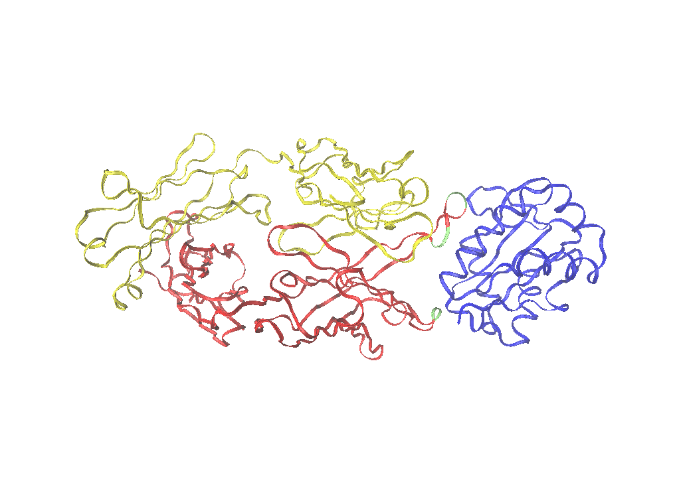
Looking at Interfacial Residues
Light Chain = Yellow
Antigen = Blue
Interfacial Residues = Green
Heavy Chain = Red

Slide 13
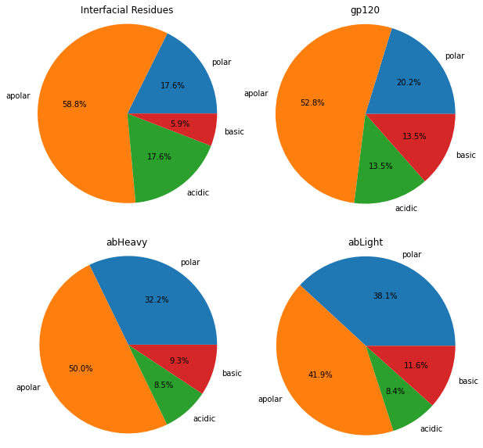
Interfacial Composition Matching
Isolated the interfacial residues based on the distance from the antigen. (VMD)
Determined which residues these corresponded to.
Compared the composition of this interface to the composition of the whole antibody and whole epitope.
I still need to look at the interfacial residues on the HIV protein to compare interface to interface.

Slide 14
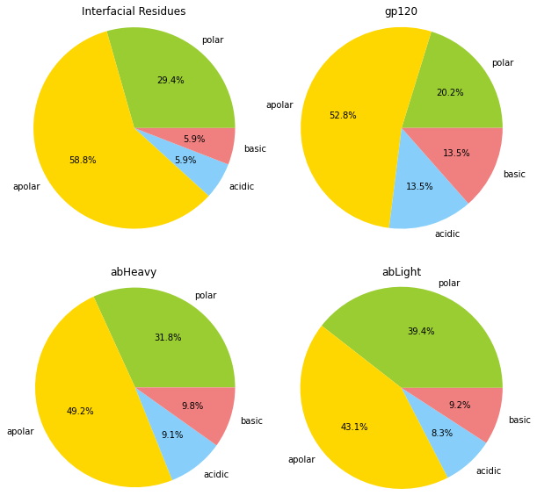
Compare the Germline Sequence to the Mature Sequence
Germline
Mature

Slide 15
Scoring of ICM
Compare percentages
Determine the order of magnitude change
Does the germline sequence match well already?
How far does the antibody change to match?
Look at data from John Mascola about how the process occurs

Slide 16
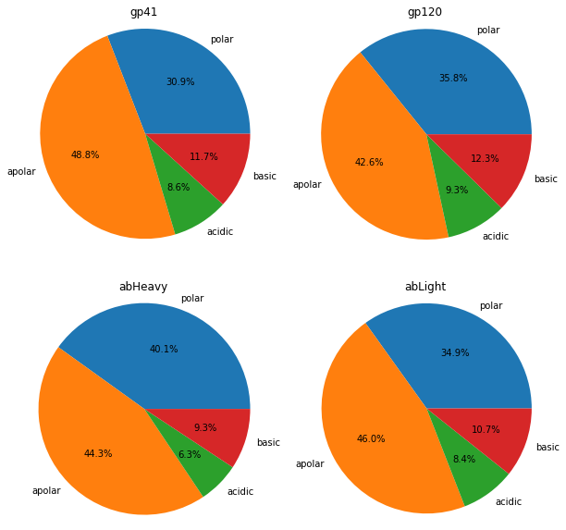
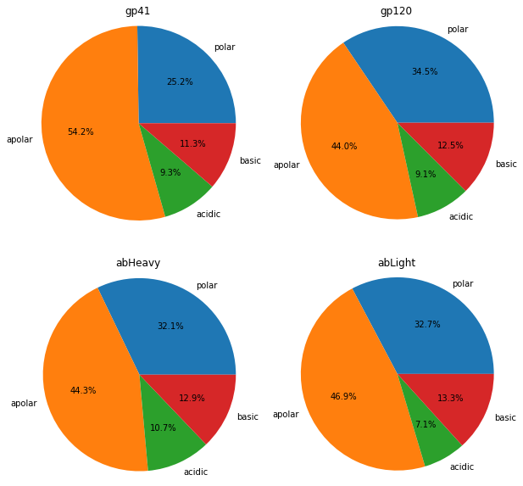
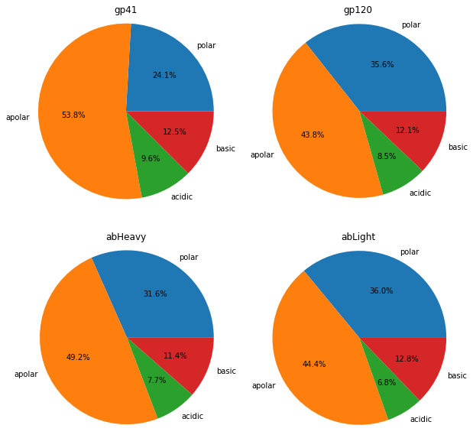
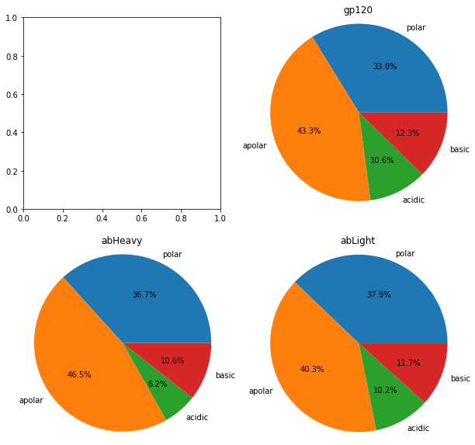
10-1074
pgt145
Duplicate the process for all the other antibodies I have.
pg16
3BNC117

Slide 17
Goal 1
Broadly Neutralizing Antibody | Epitope
10-1074 | V3 glycan
10E8 | MPER
10E8 Fab | MPER
10E8 x CD3 | MPER
10E8v4 | MPER
17b x CD3 | alphaCCR5
2E7 | gp41
35O22 | gp120-gp41
3BNC117 | CD4bs
3BNC117 | MPER
7B2 x CD3 | gp41
8ANC195 | gp120-gp41
A32 x CD3 | CD4i
A32 x CD3 MP3 | CD4i
B12 x CD3 | CD4bs
Cap256.VRC26 | V2 glycan
CD4 | CD4
CD4 x CD3 | CD4
I3 | CD4bs
iMab | alphaCD4
m36.4 | gp120 C3
N6 | CD4bs
P140 | alphaCCR5
PG9 | V2 glycan
PG9-16 | V2 glycan
PGDM1400 | V2 apex
PGDM1400fv.V8 | V2 apex
PGT121 | V3 glycan
PGT121 x CD3 | V3 glycan
PGT128 | V3 glycan
PGT128 | MPER
PGT135 | V3 glycan
PGT145 | V2 apex
PGT145 | MPER
PGT145 x CD3 | V2 apex
PGT151 | gp120-gp41
PGT151 | MPER
PRO | alphaCCR5
PRO 140 | alphaCCR5
VCR01 | CD4bs
VRC01 x CD3 | CD4bs
VRC07-523LS | CD4bs
Carry out a literature review to identify all relevant antibody (Ab)/antigen (Ag) complexes for HIV.
Notes:
Lots of repeats – still trying to figure out what they all are.

Slide 18
Goal 2
10E8 Fab
Carry out an analysis to determine the degree of interfacial composition matching (ICM) of Abs bound to different binding sites on HIV, comparing the results for the germline/mature versions of each Ab.

Slide 19
Goal 2
10E8 Fab
Carry out an analysis to determine the degree of interfacial composition matching (ICM) of Abs bound to different binding sites on HIV, comparing the results for the germline/mature versions of each Ab.

Slide 20
Goal 3
Use results from (2) to determine: (a) how prevalently employed ICM is for anti-HIV Abs, (b) how ICM varies for neut. vs. non-neut. Abs, (c) how ICM varies for different HIV binding sites, and (d) the effect of glycans on ICM.
Need to put data in chart form – find a better way to display or compare the ICM.

Slide 21
Data
10-1074
pgt145
Could the antibodies and antigens simply have a similar composition most of the time?
What is the degree of sensitivity?
Would it change if I compared position to position?

Slide 22
Goal 4
Carry out affinity maturation simulations with different initial ICM values by changing the Ab, Ag sequences.
Status: Ran one simulation.
Next step: View the data and determine how to do this with other antibodies.

