Slide 1
Co-Advising Meeting
Emily Rhodes
December 3rd, 2020

Slide 2
Projects
Project 1 – Composition Matching
John Mascola - Longitudinal analysis
Scoring Function
Project 2 – Modeling COVID
Two theories

Slide 3
Worked on this week: (Project 1)
John Mascola’s Data:
Paper: Broad and potent neutralization of HIV-1 by a gp41-specific human antibody
https://pubmed.ncbi.nlm.nih.gov/23151583/
Database: http://imgt.org/
Paper: Focused evolution of HIV-1 neutralizing antibodies revealed by structures and deep sequencing
https://pubmed.ncbi.nlm.nih.gov/21835983/
“Associated Data” - tried to access, but I am not sure how to get it

Slide 4
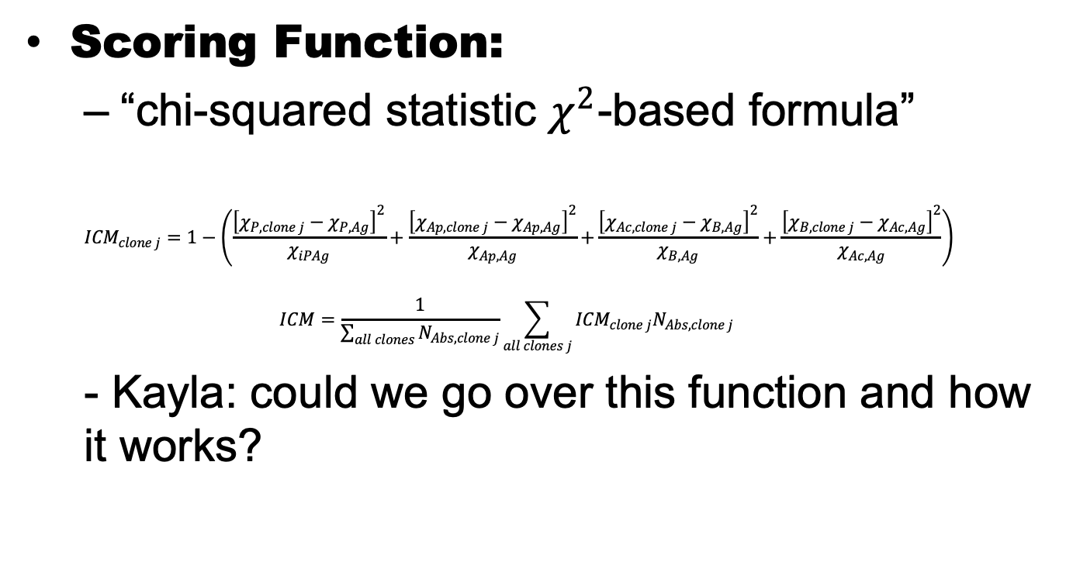
Worked on this week: (Project 1)
Scoring Function:
“chi-squared statistic $χ^{2}$-based formula”
$${ICM}_{clone j}=1−\left(\frac{{\left[χ_{P,clone j}−χ_{P,Ag}\right]}^{2}}{χ_{iPAg}}+\frac{{\left[χ_{Ap,clone j}−χ_{Ap,Ag}\right]}^{2}}{χ_{Ap,Ag}}\left.+\frac{{\left[χ_{Ac,clone j}−χ_{B,Ag}\right]}^{2}}{χ_{B,Ag}}+\frac{{\left[χ_{B,clone j}−χ_{Ac,Ag}\right]}^{2}}{χ_{Ac,Ag}}\right) \right.$$
$$ICM=\frac{1}{\sum_{all clones}{N_{Abs, clone j}}}\sum_{all clones j}{{ICM}_{clone j}N_{Abs, clone j}}$$
- Kayla: could we go over this function and how it works?

Slide 5
Worked on this week: (Project 2)
Modeling of antibodies that are neutralizing sars-cov-2
Not enough antibodies
Not a long enough equilibrium time

Slide 6
OneNote + MatLab Scripts

Slide 7
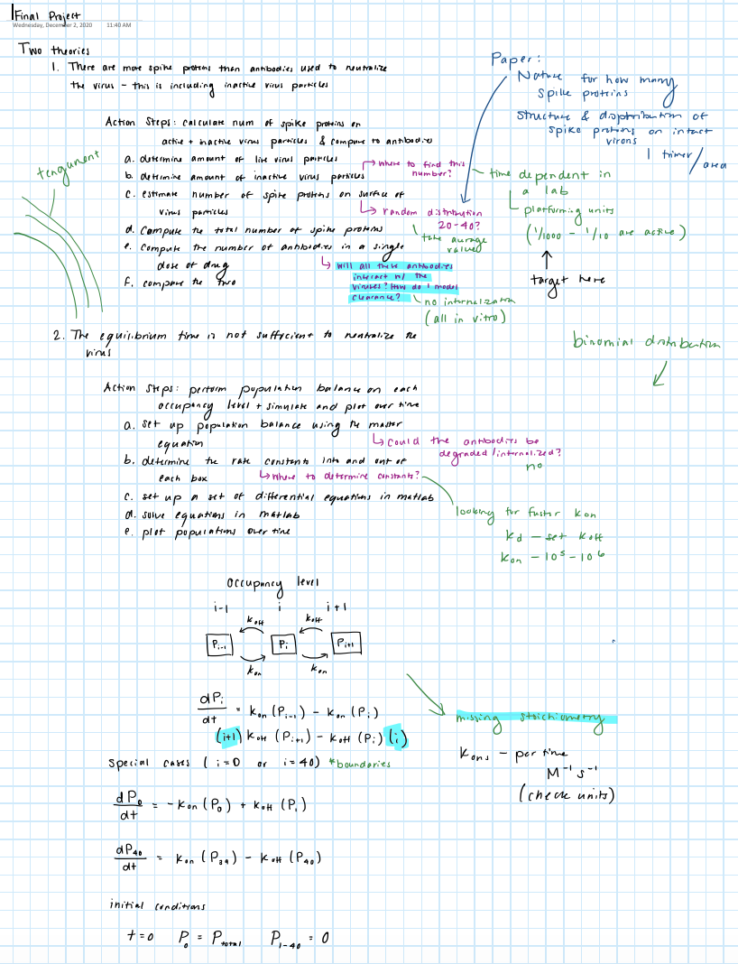

Slide 8
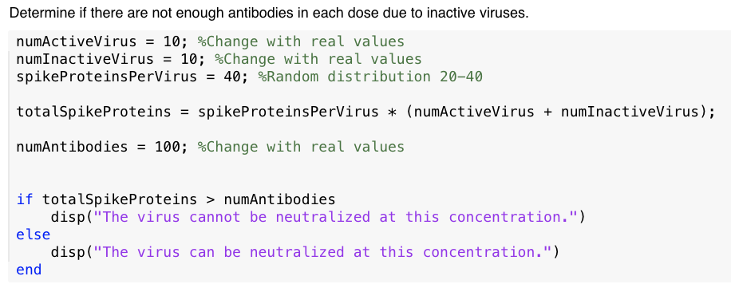

Slide 10
