Slide 1
Co-Advising Meeting
Emily Rhodes
December 10th, 2020

Slide 2
Projects
Project 1 – Composition Matching
Scoring Function
Project 2 – Modeling COVID
Two theories

Slide 3
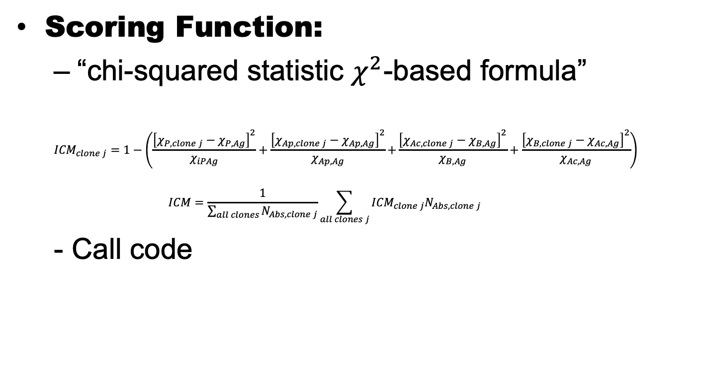
Worked on this week: (Project 1)
Scoring Function:
“chi-squared statistic $χ^{2}$-based formula”
$${ICM}_{clone j}=1−\left(\frac{{\left[χ_{P,clone j}−χ_{P,Ag}\right]}^{2}}{χ_{iPAg}}+\frac{{\left[χ_{Ap,clone j}−χ_{Ap,Ag}\right]}^{2}}{χ_{Ap,Ag}}\left.+\frac{{\left[χ_{Ac,clone j}−χ_{B,Ag}\right]}^{2}}{χ_{B,Ag}}+\frac{{\left[χ_{B,clone j}−χ_{Ac,Ag}\right]}^{2}}{χ_{Ac,Ag}}\right) \right.$$
$$ICM=\frac{1}{\sum_{all clones}{N_{Abs, clone j}}}\sum_{all clones j}{{ICM}_{clone j}N_{Abs, clone j}}$$
- Call code

Slide 4
Worked on this week: (Project 1)
Still figuring out the syntax
Will make more progress once the semester is done

Slide 5
Worked on this week: (Project 2)
Modeling of antibodies that are neutralizing sars-cov-2
Not enough antibodies
Not a long enough equilibrium time

Slide 6
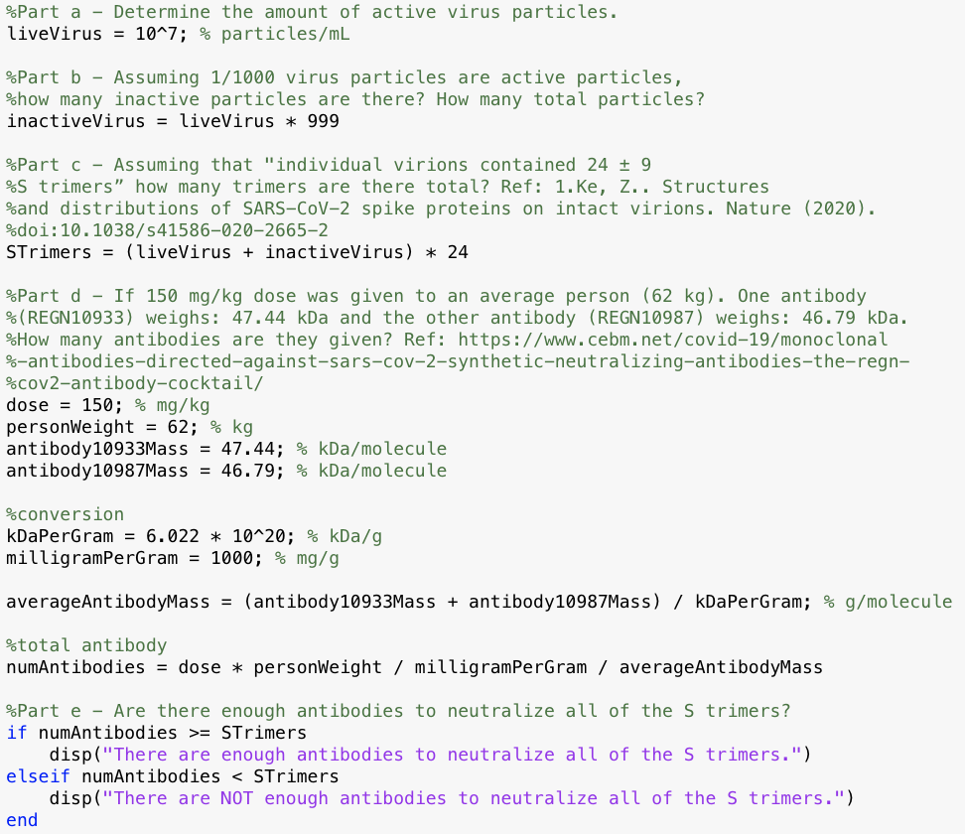
Theory 1
Number of Live Viruses – Can’t Find this Data

Slide 7
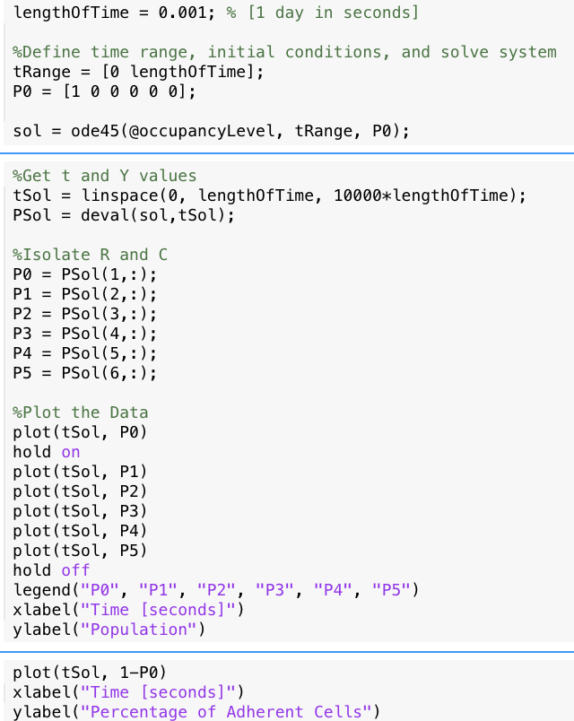
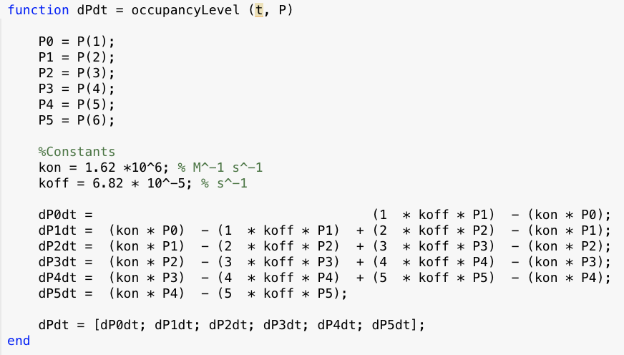
Theory 2
Modeling up to 24 occupancy levels – too much data

Slide 8
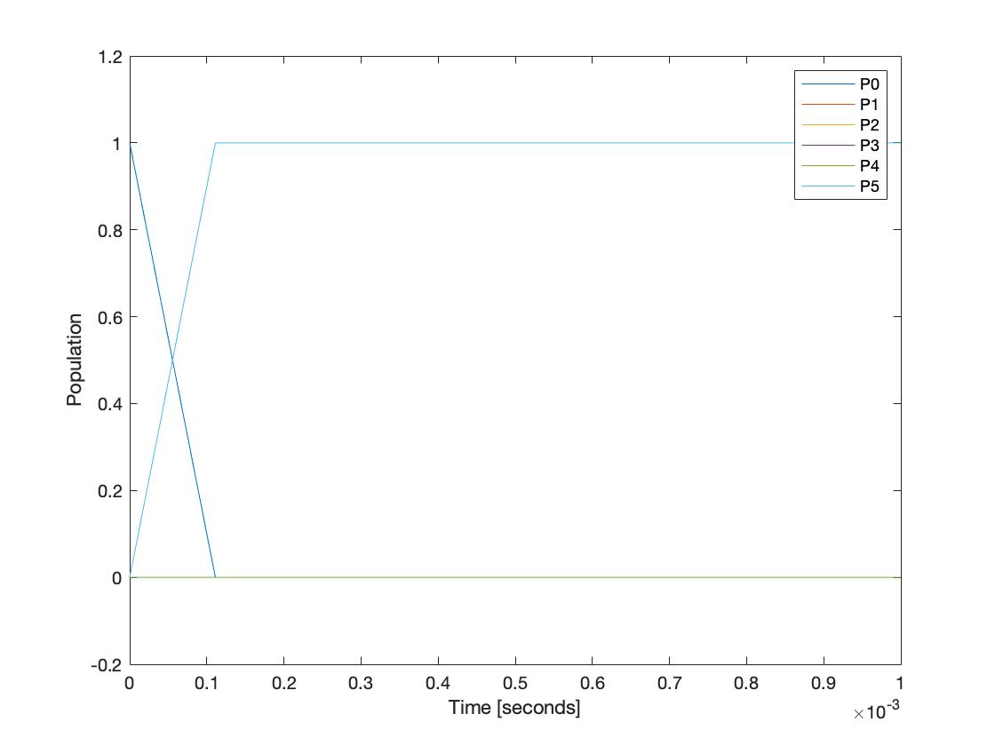
Immediately binds everything – probably true for higher occupancy levels too

