Slide 1
Framework Mutations
Emily Rhodes
April 15th, 2021

Slide 2
Goal
S scores – Score individual mutations
F scores – The combination of S scores for an individual Ab gives the
Both need validation by literature?

Slide 3
To Do:
Create a spreadsheet:
Germline
FDA approved antibodies
PSSM?
Obtain or make?
Literature for specific point mutations
Also measure some bio-physical properties
Pluckthun; Burton; Winter; McCafferty
https://elifesciences.org/articles/33038
Papers in introduction
In order to select mutations we want to have a PSSM that guides which mutations are interesting.

Slide 4
Column 1: PMID/reference
Column 2: VH gene
Column 3: individual point mutations
Column 4: biophysical method(s)
TM (melting temp
Aggregation propensity
Viscosity
Expression yield
Column 5: the name of the antibody

Slide 5
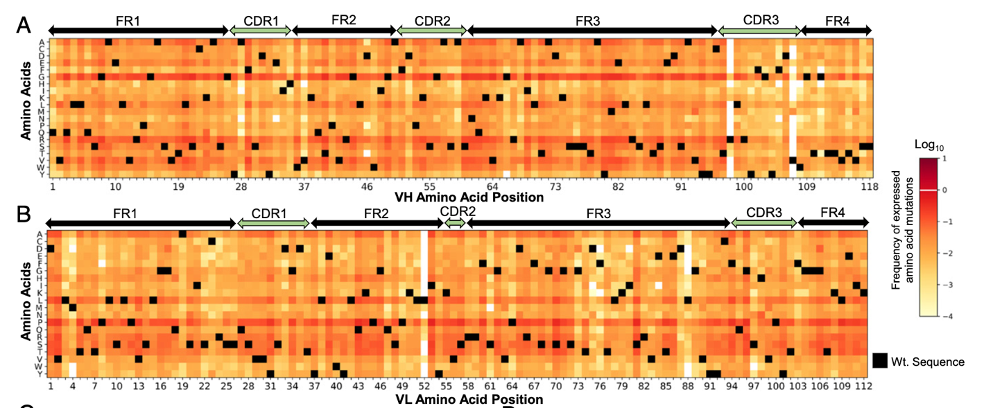
Mutational fitness landscapes reveal genetic and structural improvement pathways for a vaccine-elicited HIV-1 broadly neutralizing antibody
35 – seems to have low frequency for heavy and light chain
59 – looks particular low frequency for the heavy chain
61 – low frequency for light chain but medium frequency for heavy chain
63 – medium frequency for both
65 – medium frequency for both
These results make me want to look at residues 98 and 107 (heavy chain) and 55 and 88 (light chain). Why are they so conserved?
Notes:
https://www.pnas.org/content/118/10/e2011653118
Wholistically look at data and
Table: Germline and point mutations do we need to build the PSSM?
It is difficult to find the data sets
VH6 – best data set; no PSSM

Slide 6
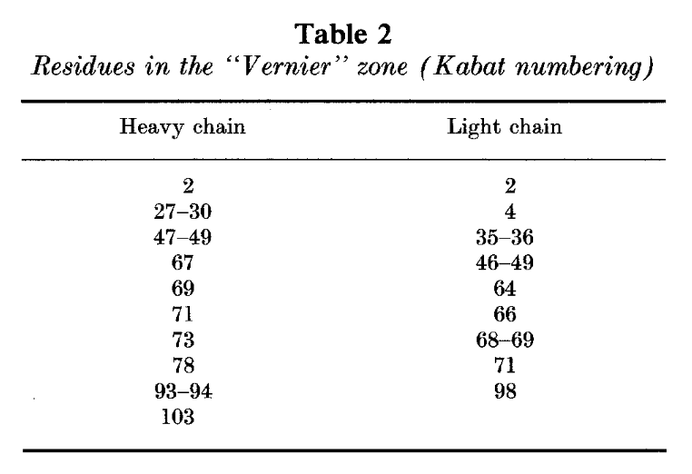
Antibody framework residues affecting the conformation of the hypervariable loops
35 is within the Vernier zone which is said to help: “adjust CDR structure and fine-tune the fit to antigen.”
Notes:
https://www.sciencedirect.com/science/article/abs/pii/002228369291010M?via%3Dihub

Slide 7
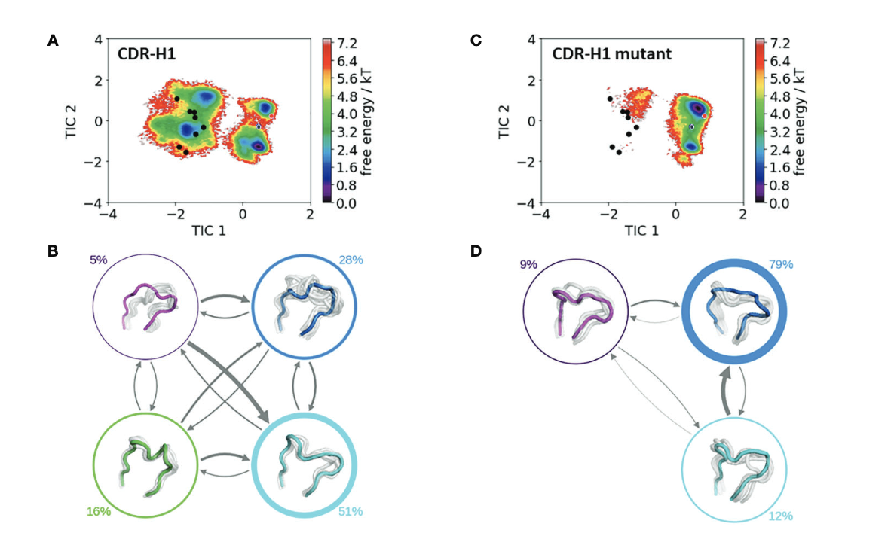
Mutation of Framework Residue H71 Results in Different Antibody Paratope States in Solution
Comparison of the free energy surfaces and Markov-state models of the CDR-H1 loop of both the human germline IGHV1-69/IGKV1-39 antibody Faband the mutant. Panel(A)illustrates the free energy surface of the CDR-H1 loop of the human germline antibody.”
They also look at H2 and H3 loops.
Notes:
https://www.frontiersin.org/articles/10.3389/fimmu.2021.630034/full

Slide 8
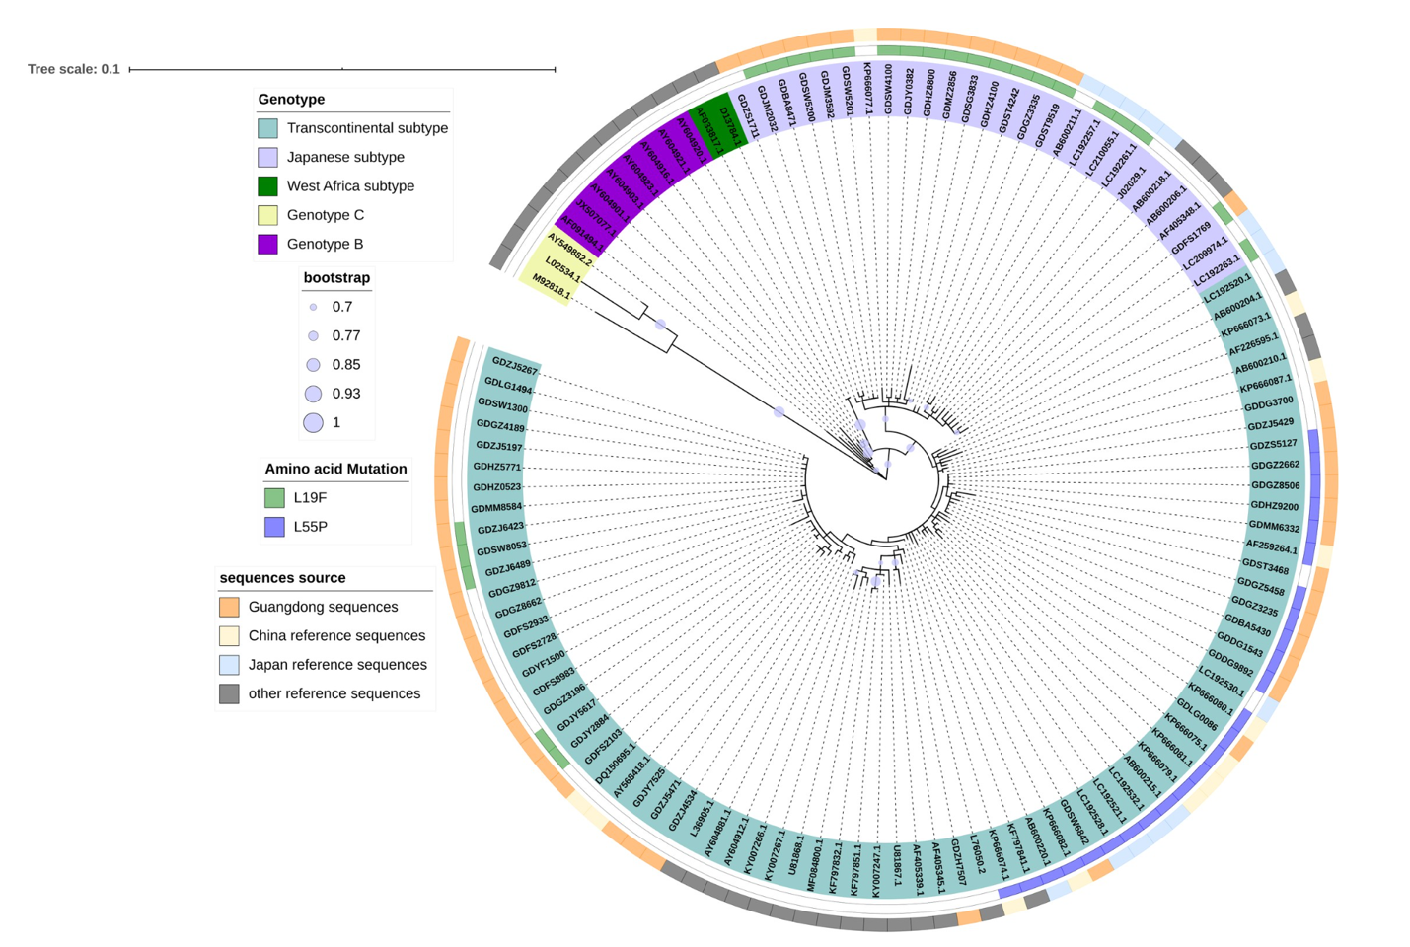
Prevalence and evolutionary analyses of human T-cell lymphotropic virus in Guangdong province, China: Transcontinental and Japanese subtype lineages dominate the prevalence
Mutations at L19 and L55. What the scores for these mutations? Could they be interesting to look at?
Notes:
https://journals.plos.org/plosntds/article?id=10.1371/journal.pntd.0009043

Slide 9
Literature Review
Other people’s findings?
Thoughts?
Next: Specific Mutation Discussion

Slide 10
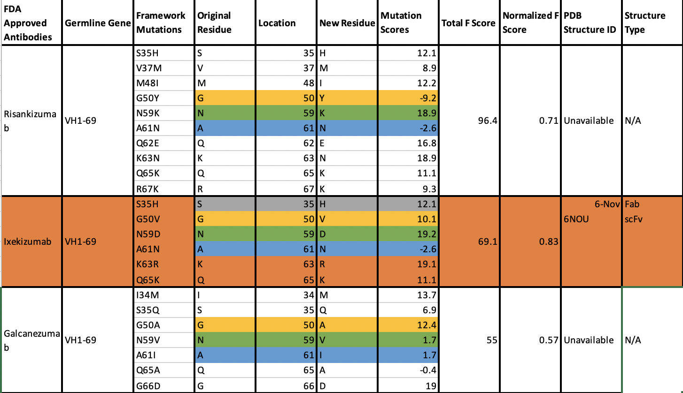
VH1-69
Mutations that occur in all three antibodies:
S35
G50
N59
A61
Q65

Slide 11
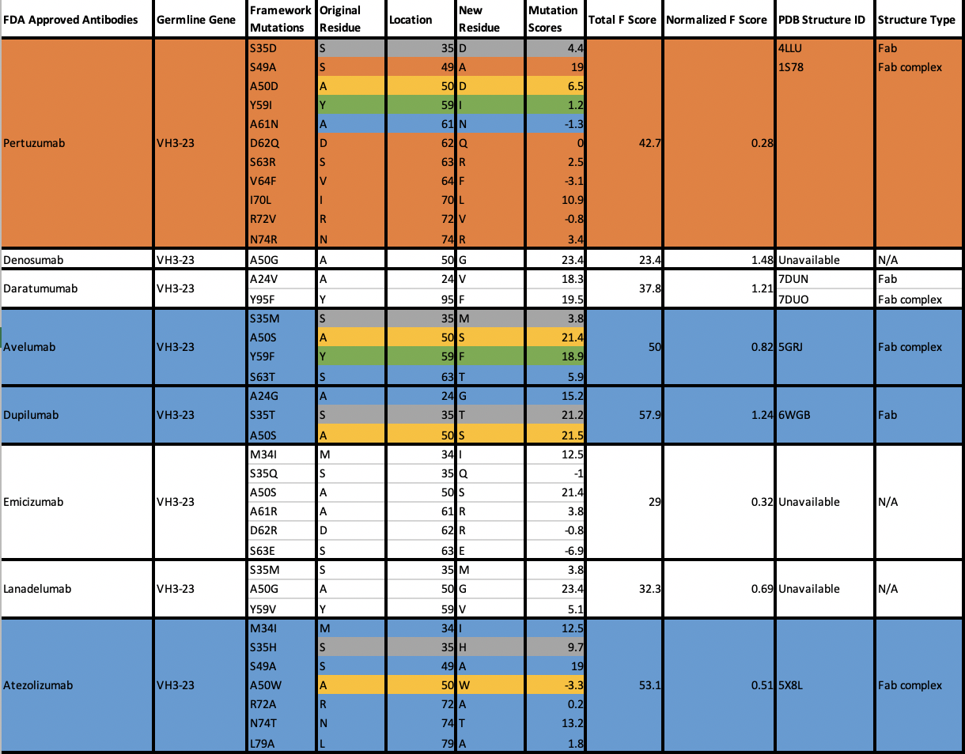
VH3-23
Mutations that occur most commonly:
S35
A50

Slide 12
Across Germlines

Slide 13
Proposed Mutations
Across Germlines:
S35
Starts with the same amino acid (S) as opposed to 50 which changes across germlines
Within Germline:
A61 (low score: why)?
Help 59?
Help 63 and 65?
Help both?
Tim’s Mutation
S49
Dupliumab
Reversion | S35
Pertuzumab
Reversion | S35
Reversion | S49
Ixekizumab
Reversion | S35
Reversion | N59
Reversion | A61 + N59
Reversion | A61
Reversion | A61 + K63 + Q65
Reversion | K63 + Q65
Reversion | N59 + A61 + K63 + Q65

