Slide 1
Weekly Updates
Emily Rhodes
April 16th, 2021

Slide 2
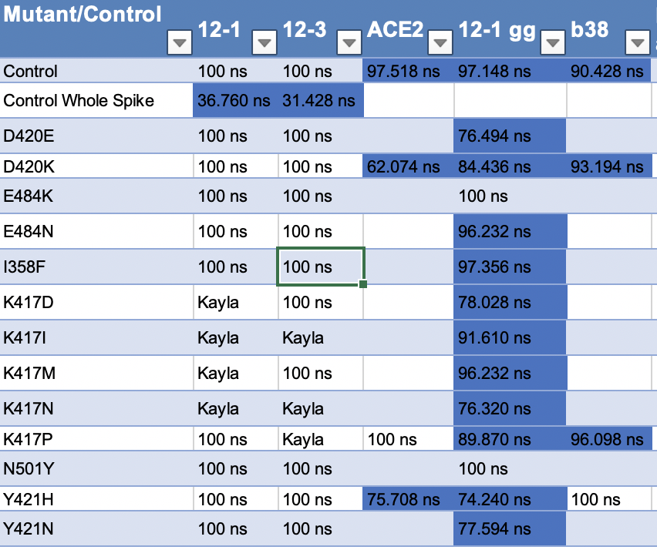
Sims Status
Notes:
Free energy calculations
I358F
RMSD – stability thing

Slide 3
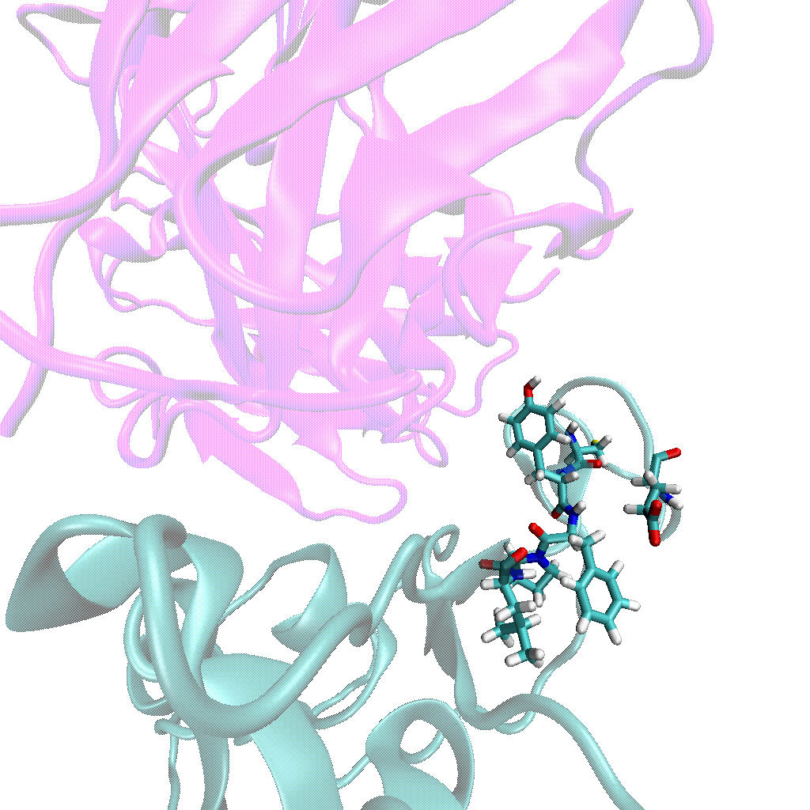
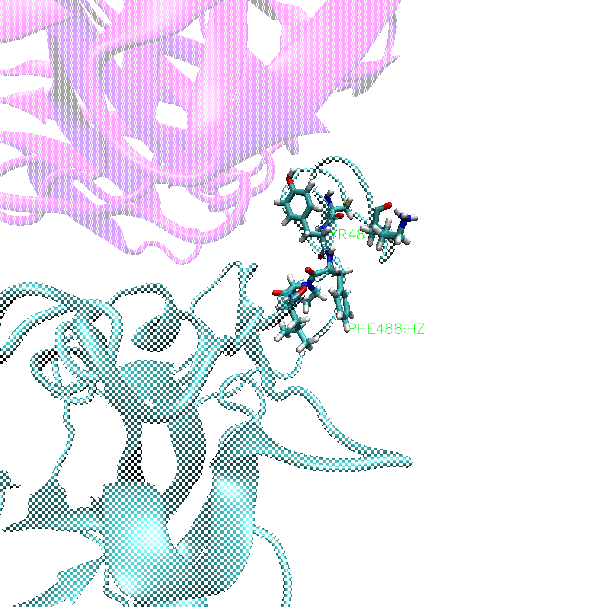
E484K
E484
E484K
Notes:
Hydrogen bond – every frame
RMSD of that section – is it less stable?
RMSF – if there is something in RMSD
- gromacs with residues (index file)

Slide 4
Brian Antibody Sims
Let him take the lead?
Push for the MD
Set up and run the simulations
Brian set up one
Notes:
35 – isolated; super common; across germlines
Set up simulation
Both germlines
Control and mutant
Check for missing residues
Modeller
Just antibody

Slide 5
Other two COVID projects
Tutorial – SDA
Collaborator: Meeting
Read it again
Function for infectivity

