Slide 1
Weekly Updates
Emily Rhodes
April 21st, 2021

Slide 2
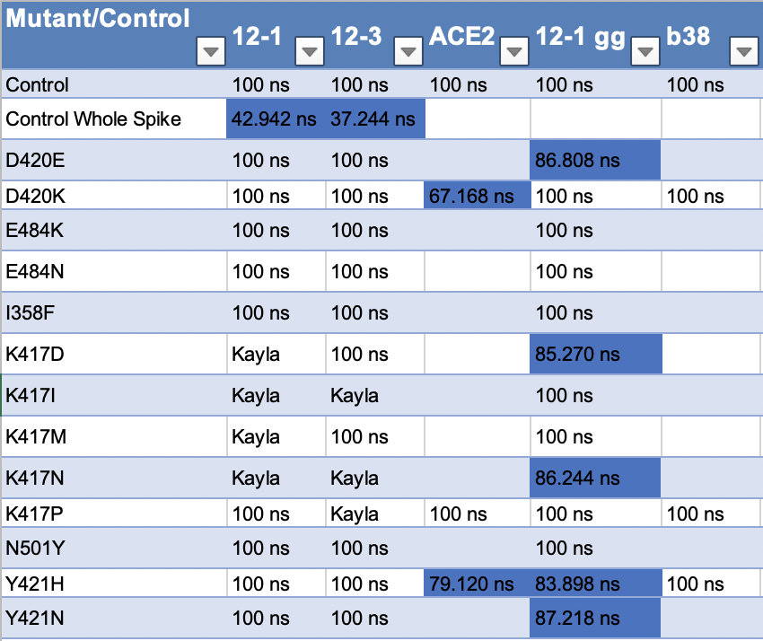
Sims Status
Notes:
Free energy calculations
I358F
RMSD – stability thing

Slide 3
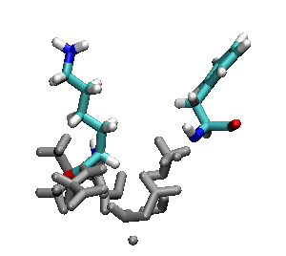
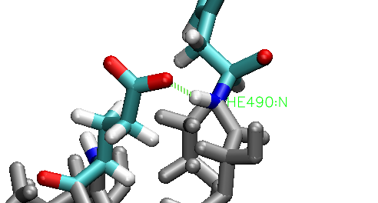
E484K
E484K
Notes:
Hydrogen bond – every frame
RMSD of that section – is it less stable?
RMSF – if there is something in RMSD
- gromacs with residues (index file)

Slide 4
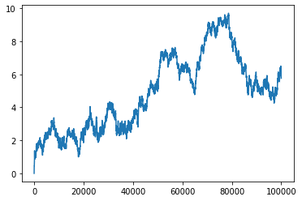
RMSD
Mutant
Notes:
Structural
RMSF – per residue

Slide 5
Antibodies
Starting S35 Mutations and working on teaching Brian how to set up his own simulations.

Slide 6
Other two COVID projects
Tutorial – SDA
Collaborator: Meeting
Read it paper again
Function for infectivity

