Slide 1
Weekly Updates
Emily Rhodes
April 23rd, 2021

Slide 2
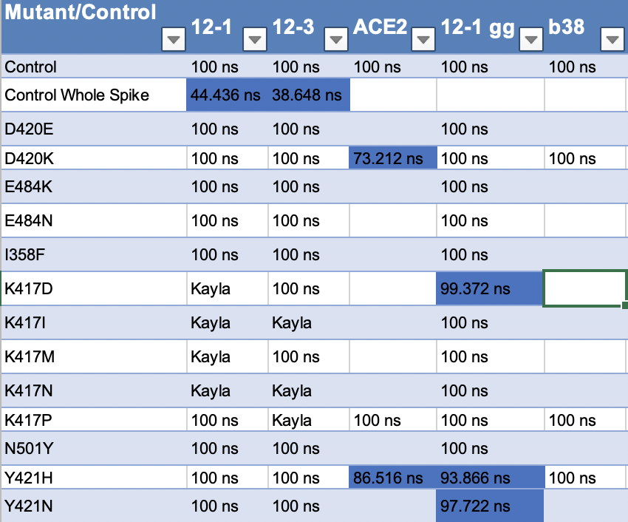
Sims Status
Notes:
Free energy calculations
I358F
RMSD – stability thing

Slide 3
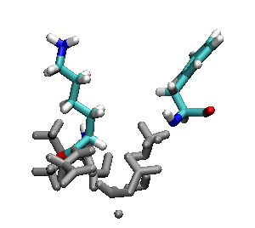
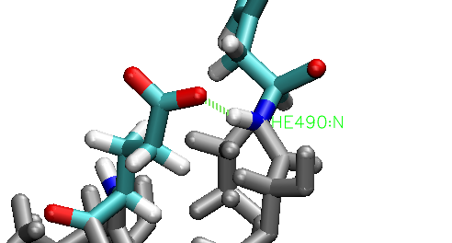
E484K
E484K
Notes:
Hydrogen bond – every frame
RMSD of that section – is it less stable?
RMSF – if there is something in RMSD
- gromacs with residues (index file)

Slide 4
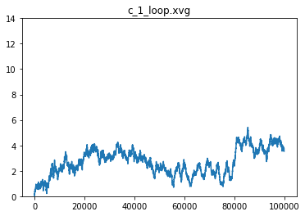
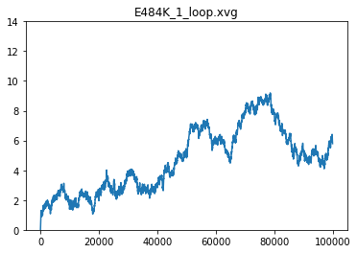
CC12.1 RMSD

Slide 5
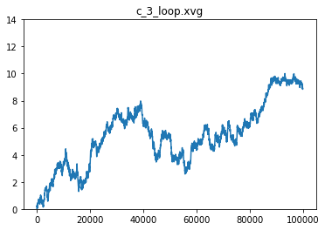
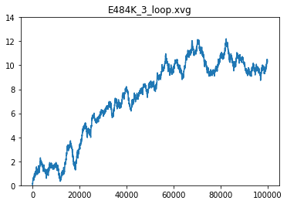
CC12.3 RMSD

Slide 6
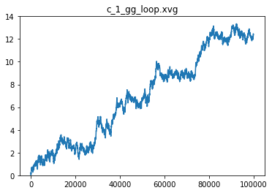
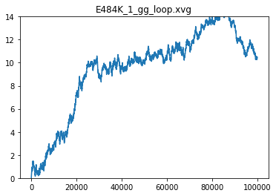
CC12.1 (GG) RMSD
Notes:
Structural
RMSF – per residue

Slide 7
Next Steps
MMPBSA

Slide 8
Antibodies
Starting S35 Mutations and working on teaching Brian how to set up his own simulations.
Haven’t done yet. Still need to confirm with Brian.

Slide 9
Other two COVID projects
Tutorial – SDA
Collaborator: Meeting
Read it paper again
Function for infectivity

