Slide 1
Weekly Updates
Emily Rhodes
April 28th, 2021

Slide 2
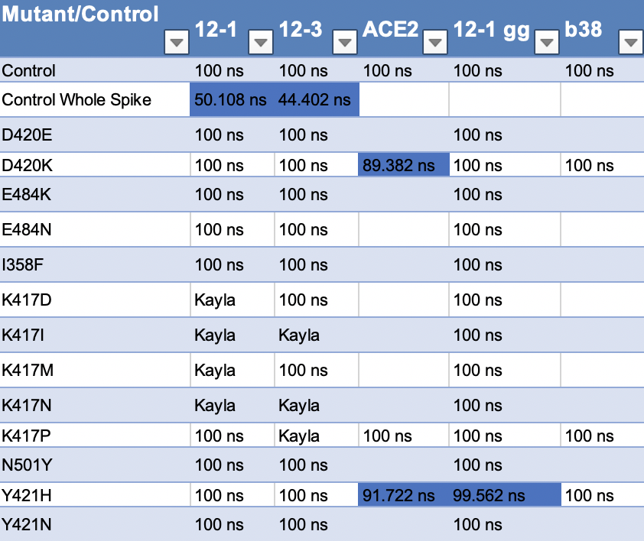
Sims Status
Notes:
Free energy calculations
I358F
RMSD – stability thing

Slide 3
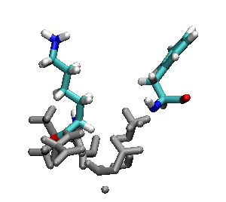
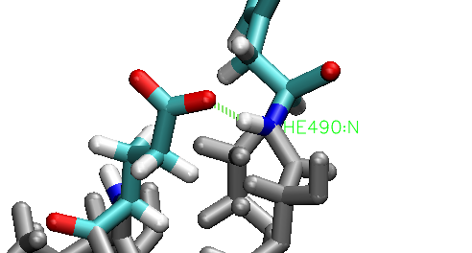
E484K
E484K
Notes:
Hydrogen bond – every frame
RMSD of that section – is it less stable?
RMSF – if there is something in RMSD
- gromacs with residues (index file)

Slide 4
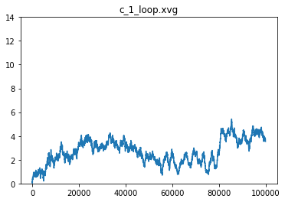
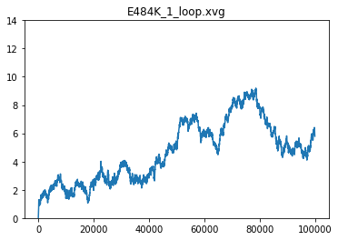
CC12.1 RMSD

Slide 5
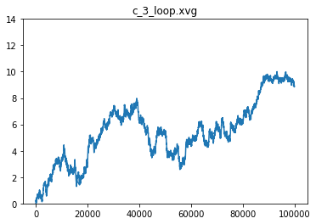
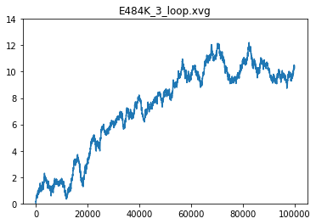
CC12.3 RMSD

Slide 6
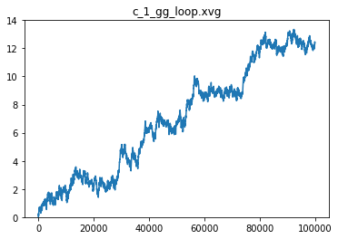
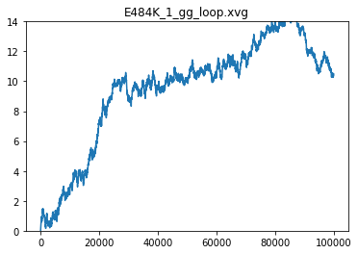
CC12.1 (GG) RMSD
Notes:
Structural
RMSF – per residue

Slide 7
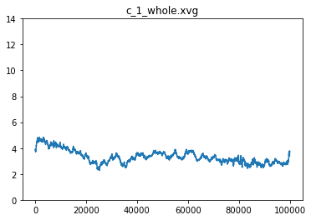
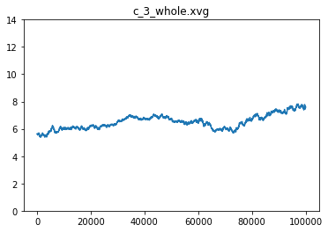
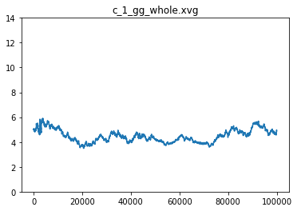
RMSD - All Sims

Slide 8
Papers to Read
Dennis Burton *
Ian Wilson
Joe – Scripts, Antibody guy
Andreas Plückthun *
Paul Carter
Simon Moroney
Sir Gregory Paul Winter *
James Huston
Alain Beck *
Sachdev Sidhu *
John McCafferty *
Dane Wittrup *
Roland Kontermann *
Florian Wurm *
Tillman Gerngross *
Roy Jefferis *
James Marks *
Brent Iverson *
Richard Begent *
Jeffrey Ravetch *
Gregg Silverman *
* = is a professor
My goal: read the most highly cited paper by each person before prelims.

Slide 9
Wet Lab
Talking to Irene and Alison about next steps

Slide 10
Antibodies
S35 and *50 Sims
Germline | Antibody | Control | S35 | *50
VH3-23 | Pertuzumab | nvt | em | em
VH3-24 | Dupilumab | structures made | structures made | structures made
VH3-25 | Atezolizumab | structures made | structures made | structures made
VH1-69 | Ixekizumab | structures made | structures made | structures made

Slide 11
Other two COVID projects
Tutorial – SDA
Collaborator: Meeting
Read it paper again
Function for infectivity

