Slide 1
Weekly Updates
Emily Rhodes
April 30th, 2021

Slide 2
Gantt Chart
Go to excel sheet

Slide 3
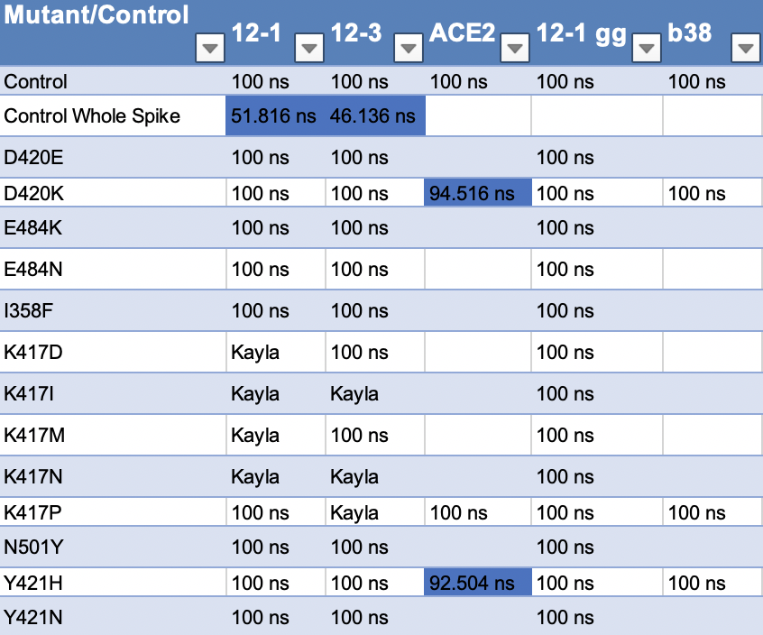
Sims Status
Notes:
Free energy calculations
I358F
RMSD – stability thing

Slide 4
Trajectory Analysis
Look at: (after final tomorrow)
N501Y
K417*
I358F
Notes:
Make trajectories whole & no jump + download

Slide 5
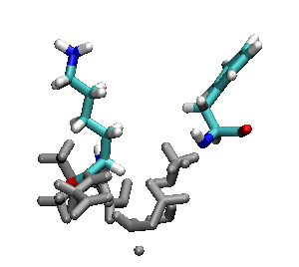
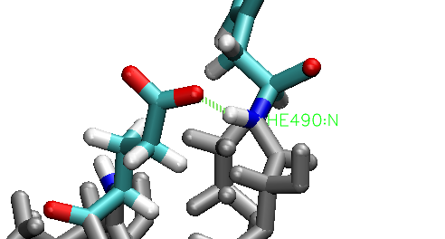
E484K
E484K
Notes:
Hydrogen bond – every frame
RMSD of that section – is it less stable?
RMSF – if there is something in RMSD
- gromacs with residues (index file)

Slide 6
Tim’s Thoughts
E484K is not an escape for CC12.1 and CC12.3, and the antibodies it is an escape for it contacts at that site so the loop movement is not an important part of the story

Slide 7
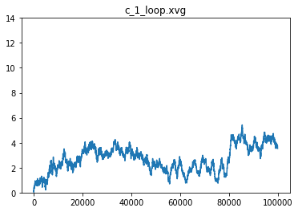
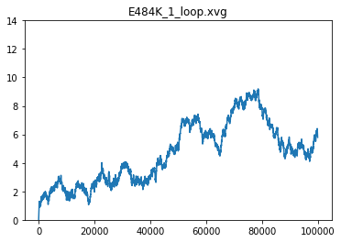
CC12.1 RMSD

Slide 8
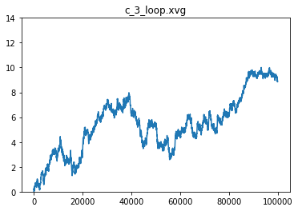
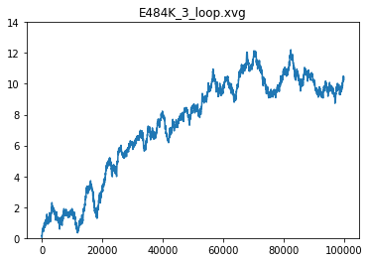
CC12.3 RMSD

Slide 9
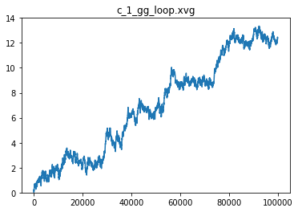
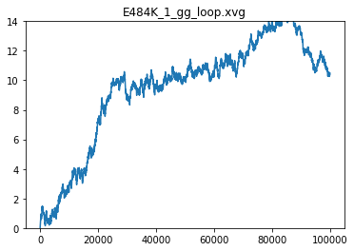
CC12.1 (GG) RMSD
Notes:
Structural
RMSF – per residue

Slide 10
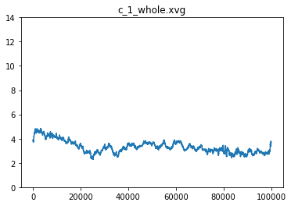
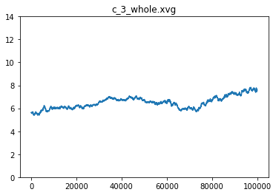
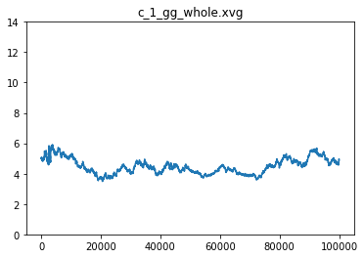
RMSD – Protein

Slide 11
RMSD – All mutations
Did they reach a steady configuration?
Controls = seem like it
Need to do: E484K (whole protein)
I still need to make and download all RMSD plots

Slide 12
Papers to Read
Dennis Burton *
Ian Wilson
Joseph G. Jardine
Andreas Plückthun *
Paul Carter
Simon Moroney
Sir Gregory Paul Winter *
James Huston
Alain Beck *
Sachdev Sidhu *
John McCafferty *
Dane Wittrup *
Roland Kontermann *
Florian Wurm *
Tillman Gerngross *
Roy Jefferis *
James Marks *
Brent Iverson *
Richard Begent *
Jeffrey Ravetch *
Gregg Silverman *
Jim Wells *
* = is a professor
My goal: read the most highly cited paper by each person before prelims.
Names to add to the list?
Tim - Read the paper about additive mutations by Pluckthun.
Notes:
Add in computational people
Affinity maturation – Arup; individual papers

Slide 13
Wet Lab
Getting sequenced
Next steps: analyze point mutations
Alison & Irene – talk to about starting to write & analysis of individual point mutations
Notes:
Closer to co-first (with writing)

Slide 14
Antibodies
S35 and *50 Sims
I got them started and then realized they are all missing many residues..
Can I learn how to use modeler?
Notes:
Jon – after Saturday

Slide 15
Stefano
Email – about working together over the summer
Notes:
See if Stefano can help with some of the projects I have: neutralization threshold

Slide 16
Fellowships
WIC: https://www.aiche.org/community/awards/women-chemical-engineering-wic-travel-award
Due: August 31st
GAANN: https://www2.ed.gov/programs/gaann/applicant.html
Due: March 1st, 2021
Department version was in May last year?
Asked Dom – he said it would be mid-may
Bio-physics fellowship: https://www.colorado.edu/biophysics/
Due: ?
Ask Alison
Ruth L. Kirschstein Predoctoral Individual National Research Service Award: https://researchtraining.nih.gov/programs/fellowships/F31
Due: ?
Get an application from someone who won
F31

Slide 17
Classes
BioChem – Tim
BCHM 2700
Foundations of Biochemistry
BCHM 5771 (Grad Level)
Advanced General Biochemistry 1
CSCI 3022
Introduction to Data Science with Probability and Statistics
CSCI 5352
Network Analysis and Modeling
Notes:
Ask Jon – same classes?

Slide 18
Other two COVID projects
Tutorial – SDA
Collaborator: Meeting
Read it paper again
Function for infectivity

