Slide 1
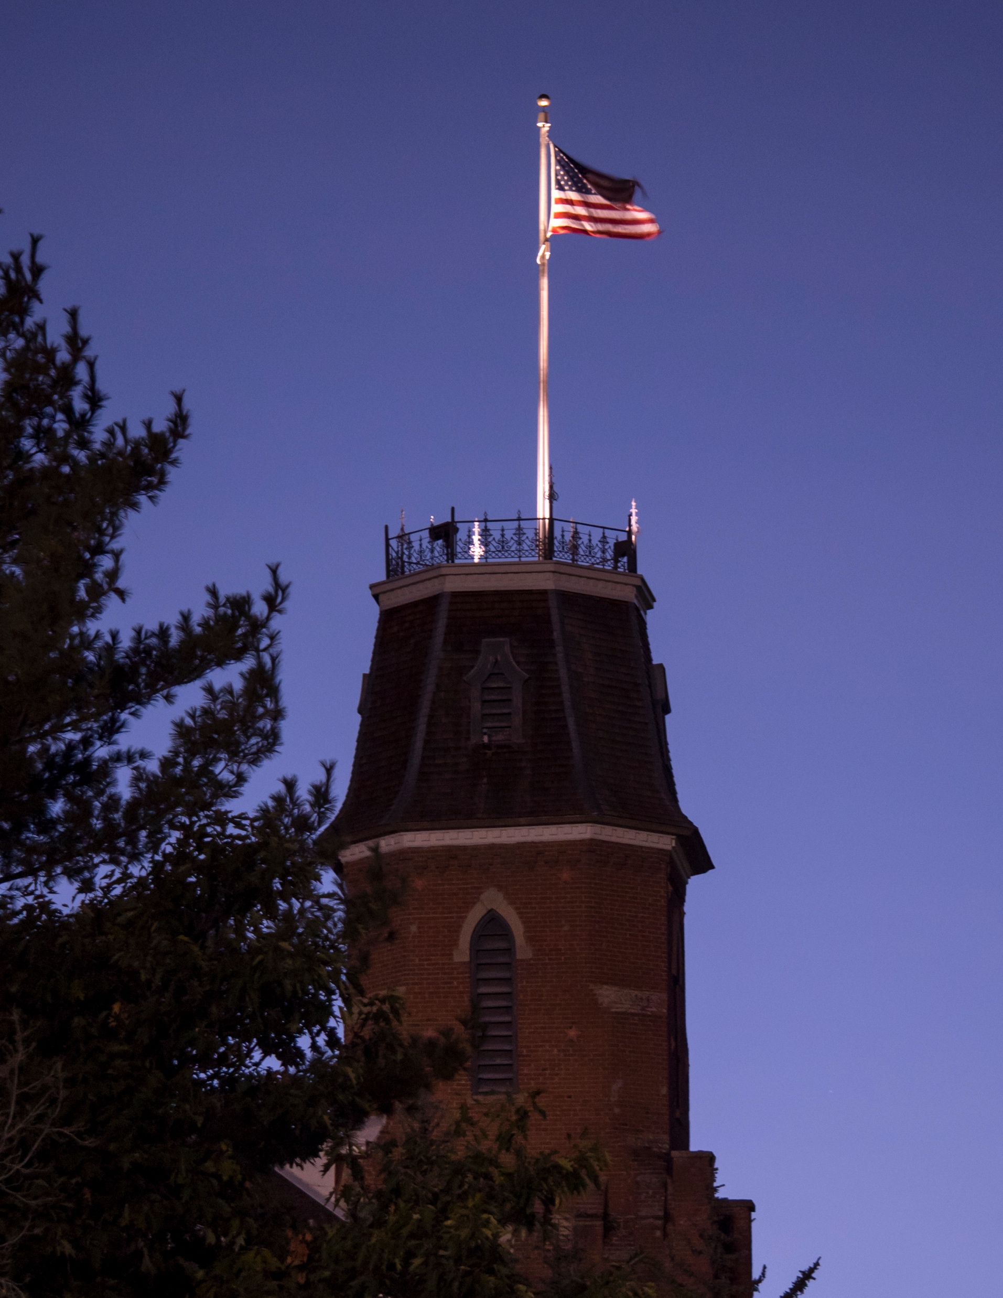
Escape Mutation Mechanisms: Impact and Implications
Emily Rhodes
May 14th, 2021
Group Meeting
Notes:
Today I will be telling you antigen escape mutation mechanisms and how binding is impacted by antigen structure. In particular, I will discuss our efforts to explain why some antibodies are resistant to escape and what features of binding are impacted by escape mutations.

Slide 2
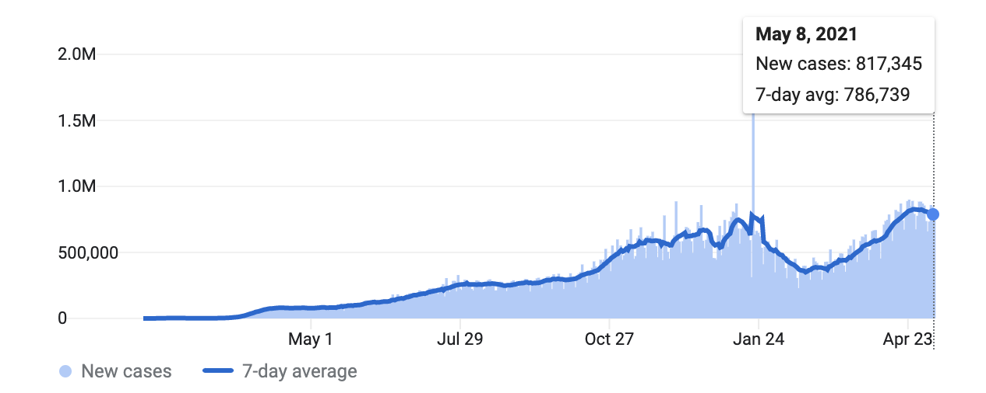
SARS-CoV-2
161 M
Cases
3.35 M
Deaths
Wang, W. B.. E484K mutation in SARS-CoV-2 RBD enhances binding affinity with hACE2 but reduces interactions with neutralizing antibodies and nanobodies: Binding free energy calculation studies. (2021). doi:10.1101/2021.02.17.431566
Notes:
December 31st, 2019 a cluster of pneumonia cases was reported in Wuhan, Hubei Province. These cases were identified as a new coronavirus. The few cases spread and swept the world in a global pandemic over the following months. Currently, 161 million cases and 3.35 million deaths have been recorded. Although it is a respiratory illness, similar to influenza, it spreads more quickly and results in more severe cases in some people.

Slide 3
Vaccine
mRNA
Contains genetic material for the body to produce SARS-CoV-2 surface proteins
Protein Subunit
Contains parts of SARS-CoV-2 surface proteins
Vector
Contains a virus with modified genetic material
Notes:
To combat the virus, several companies have developed vaccines to utilize the body’s natural features to defend against the virus. There are three main types used with COVID: mRNA vaccines that contain the genetic material for the surface proteins, protein subunit vaccines that contain the surface proteins or vector vaccines that contain a modified version of the genetic material within the virus. Each of these vaccines presents the body with a foreign object (antigen) which the body then learns to recognize and produces antibodies to defend against.

Slide 4
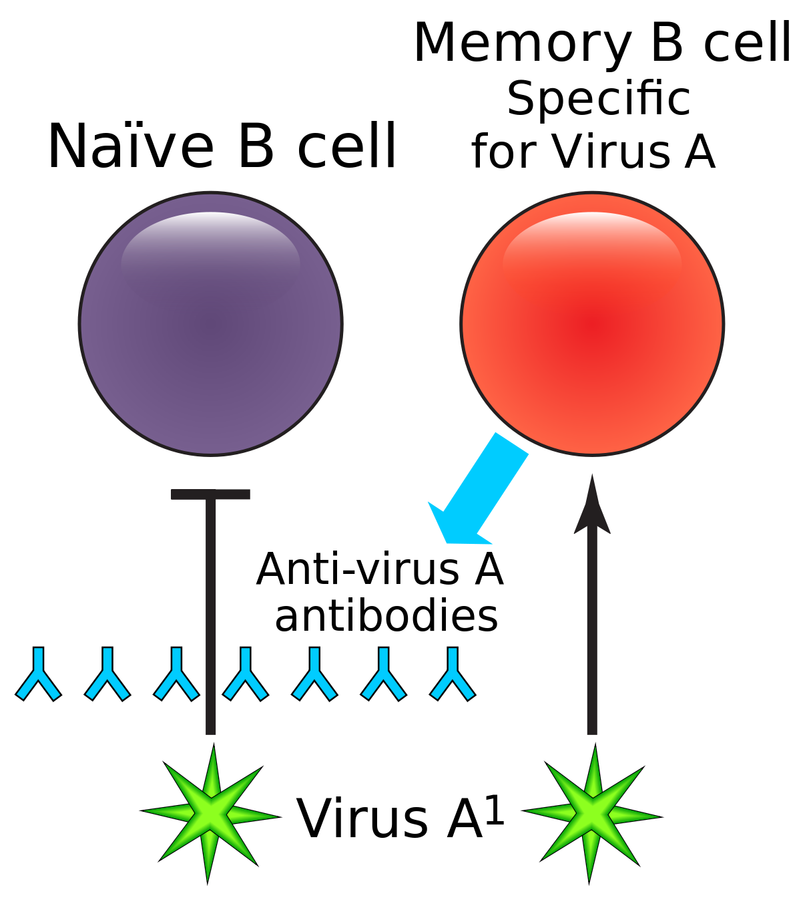
Memory B Cell
Notes:
Because the body produced its own antibodies, it keeps the cells that made these antibodies, memory B cells, in case your body has a future encounter with the virus. With these memory cells, your body will theoretically be to defend itself.

Slide 5
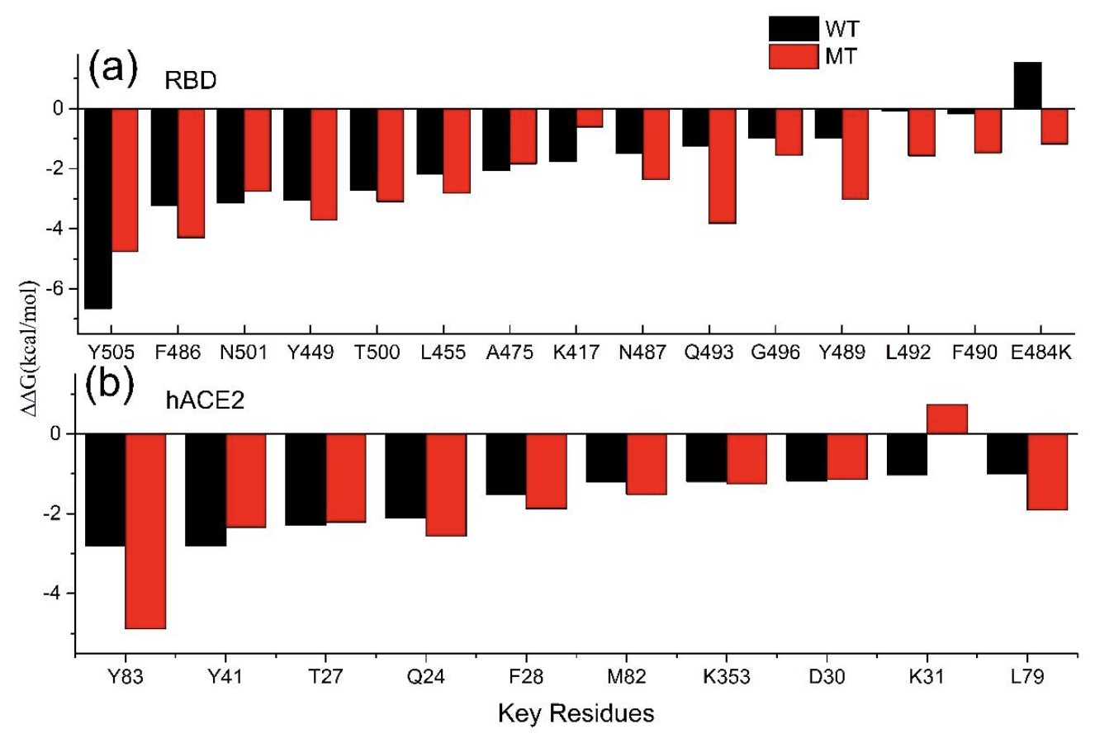
Escape Mutations
Wang, W. B.. E484K mutation in SARS-CoV-2 RBD enhances binding affinity with hACE2 but reduces interactions with neutralizing antibodies and nanobodies: Binding free energy calculation studies. (2021). doi:10.1101/2021.02.17.431566
Notes:
Although, there are currently a number of vaccines for the strain of corona virus spreading throughout the world, several mutations have concerned scientists regarding the ability for antibodies to bind them. These mutations increase the binding free energy of the antibody to the RBD but decrease the binding free energy of the antibody to ACE2. The mechanisms that shift these binding free energies are unclear.
Include mapping of epitopes on the RBD
0, 1, 2, 3, up association rate (affinity maturation) glycoclination

Slide 6
Set Up Simulations
Notes:
To understand these mechanisms of escape, we set up a series of simulations that will simulate the interaction between the antibody and the surface proteins. I will explain what surface protein (antigen) we looked at, which antibodies we looked at and what escape mutations were made.

Slide 7
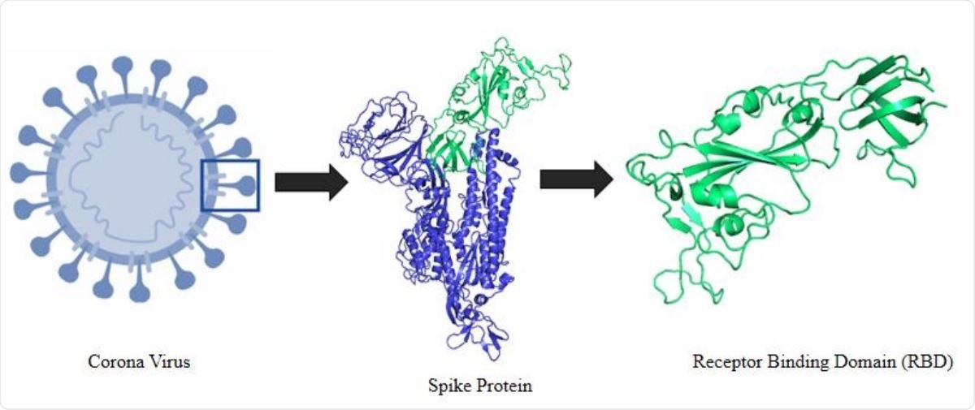
Antigen: RBD
Notes:
First, we used RBD (receptor binding domain) as our antigen. This a region on the surface protein on the SARS-CoV-2 virus where a number of antibodies bind.

Slide 8
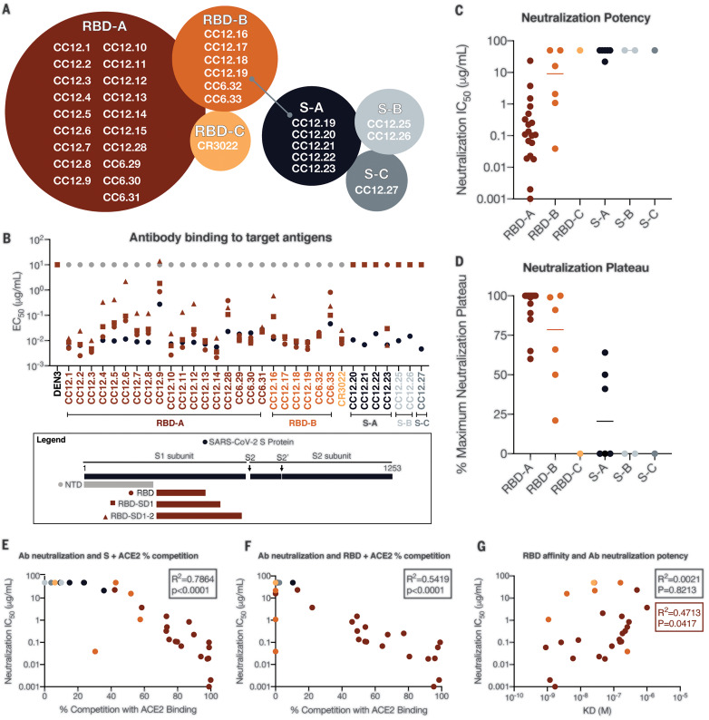
Antibody: CC12.1, CC12.3
Rogers, T. F.. Isolation of potent SARS-CoV-2 neutralizing antibodies and protection from disease in a small animal model. Science 369, 956–963 (2020).
Notes:
Next, we selected antibodies to analyze. These antibodies used to identify SARS-CoV-2 were identified by Thomas Rogers and a number of other scientists within Dennis Burton’s lab. We decided to look at CC12.1 and CC12.3 which bind to RBD-A with a low IC50 indicating strong binding. Finally, these antibodies were selected because RBD, our antigen, could mutate away from these antibodies.

Slide 9
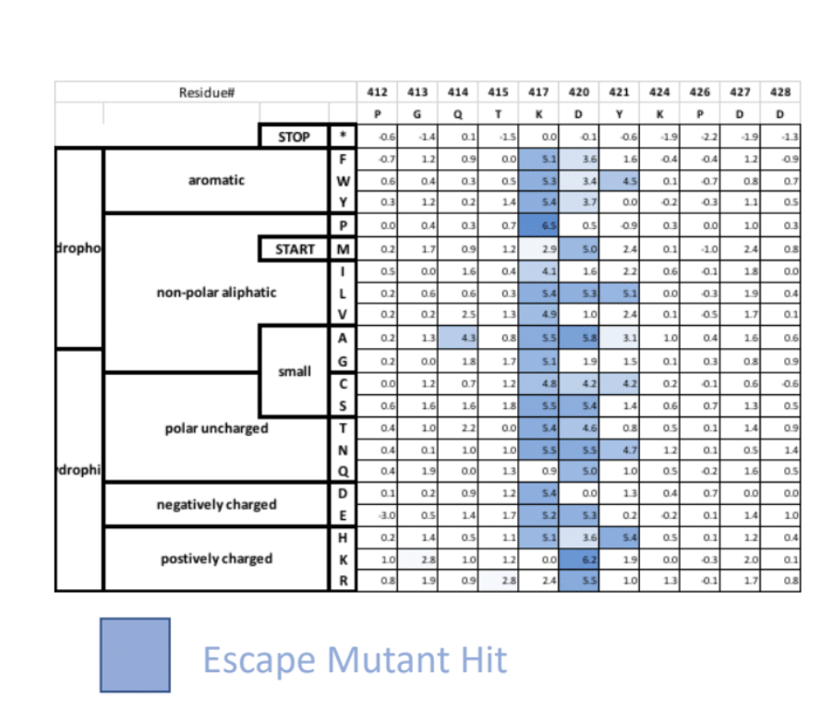
Escape Mutations
Notes:
Finally, we made a number of mutations. These mutations correspond to areas where we saw escape in complementary wet lab experiments.

Slide 10
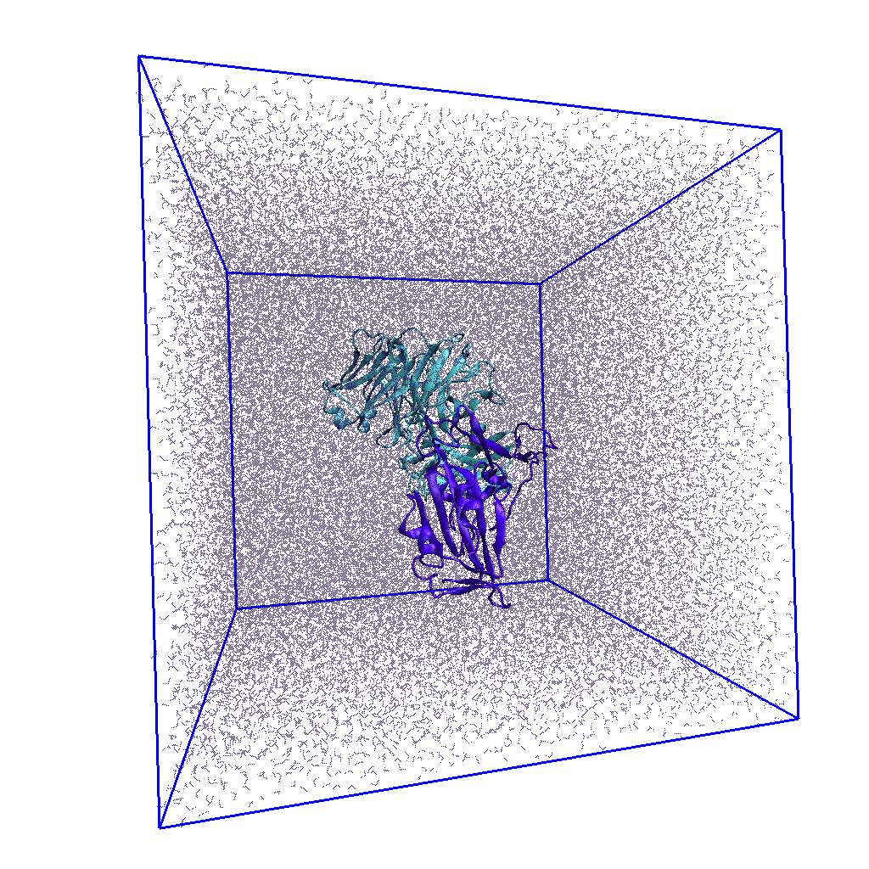
Simulation
In the Box
Antibody (CC12.1, CC12.3)
Antigen (RBDD)
Water
Ions
Notes:
Once we had our antibody and antigen and made mutations, we set up our simulations. The antibody, either CC12.1 or CC12.3 was placed in a box full of water and ions and aligned to our antigen, RBD. The mutations were then made and the energy of the system was minimized and system was equilibrated by first allowing the pressure to change with constant temperature and constant volume (NVT) and next by allowing the volume to change with constant temperature and pressure (NPT). Finally, the simulation was run for a production step where the volume again was allowed to change with constant temperature and pressure (NPT).

Slide 11
End of Motivation
Next: Results

