Slide 1
COVID Projects
Emily Rhodes
January 29th, 2021

Slide 2
Housekeeping
I haven’t heard anything about the PyRosettaBootcamp 2021.
No confirmation
Should I follow up?
Do you know if I am on the list?
Emailed twice (first time I did not reply to the email, second time I did)

Slide 3
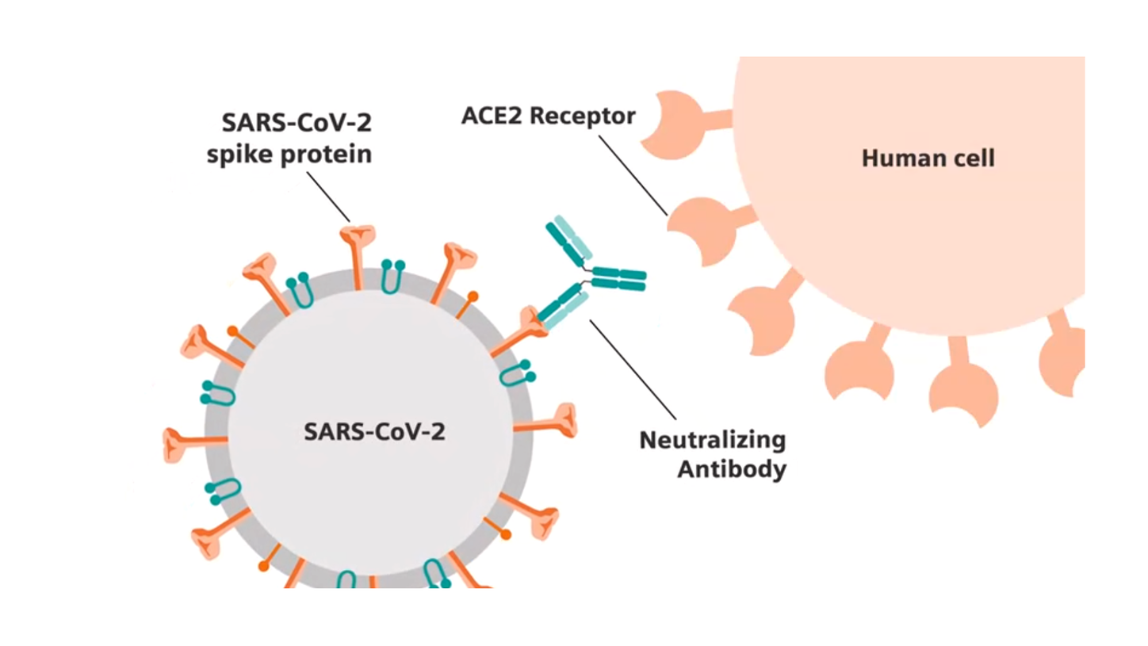
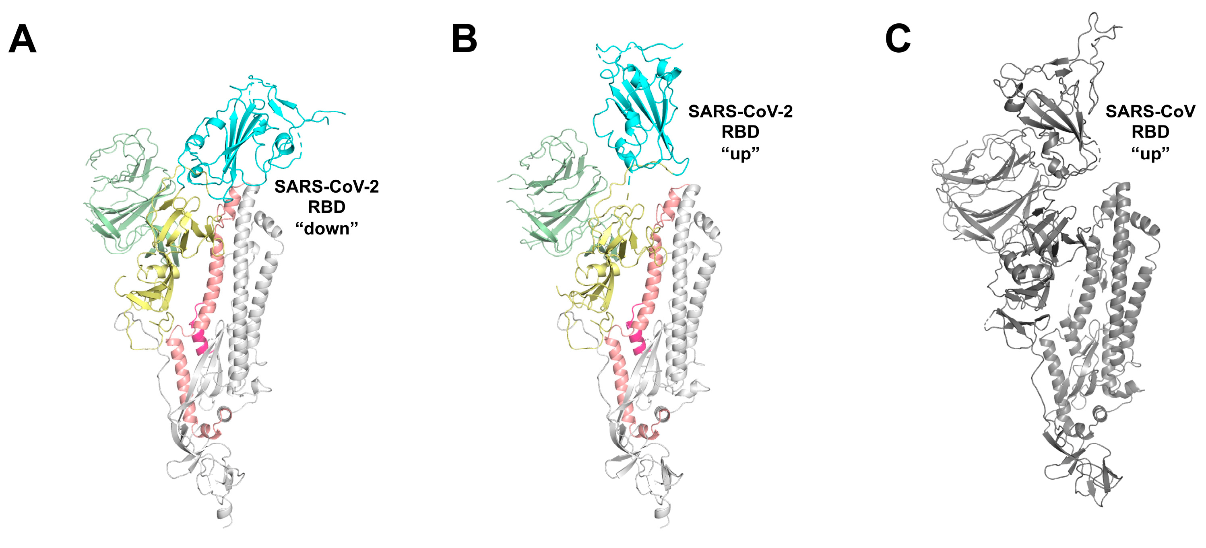
Areas of Investigation
Antibody neutralization cut-off
Understand RBD conformation impact on association rate
Notes:
Antibody neutralization cut-off
Explain what this is
We want to know why this happens & predict it with COVID
Understand RBD conformation impact on association rate

Slide 4
Neutralization Cut-Off
Project 1

Slide 5
Procedure:
Write differential equations to describe the number of antibodies bound to each virus.
Write a function for infectivity that depends on the number of spike proteins bound.
Using the concentrations and times of neutralization provided fit the function for infectivity
Test the model by trying to “predict” neutralization cut-offs for known antibodies and check if they are correct.
Use the model to predict neutralization cut-offs for new antibodies.

Slide 6
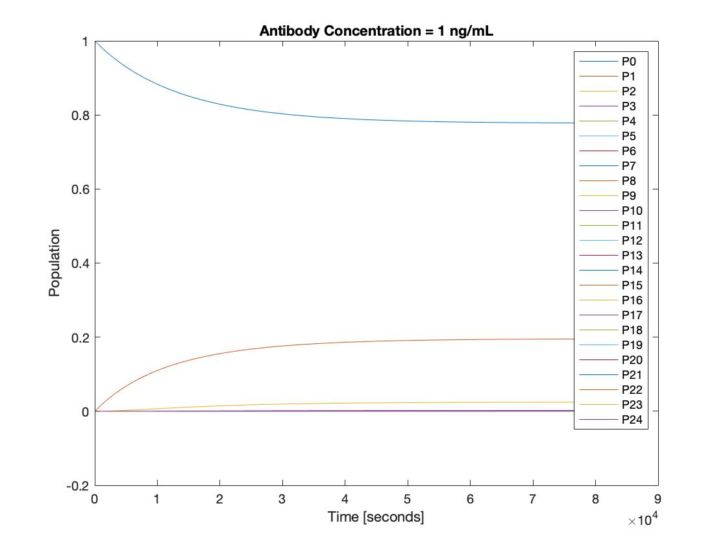
Population of Viruses with Antibodies Bound:
At equilibrium, most viruses have no antibodies bound, but some have 1 out of 24.
Notes:
Assumed infectivity was linearly related to spikes bound

Slide 7
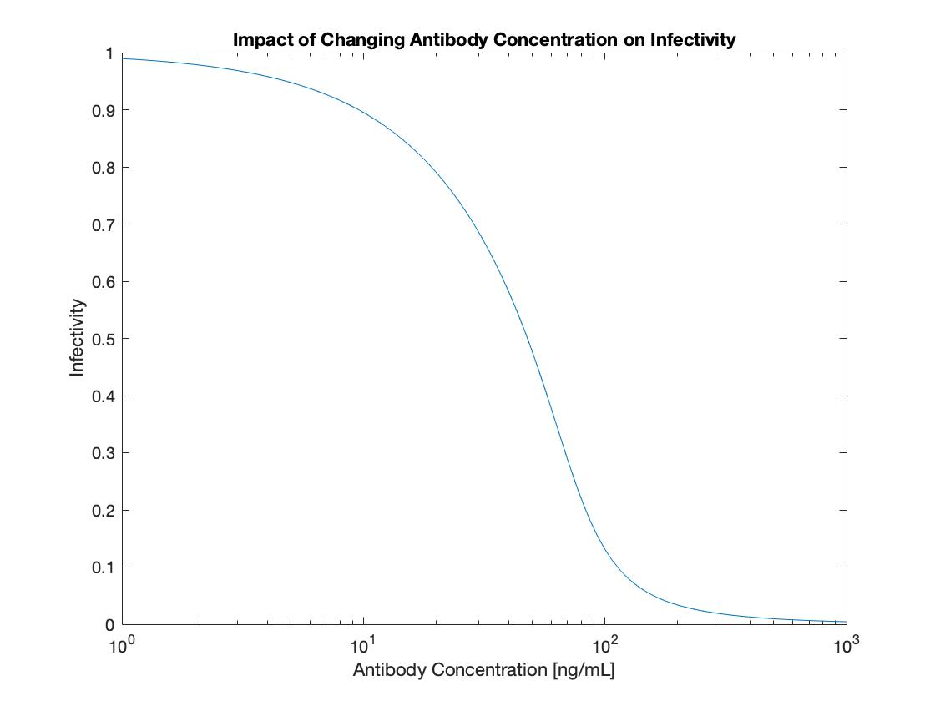
Original Model of Infectivity:
Original model of infectivity predicted it would drop at around 100 ng/mL. Does not agree with experiments.

Slide 8
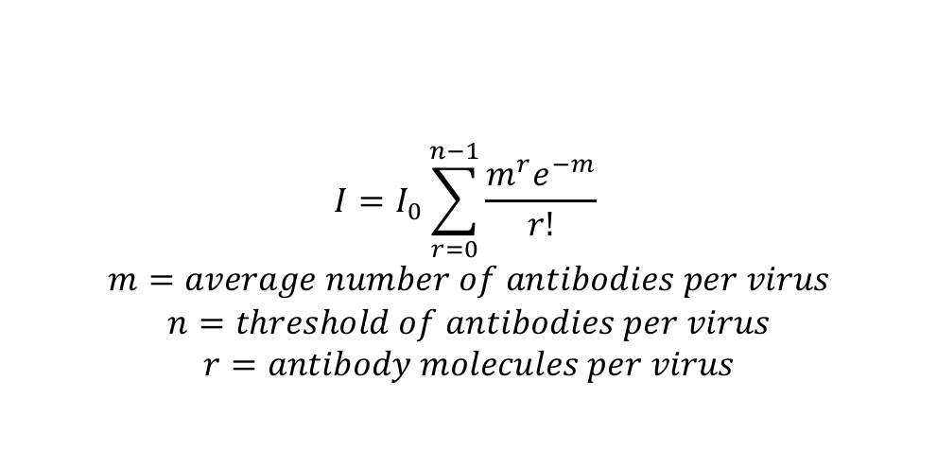
Antibodies Bound, Infectivity, and Neutralization
Antibodies Bound
Infectivity
$$I=I_{0}\sum_{r=0}^{n−1}{\frac{m^{r}e^{−m}}{r!}}$$
$$m=average number of antibodies per virus$$
$$n=threshold of antibodies per virus$$
$$r=antibody molecules per virus$$

Slide 9
Antibodies Bound, Infectivity, and Neutralization
Antibodies Bound
Infectivity
$$I=Neutralization −1$$
Neutralization

Slide 10
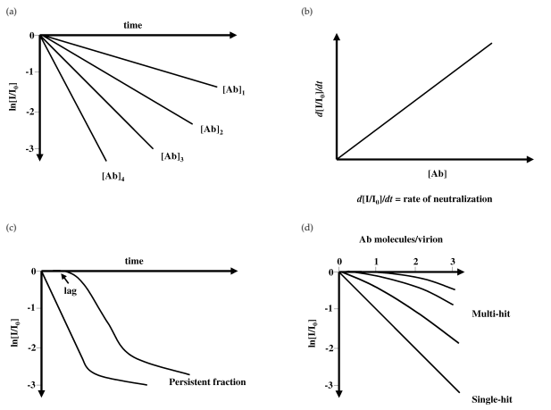
Starting with Whitehead’s Papers
Increasing antibody concentration

Slide 11
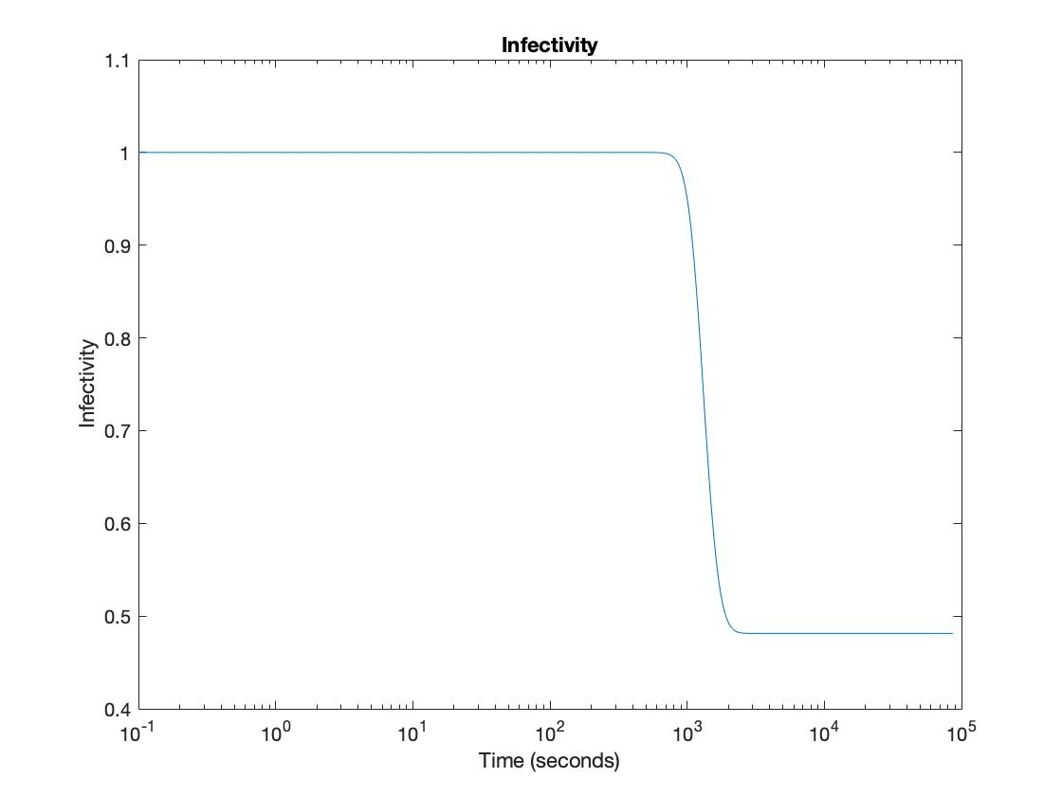

Slide 12
Procedure:
Write differential equations to describe the number of antibodies bound to each virus.
Write a function for infectivity that depends on the number of spike proteins bound.
Using the concentrations and times of neutralization provided fit the function for infectivity
Test the model by trying to “predict” neutralization cut-offs for known antibodies and check if they are correct.
Use the model to predict neutralization cut-offs for new antibodies.

Slide 13
RBD Conformation Impact on Association Rate
Project 2

Slide 14
Procedure
Find the spike protein in 4 different states: 0 up, 1 up, 2 up, 3 up and align it to the antibody
Determine the association rate corresponding to each of these states
Model affinity maturation of B cells where the antigens are the spike proteins in different conformations.
Show how the different conformations impact affinity maturation.
Apply this theory to other strains of COVID.
Notes:
Pamela Bjorkman - identifying 4 major epitopes using cryo-EM; CalTech (Cell 2020)
Affinity maturation – unique to our lab; be able to show
*Think about this more*
Mutagenesis for RBD: bind ACE2 but no longer be recognized by antibodies
Find something general that can be used across Corona viruses
PROSS – calculated the structures and designs for spikes
Effect of mutation on association rates
Real sequences – how do antibodies evolve
Determination of binding affinity upon mutation for type I dockerin–cohesin complexes from Clostridium thermocellum and Clostridium cellulolyticum using deep …
CA Kowalsky, TA Whitehead
Proteins: Structure, Function, and Bioinformatics 84 (12), 1914-1928

Slide 15
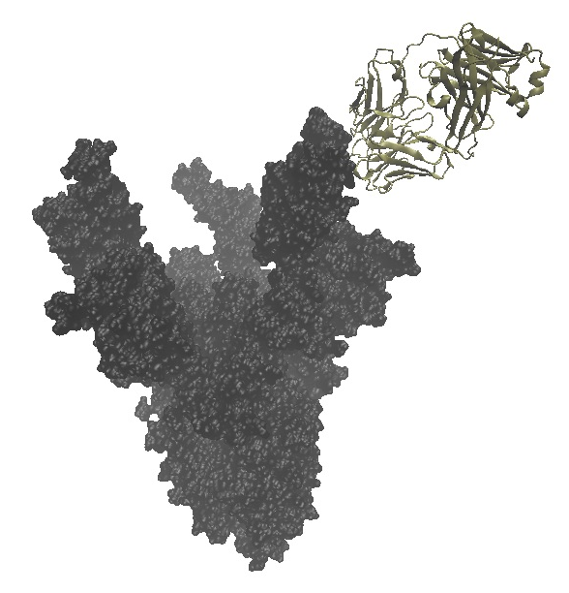
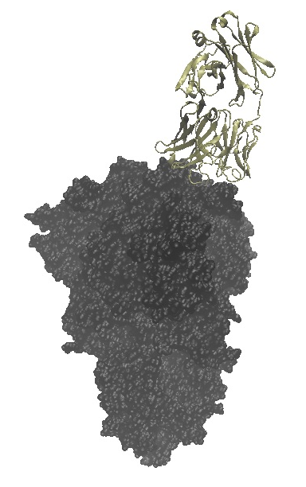
3 up
0 up
Notes:
Look at different antibodies – find association rates; average

Slide 16
Procedure
Find the spike protein in 4 different states: 0 up, 1 up, 2 up, 3 up and align it to the antibody
Determine the association rate corresponding to each of these states
Model affinity maturation of B cells where the antigens are the spike proteins in different conformations.
Show how the different conformations impact affinity maturation.
Apply this theory to other strains of COVID.

Slide 17
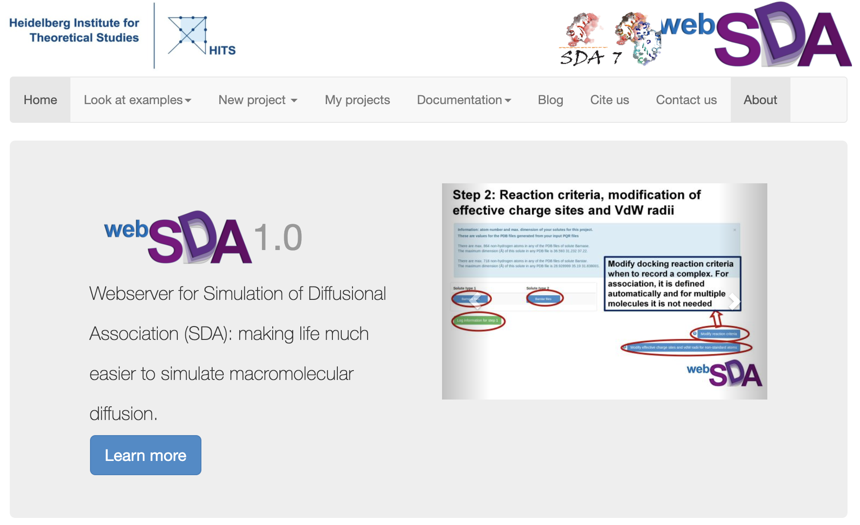
Notes:
Ian Willson; Which antibodies bind to which epitopes - dock the antibodies to which epitope?
Do simulations of the mutants

