Slide 1
Isolating and engineering human antibodies using yeast surface display
Ginger Chao, Wai L Lau, Benjamin J Hackel, Stephen L Sazinsky, Shaun M Lippow & K Dane Wittrup

Slide 2
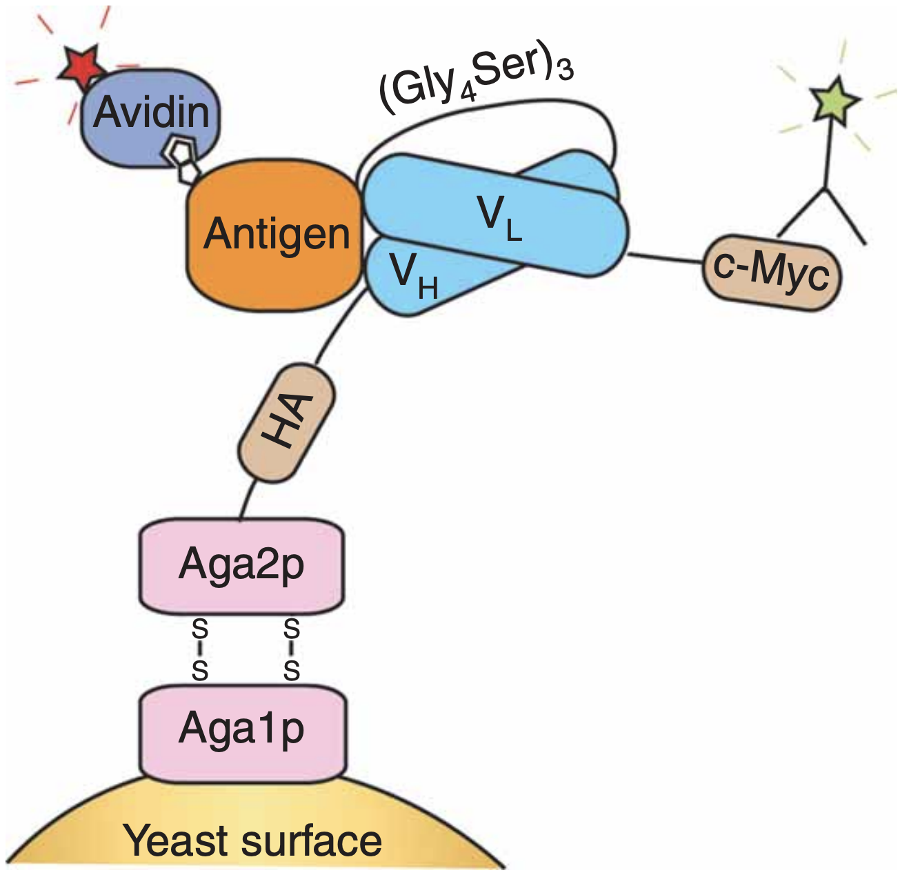
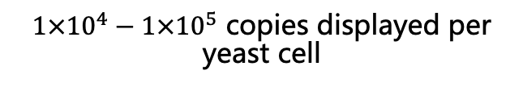
Yeast Display Platform
a single-chain variable fragment (scFv) format is displayed (not the whole antibody)
heavy and light chains are connected by a flexible polypeptide linker
the scFv is fused to the adhesion subunit of the yeast agglutinin protein Aga2p, which attaches to the yeast cell wall through disulfide bonds to Aga1p
expression of the Aga2pscFv is under the control of a galactose-inducible promoter
$1×{10}^{4}−1×{10}^{5}$ copies displayed per yeast cell
Notes:
the antibody is displayed in a single-chain variable fragment (scFv) format in which the heavy and light chains are connected by a flexible polypeptide linker
The scFv is fused to the adhesion subunit of the yeast agglutinin protein Aga2p, which attaches to the yeast cell wall through disulfide bonds to Aga1p.
Expression of the Aga2pscFv is under the control of a galactose-inducible promoter on the yeast display plasmid, which is maintained in yeast episomally with a nutritional marker, whereas Aga1p is expressed from a chromosomally integrated galactose-inducible expression cassette.

Slide 3
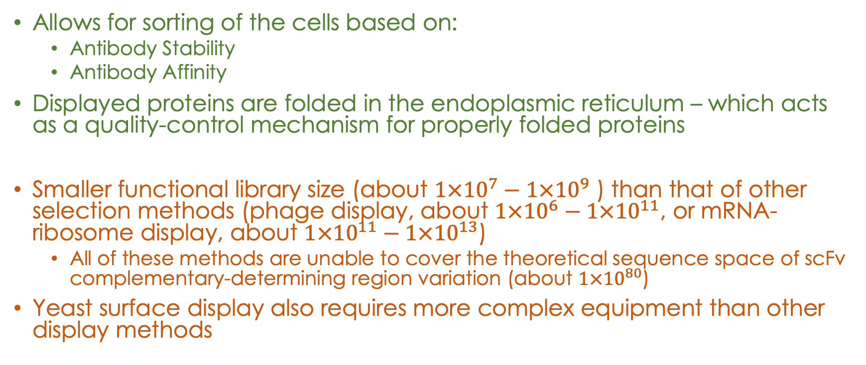
Benefits and Limitations of the Yeast Display Platform
Allows for sorting of the cells based on:
Antibody Stability
Antibody Affinity
Displayed proteins are folded in the endoplasmic reticulum – which acts as a quality-control mechanism for properly folded proteins
Smaller functional library size (about $1×{10}^{7}−1×{10}^{9}$ ) than that of other selection methods (phage display, about $1×{10}^{6}−1×{10}^{11}$, or mRNA-ribosome display, about $1×{10}^{11}−1×{10}^{13}$)
All of these methods are unable to cover the theoretical sequence space of scFv complementary-determining region variation (about $1×{10}^{80}$)
Yeast surface display also requires more complex equipment than other display methods

Slide 4
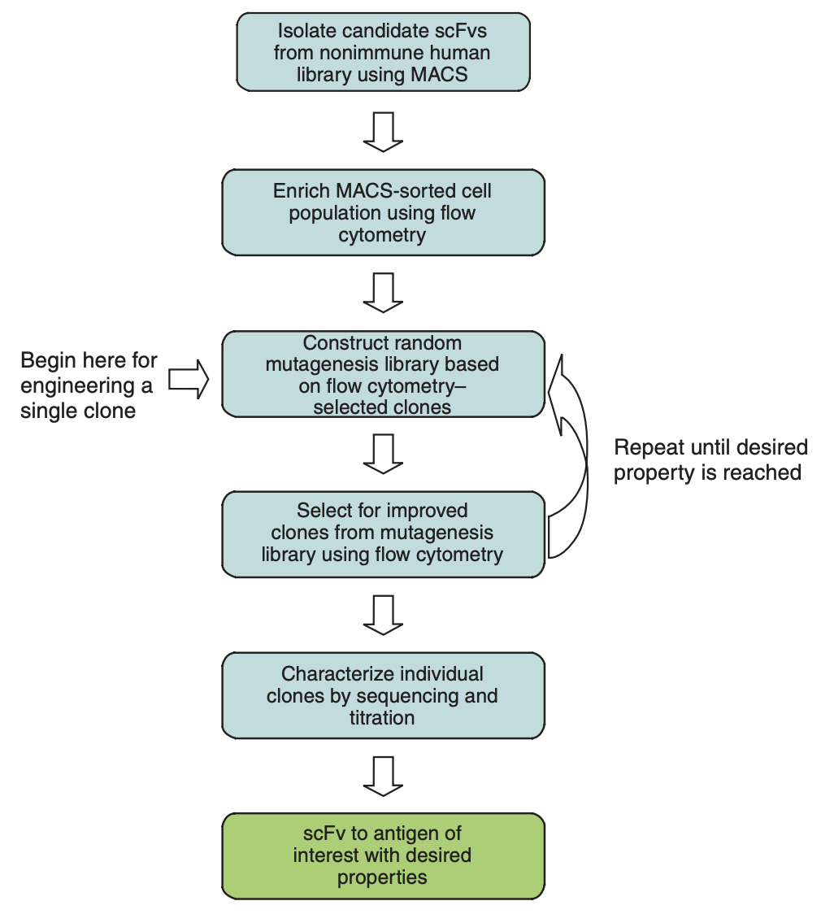
scFv Yeast Display Uses
Antibody directed evolution
If soluble antigen is not available, yeast-displayed scFvs can be ’panned’ against mammalian cell monolayers or incubated with mammalian cells in solution and separated by density centrifugation
For more information: sources 17 and 18

Slide 5
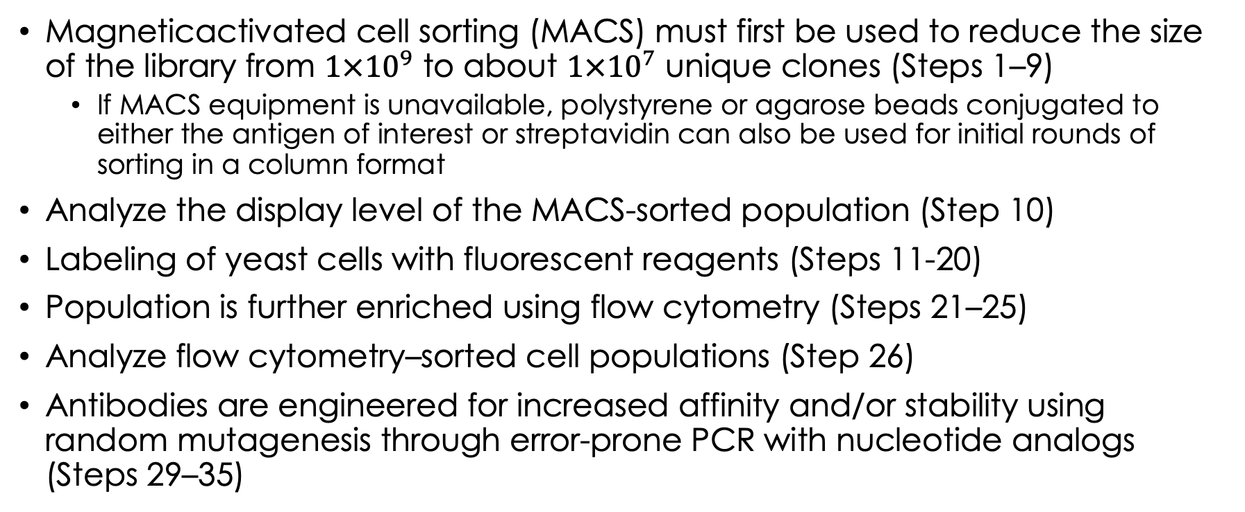
Overview of the Steps of scFv Yeast Display
Magneticactivated cell sorting (MACS) must first be used to reduce the size of the library from $1×{10}^{9}$ to about $1×{10}^{7}$ unique clones (Steps 1–9)
If MACS equipment is unavailable, polystyrene or agarose beads conjugated to either the antigen of interest or streptavidin can also be used for initial rounds of sorting in a column format
Analyze the display level of the MACS-sorted population (Step 10)
Labeling of yeast cells with fluorescent reagents (Steps 11-20)
Population is further enriched using flow cytometry (Steps 21–25)
Analyze flow cytometry–sorted cell populations (Step 26)
Antibodies are engineered for increased affinity and/or stability using random mutagenesis through error-prone PCR with nucleotide analogs (Steps 29–35)

Slide 6
Overview of the Steps of scFv Yeast Display (Continued)
Mutagenized yeast library is created by:
transformation of yeast with linearized vector and the error-prone PCR product
in vivo homologous recombination occurs between the vector and PCR insert to generate the display plasmid
Yeast transformation by electroporation (Steps 36–48)
Rounds of mutagenesis followed by flow cytometry sorting are done until the scFv population reaches the desired property (Steps 49-50)
Individual clones of the population are characterized in depth by titration of scFvs displayed on the yeast surface (Steps 51–63)

Slide 7
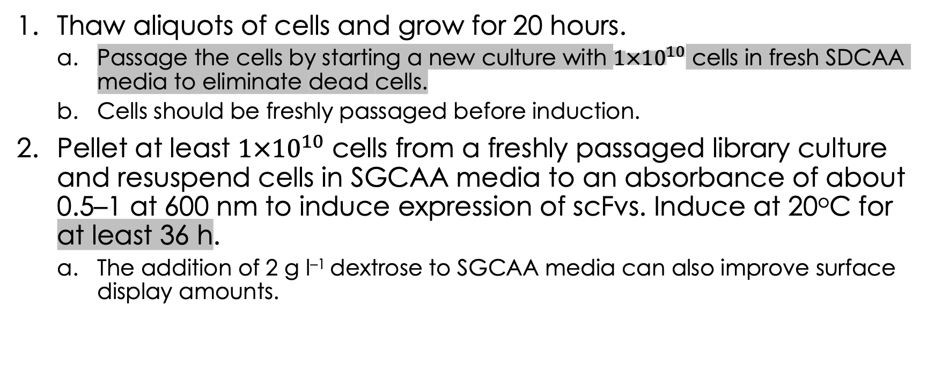
Detailed Steps:
Thaw aliquots of cells and grow for 20 hours.
Passage the cells by starting a new culture with $1×{10}^{10}$ cells in fresh SDCAA media to eliminate dead cells.
Cells should be freshly passaged before induction.
Pellet at least $1×{10}^{10}$ cells from a freshly passaged library culture and resuspend cells in SGCAA media to an absorbance of about 0.5–1 at 600 nm to induce expression of scFvs. Induce at 20ºC for at least 36 h.
The addition of 2 g l^{–1} dextrose to SGCAA media can also improve surface display amounts.
Typically, at least tenfold oversampling of any yeast population is used to reduce the probability of losing unique clones.

Slide 8
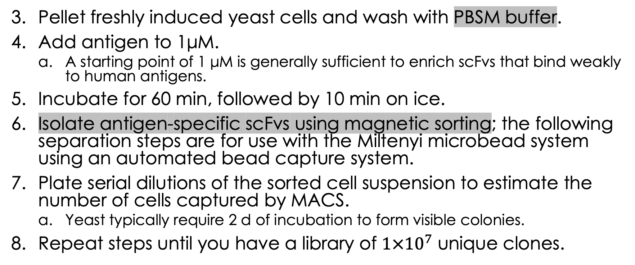
Detailed Steps:
Pellet freshly induced yeast cells and wash with PBSM buffer.
Add antigen to 1μM.
A starting point of 1 μM is generally sufficient to enrich scFvs that bind weakly to human antigens.
Incubate for 60 min, followed by 10 min on ice.
Isolate antigen-specific scFvs using magnetic sorting; the following separation steps are for use with the Miltenyi microbead system using an automated bead capture system.
Plate serial dilutions of the sorted cell suspension to estimate the number of cells captured by MACS.
Yeast typically require 2 d of incubation to form visible colonies.
Repeat steps until you have a library of $1×{10}^{7}$ unique clones.

Slide 9
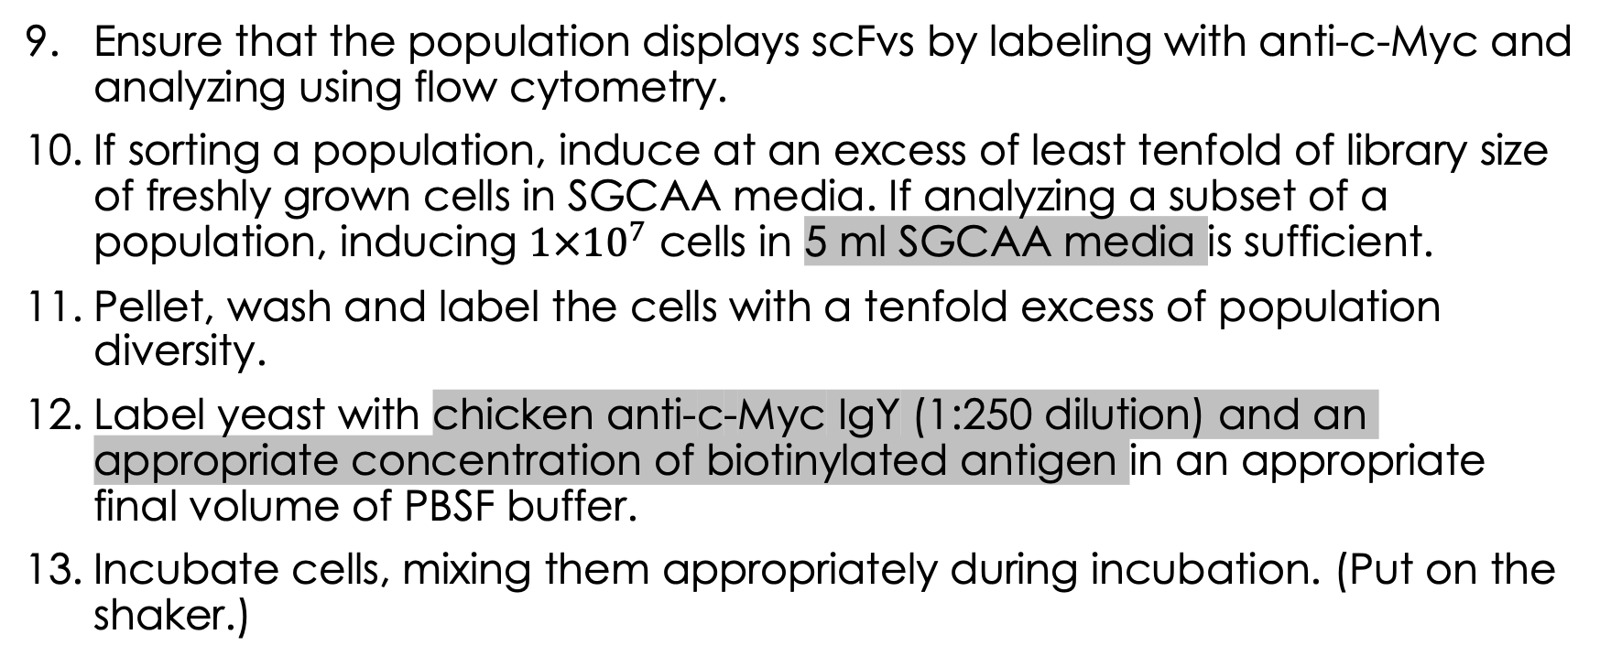
Detailed Steps:
Ensure that the population displays scFvs by labeling with anti-c-Myc and analyzing using flow cytometry.
If sorting a population, induce at an excess of least tenfold of library size of freshly grown cells in SGCAA media. If analyzing a subset of a population, inducing $1×{10}^{7}$ cells in 5 ml SGCAA media is sufficient.
Pellet, wash and label the cells with a tenfold excess of population diversity.
Label yeast with chicken anti-c-Myc IgY (1:250 dilution) and an appropriate concentration of biotinylated antigen in an appropriate final volume of PBSF buffer.
Incubate cells, mixing them appropriately during incubation. (Put on the shaker.)
Notes:
We don’t label with anti-c-myc at the same time as biotinylated antigen.

Slide 10
Detailed Steps:

Slide 11
Detailed Steps:

Slide 12
Detailed Steps:

Slide 13
Detailed Steps:

Slide 14
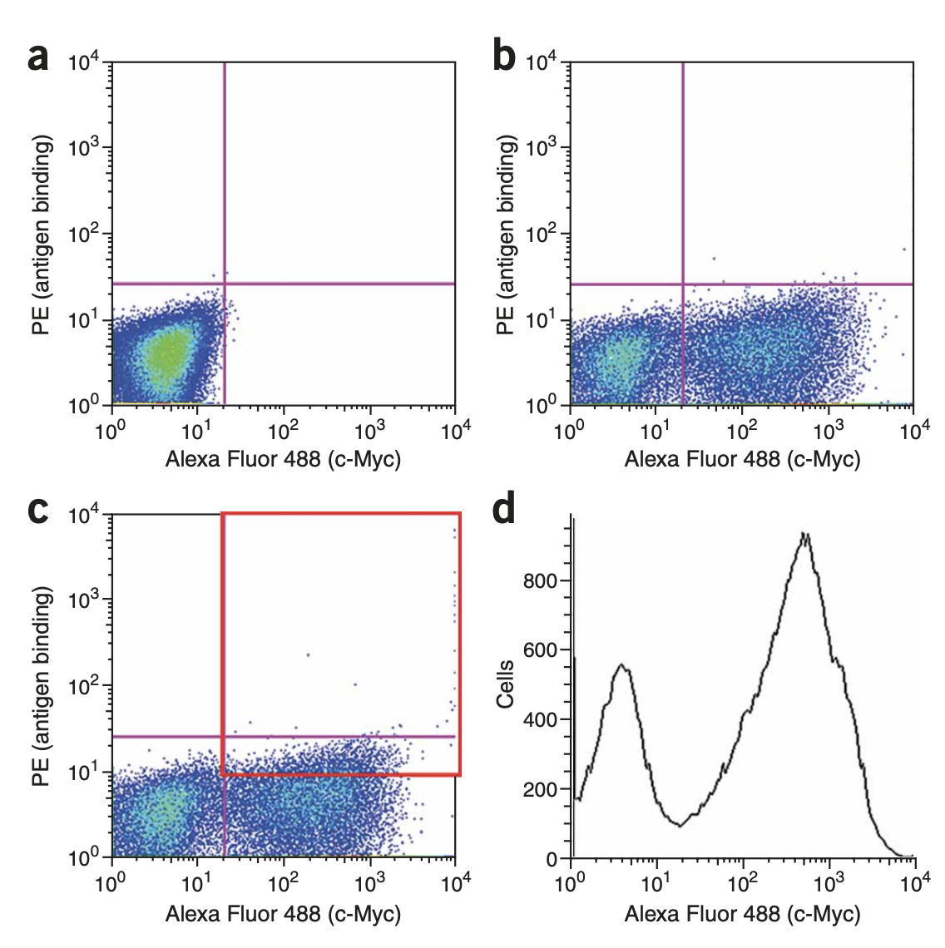

Slide 15
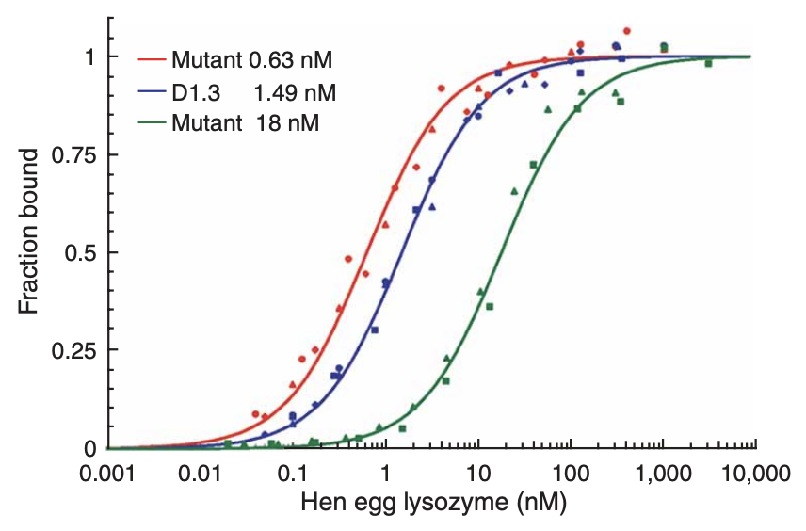

Slide 16
