Slide 1
Are Framework Mutations Stabilizing?
Emily Rhodes
May 24th, 2021

Slide 2
RMSD
Framework Mutations

Slide 3
Npt_prod Reference

Slide 4
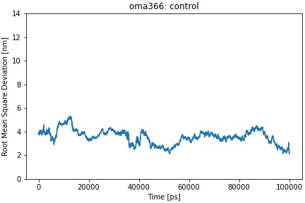
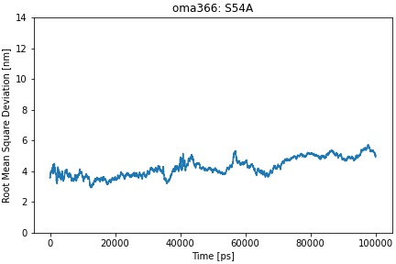
Control
A54 reverted back to S54
FDA Approved Antibody | Germline Gene | Framework Mutations | Mutation Scores | FR Score | PDB ID
Omalizumab | VH3-66 | S54A V55S | 17.0 8.7* | 0.75 | 4X7S
Omalizumab, Germline VH3-66

Slide 5
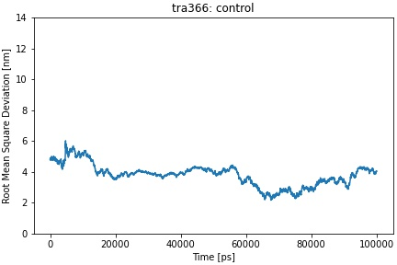
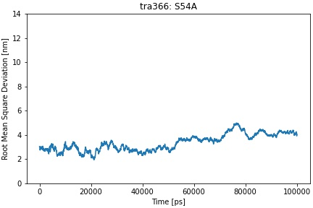
Control
A54 reverted back to S54
FDA Approved Antibody | Germline Gene | Framework Mutations | Mutation Scores | FR Score | PDB ID
Trastuzumab | VH3-66 | S54A V55R | 17.0 8.0* | 0.69 | 6B9Z
Trastuzumab, Germline VH3-66

Slide 6
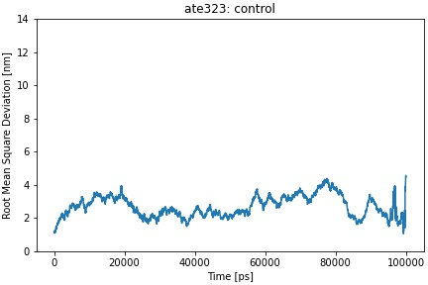
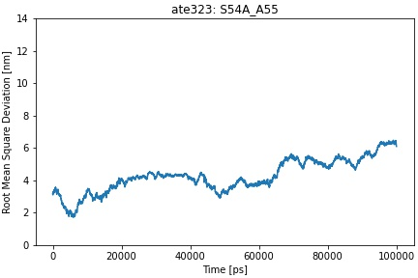
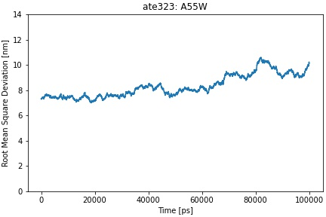
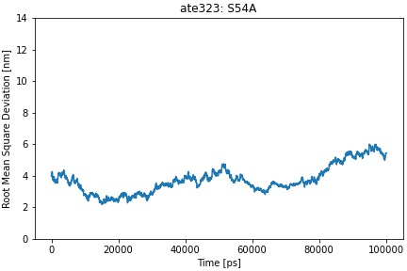
Both Mutations Reverted Back
Control
W55 reverted back to A55
A54 reverted back to S54
FDA Approved Antibody | Germline Gene | Framework Mutations | Mutation Scores | FR Score | PDB ID
Atezolizumab | VH3-23 | S54A A55W | 20.9 -7.7 | 0.51 | 5X8L
Atezolizumab, Germline VH3-23

Slide 7
FDA Approved Antibody | Germline Gene | Framework Mutations | Mutation Scores | FR Score | PDB ID
Pertuzumab | VH3-23 | S40D S54A A55D D69Q S70R V71F | 6.7* 20.9 5.1 2.2* 2.1* -0.1* | 0.28 | 4LLU
Pertuzumab, Germline VH3-23

Slide 8
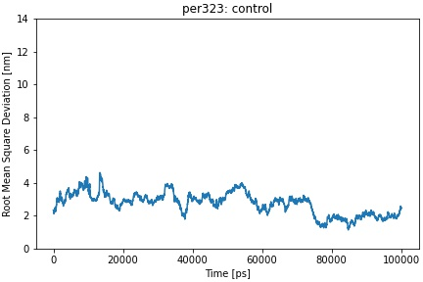
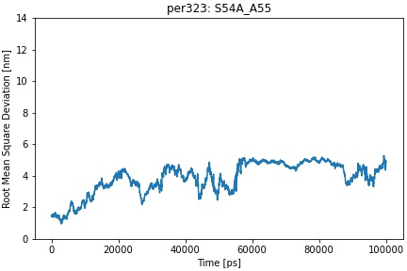
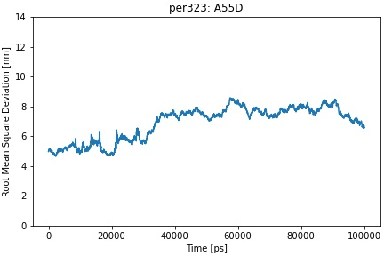
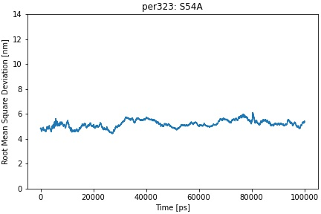
Both Mutations Reverted Back
Control
D55 reverted back to A55
A54 reverted back to S54
Pertuzumab, Germline VH3-23

Slide 9
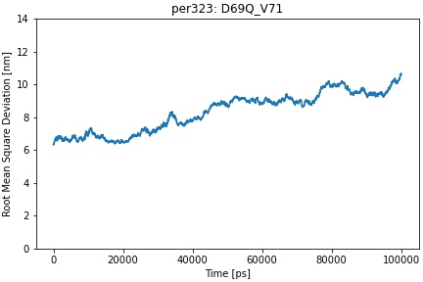
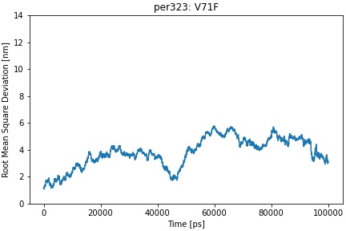
Both Mutations Reverted Back
Control
FDA Approved Antibody | Germline Gene | Framework Mutations | Mutation Scores | FR Score | PDB ID
Pertuzumab | VH3-23 | S40D S54A A55D D69Q S70R V71F | 6.7* 20.9 5.1 2.2* 2.1* -0.1* | 0.28 | 4LLU
F71 reverted back to V71
Pertuzumab, Germline VH3-23

Slide 10
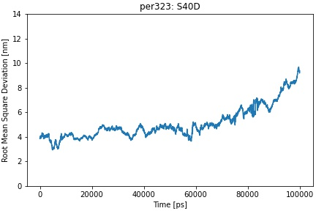
Control
FDA Approved Antibody | Germline Gene | Framework Mutations | Mutation Scores | FR Score | PDB ID
Pertuzumab | VH3-23 | S40D S54A A55D D69Q S70R V71F | 6.7* 20.9 5.1 2.2* 2.1* -0.1* | 0.28 | 4LLU
D40 reverted back to S40
Pertuzumab, Germline VH3-23

Slide 11
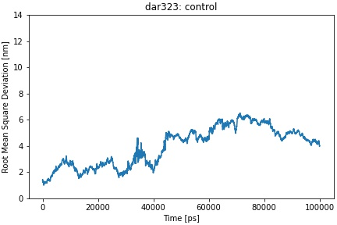
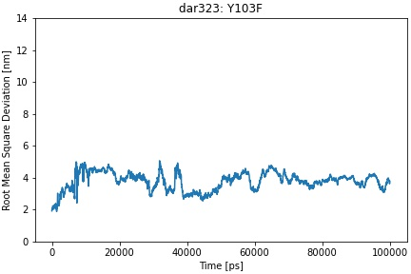
Control
FDA Approved Antibody | Germline Gene | Framework Mutations | Mutation Scores | FR Score | PDB ID
Daratumumab | VH3-23 | Y103F | 22.6 | 1.24 | 7DUN
F103 reverted back to Y103
Daratumumab, Germline VH3-23

Slide 12
EM Reference

Slide 13
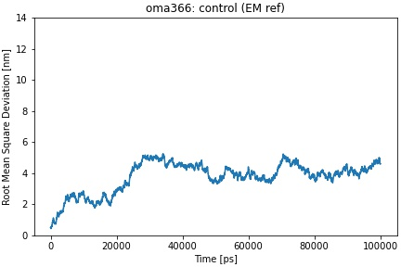
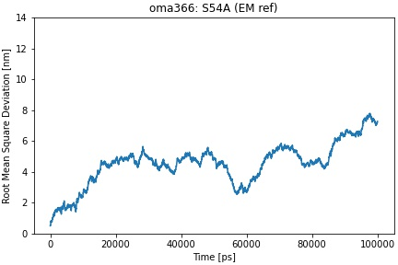
Control
A54 reverted back to S54
FDA Approved Antibody | Germline Gene | Framework Mutations | Mutation Scores | FR Score | PDB ID
Omalizumab | VH3-66 | S54A V55S | 17.0 8.7* | 0.75 | 4X7S
Omalizumab, Germline VH3-66

Slide 14
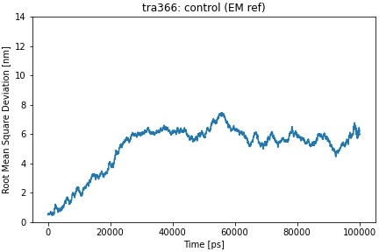
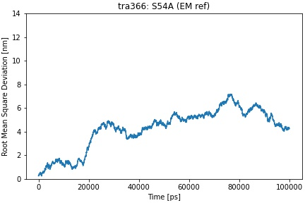
Control
A54 reverted back to S54
FDA Approved Antibody | Germline Gene | Framework Mutations | Mutation Scores | FR Score | PDB ID
Trastuzumab | VH3-66 | S54A V55R | 17.0 8.0* | 0.69 | 6B9Z
Trastuzumab, Germline VH3-66

Slide 15
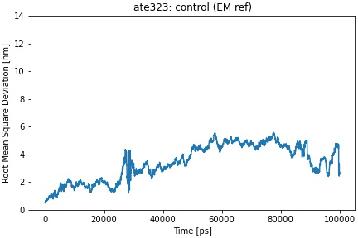
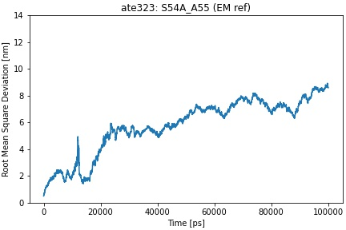
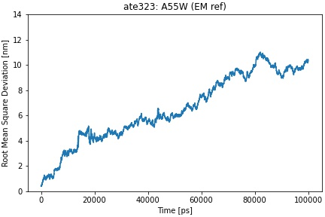
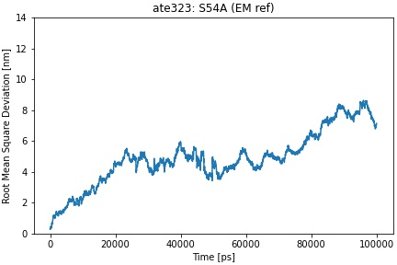
Both Mutations Reverted Back
Control
W55 reverted back to A55
A54 reverted back to S54
FDA Approved Antibody | Germline Gene | Framework Mutations | Mutation Scores | FR Score | PDB ID
Atezolizumab | VH3-23 | S54A A55W | 20.9 -7.7 | 0.51 | 5X8L
Atezolizumab, Germline VH3-23

Slide 16
FDA Approved Antibody | Germline Gene | Framework Mutations | Mutation Scores | FR Score | PDB ID
Pertuzumab | VH3-23 | S40D S54A A55D D69Q S70R V71F | 6.7* 20.9 5.1 2.2* 2.1* -0.1* | 0.28 | 4LLU
Pertuzumab, Germline VH3-23

Slide 17
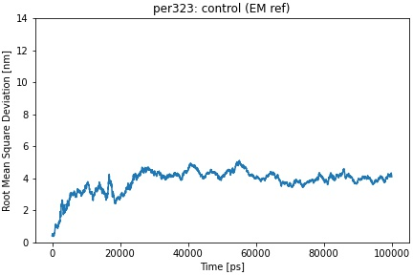
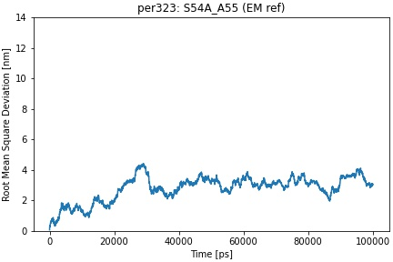
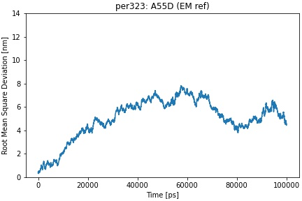
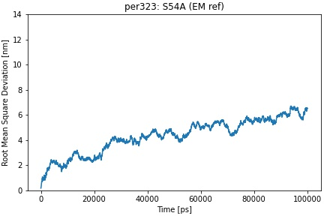
Both Mutations Reverted Back
Control
D55 reverted back to A55
A54 reverted back to S54
Pertuzumab, Germline VH3-23

Slide 18
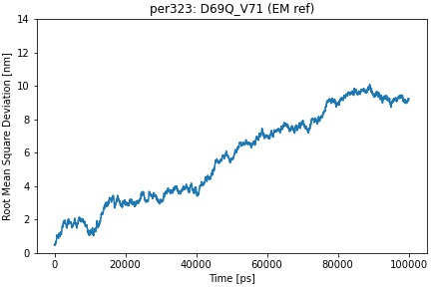
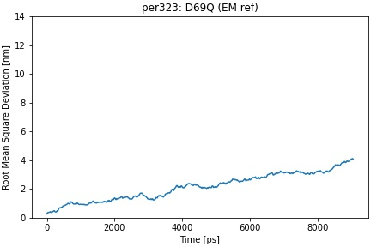
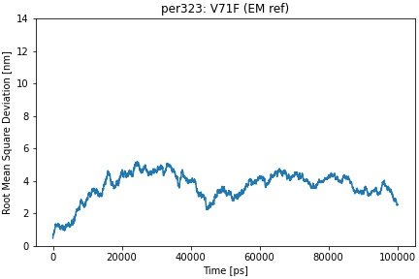
Both Mutations Reverted Back
Control
F71 reverted back to V71
Q69 reverted back to D69
Pertuzumab, Germline VH3-23

Slide 19
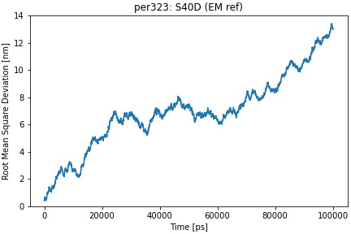
Control
FDA Approved Antibody | Germline Gene | Framework Mutations | Mutation Scores | FR Score | PDB ID
Pertuzumab | VH3-23 | S40D S54A A55D D69Q S70R V71F | 6.7* 20.9 5.1 2.2* 2.1* -0.1* | 0.28 | 4LLU
D40 reverted back to S40
Pertuzumab, Germline VH3-23

Slide 20
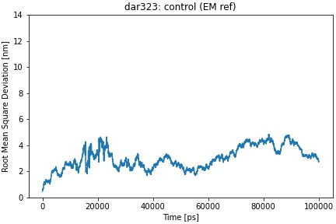
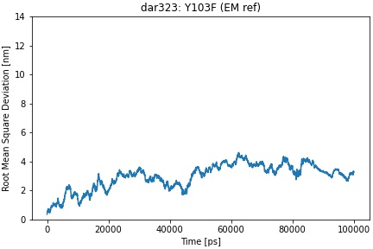
Control
FDA Approved Antibody | Germline Gene | Framework Mutations | Mutation Scores | FR Score | PDB ID
Daratumumab | VH3-23 | Y103F | 22.6 | 1.24 | 7DUN
F103 reverted back to Y103
Daratumumab, Germline VH3-23

