Slide 1
Are Framework Mutations Stabilizing?
Emily Rhodes
May 24th, 2021

Slide 2
RMSD
Framework Mutations

Slide 3
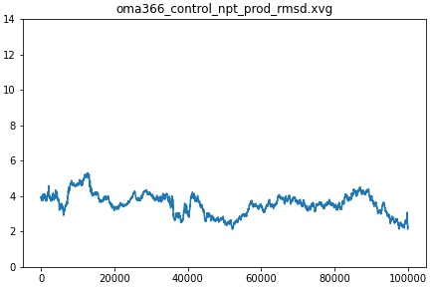
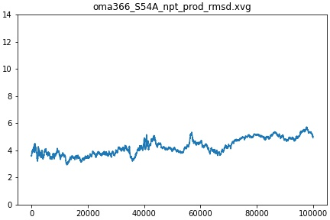
Control
A54 reverted back to S54
Omalizumab, Germline VH3-66

Slide 4
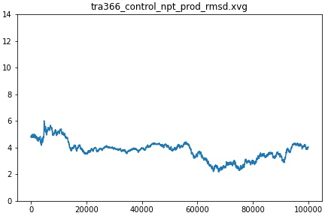
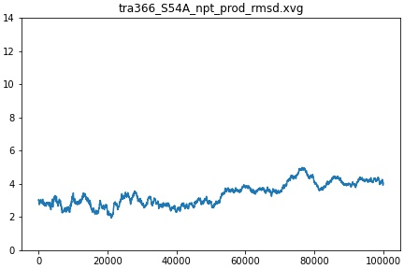
Control
A54 reverted back to S54
Trastuzumab, Germline VH3-66

Slide 5
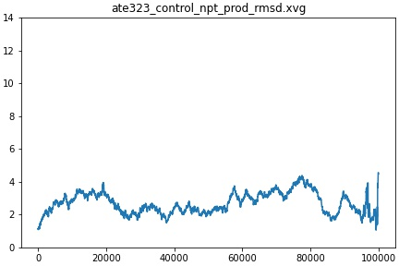
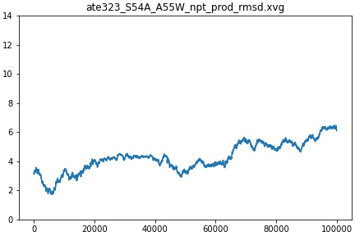
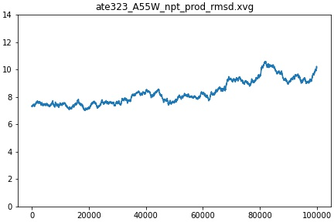
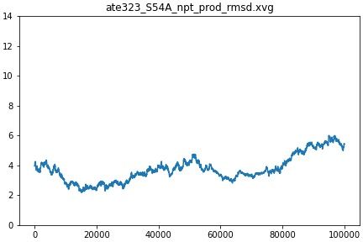
Both Mutations Reverted Back
Control
W55 reverted back to A55
A54 reverted back to S54
Atezolizumab, Germline VH3-23

Slide 6
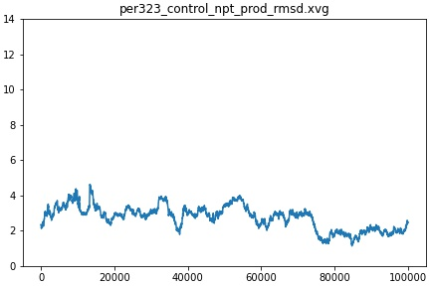
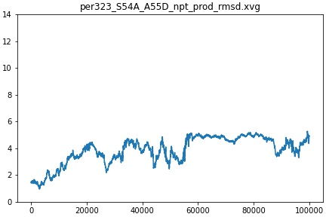
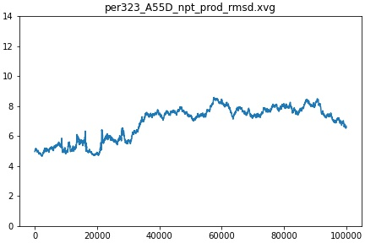
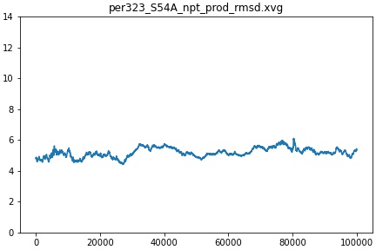
Both Mutations Reverted Back
Control
D55 reverted back to A55
A54 reverted back to S54
Pertuzumab, Germline VH3-23

Slide 7
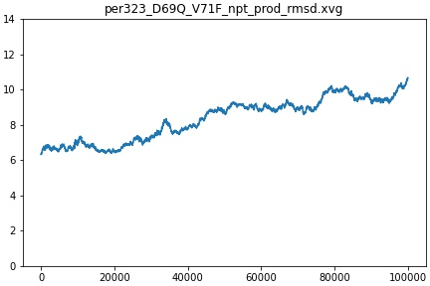
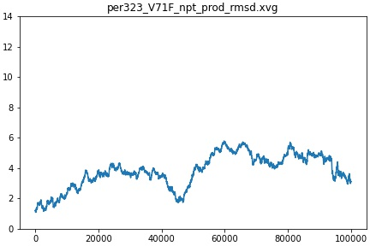
Both Mutations Reverted Back
Control
F71 reverted back to V71
Pertuzumab, Germline VH3-23

Slide 8
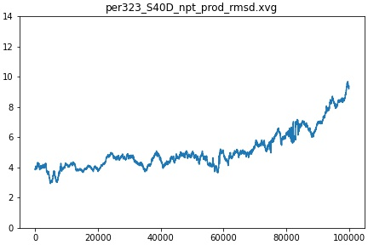
Control
D40 reverted back to S40
Pertuzumab, Germline VH3-23

Slide 9
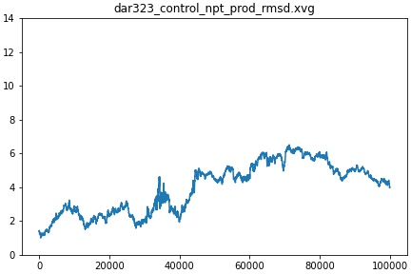
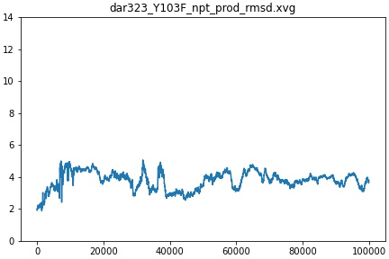
Control
F103 reverted back to Y103
Daratumumab, Germline VH3-23

