Slide 1
Rough Figures

Slide 2
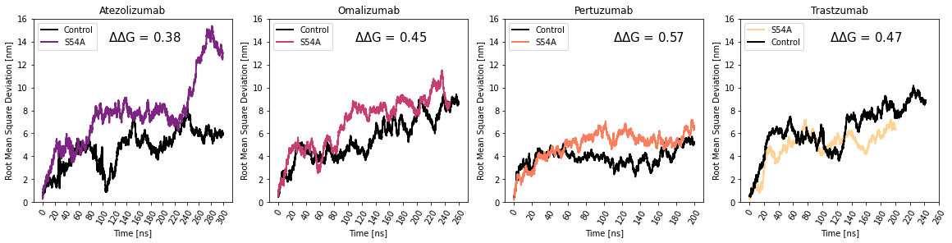
S54A
 | VH1-2 | VH1-24 | VH1-3 | VH1-46 | VH1-69 | VH2-5 | VH3-20 | VH3-21 | VH3-23 | VH3-30 | VH3-33 | VH3-48 | VH3-66 | VH3-7 | VH3-74 | VH3-9 | VH4-30-4 | VH4-31 | VH4-34 | VH4-39 | VH4-4 | VH4-59 | VH4-61 | VH5-51 | VH6-1
54A | 15 | 14 | 16 | 16 | 10 | #WT | 20 | 21 | 19 | #WT | #WT | 22 | 17 | #WT | 20 | 20 | 18 | 17 | 15 | 20 | 11 | 19 | 17 | 17 | 11
54C | -3 | -1 | -2 | -5 | -4 | -3 | 18 | -2 | 0 | -3 | -3 | 0 | -1 | -5 | 5 | 7 | -4 | -4 | -5 | -8 | -5 | -1 | -4 | -1 | -4
54D | -1 | -1 | 1 | -1 | -5 | -3 | -2 | -1 | -2 | -5 | -8 | 1 | -1 | 2 | -2 | -4 | -3 | -1 | -2 | -2 | -3 | 0 | -3 | -3 | 4
54E | 0 | 3 | 3 | 2 | 2 | 1 | -1 | -5 | -3 | -2 | 0 | -3 | -2 | -7 | -4 | 0 | 2 | 2 | 2 | 2 | 0 | 0 | 1 | 2 | 5
54F | -1 | -5 | -4 | -8 | -7 | 1 | 1 | -6 | -8 | -9 | -9 | -4 | -5 | -7 | -2 | -8 | -14 | -17 | -10 | -9 | -11 | -10 | -8 | -7 | -13
54G | #WT | #WT | #WT | #WT | #WT | 17 | 5 | 8 | 4 | 13 | 13 | 7 | 17 | 15 | 6 | 7 | #WT | #WT | #WT | #WT | #WT | #WT | #WT | #WT | #WT
54H | -5 | -3 | -5 | -2 | -5 | -5 | 6 | -1 | -1 | 0 | -3 | 4 | 0 | -5 | 1 | 1 | 7 | -7 | -6 | -3 | -4 | -6 | -4 | -7 | -4
54I | -8 | -9 | -8 | -4 | -13 | -4 | -2 | -9 | -8 | -2 | -6 | -5 | 3 | -2 | -6 | -5 | -7 | -7 | -5 | -7 | -5 | -8 | -5 | -5 | -4
54K | -8 | -6 | -5 | -14 | -11 | -11 | -8 | -7 | -7 | -7 | -7 | -5 | -4 | -10 | -8 | -7 | -11 | -14 | -9 | -9 | -13 | -13 | -10 | -12 | -7
54L | 0 | -1 | -5 | 0 | 0 | 2 | 4 | 3 | 4 | -1 | -2 | 4 | 5 | -1 | 4 | 5 | -1 | -4 | 1 | -2 | -4 | -3 | -1 | 2 | -1
54M | -9 | -8 | -5 | -7 | -8 | -10 | -1 | -13 | -10 | -7 | -7 | -10 | -11 | -13 | -13 | -2 | -12 | -10 | -9 | -9 | -11 | -14 | -12 | -8 | -12
54N | -9 | -5 | -12 | -9 | -10 | -15 | -8 | -3 | -1 | -6 | -9 | -2 | -1 | -8 | -6 | -8 | -6 | -3 | 2 | -9 | -6 | -5 | -5 | -7 | -4
54P | -3 | 2 | -5 | -3 | -3 | 5 | 8 | 5 | 4 | 2 | 3 | 6 | 6 | 3 | 7 | 6 | -3 | -3 | -3 | -2 | -3 | -1 | 0 | -2 | -1
54Q | -7 | 1 | -10 | -4 | 1 | -6 | 4 | 0 | -1 | 3 | 0 | 1 | 7 | -4 | 0 | 9 | -1 | 0 | -8 | -7 | -11 | -9 | -5 | 1 | -1
54R | 3 | 4 | 5 | 4 | 4 | -4 | 6 | -2 | -1 | -1 | -3 | -2 | 3 | -2 | 1 | -1 | 4 | 5 | 7 | 3 | 3 | 2 | 5 | 5 | 6
54S | 7 | 7 | 4 | 8 | 5 | 14 | #WT | #WT | #WT | 17 | 15 | #WT | #WT | 12 | #WT | #WT | 2 | 2 | 2 | 1 | 2 | 4 | 4 | 4 | 2
54T | 3 | -3 | 5 | 4 | -5 | 15 | 7 | 5 | 5 | 17 | 15 | 7 | 5 | 9 | 7 | 6 | -2 | -2 | -3 | -2 | -4 | -1 | 2 | -1 | 1
54V | 1 | 4 | 2 | 1 | 1 | 9 | 3 | -3 | -2 | 5 | 5 | 0 | 1 | 6 | 0 | -3 | 9 | 10 | 4 | 10 | 3 | 3 | 9 | 6 | 9
54W | -1 | -8 | -3 | -4 | -4 | -2 | -5 | -5 | -3 | -6 | -4 | -7 | -4 | -10 | -5 | -4 | 2 | 3 | 2 | 1 | 8 | 3 | 3 | 3 | -4
54Y | -8 | -7 | -7 | -7 | -11 | -10 | 0 | -7 | -8 | -5 | -6 | 0 | -4 | -11 | -8 | -8 | -5 | -11 | -9 | -4 | -7 | -1 | -1 | -9 | -8
Highest Score
Lowest Score
3-23 Mechanisms
3-66 Mechanisms

Slide 3
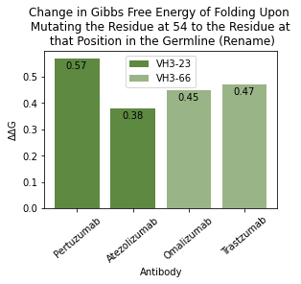
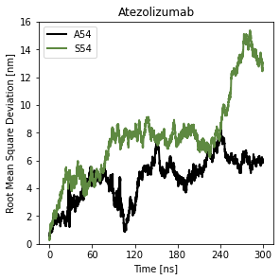
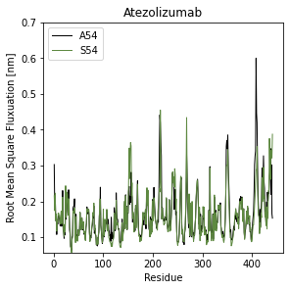
 | VH1-2 | VH1-24 | VH1-3 | VH1-46 | VH1-69 | VH2-5 | VH3-20 | VH3-21 | VH3-23 | VH3-30 | VH3-33 | VH3-48 | VH3-66 | VH3-7 | VH3-74 | VH3-9 | VH4-30-4 | VH4-31 | VH4-34 | VH4-39 | VH4-4 | VH4-59 | VH4-61 | VH5-51 | VH6-1
Ala | 15 | 14 | 16 | 16 | 10 | WT | 20 | 21 | 21 | WT | WT | 22 | 17 | WT | 20 | 20 | 18 | 17 | 15 | 20 | 11 | 19 | 17 | 17 | 11
Cys | -3 | -1 | -2 | -5 | -4 | -3 | 18 | -2 | 0 | -3 | -3 | 0 | -1 | -5 | 5 | 7 | -4 | -4 | -5 | -8 | -5 | -1 | -4 | -1 | -4
Gly | WT | WT | WT | WT | WT | 17 | 5 | 8 | 6 | 13 | 13 | 7 | 17 | 15 | 6 | 7 | WT | WT | WT | WT | WT | WT | WT | WT | WT
Ser | 7 | 7 | 4 | 8 | 5 | 14 | WT | WT | WT | 17 | 15 | WT | WT | 12 | WT | WT | 2 | 2 | 2 | 1 | 2 | 4 | 4 | 4 | 2
Thr | 3 | -3 | 5 | 4 | -5 | 15 | 7 | 5 | 7 | 17 | 15 | 7 | 5 | 9 | 7 | 6 | -2 | -2 | -3 | -2 | -4 | -1 | 2 | -1 | 1

Slide 4
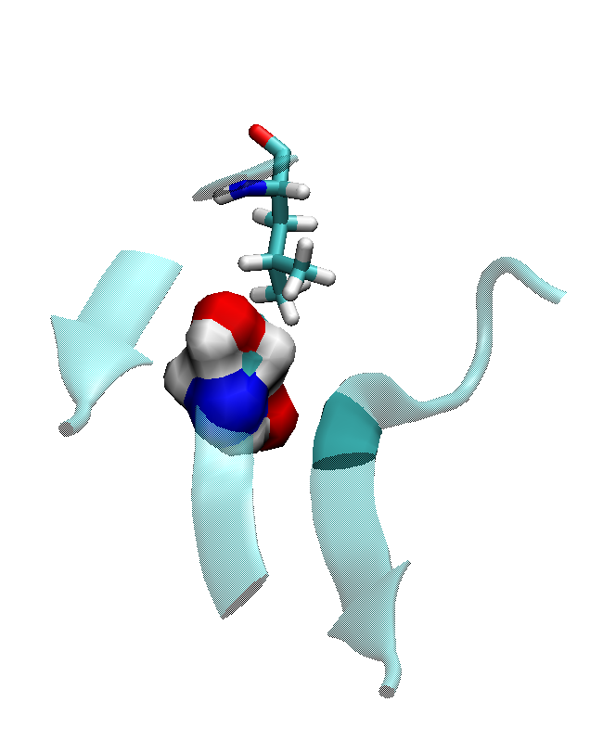
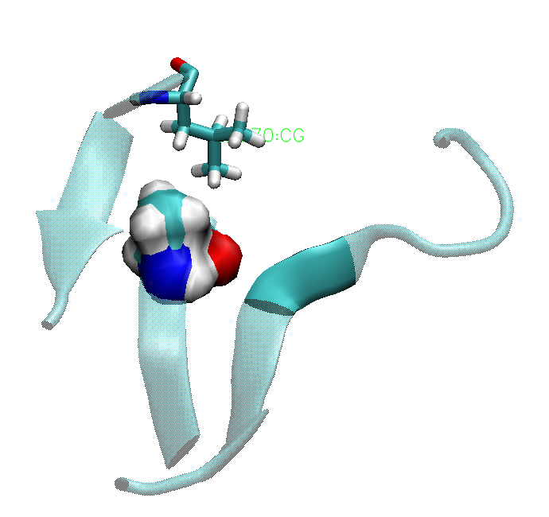
Pertuzumab
Mature Antibody A54
Reversion S54
Notes:
Shifting loop – change in orientation of 70 (licorice)
Mutated residue = surf

Slide 5
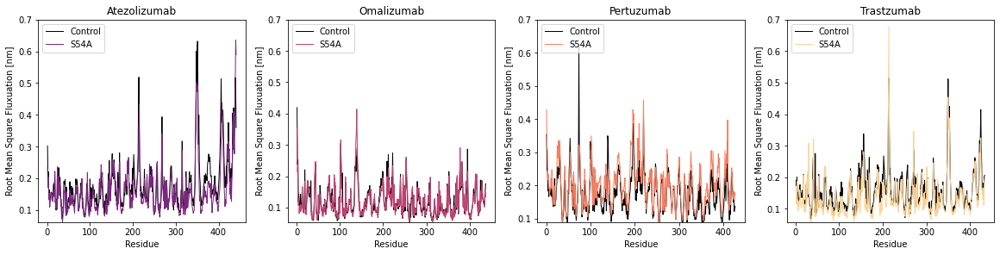

Slide 6
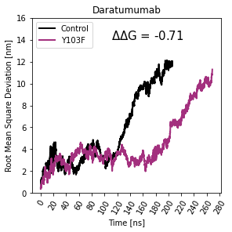
Y103F
 | VH1-2 | VH1-24 | VH1-3 | VH1-46 | VH1-69 | VH2-5 | VH3-20 | VH3-21 | VH3-23 | VH3-30 | VH3-33 | VH3-48 | VH3-66 | VH3-7 | VH3-74 | VH3-9 | VH4-30-4 | VH4-31 | VH4-34 | VH4-39 | VH4-4 | VH4-59 | VH4-61 | VH5-51 | VH6-1
103A | -7 | -9 | -5 | -7 | -6 | -5 | -8 | -6 | -3 | -4 | -2 | -9 | -7 | -6 | -6 | -5 | -4 | -6 | -7 | -5 | -6 | -4 | -7 | -1 | -5
103C | 5 | 5 | 9 | 7 | 7 | 7 | 5 | 6 | 22 | 4 | 5 | 6 | 4 | 6 | 6 | 7 | 7 | 7 | #WT | 5 | #WT | 6 | 5 | 5 | 7
103D | -1 | -1 | 1 | 0 | 0 | 0 | 0 | 0 | -3 | -1 | -1 | 0 | 0 | -1 | 0 | 0 | 2 | 0 | 0 | 0 | -1 | 2 | 0 | -1 | 3
103E | -7 | -8 | -5 | -5 | -8 | -9 | -6 | -7 | -8 | -7 | -7 | -8 | -7 | -7 | -7 | -6 | -6 | -6 | -7 | -6 | -6 | -4 | -6 | -7 | -7
103F | 21 | 21 | 20 | 23 | 21 | 23 | 21 | 21 | 19 | 19 | 19 | 20 | 22 | 23 | 21 | 21 | 21 | 23 | 21 | 22 | 20 | 21 | 21 | 20 | 20
103G | -7 | -8 | -3 | -4 | -3 | -3 | -4 | -5 | -4 | -1 | -8 | -6 | -2 | -5 | -5 | -4 | -1 | -6 | -3 | -5 | -8 | -4 | -4 | -7 | -4
103H | 8 | 7 | 10 | 11 | 7 | 15 | #WT | 12 | 10 | 12 | 12 | 13 | 12 | 15 | 13 | 12 | 13 | 12 | 7 | 11 | 9 | 10 | 9 | 8 | 6
103I | -6 | -6 | -7 | 4 | -6 | -4 | -4 | -4 | -6 | -2 | -6 | -9 | -4 | -4 | -5 | -3 | -6 | -7 | -7 | -5 | -7 | -6 | -4 | -8 | -9
103K | -9 | -9 | -7 | -10 | -11 | -8 | -3 | -12 | -10 | -6 | -6 | -14 | -2 | -8 | -9 | -5 | -12 | -13 | -12 | -12 | -13 | -8 | -11 | -11 | -4
103L | 3 | 3 | 2 | 4 | 3 | 5 | 5 | 4 | 1 | 5 | 3 | 3 | 3 | 3 | 2 | 7 | 4 | 5 | 4 | 4 | 3 | 4 | 5 | 6 | 6
103M | -11 | -10 | -14 | -8 | -14 | -10 | -8 | -9 | -13 | -10 | -8 | -13 | -12 | -11 | -11 | -10 | -12 | -13 | -12 | -14 | -13 | -9 | -12 | -9 | -8
103N | -2 | -1 | 1 | -1 | -1 | 4 | -1 | 2 | -1 | 0 | -1 | -1 | -2 | 0 | -1 | -1 | 1 | 0 | 0 | 0 | -2 | -2 | -1 | -1 | -1
103P | -7 | -8 | -4 | -6 | -5 | -2 | 1 | -5 | -8 | -6 | -7 | -5 | -5 | -6 | -7 | 0 | -1 | -2 | -7 | -5 | -5 | -3 | -4 | -5 | -4
103Q | -5 | -5 | -6 | -6 | -8 | -6 | 2 | -4 | -7 | -7 | -3 | -5 | -6 | -3 | -7 | -4 | -3 | -7 | -7 | -7 | -8 | -8 | -5 | -8 | -6
103R | -2 | -4 | 0 | -2 | -2 | -2 | 5 | -2 | -1 | 0 | 0 | -2 | 7 | 2 | 2 | -1 | -2 | 3 | -6 | -1 | -5 | -2 | -2 | -2 | -1
103S | 8 | 5 | 11 | 8 | 7 | 12 | 6 | 6 | 6 | 11 | 9 | 7 | 7 | 8 | 10 | 8 | 10 | 7 | 6 | 12 | 5 | 7 | 8 | 5 | 5
103T | -7 | -4 | 3 | -4 | -4 | 0 | -3 | -6 | -6 | -3 | 0 | -9 | -3 | -2 | -6 | -4 | -5 | -3 | -7 | -2 | -6 | -4 | -3 | -4 | -6
103V | -6 | -4 | -3 | -2 | -4 | 1 | -3 | -2 | -4 | -3 | -6 | -4 | -3 | -4 | -3 | 1 | -3 | 1 | -3 | -2 | -2 | -2 | -2 | -3 | -3
103W | 0 | -1 | -2 | 5 | 1 | 1 | -2 | 0 | 0 | 0 | 1 | -2 | -2 | 0 | -3 | -1 | 0 | 4 | -1 | 3 | -2 | 0 | 0 | -1 | 0
103Y | #WT | #WT | #WT | #WT | #WT | #WT | #WT | #WT | #WT | #WT | #WT | #WT | #WT | #WT | #WT | #WT | #WT | #WT | #WT | #WT | #WT | #WT | #WT | #WT | #WT
Highest Score
Lowest Score
Mechanisms

Slide 7
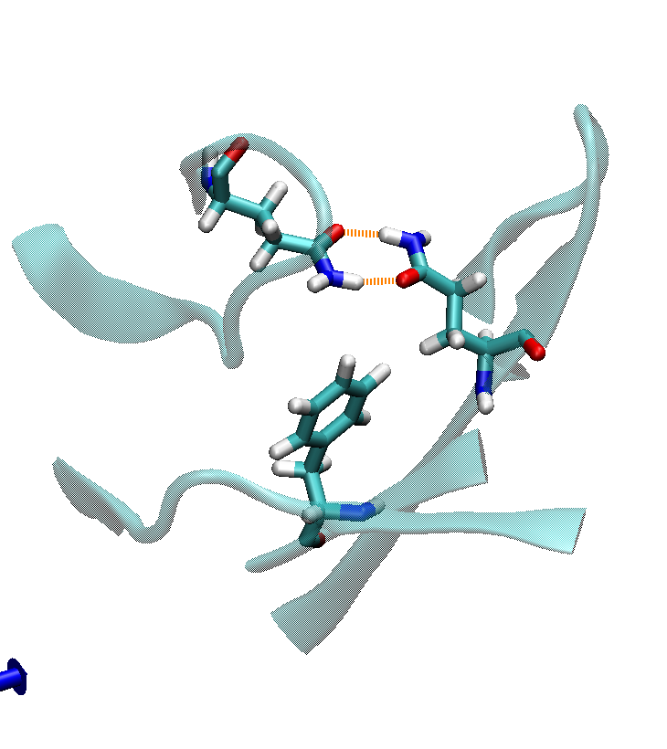
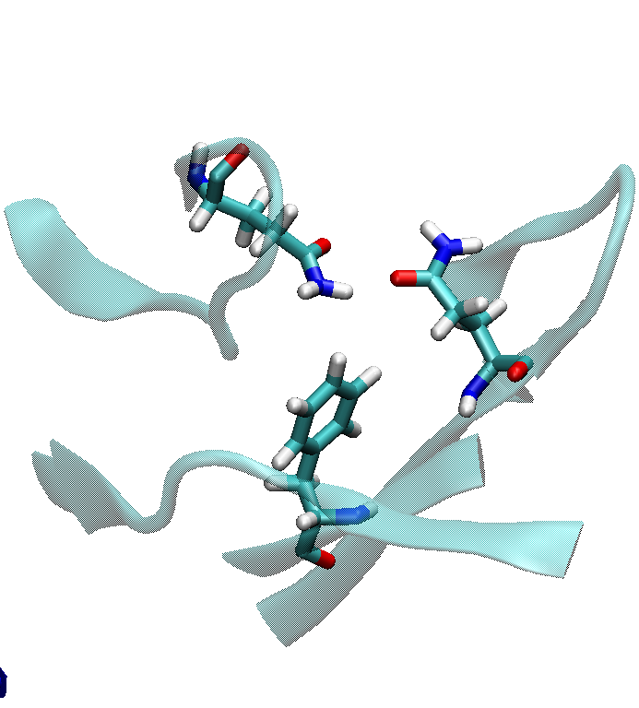
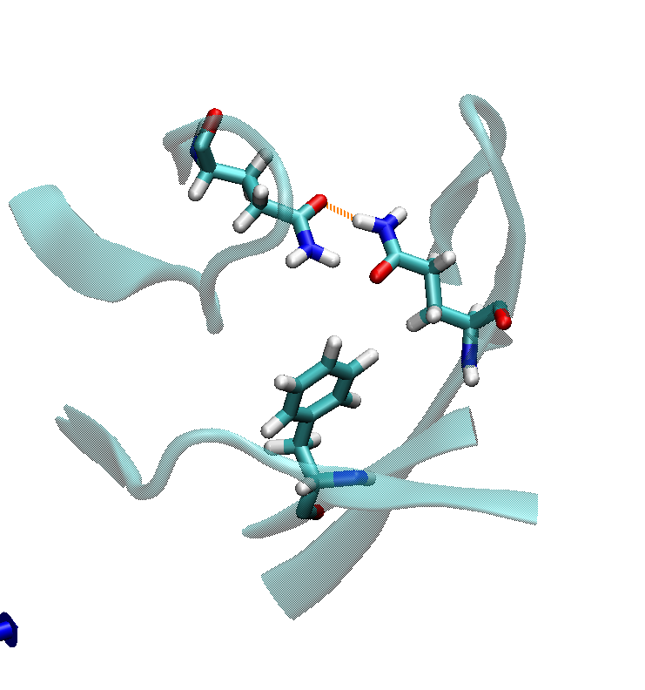
Daratumumab – 200 ns
Control – early
Control – middle
Control – late

Slide 8
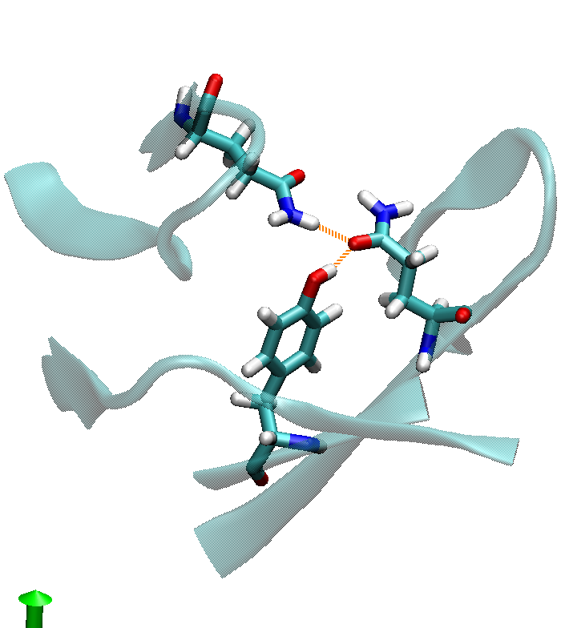
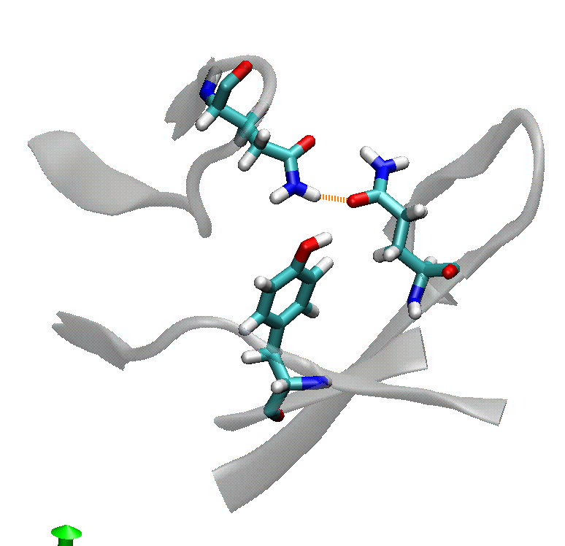
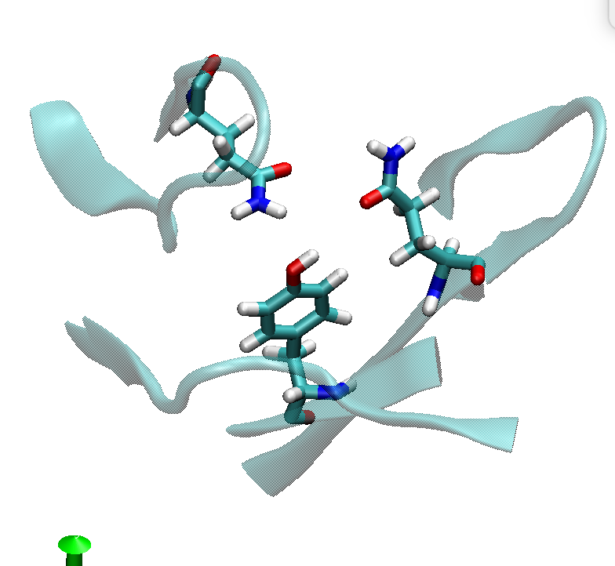
Daratumumab – 200 ns
Reversion – early
Reversion – middle
Reversion – late

Slide 9
