Slide 1
Rough Figure

Slide 2
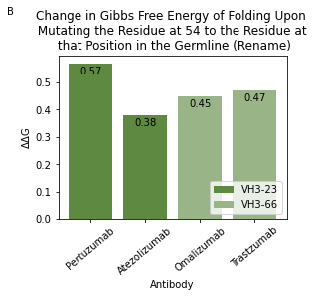
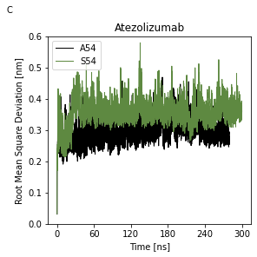
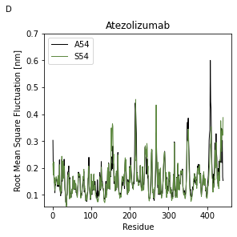
 | VH1-2 | VH1-24 | VH1-3 | VH1-46 | VH1-69 | VH2-5 | VH3-20 | VH3-21 | VH3-23 | VH3-30 | VH3-33 | VH3-48 | VH3-66 | VH3-7 | VH3-74 | VH3-9 | VH4-30-4 | VH4-31 | VH4-34 | VH4-39 | VH4-4 | VH4-59 | VH4-61 | VH5-51 | VH6-1
Ala | 15 | 14 | 16 | 16 | 10 | WT | 20 | 21 | 21 | WT | WT | 22 | 17 | WT | 20 | 20 | 18 | 17 | 15 | 20 | 11 | 19 | 17 | 17 | 11
Cys | -3 | -1 | -2 | -5 | -4 | -3 | 18 | -2 | 0 | -3 | -3 | 0 | -1 | -5 | 5 | 7 | -4 | -4 | -5 | -8 | -5 | -1 | -4 | -1 | -4
Gly | WT | WT | WT | WT | WT | 17 | 5 | 8 | 6 | 13 | 13 | 7 | 17 | 15 | 6 | 7 | WT | WT | WT | WT | WT | WT | WT | WT | WT
Ser | 7 | 7 | 4 | 8 | 5 | 14 | WT | WT | WT | 17 | 15 | WT | WT | 12 | WT | WT | 2 | 2 | 2 | 1 | 2 | 4 | 4 | 4 | 2
Thr | 3 | -3 | 5 | 4 | -5 | 15 | 7 | 5 | 7 | 17 | 15 | 7 | 5 | 9 | 7 | 6 | -2 | -2 | -3 | -2 | -4 | -1 | 2 | -1 | 1
A

Slide 3
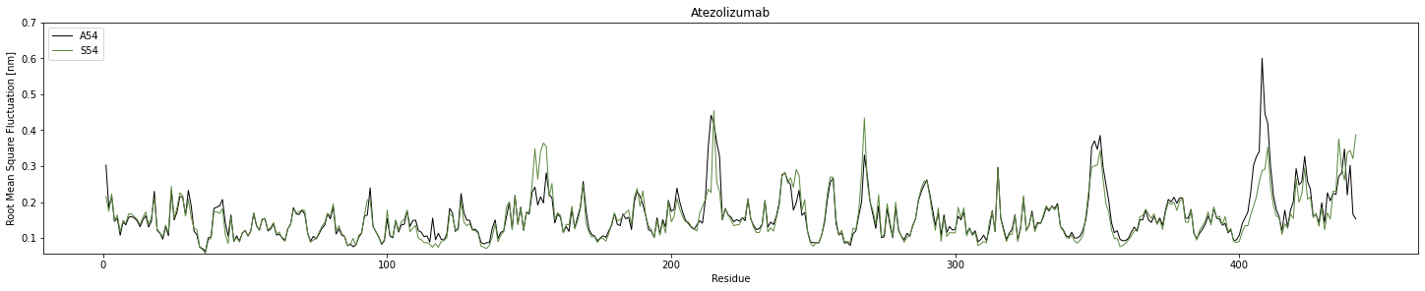

Slide 4
One of the sites that was particularly interesting was at residue 54 where many of the germlines evolved a mutation to A54. This mutation frequency was enhanced (scores between 17-21) for antibodies where the germline structure started with a Serine (Fig. 7A). To explore this trend we set up a series of molecular dynamics (MD) simulation of Atezolizumab, a mature VH3-23 antibody, with and without this mutation. Upon reversion to the germline residue (S54) the antibody was clearly more unstable than if the mutation was made (A54) as shown in Fig. 7C. A calculation of the Gibbs free energy of folding (ΔΔG) of reverting the mutation by PremPS (Fig. 7B) additionally supported the finding that A54 is more favorable than S54. We analyzed the RMSF (root mean square fluctuation) to analyze how the overall structure was impacted by this mutation (Fig. 7D). There were several spikes where the mutation either increased or decreased fluctuations such as regions: a (residues: 24-65), b (residues: *specify*), and c (residues: *specify*) (Fig. 7E). These regions map to portions of the antibody that are within both the framework and variable regions meaning that the mutations can portions of the antibody that bind to its cognate antigen. As shown in Fig. 7F, A54 sits nicely in a hydrophobic pocket resulting in relatively small fluctuations. However, Fig. 7G, indicates that a Serine at this location (S54) has an unsaturated hydrogen bond. In order to find a more favorable orientation, the amino acid rotates around causing the surrounding loops to experience relatively large fluctuations. Overall, this mutation increases the stability of the antibody.

Slide 5
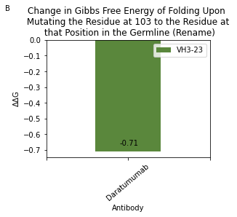
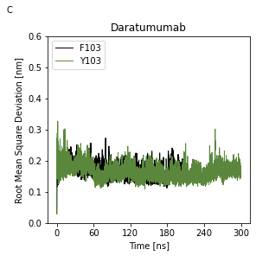
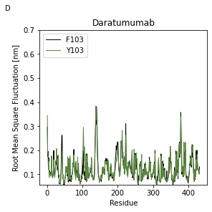
A
 | VH1-2 | VH1-24 | VH1-3 | VH1-46 | VH1-69 | VH2-5 | VH3-20 | VH3-21 | VH3-23 | VH3-30 | VH3-33 | VH3-48 | VH3-66 | VH3-7 | VH3-74 | VH3-9 | VH4-30-4 | VH4-31 | VH4-34 | VH4-39 | VH4-4 | VH4-59 | VH4-61 | VH5-51 | VH6-1
Phe | 21 | 21 | 20 | 23 | 21 | 23 | 21 | 21 | 23 | 19 | 19 | 20 | 22 | 23 | 21 | 21 | 21 | 23 | 21 | 22 | 20 | 21 | 21 | 20 | 20
His | 8 | 7 | 10 | 11 | 7 | 15 | WT | 12 | 13 | 12 | 12 | 13 | 12 | 15 | 13 | 12 | 13 | 12 | 7 | 11 | 9 | 10 | 9 | 8 | 6
Met | -11 | -10 | -14 | -8 | -14 | -10 | -8 | -9 | -11 | -10 | -8 | -13 | -12 | -11 | -11 | -10 | -12 | -13 | -12 | -14 | -13 | -9 | -12 | -9 | -8
Trp | 0 | -1 | -2 | 5 | 1 | 1 | -2 | 0 | 2 | 0 | 1 | -2 | -2 | 0 | -3 | -1 | 0 | 4 | -1 | 3 | -2 | 0 | 0 | -1 | 0
Tyr | WT | WT | WT | WT | WT | WT | WT | WT | WT | WT | WT | WT | WT | WT | WT | WT | WT | WT | WT | WT | WT | WT | WT | WT | WT

Slide 6
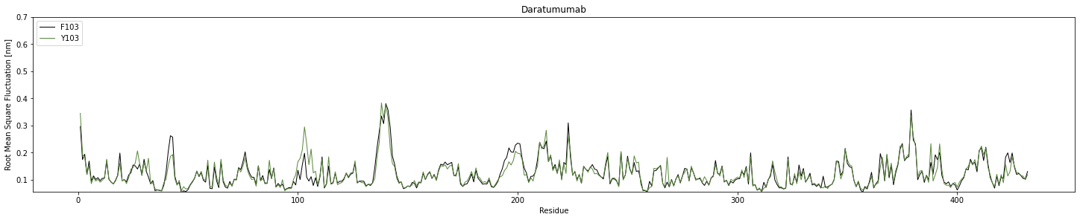

Slide 7
Write Up
We were curious why residue Y103 mutates to F103 very frequently (Fig. 8A). To explore this trend we set up a series of molecular dynamics (MD) simulation of Daratumumab, a mature VH3-23 antibody, with and without this mutation. In mature antibody the mutation, shows increased fluctuations as shown in RMSD (root mean square deviation) calculations which suggests that is it allowing for unfolding to occur (Fig. 8C). This is corroborated by calculating the change in Gibbs free energy of folding (ΔΔG) of reverting the mutation by PremPS (Fig. 8B). In other words, reverting the mutation to its germline sequence allows for a more favorable conformation than making the F103 mutation. Finally, we analyzed the RMSF (root mean square fluctuation) to determine what residues within the structure were most significantly impacted by the change at 103 (Fig. 8D). Residues 100-105 resulted in root mean fluctuations that were shifted by 0.05 nm or more. Additionally, residue 26, 137 and 387 had significant decreases in RMSF when the mutation was reverted back to the germline sequence. Overall, this mutation does not appear to increase stability but instead allows for some unfolding of the antibody. This suggests that it allows the antibody to expose residues that are generally hidden in the germline structure and therefore allows for new antibody epitopes to arise. As opposed to other mutations at this site that could occur, the F103 mutation that is made in the mature antibody is beneficial due to its ability to compete for hydrogen bonding with residues 39 and 263, while still maintaining the same Tryptophan-like shape.
New RMSD plot – doesn’t have that clear shift anymore. Unsure how to tell this story

Slide 8
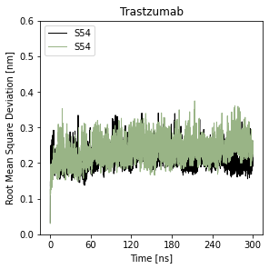
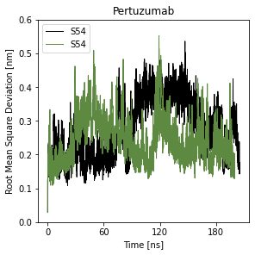
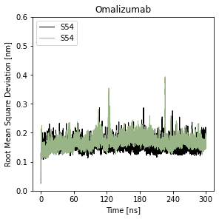
SI

Slide 9
To Do:
Look at residues 115, 212-213, 215-216, 151-155, 242-243, 266-267, 347. 348, 352, 403-410 and 430-431, 434, 436-437, 439-443 on Atezoliumab and see if there is a significant change.
Look at residues 26, 137 and 387 on Daratumumab and see if there is a significant change
For the residue numbers on the bottom of the RMSF calculations, add a key that shows what section of the antibody, the residue is in

