Slide 1
Research Updates
Emily Rhodes

Slide 2
Outline
Meeting Structure
________________________________________
Big Picture Overview
Research Updates
Goals
Big Picture Direction

Slide 3
Meeting Structure
How I would like to structure meetings going forward:
Big picture overview
Advisor help: big picture re-direction
Research updates (for each project)
Advisor help: troubleshooting current problems
Goals for the upcoming week with specific due dates
Advisor help: goals to add or change
Specific questions for my advisors
Big picture direction – next steps
Advisor help: big picture re-direction

Slide 4
Big Picture Overview
Motivation: The pandemic was a life-altering phenomenon that shows us we need be more prepared and have better tools to develop improved therapeutics.
Overarching question: How do we design/evolve antibodies to provide long-term protection against viral infections with highly mutable pathogens (i.e., design/evolve antibodies that are (a) resistant to viral escape and (b) stable)?
General approach: Use an integrated experimental and computational approach to determine fundamental antibody sequence-property relationships and leverage this information to optimize antibody sequences for improved immunotherapies.
Hypothesis 1: When antibodies undergo affinity maturation (project – Affinity Maturation) they evolve to bind more strongly (project – covid MD) to their cognate antigen (project – low Kd) which makes them more resistant to escape.
Methods:
Project – Affinity Maturation
Project – Low Kd
Project – COVID MD
Hypothesis 2: You can engineer super stable antibodies by combining protein engineering (project – Framework Mutations) with polymer chemistry (project – Proteins and Polymers and project – Backpack Simulations).
Methods:
Project – Framework Mutations
Project – Proteins and Polymers
Project – Backpack Simulations
Hypothesis 3: Antibodies do have a limit of neutralization that cannot be overcome (project – Neutralization Threshold).
Methods:
Project – Neutralization Threshold

Slide 5
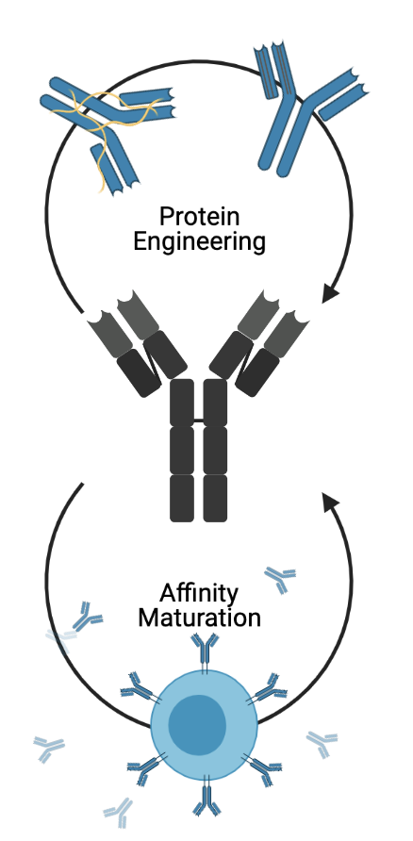

Slide 6
Research Updates
Project – Affinity Maturation
Overview: I want to understand how the conformation of the RBD affects the recruitment of bnAbs.
Have Done:
Read the work done by Kayla so far
To Do:
Calculate the differences in affinity maturation for 0 up and 3 up for the RBD
Input in the dissociation rates
Analyze the output

Slide 7
Research Updates
Project – Low Kd
Overview: I want to understand if antibodies with higher affinity for their cognate antigen are more resistant to escape.
Have Done:
Made copies of the plasmid
I have 300 uL of ~150 ng/uL of pJS699 and pJS697
These are plasmids for RBD yeast display
To Do:
Make sure this has not already been done – literature search
Transform into yeast

Slide 8
Research Updates
Project – Framework Mutations
Overview: I want to figure out which mutations occur first in the affinity maturation process and if these mutations are universally used for flexibility compared to later mutations which are used for stability.
Have Done:
Code from Brian – tried running it
To Do:
Troubleshoot the errors

Slide 9
Research Updates
Project – COVID MD
Overview: I want to figure out if the mutations we choose to simulate have any trends that can explain or predict escape.
Have Done:
Some analysis
Mary (HS Student): Writing summaries of the basic features of the simulations
To Do:
Edit my script to do broad analysis of all the mutations
Binding free energy
RMSD
RMSF
Distance between the center of masses of the antibody and the RBD

Slide 10
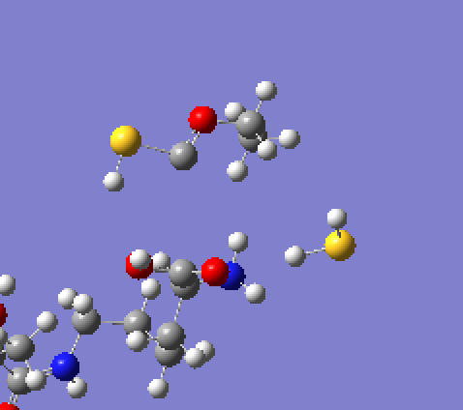
Research Updates
Project – Proteins and Polymers x 2
Overview: What are polymers doing on a molecular scale to stabilize proteins?
Have Done:
Spoken with experimental collaborators
Set up Gaussian simulations to model the partial charges of some of the polymers
To Do:
Redo the Gaussian simulations to prevent the bonds from breaking

Slide 11
Research Updates
Project – Backpack Simulations
Overview: Is there a rigorous way to predict which polymers are best at stabilizing which proteins?
Have Done:
Spoken with experimental collaborators
To Do:
Design a platform to take in information about the protein and the polymer and output information about the stability of the protein

Slide 12
Research Updates
Project – Neutralization Threshold
Overview: Is there a theoretical reason why antibodies are not able to neutralize a virus below a certain concentration? Can we model this/predict it using computation?
Have Done:
Created the model
To Do:
Add a function for infectivity that is more accurate
Add in the impact of having three different RBDs that can go “up” and “down”

Slide 13
Goals
Project | Goal | Due Date
Affinity Maturation | Input in the dissociation rates | August 12th
Low Kd | Make sure this has not already been done – literature search Transform into yeast | August 9th August 6th
Framework Mutations | Troubleshoot the errors | August 6th
COVID MD | Edit my script to do broad analysis of all the mutations | August 12th
Proteins and Polymers | Redo the Gaussian simulations | August 5th
Backpack Simulations | Design the platform | August 16th
Neutralization Threshold | Function for infectivity RBD up and down | August 9th August 12th
Prelims | Draft my prelim paper Draft my prelim presentation | August 19th August 9th
AICHE | Make my posters | August 26th
Fellowships | Make a list of fellowships I want to apply to this year Write a draft of one application | August 6th August 12th

Slide 14
Questions
What literature should I be reading? Can I get a list from both of you?
What are things I can do to be best prepared for the future?
Overall, how does all of this sound?

Slide 15
Big Picture Direction
Make a framework that combines everything I have uncovered about antibodies and antigens to be able to take a viral protein and provide engineering principles that will help guide someone in the right direction for making antibody therapeutics (antibody engineering) or a vaccine (antigen engineering).
Framework – Governing rules for engineering

