Slide 1
Research Updates
Emily Rhodes

Slide 2
Outline
Big Picture Overview
Research Updates
Goals
Big Picture Direction

Slide 3
Meeting Structure
How I would like to structure meetings going forward:
Big picture overview
Advisor help: big picture re-direction
Research updates (for each project)
Advisor help: troubleshooting current problems
Goals for the upcoming week with specific due dates
Advisor help: goals to add or change
Specific questions for my advisors
Big picture direction – next steps
Advisor help: big picture re-direction

Slide 4
Big Picture Overview: Immunology + Protein Engineering
Motivation: The pandemic was a life-altering phenomenon that shows us we need be more prepared and have better tools to develop improved therapeutics.
Overarching question: How do we design/evolve antibodies to provide long-term protection against viral infections with highly mutable pathogens (i.e., design/evolve antibodies that are resistant to viral escape)?
General approach: Use an integrated experimental and computational approach to determine fundamental antibody sequence-property relationships and leverage this information to optimize antibody sequences for improved immunotherapies.
Aim 1: Investigate and generalize the mechanisms driving escape between an antibody and its cognate antigen.
Method: Simulate antibodies with an antigen both with and without mutations to determine what interactions are gained or lost when escape mutations are introduced.
Aim 2: Consider how mutations outside of the binding site impact flexibility and make antibodies more resistant to escape.
Method: Revert framework mutations in FDA approved antibodies to determine how these mutations impact the flexibility of the antibodies and if they are crucial to antibody rigidity.
Aim 3: Determine the likelihood escape of antigens with high affinity antibodies.
Method: Use a yeast display platform to screen high affinity antibodies for their ability to resist escape to highly mutable pathogens.

Slide 5
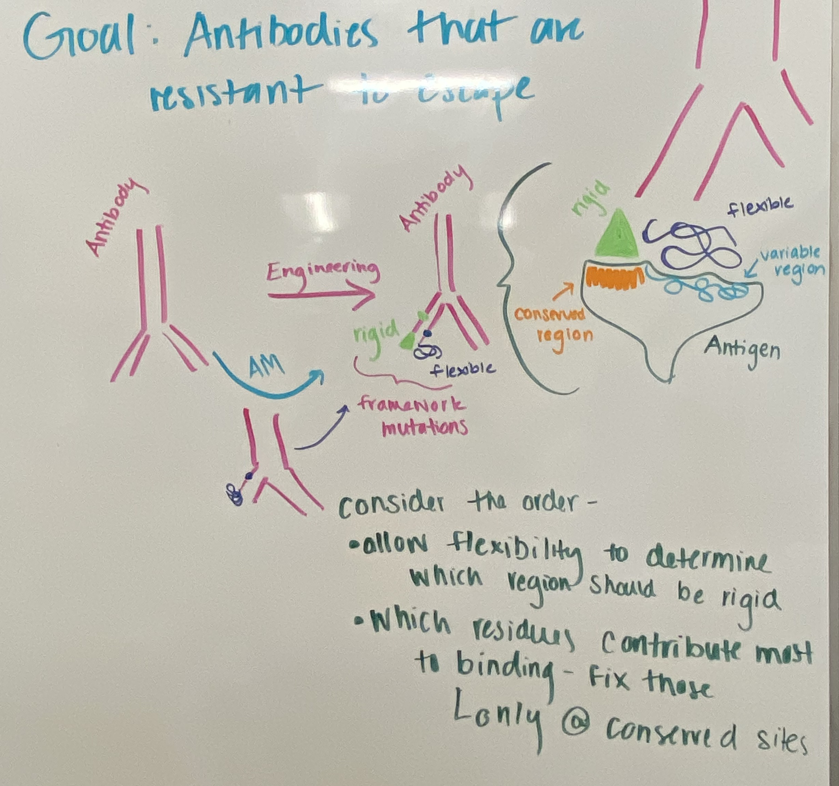
New Idea: Immunology + Protein Engineering
Goal: Design antibodies that are resistant to escape by characterizing mutations for their impact on antibody flexibility and rigidity.
Hypothesis: If you make an antibody rigid in an area where the antigen is conserved and the antibody binds tightly, but flexible in highly variable regions, the antibody will be more tolerant to escape.

Slide 6
Big Picture Overview: Polymers + Protein Engineering
Motivation: Extreme conditions (high temp or certain solvents) can denature proteins and preventing them from being effective.
Overarching question: How can we use polymers to mitigate destabilizing factors for proteins?
General approach: Use a computational approach to determine fundamental protein – polymer relationships and leverage this information to optimize protein stabilization and effectiveness.
Aim 1: Investigate how proteins interact with polymers when these polymers are attached to their surface.
Method: Simulate a protein where the polymers are attached to surface exposed lysine residues on the protein.
Aim 2: Consider the impact of proteins being in a polymer solution.
Method: Simulate a protein in a polymer solution where the polymer chemistry is varied systematically to derive rules about protein-polymer interactions. (I predict the highest chemical match – both composition and functional group chemistry – will result in the most stabilizing effects.)
Aim 3: Explore self-assembly of polymers around proteins.
Method: Simulate a block polymer with both hydrophilic and hydrophobic components that are allowed to interact with the protein in an aqueous environment. (I predict the polymer will aggregate with the protein in such a way that the hydrophilic and hydrophobic parts align.)

Slide 7
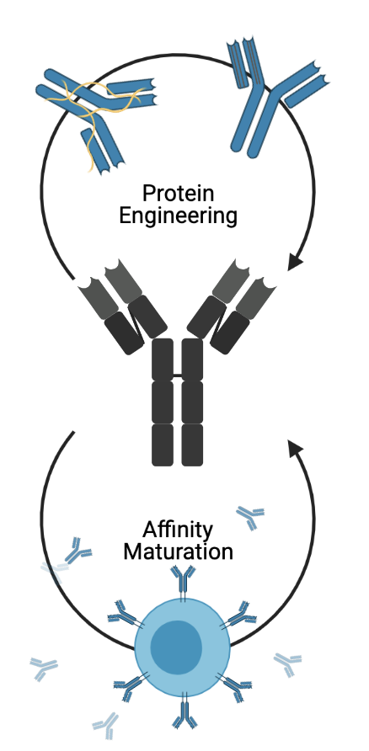
Edit

Slide 8
Research Updates
Project – Affinity Maturation
Overview: I want to understand how the conformation of the RBD affects the recruitment of bnAbs.
Have Done:
Read the work done by Kayla so far
To Do:
Calculate the differences in affinity maturation for 0 up and 3 up for the RBD
Input in the dissociation rates
Analyze the output

Slide 9
Research Updates
Project – Low Kd
Overview: I want to understand if antibodies with higher affinity for their cognate antigen are more resistant to escape.
Have Done:
Made copies of the plasmid
I have 300 uL of ~150 ng/uL of pJS699 and pJS697
These are plasmids for RBD yeast display
To Do:
Make sure this has not already been done – literature search
Wanted to get done this week and didn’t
Transform into yeast
Wanted to get done this week and didn’t

Slide 10
Research Updates
Project – Framework Mutations
Overview: I want to figure out which mutations occur first in the affinity maturation process and if these mutations are universally used for flexibility compared to later mutations which are used for stability.
Have Done:
Code from Brian – tried running it
To Do:
Troubleshoot the errors
Wanted to get done this week and didn’t
Respond to reviewers – writing a draft (I can send this to both of you before I send it to Brian if you would like)

Slide 11
Research Updates
Project – COVID MD
Overview: I want to figure out if the mutations we choose to simulate have any trends that can explain or predict escape.
Have Done:
Some analysis
Mary (HS Student): Writing summaries of the basic features of the simulations
To Do:
Edit my script to do broad analysis of all the mutations
Binding free energy – still need to do
RMSD - run
RMSF - run
Distance between the center of masses of the antibody and the RBD – still need to do

Slide 12
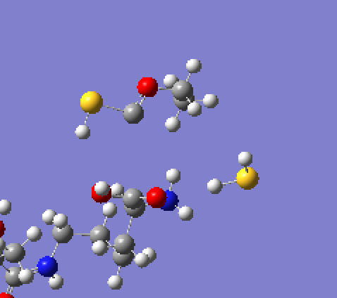
Research Updates
Project – Proteins and Polymers x 2
Overview: What are polymers doing on a molecular scale to stabilize proteins?
Have Done:
Spoken with experimental collaborators
Set up Gaussian simulations to model the partial charges of some of the polymers
To Do:
Redo the Gaussian simulations to prevent the bonds from breaking

Slide 13
Research Updates
Project – Backpack Simulations
Overview: Is there a rigorous way to predict which polymers are best at stabilizing which proteins?
Have Done:
Spoken with experimental collaborators
To Do:
Design a platform to take in information about the protein and the polymer and output information about the stability of the protein

Slide 14
Research Updates
Project – Neutralization Threshold
Overview: Is there a theoretical reason why antibodies are not able to neutralize a virus below a certain concentration? Can we model this/predict it using computation?
Have Done:
Created the model
To Do:
Add a function for infectivity that is more accurate
Add in the impact of having three different RBDs that can go “up” and “down”

Slide 15
Goals
Project | Goal | Due Date
Affinity Maturation | Input in the dissociation rates | August 12th
Low Kd | Make sure this has not already been done – literature search Transform into yeast | August 9th August 6th
Framework Mutations | Troubleshoot the errors Respond to reviewers | August 6th
COVID MD | Edit my script to do broad analysis of all the mutations | August 12th
Proteins and Polymers | Redo the Gaussian simulations | August 5th
Backpack Simulations | Design the platform | August 16th
Neutralization Threshold | Function for infectivity RBD up and down | August 9th August 12th
Prelims | Draft my prelim paper Draft my prelim presentation | August 19th August 9th
AICHE | Make my posters | August 26th
Fellowships | Make a list of fellowships I want to apply to this year Write a draft of one application | August 6th August 12th

Slide 16
Questions
List of Literature
I have a list from Kayla
Tim?

Slide 17
Big Picture Direction
Make a framework that provides direction (flexibility/rigidity mutations and what the K_{d} should be) for how to make antibodies that are resistant to escape.
Framework – Governing rules for engineering

