Slide 1
Simulation Update
Emily Rhodes

Slide 2
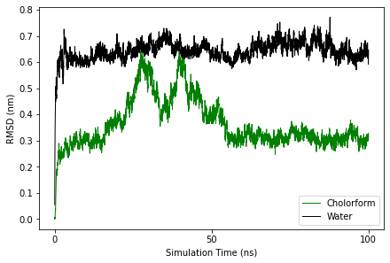

Slide 3
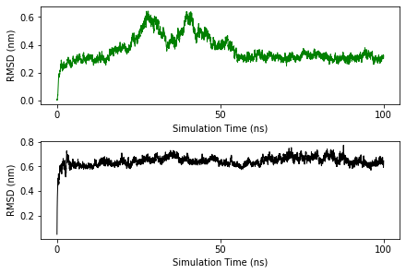

Slide 4
Next Steps
Understand what is happening in each sim – VMD
Cholorform – what are the bumps?
Higher temp

