Slide 1
Shape Change Particles Update
November 30th, 2021

Slide 2
Simulation Status
 | Chloroform | Control (Water)
Trial 1 | 340810 ps | 168058 ps
Trial 2 | 241676 ps | 174876 ps
Trial 3 | 346050 ps | 173274 ps

Slide 3
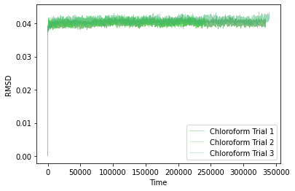
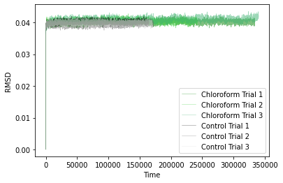
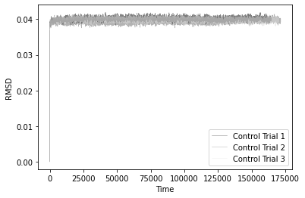
RMSD
Average Difference between Chloroform and Control:
0.0007360312647600569 +/- 0.0005490532647217071

Slide 4
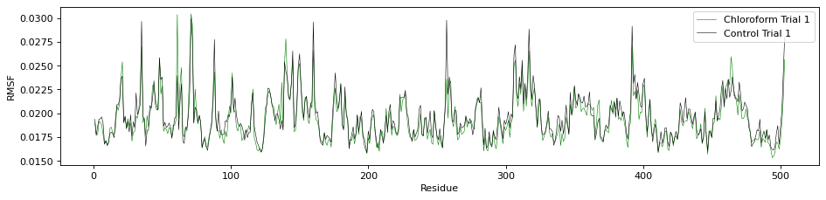
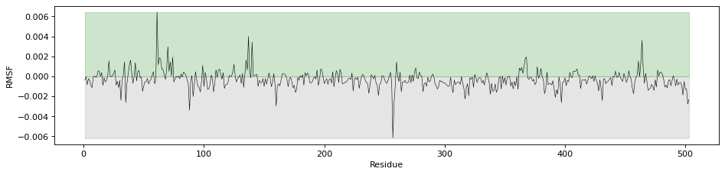
RMSF

Slide 5
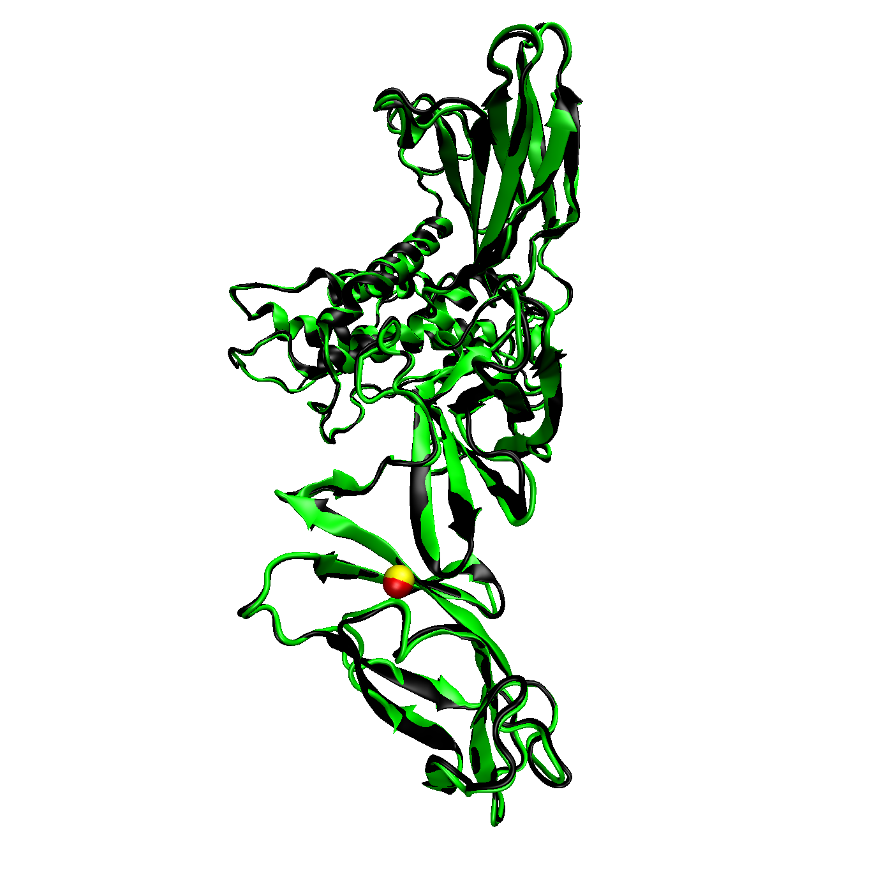
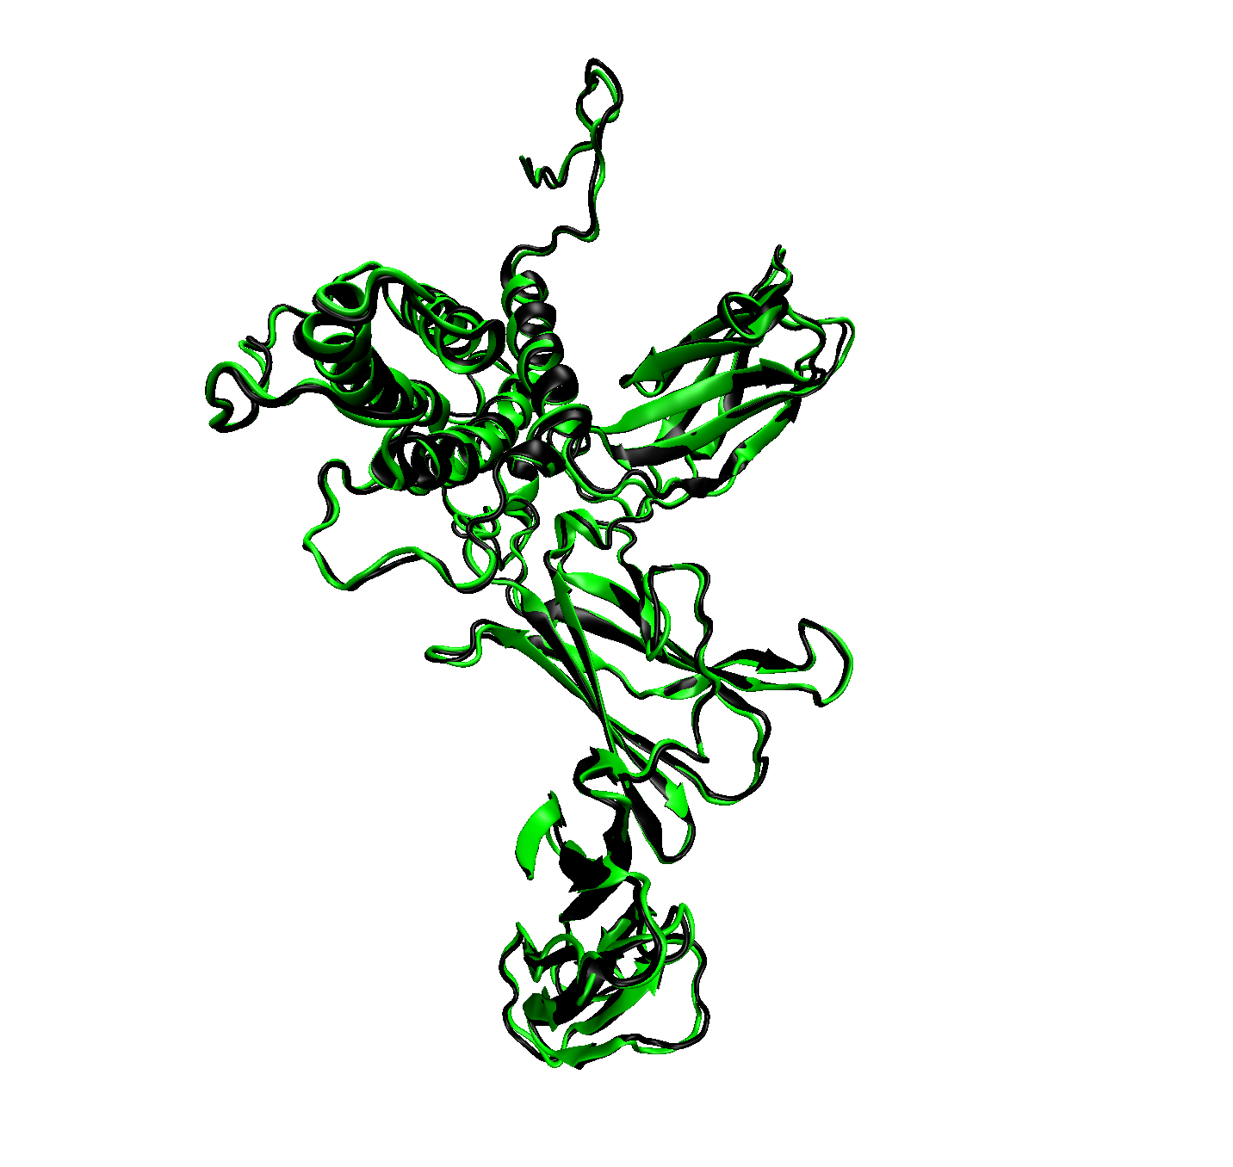
Images

Slide 6
Ramachandran
Still working on plotting these values

