Slide 1
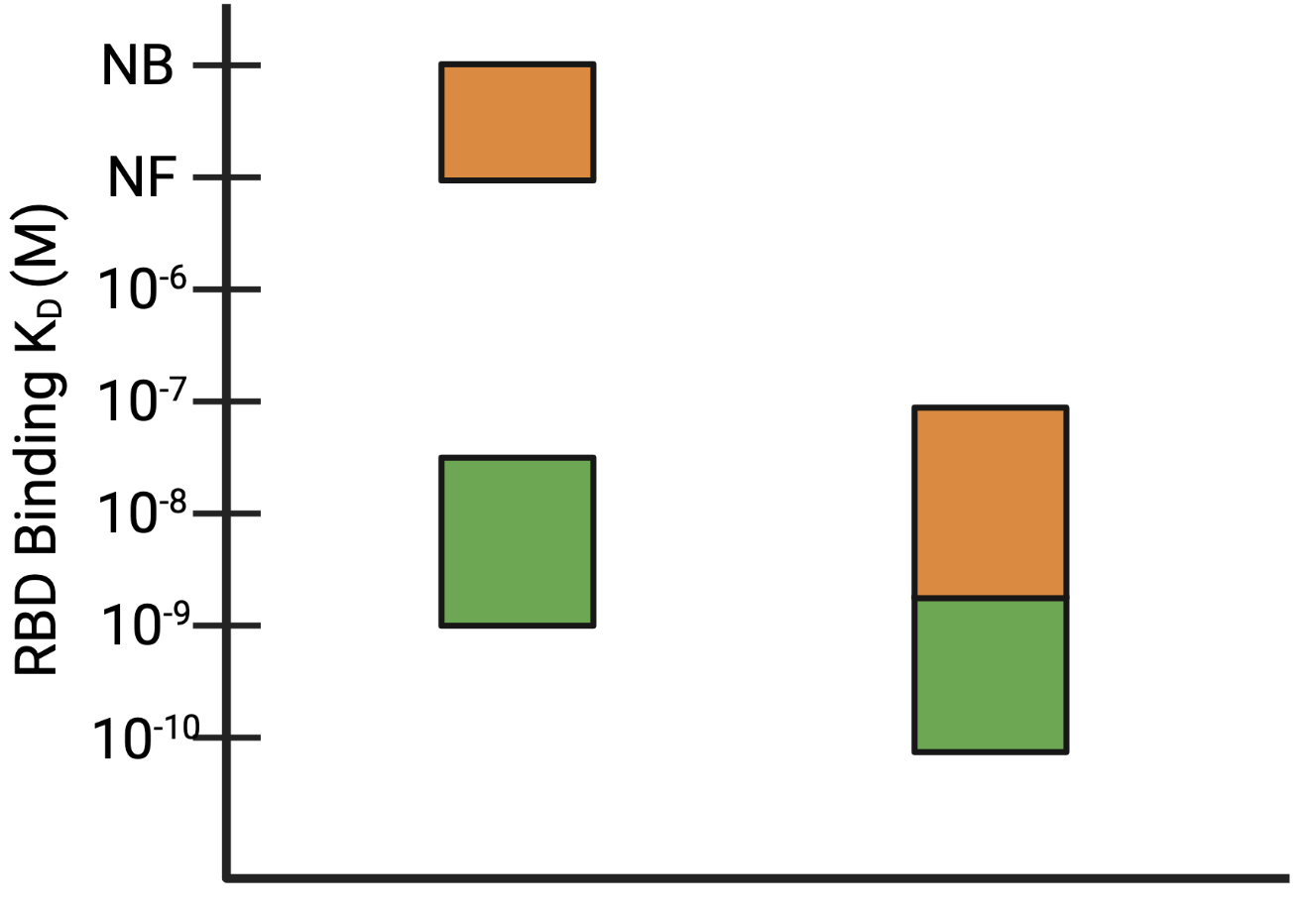


Range of Antigens Binding
Antibody BEFORE Engineering
Antibody AFTER Engineering
K_{D} = 10⁻⁷ – 10⁻⁹ M
Some antigens not bound
K_{D} = 10⁻⁷ – 10⁻¹⁰ M
All antigens bound
NB = Not Binding
NF = Not Fit
Notes:
Slide 8: Furthermore, my hypothesis is motivated by work done by members of the Whitehead Lab and collaborators at SCRIPPS. Our collaborators at SCRIPPS found that they could engineer an antibody to have a lower Kd for its specific cognate antigen (the receptor binding domain on SARS-CoV-2) and by doing so the antibody was less susceptible to escape. Before engineering, the antibody had some antigen variants it could not bind to and bound with a Kd in between 10 to the -7th and 10 to -9th M, but after engineering, the tightest binder was now 10 to the -10th and there were no antigen variants that could not bind.
Potential Questions:
The Kd values look relatively the same – why are you saying the Kd is lower for the antibody after engineering?
Show and explain figure from paper
What is the appropriate Kd for antibodies?
Why does the shift not shift it more? (explain some not binding to all binding better)
Change the figure to better show it - arrow for the boxes: animate , break the scale so orange is not attached

Slide 2
