Slide 1
Lab General Items
Petalibrary – get hard drives?
Marketplace – order hard drives
Travis – happy hour at Avery at 4:30 PM
Drivers:
Travis
1-2 others
Slack reminder
Call about underage students
Other?

Slide 2
Cytokine Stabilization
Emily Rhodes
Sprenger/Whitehead Labs
February 10th, 2022

Slide 3
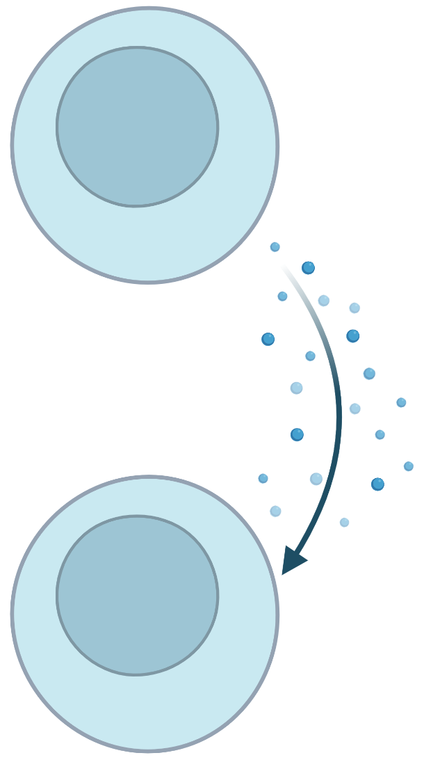
Cytokines are Small Proteins Crucial to Cell Signaling
There are many types of cytokines:
lymphokine (cytokines made by lymphocytes)
monokine (cytokines made by monocytes)
chemokine (cytokines with chemotactic activities)
interleukin (cytokines made by one leukocyte and acting on other leukocytes)
Cytokines may act on:
the cells that secrete them (autocrine action)
nearby cells (paracrine action)
distant cells (endocrine action)
There are both pro-inflammatory and anti-inflammatory cytokines.

Slide 4
IL-12’s Proinflammatory Properties can Help Cells Kill Diseased Cells
IL-12 can:
induce T_{H}1 cell differentiation ¹
increase activation and cytotoxic capacities of T and NK cells ¹
inhibit or reprogram immunosuppressive cells, such as tumor associated macrophages (TAMs) and myeloid-derived suppressor cells (MDSCs)¹
1. Nguyen, Frontiers in Immunology (2020)

Slide 5
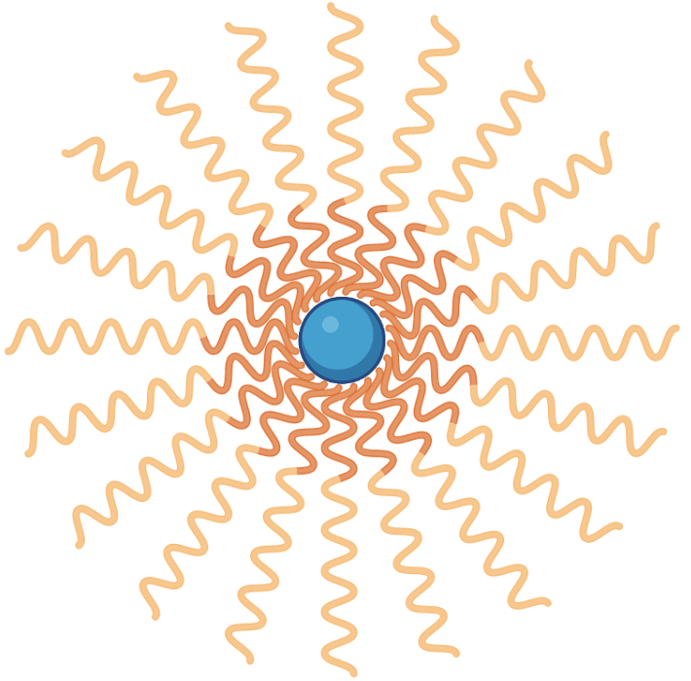
Delivery of Cytokines is Important for Therapeutic Applications
For cancer applications, delivery of cytokines can help reprogram cells instead of introducing foreign molecules.
Benefits:
Directed delivery of cytokines
Harnessing the body’s ability to destroy cancer cells
Challenge:
This system has worked for one specific set up, but is not an off-the-shelf type system… yet

Slide 6

Proteins can be Denatured Depending on their Environment
3. Change in chemical environment
4. UV Radiation
Denaturation occurs when the intra/intermolecular interactions are disrupted.
2. Change in pH
5. Interactions with heavy metal ions
1. Elevated Temperature
Notes:
Heat above 50°C or ultraviolet (UV) radiation - Heat or UV radiation supplies kinetic energy to protein molecules, causing their atoms to vibrate more rapidly and disrupting relatively weak hydrogen bonding and dispersion forces.
Use of organic compounds, such as ethyl alcohol - These compounds are capable of engaging in intermolecular hydrogen bonding with protein molecules, disrupting intramolecular hydrogen bonding within the protein.
Salts of heavy metal ions, such as mercury, silver, and lead - These ions form strong bonds with the carboxylate anions of the acidic amino acids or SH groups of cysteine, disrupting ionic bonds and disulfide linkages.
Alkaloid reagents, such as tannic acid (used in tanning leather) - These reagents combine with positively charged amino groups in proteins to disrupt ionic bonds.

Slide 7
Zongmin’s Method Prevents Denaturation
Protocol A: PLGA nanoparticle preparation (from Zongmin in 2019)
Protocol B: PLGA nanoparticle preparation
(From 2021 Nature BME paper)
Dissolve 10-40 mg PLGA in 1.5-2.0 ml DCM (organic phase).
Add 0.2-0.3 mL phase water (50 ug cytokine in 0.05-0.1% BSA PBS solution) into the organic phase, vortex for 20 s.
Sonicate the mixture for 3 min using a bath sonicator until see a white emulsion (primary emulsion).
Add the primary emulsion to 10-15 mL 1.5% PVA solution dropwise.
Sonicate the mixture for 40 s under 70% magnitude using a probe sonication (second emulsion). Pulse on 20 s, pulse off 10 s.
Put the second emulsion in hood under stirring overnight to evaporate DCM.
Dissolve 20 mg PLGA in 1.0 mL DCM (organic phase).
Add 0.2 mL phase water (50 ug cytokine in 0.1% BSA PBS solution) into the organic phase, vortex for 20 s.
Sonicate the mixture for 40 sec (20 s pulse on, 10 s pulse off and then 20 s pulse on) using a probe sonicator (primary emulsion).
Add the primary emulsion to 11 mL 1.5% PVA solution dropwise under constant stirring.
Sonicate the mixture for 40 s under 70% magnitude using a probe sonication (second emulsion). Pulse on 20 s, pulse off 10 s.
Put the second emulsion in hood under stirring overnight to evaporate DCM.
Centrifuge the particles 12,000xg for 10 min and analyze supernatant for non-encapsulated cytokine.
Wash the particles twice in PBS to remove residual PVA from particle surfaces (optional; application-dependent).

Slide 8
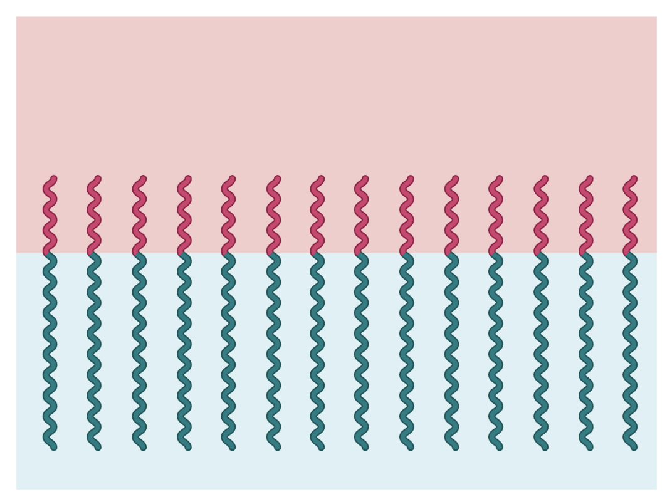
The Polymer Aligns at the Interface

Slide 9
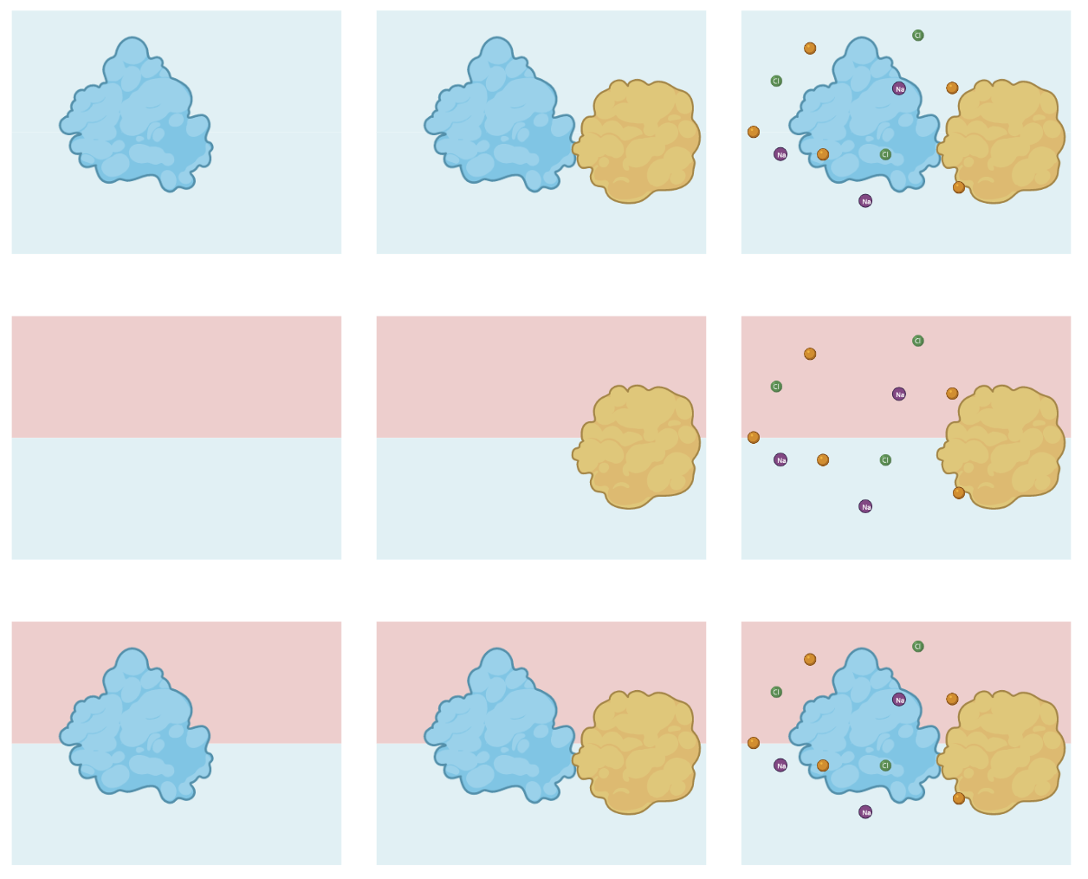
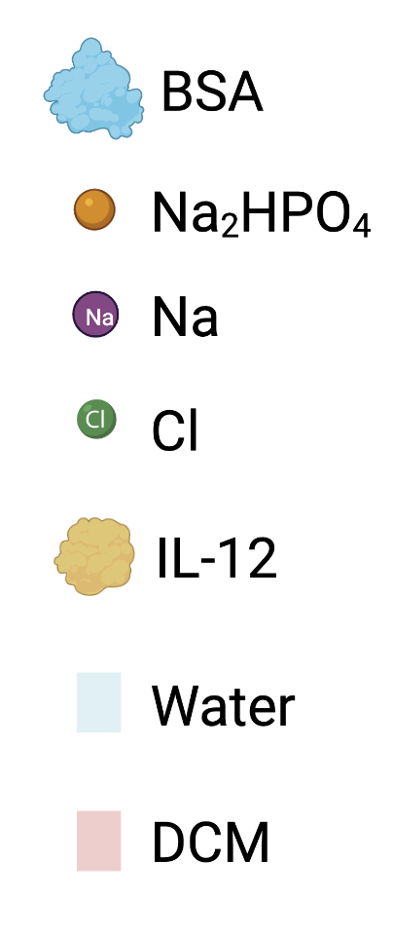
Something about this configuration is optimal...
Our goal: Figure out molecular level interactions are happening that limit denaturation of the cytokine

Slide 10
Experimental Plan to Test Denaturation Conditions
Cytokine alone
Cytokine with BSA
Cytokine with BSA and PBS
Interface alone
Interface with BSA
Interface with BSA and PBS
Interface with Cytokine
Interface with Cytokine and BSA
Interface with Cytokine and BSA and PBS
Notes:
It is a water-based salt solution containing disodium hydrogen phosphate (gaussian), sodium chloride (already done) and, in some formulations, potassium chloride and potassium dihydrogen phosphate.

Slide 11
Experimental Plan to Test Denaturation Conditions
Cytokine alone
Cytokine with BSA
Cytokine with BSA and PBS
Interface alone
Interface with BSA
Interface with BSA and PBS
Interface with Cytokine
Interface with Cytokine and BSA
Interface with Cytokine and BSA and PBS
Notes:
It is a water-based salt solution containing disodium hydrogen phosphate (gaussian), sodium chloride (already done) and, in some formulations, potassium chloride and potassium dihydrogen phosphate.
Step 1 – size of the box to contain both proteins : 180 Angstroms; 18 nm^2
Step 2 -

Slide 12
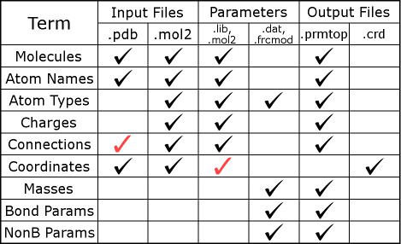
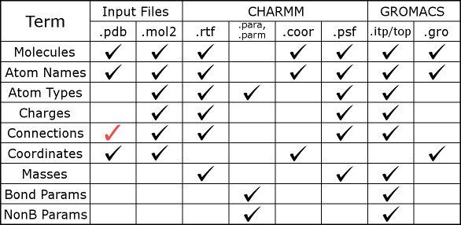
Computational Implementation Requires LEaP and Acpype
LEaP
acpype

Slide 13
Step 1. Get a PDB File for my Solvent
**Get a pdb**
Steps:
1. Drew the molecule in gausview.
Command: gview.exe (open gausview)
2. Optimized the structure using dft: pbe method with the 6-31g basis set.
a. Check that the structure is converged and it finished normally.
3. Loaded the log file into gaussview.
4. Saved the output as a pdb.

Slide 14
Step 2. Make a Mol2 File from the PDB
**Make a mol2 file**
Steps:
1. Use openbabble to convert the pdb to a pdb to get the correct formatting.
2. Change the name of the group in the pdb.
Command: control - v, highlight groups, press c, type new group name, press esacpe
3. Make a mol2 from the pdb.
Command: antechamber -i [outputFileName].pdb -fi pdb -o [newMol2FileName].mol2 -fo mol2

Slide 15
Step 3. Run tleap to Combine Information into Proper Format
**Run tleap**
Steps:
Make a tleap.in file (input file) *Sample in comments*
2. Load ambertools.
Command: conda activate AmberTools20
3. Run the tleap program
Command: tleap -s -f tleap.in > tleap.out
Note: you need a parameterized system for this to work
Notes:
#Source: https://ambermd.org/tutorials/pengfei/index.htm
#Source force fields
source leaprc.protein.ff14SB #Source leaprc file for ff14SB protein force field
source leaprc.gaff #Source leaprc file for gaff
source leaprc.water.tip3p #Source leaprc file for TIP3P water model
#Load the prep files and the params files
loadOff ch2cl2.off #Load the off library for the ligand
#loadamberprep prep.chcl3 #Load the prepi file for the ligand
loadamberparams frcmod.ch2cl2 #Load the additional frcmod file for ligand
#Trying loading a mol2 file
DCM=loadmol2 dcm.mol2
#Save new files
saveamberparm DCM dcm.prmtop dcm.inpcrd #Save AMBER topology and coordinate files
#Quit the program
quit #Quit tleap program

Slide 16
Step 4. Run acpype
**Run acpype**
Steps:
1. Edit the command: acpype -p dcm.prmtop -x dcm.inpcrd -r
a. -p is the prmtop input file
b. -x is the inpcrd input file
c. -r is the output to specify acpype to make the files required for gromacs
Help: acpype -h will give you all the information about all the possible flags.

Slide 17
The Resulting Files can be Used Directly In Simulations
Out: top and gro files
Top file = topology that I can include in my topol.top file
Gro file = molecular structure that I can use to solvate my box

Slide 18
Next Steps:
Parameterize Na₂HPO₄
Set up the simulations
Packmol – fill my box
Future work: consider polymer – protein interactions

Slide 19


Acknowledgements
Sprenger Research Group
Whitehead Research Group
Professor Kayla Sprenger
Brian Petersen
Jon Faris
Daisy Fuchs
Bailey Zinger
Travis Dong
Emma Lietzke
Megan Makam
Daniel Heher
Arielle Lawton
Dan Orbidan
Professor Timothy Whitehead
Monica Kirby
Zach Baumer
Irene Francino Urdaniz
Alison Leonard
Brian Petersen
Zoë Davis
Mia Keyser
Cyrus Haas
Sophia Ulmer
GAANN
Notes:
Slide 33: I’d like to thank both the Sprenger Research Group as well as the Whitehead Research Group for their support and effort while doing this research. In particular, Brian and Irene were great collaborators to work with when writing the papers I was a part of this year. Finally, I would like to thank my funding sources, namely GAANN, and you all for listening to my prelim.

Slide 20
Questions?

