Slide 1
Antibodies to Study - Anchor Epitope
Emily Rhodes
February 28th, 2022
Sprenger and Whitehead Labs

Slide 2
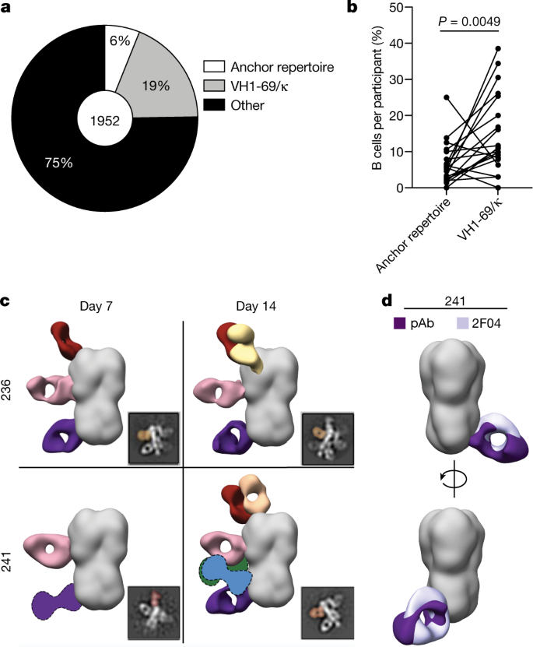
Goal
I am looking to study antibodies that bind to the anchor epitope of Hemagglutinin
These were isolated by Jenna J. Guthmiller who is now at CU Anschutz
I want to look at two heavy chains and two light chains
Goal:
What is the impact of a changing CDRH3 length?
What interactions do the most representative antibodies have with the anchor of Humagglutinin?

Slide 3
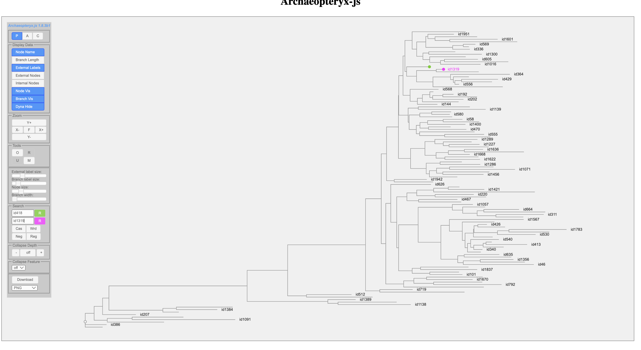
Heavy Chain
CDRH3 – 16
ID: 418
Score: 218.0
HC_V locus: VH3-23
LC Type: Kappa
LC_V locus: VK3-11

Slide 4
Heavy Chain
CDRH3 – 18
ID: 1319
Score: 199.0
HC_V locus: VH3-23
LC Type: Kappa
LC_V locus: VK3-15

Slide 5
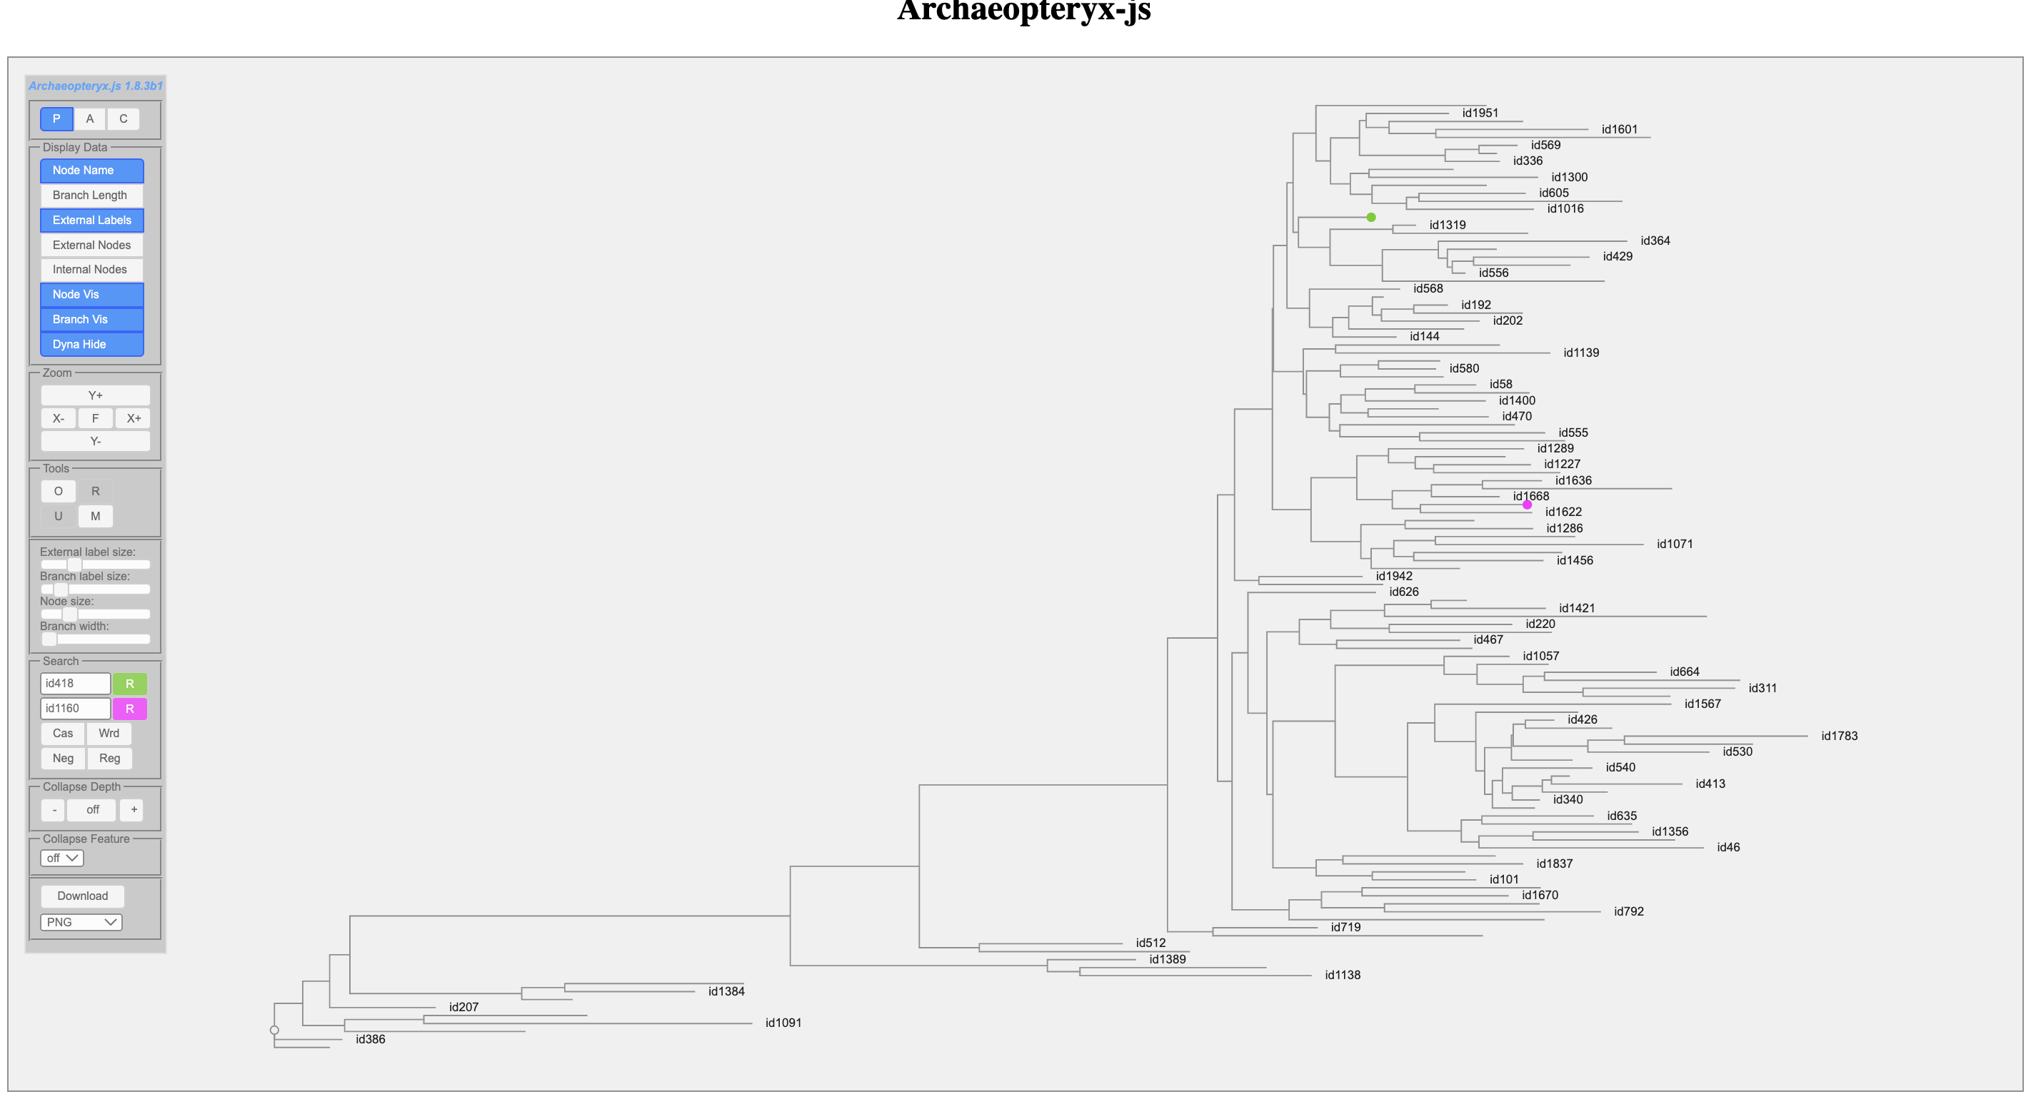
Heavy Chain
CDRH3 – 14
ID: 1160
Score: 190.0
HC_V locus: VH3-23
LC Type: Kappa
LC_V locus: VK3-15

Slide 6
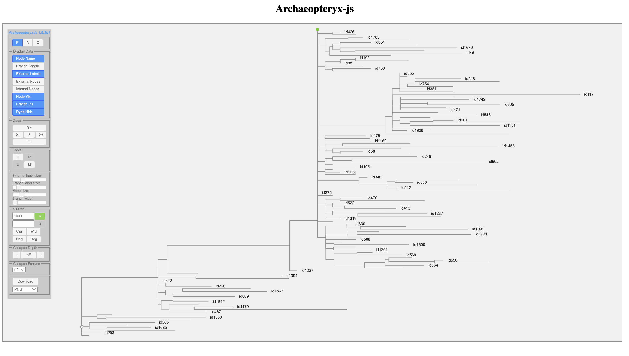
Light Chain
ID: 1003
LC Type: Kappa
LC_V locus: VK3-15

Slide 7
Next Steps
Clone g-blocks into plasmids
Read Influenza papers

Slide 8
Project 2 – Tim’s Description
Mapping sequence determinates for the anchor epitope for hemagglutinin anchor epitope
There are also other epitopes included in the ”other” fraction: https://www.nature.com/articles/s41586-021-04356-8#Sec37
Options include: RBS, STEM,
Anchor epitope:
Antibodies have a really long CDR H3 loop
The V_{H} changes but the V_{L} stays the same for all the broadly neutralizing antibodies
Can study the antibodies both experimentally and computationally
Experimental: finding sequence determinates
Computational: studying the molecular interactions and predicting the impact of other mutations; using the AM code to map potential pathways?
Both MD and Rosetta?
Take the Inferred precursor (UCA) and move forward to determine the mutations that must happen to make a broadly neutralizing antibody
Difficulty: Medium

Slide 9
Literature
Papers we talked about:
https://www.nature.com/articles/s41586-021-04356-8#Sec3
https://www.ncbi.nlm.nih.gov/pmc/articles/PMC7105897/
Recent Review:
https://virologyj.biomedcentral.com/articles/10.1186/s12985-017-0918-y
Other:
https://www-nature-com.colorado.idm.oclc.org/articles/s41564-019-0392-y
https://www-science-org.colorado.idm.oclc.org/doi/10.1126/science.aay0678
https://www-pnas-org.colorado.idm.oclc.org/content/115/1/168
https://www-science-org.colorado.idm.oclc.org/doi/10.1126/science.aaq0620
https://www-sciencedirect-com.colorado.idm.oclc.org/science/article/pii/S0092867419303976?via%3Dihub

