Slide 1
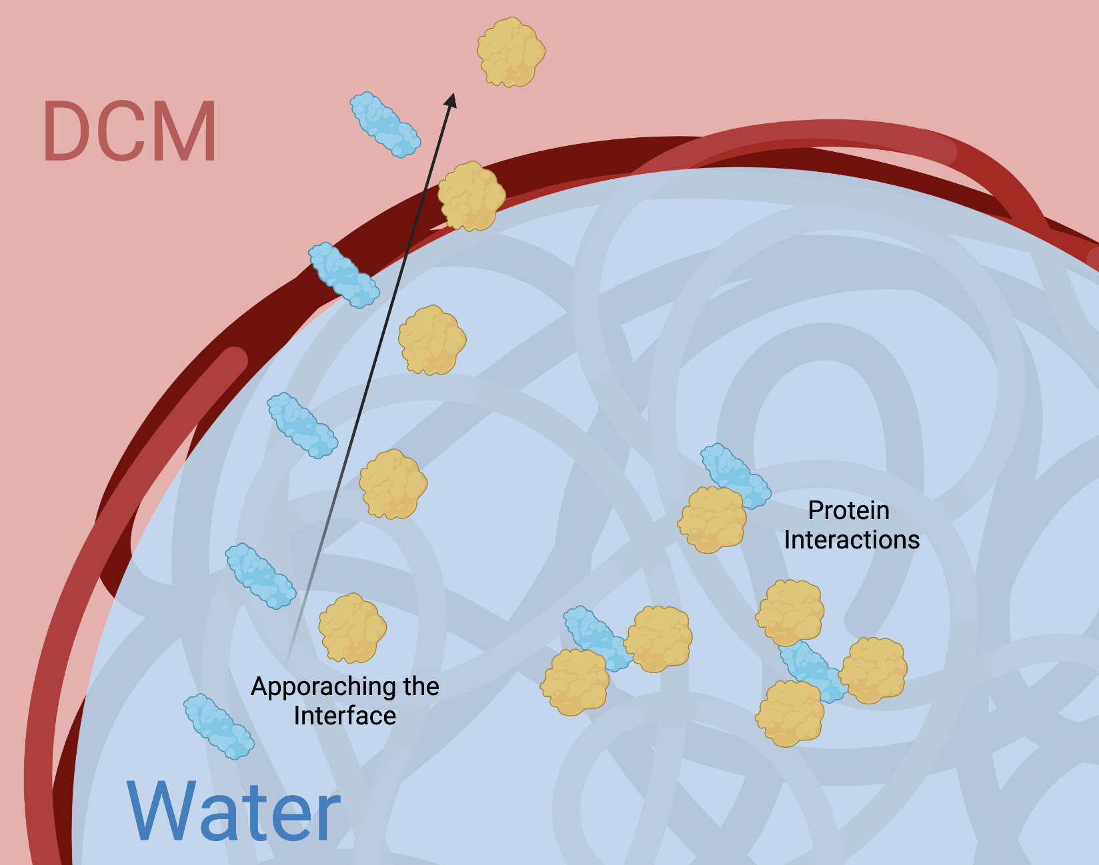
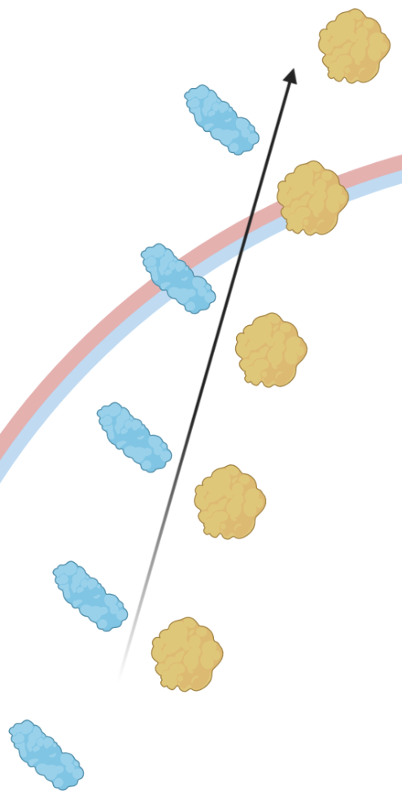
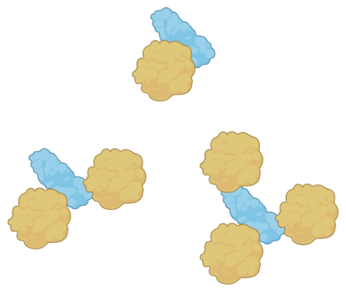


Kill Them with “Kine”ness:
Using MD Simulations to Guide the Design of Cytokine Drug Delivery Platforms for Cancer Therapy
Authors: Emily Rhodes¹, Nicole Day¹, Wyatt Shields¹ and Kayla Sprenger¹
[1] University of Colorado, Boulder
Overview: Cytokines are small proteins crucial to cell signaling and are often delivered to cells for therapeutic applications. However, these cytokines must be localized to highly specific locations in the body, requiring directed delivery. Zongmin et. al has created a nanoparticle platform for cytokine delivery in lung metastases applications.^{1,2} While these solutions are highly relevant, they do not broadly guide design of cytokine encapsulated nanoparticles, nor underline the features of the system that allow for proper drug delivery, namely with regards to: protection of the cytokine, maximal loading of the cytokine and tailored release of the cytokine. A deep molecular understanding of the nanoparticle structure and subsequent internal interactions between the polymers, proteins and solvents has allowed us to suggest the governing features of this system that allow for success. To this end, molecular dynamics (MD) simulations were harnessed to investigate key BSA/Cytokine interactions at the interface of the nanoparticle and solvent, where water meets DCM.
Hypothesis 1: Approaching the Interface
Hypothesis 2: Protein Interactions
Results: Cytokines denature in DCM. This denaturation typically occurs on the exterior of the protein due to interactions between the protein and DCM. However, the secondary structure of a cytokine, in this case IL12, is preserved when the cytokine is surrounded by BSA. Additionally, BSA denatures at the interface of DCM and water providing a secondary layer of protection by occupying the space where IL12 would typically denature. BSA, as a carrier protein, prevents IL12 from denaturing and can allow for proper drug delivery.
Describe differences
Next Steps: While both methods of protection are demonstrated, the prevalent method of protection remains unclear. To determine BSA’s role in the nanoparticle, we will continue to investigate the timescales of both interfacial approach and protein interactions. We believe the the method that occurs most rapidly will indicate the main protective effect as these features compete with one another.
References:
[1] Zhao, Z., Ukidve, A., Krishnan, V. et al. “Systemic tumour suppression via the preferential accumulation of erythrocyte-anchored chemokine-encapsulating nanoparticles in lung metastases”, Nat Biomed Eng, 2021, 5, 441–454
[2] Zhao, Z., Ukidve, A., Gao, Y., Kim, J., and Mitragotri, S., “Erythrocyte leveraged chemotherapy (ELeCt): Nanoparticle assembly on erythrocyte surface to combat lung metastasis” Science Advances, 2019, 5, eaax9250
Funding Sources:
GAANN

