Slide 1

Analyzing Expansion Opportunities for Texas Roadhouse
This project is not affiliated with Texas Roadhouse.
by Emily Buchanan-Schnepp

Slide 2

Introduction
This project aims to explore expansion opportunities for the restaurant chain Texas Roadhouse in five states – Montana, Idaho, Colorado, South Carolina, and Utah. These states were identified for their recent population growth.
Potential Business Use Cases:
Understanding expansion opportunities relevant to current ratings.
Predicting new business locations using socioeconomic data and performance of current restaurants.
The data used in this project was obtained from the US Census Bureau and Google Places, through their APIs, and with respect to their usage guidelines.

Slide 3
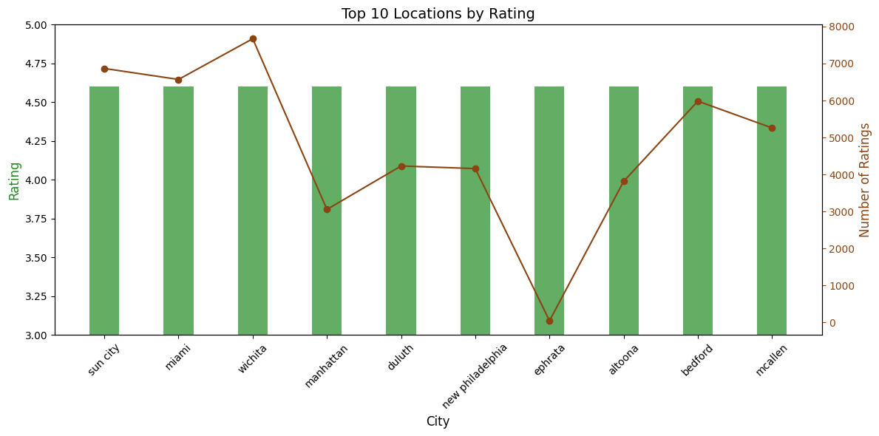
Top Existing Locations
There is no correlation between number of reviews and overall rating.
Wichita boasts an incredibly high rating with a lot of reviews.
Best practices could be collected from the Wichita location and implemented company-wide.

Slide 4
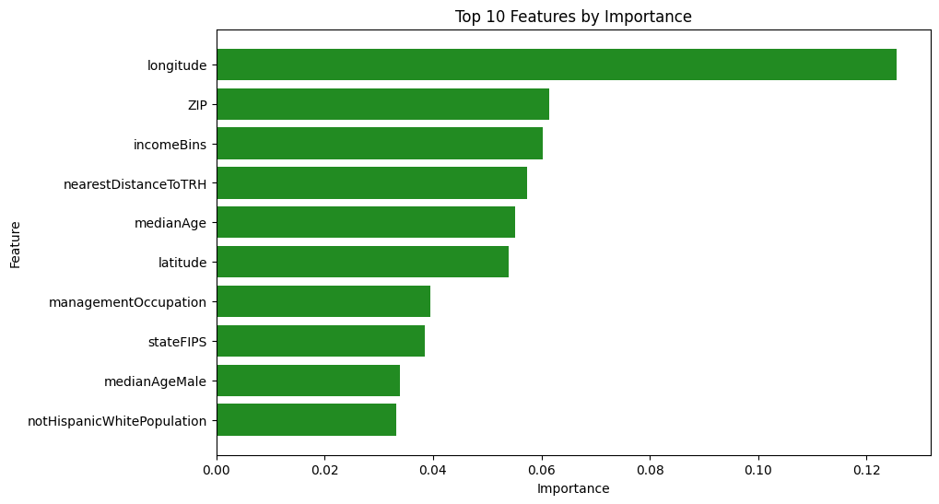
How New Locations Are Predicted
The most important features to predict locations are location-related themselves (longitude, ZIP, closest TRH, latitude, state codes).
Income and other economic factors, like occupation, are moderately important. Age is also moderately important.

Slide 5
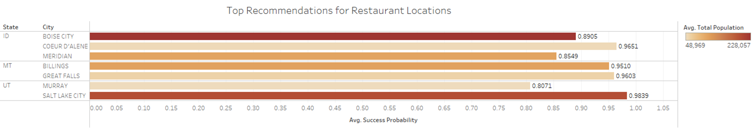
Best New Location Recommendations
The top recommendations for new restaurants are:
Great Falls, Montana with an average success probability of 0.9603
Salt Lake City, Utah with an average success probability of 0.9839.
Some of the cities in this list of recommendations already have existing Texas Roadhouse locations. This could be indicative of support for multiple locations in the area.

Slide 6
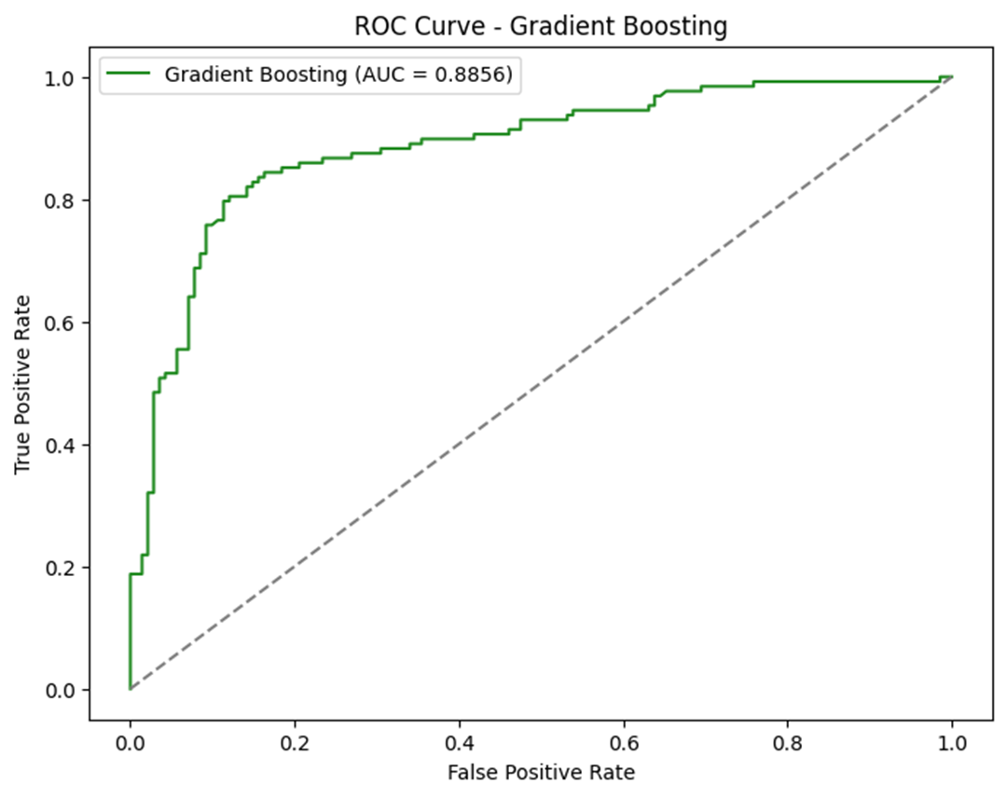
Predictive Model Performance
The machine learning model performs well, accurately deciphering the outcome (Likely Successful, Unlikely Successful) 88.56% of the time.

Slide 7
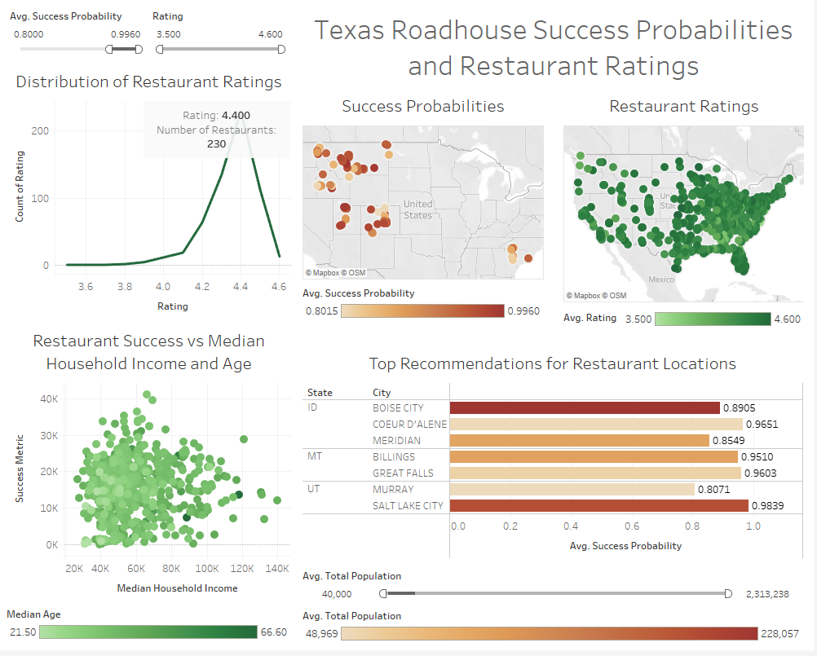
Further Analysis
The most common restaurant rating on Google is 4.4.
Restaurant success is highest in areas with a median household income of $60,000 and a median age in early-mid 30s.
Note: This interactive Tableau dashboard can be accessed by clicking here, where the data can be filtered by success probability and restaurant rating.

Slide 8

Future Work
Consider expanding analysis to additional states to find even more new location opportunities.
1
Include more variables to improve location predictions, such as competitor or population growth data.
2
Collect review data from Yelp! as well, for a more holistic view of restaurant perception.
3
Analyze reviews of Wichita store, who has both a high rating and high rating count, to glean best practices.
4

Slide 9
Thank you!

