Slide 1

Apple Stock Price Prediction Visualizations and Results by Emily Buchanan-Schnepp

Slide 2
Introduction
This project uses advanced learning models (LSTM) to predict Apple stock prices, training on data from 2008-2017 and evaluating performance on data from 2018-2021.
By integrating competitor data (Google stock performance), we explored how market dynamics between smartphone rivals influence stock prices.
These insights demonstrate the value of leveraging existing factors to improve accuracy and support businesses navigating competitive industries.

Slide 3
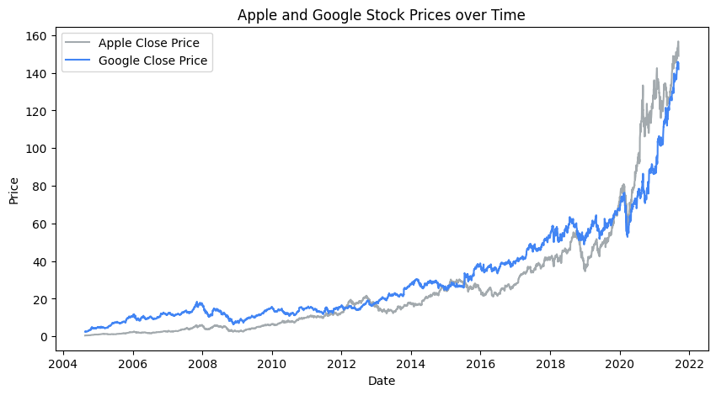
Google and Apple Stock Prices Over Time
Before 2020, Google stock outperformed Apple’s. In 2020, Apple prices surpassed Google’s, showing competitor influence and justifying the inclusion of Google data.

Slide 4

Model Overviews
Three models were tested to predict Apple’s future ‘Close’ price, each progressively increasing in complexity:
Model 1: A baseline model using only Apple’s historic ‘Close’ price for prediction.
Model 2: A more complex model using additional Apple-specific variables.
Model 3: An advanced model integrating Google Stock data to account for competition.

Slide 5

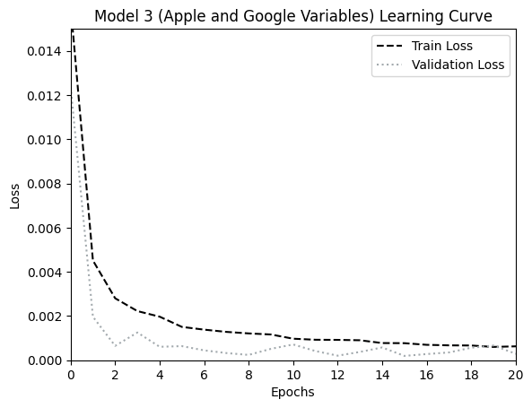
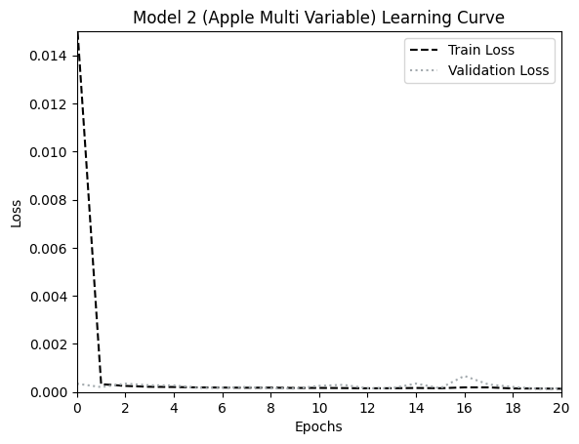
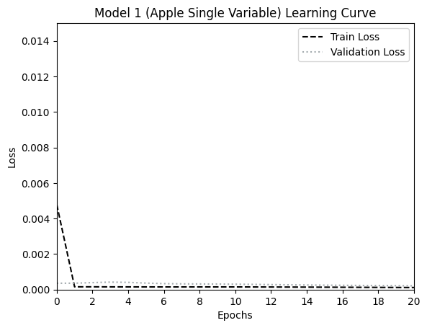
Learning Curves
Model 3 required more training due to added complexity, but achieved the best overall performance, demonstrating the value of integrating competitor data.

Slide 6
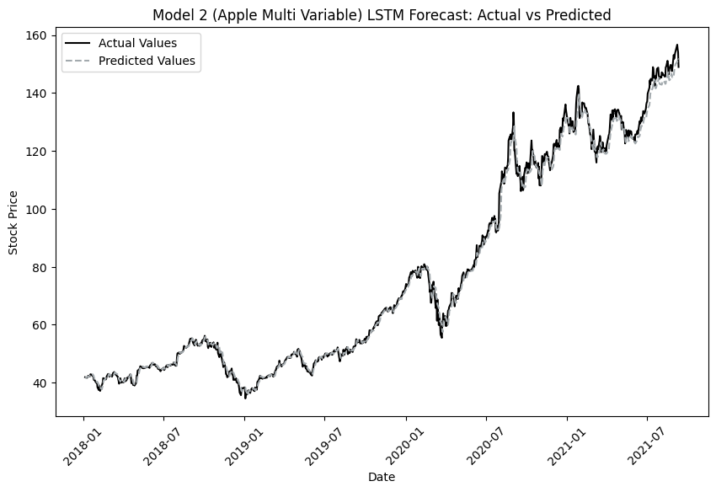
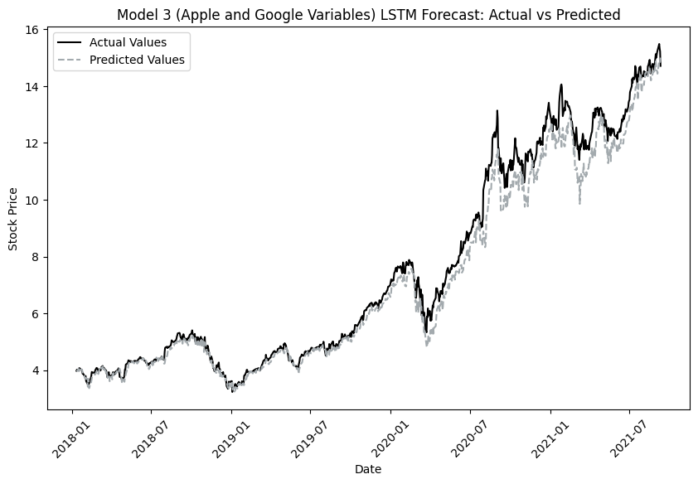
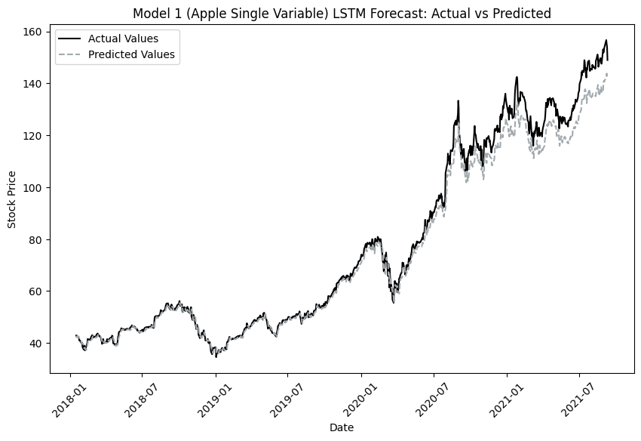
Line Graphs of Predicted vs Actual
Model 3 closely matches actual prices, especially in the short term, making it the most effective for real-world financial forecasting.

Slide 7
Model Results and Metrics
Model 3’s accuracy demonstrates the value of understanding competitor relationships. Businesses in competitive industries can use these insights to better anticipate market trends and refine strategies.
Model 3 outperforms all others with the lowest error (Test RMSE ~ 0.56, within $1 of actual prices) and minimal overfitting, making it ideal for practical use.

Slide 8
Conclusion
This project highlights the importance of external factors, like competitor performance, in forecasting. For businesses, especially in tech, these models can support better decision-making, from investment strategies to understanding market dynamics.
Including Google Data in Model 3 significantly improved prediction accuracy and reduced overfitting, showing how external marketing factors can enhance financial forecasting.

