Slide 1
LSTM Stock Price Prediction Visualizations and Results
by Emily Buchanan-Schnepp

Slide 2
Introduction
This project uses three LSTM models trained on Apple and Google stock data (2004-2017) to predict Apple’s future stock prices. The test data covers 2018 to 2021. Please refer to the GitHub ReadMe for more information on the project.

Slide 3
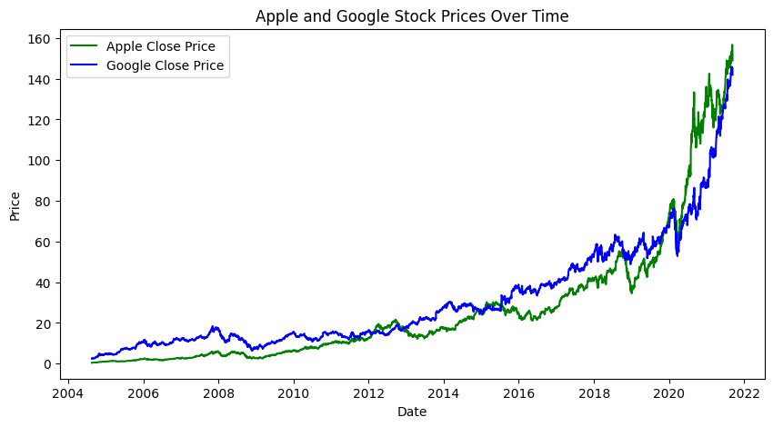
Google and Apple Stock Prices Over Time
Google stock consistently performed better than Apple stock prior to 2020.
However, in 2020 the price of Apple stock exceeded the price of Google stock.

Slide 4
Model Overviews
Model 1: Predict Apple’s future price using only historic ‘Close’ prices.
Model 2: Add Apple variables like RSI and Volume.
Model 3: Include both Apple and Google variables like MACD, %K, and volume.

Slide 5
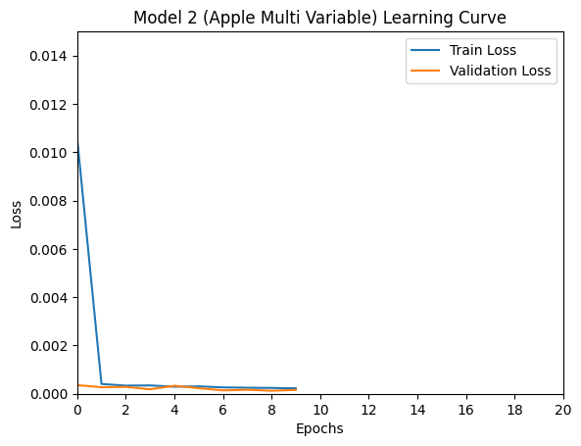
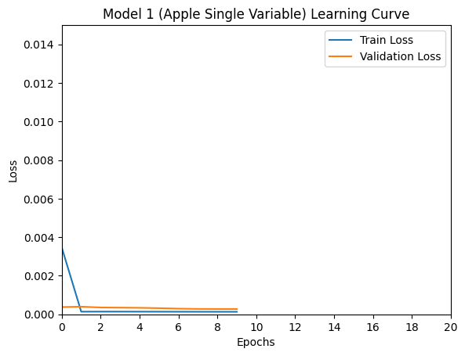
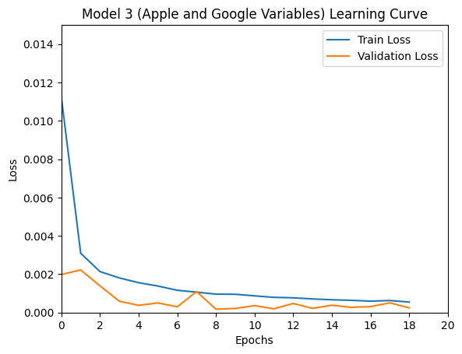
Learning Curves
Models 1 and 2 converge at 9 epochs.
Model 3 takes 18 epochs due to added complexity.
Model 3’s training loss starts off highest while model 1’s training loss starts off lowest.

Slide 6
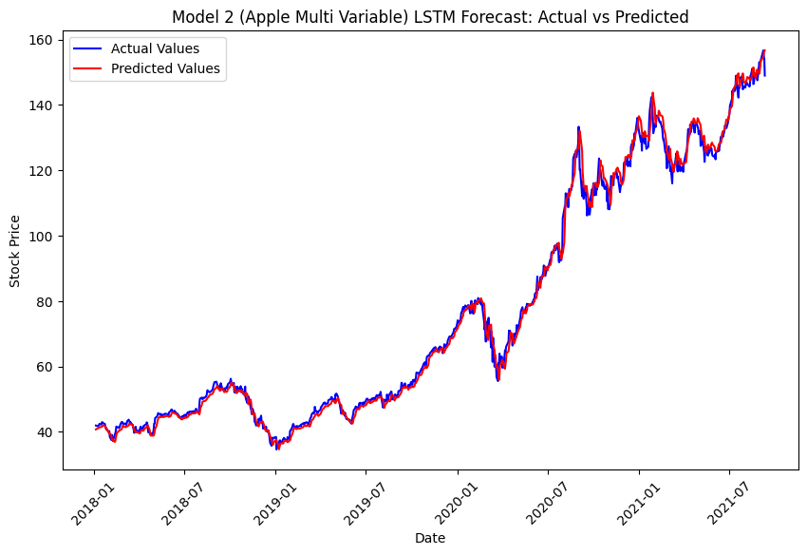
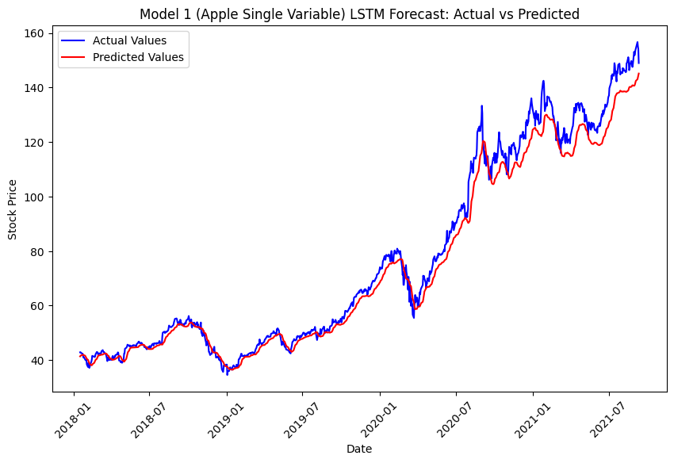
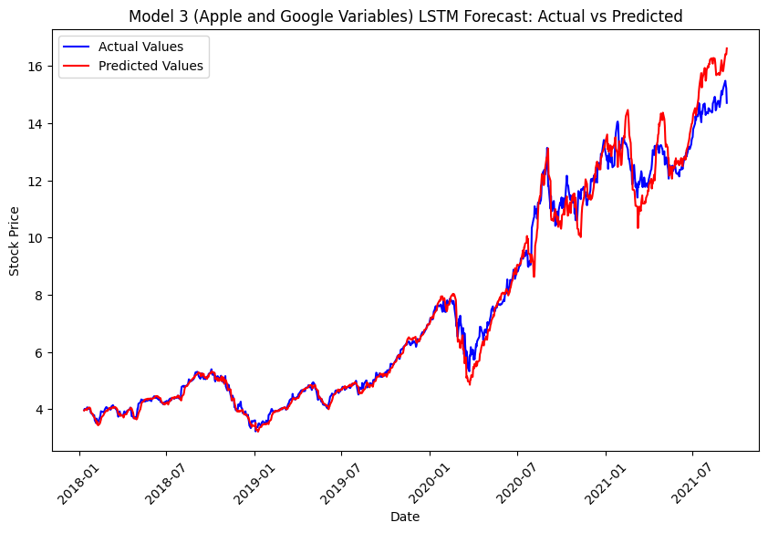
Line Graphs of Predicted vs Actual
Model 1 shows the worst performance.
Model 2 has more consistent performance.
Model 3 starts strong but weakens after two years.

Slide 7

Results
Model 1 overfits (Test MSE: 27.50).
Model 2 reduces overfitting (Test MSE 5.87, RMSE 2.42).
Model 3 performs best overall (Test MSE: 0.23, RMSE 0.48)

Slide 8
Conclusion
Model 3 performs best overall and reduces overfitting, despite the added complexity.

