Slide 1
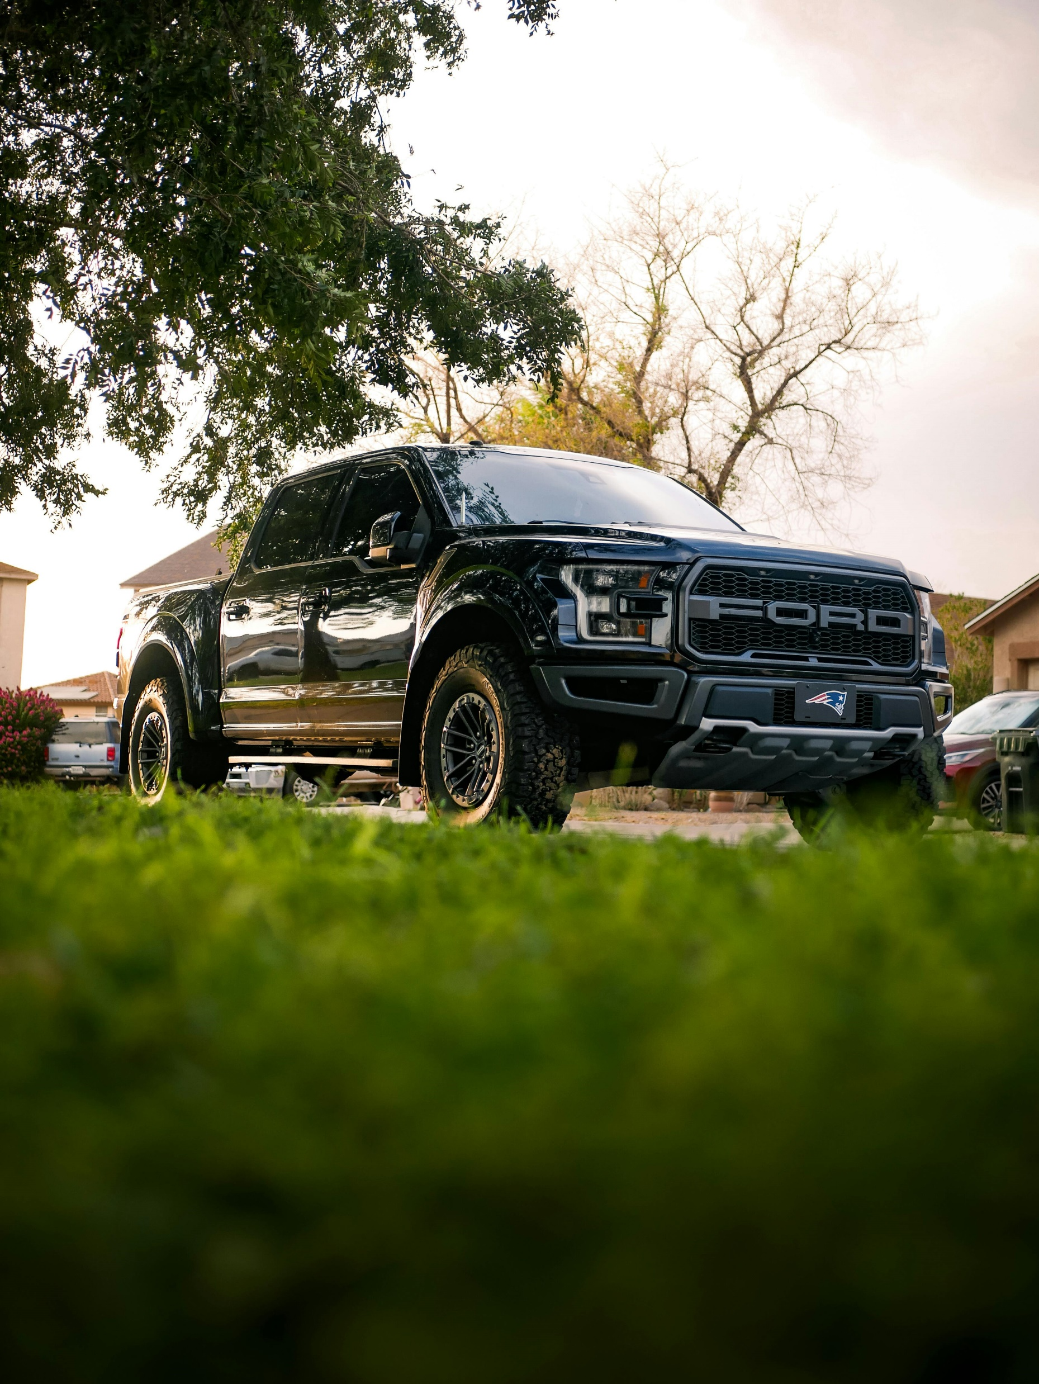
Ford Social Listening: Unlocking Reddit Sentiment for Strategic Growth
Driving insights from data to fuel Ford’s future.
Data gathered with Reddit API. This is an independent analysis not affiliated with or endorsed by Ford Motor Company or Reddit.

Slide 2
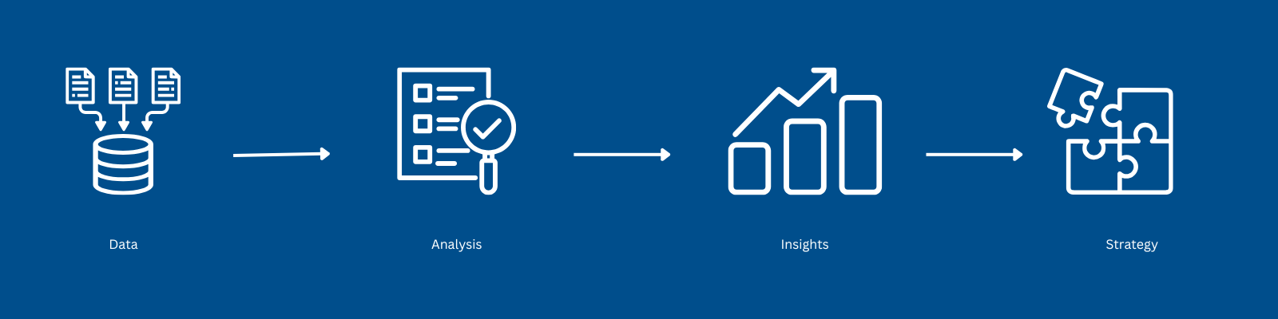
Introduction
This project analyzes Reddit data to understand how Ford is perceived on social media relative to its competitors.
The goal is to provide actionable insights for smarter marketing decisions.

Slide 3
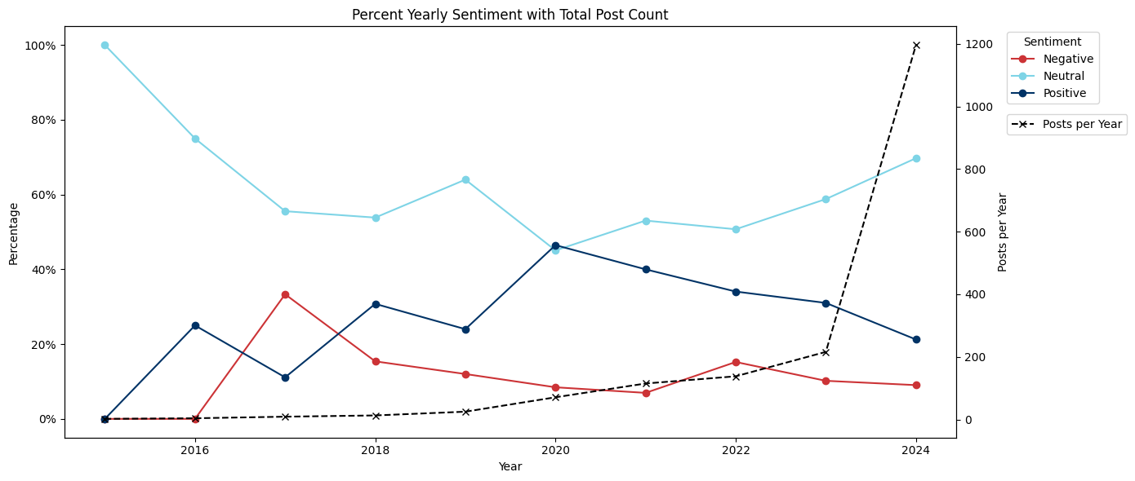
Ford’s Sentiment Trends Over Time
Neutral sentiment has steadily decreased, while positive sentiment shows consistent growth, indicating Ford’s improved perception.
Post volume spikes sharply in 2024, suggesting increased discussion and engagement about Ford.
Negative sentiment remains low but stable - improvement opportunities exist.

Slide 4
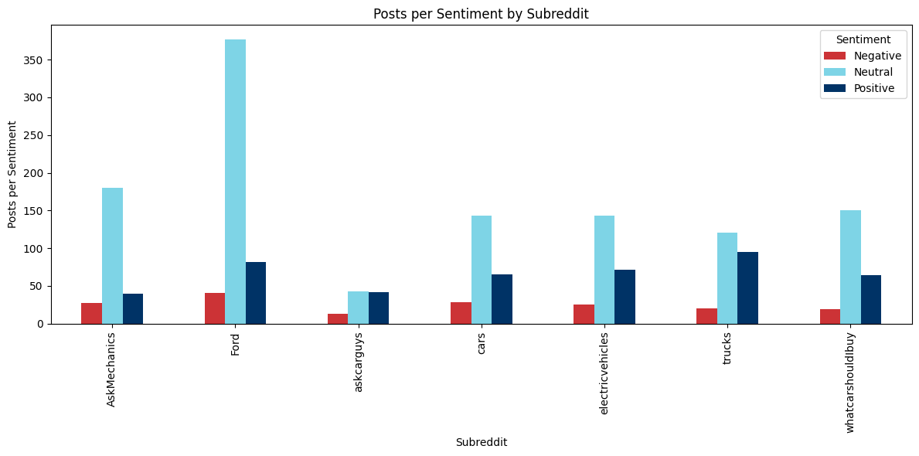
Break Down of Sentiment by Subreddit
r/Ford shows a higher proportion of positive and neutral posts, indicating strong community support.
r/electricvehicles and r/trucks show higher concentrations of neutral sentiment, highlighting opportunities for conversion to positive sentiment.
Negative sentiment remains low but needs monitoring.
Actionable Insight: Focus on engaging with subreddits showing high neutral sentiment to increase positivity.

Slide 5
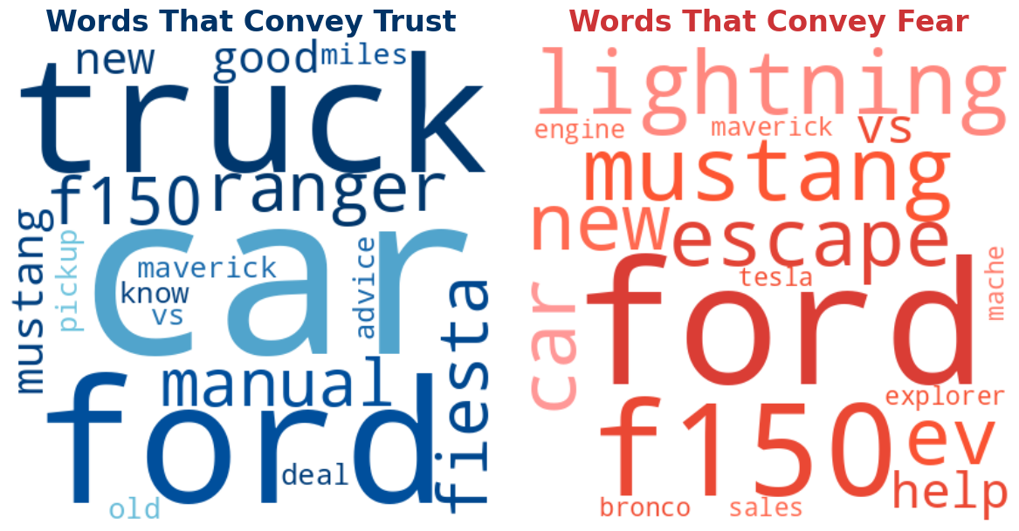
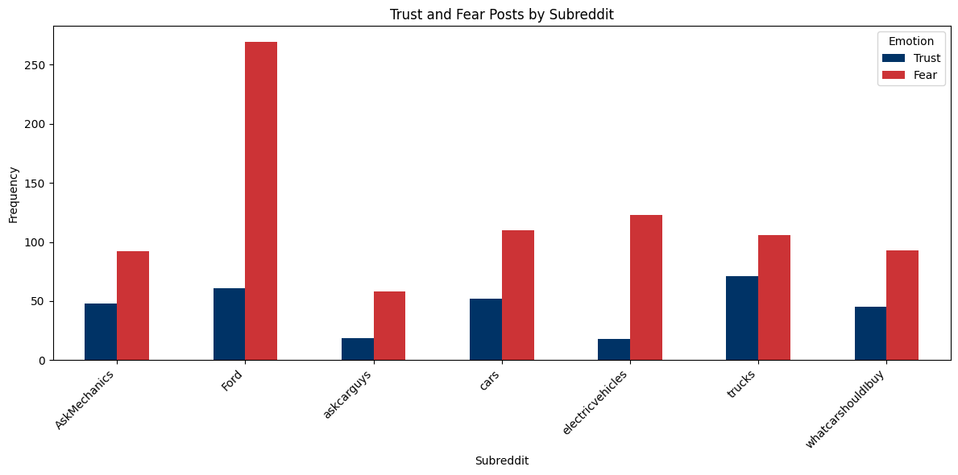
Dominant Emotions: Trust and Fear Across Subreddits
Fear is the most dominant positive emotion, with the highest concentration in r/electricvehicles.
Trust is the most positive dominant emotion, particularly in subreddits focused on product reliability.
Fear-related discussions often include keywords like ‘engine,’ ‘lightning,’ and ‘Mustang’ highlight concerns about reliability or recalls.
Trust-related keywords like ‘reliability’ and ‘manual’ emphasize Ford’s quality and reliability.
Actionable Insight: Address fear in r/electricvehicles to amplify trust in reliability-focused conversations.

Slide 6
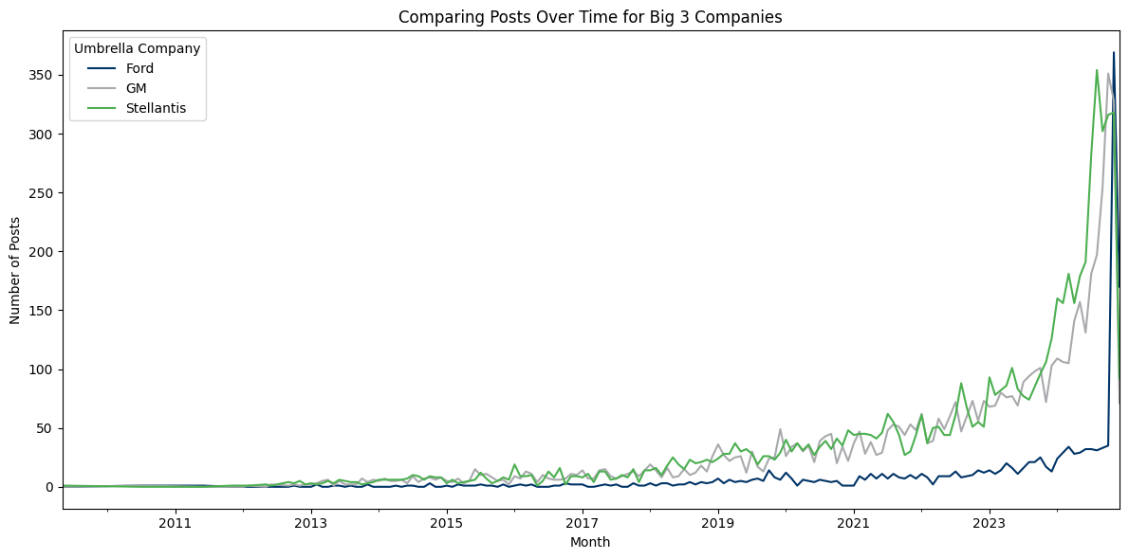
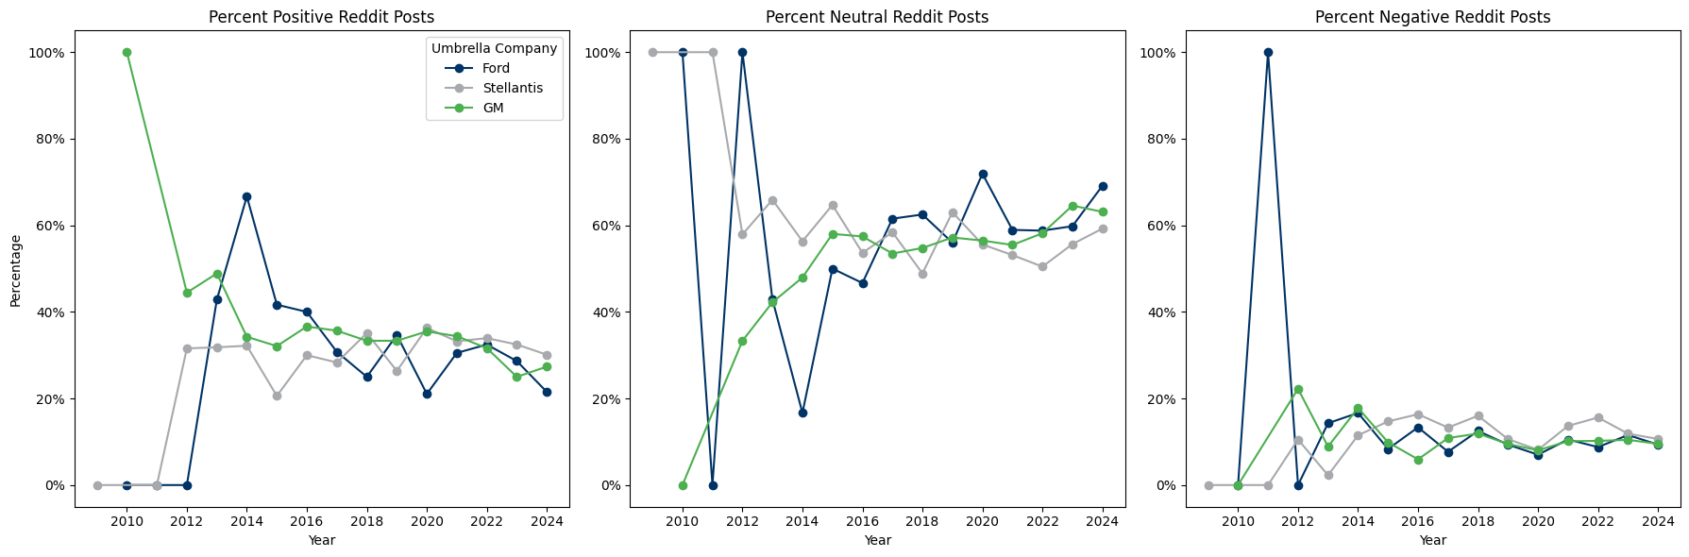
Comparing Competitor Posts Over Time
Ford has historically been discussed less than Stellantis and GM on Reddit, but recently surpassed both competitors in post volume.
This surge may reflect new marketing initiatives or increased customer interest.
Despite the increase in post counts, overall positive sentiment has declined slightly, neutral sentiment has spiked (up to ~70-80%), and negative sentiment remains below 20%.
Actionable Insight: Leverage Ford’s increased visibility on reddit to actively engage users and address growing neutral sentiment with targeted, trust-focused messaging.

Slide 7
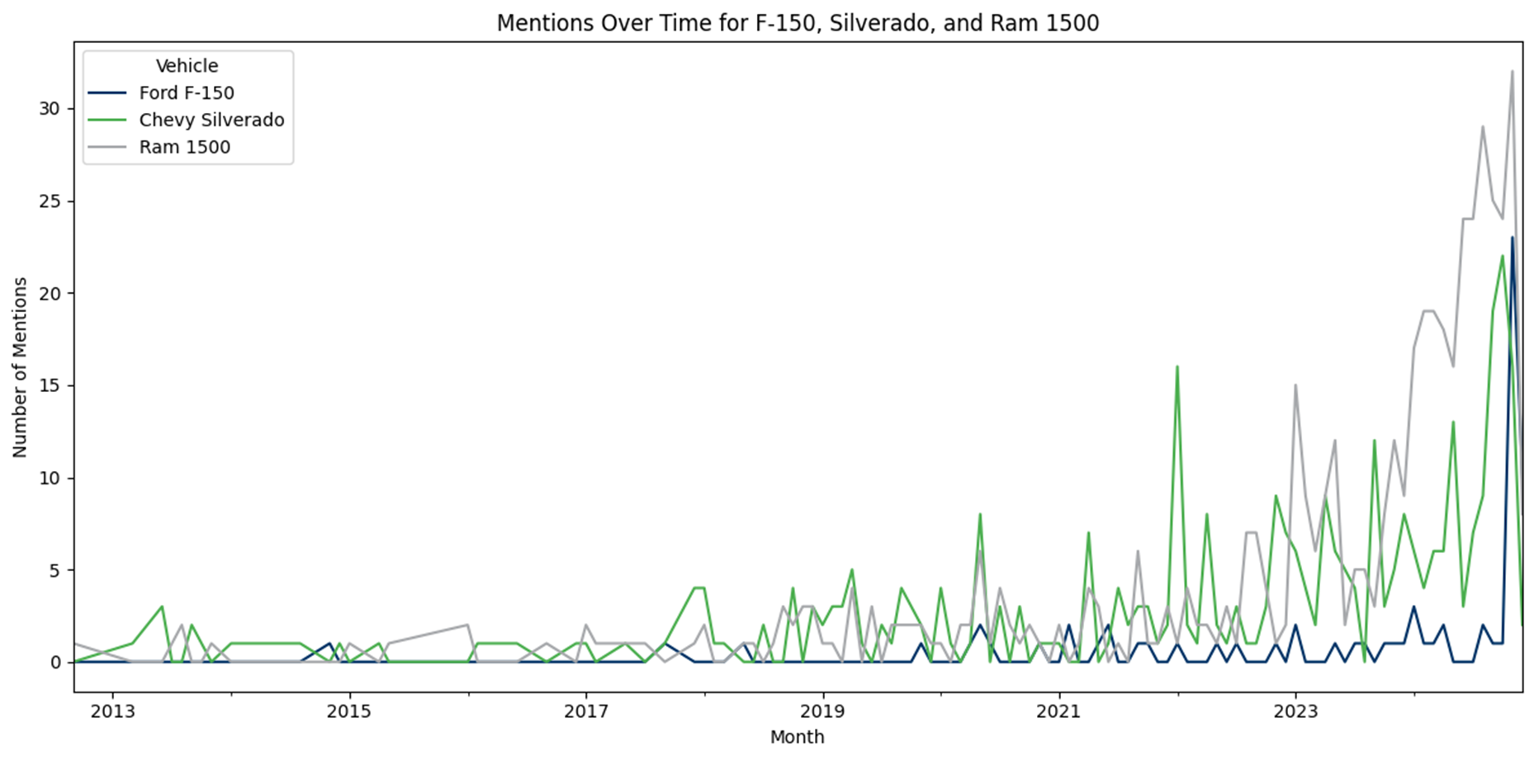
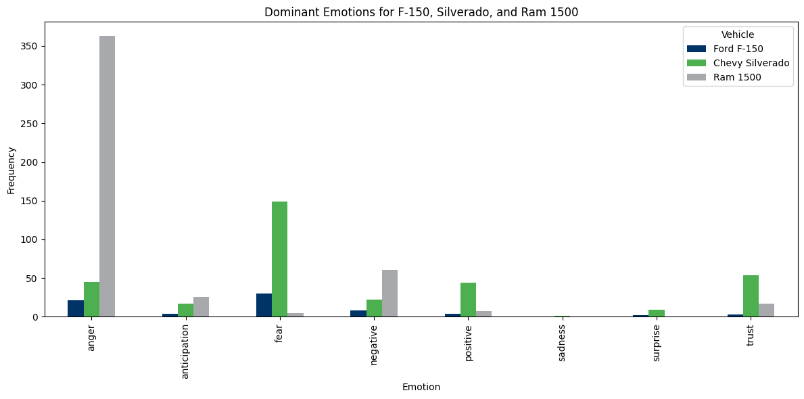
Product Sentiment: Opportunities for the F-150
F-150 shows higher fear-related sentiment compared to Silverado and Ram 1500, tied to concerns about reliability and safety.
Silverado leads in positive sentiment, indicating successful messaging Ford can learn from.
Ram 1500 exhibits higher negative sentiment, offering Ford an opportunity to capitalize on competitor weaknesses.
Actionable Insight: Address fear in F-150 marketing by emphasizing safety and reliability.

Slide 8
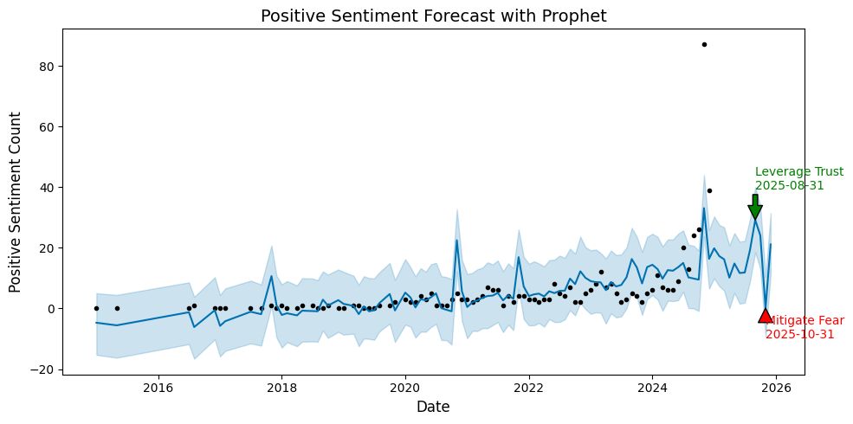
Predicting Sentiment Trends: Opportunities and Risks
Peak positive sentiment: 3rd quarter 2025. Leverage this period for trust-driven marketing campaigns.
Peak negative sentiment: 4th quarter 2025. Leverage marketing efforts in this period to mitigate fear-related narratives.

