Slide 1
Policy Evaluation I
(Performance Measures and Alternative control systems)
Lecture 6

Slide 2
Performance Measures-I
Performance measures should:
  relate directly to the management goals;
  be understandable to the decision makers; and
  change in a consistent way (so that “good” is easily discriminated from “bad”)
Notes:
Fisheries are more legalistic than other natural resource systems (at least in the U.S.)
Different ways to formulate these measures – want to keep things easily understood by all parties

Slide 3
Management Goals
We distinguish between high-level objectives (e.g. conserve the stock) and operational (quantitative) objectives (the probability of dropping below 0.1B₀ should not be greater than 0.1 over a 20-year period).
Many decision makers confuse the tactics (what to do next year) with the objectives (why are we doing what we are doing next year).
Notes:
High-level objectives are usually the realm of bigger bureaucrats/political people
Don’t expect decision makers to tell you what their real objectives are – ex: whaling commission

Slide 4
Objectives for Fisheries Management
(typical high-level objectives)
High level objectives arise from:
  National legislation (MMPA, Magnusson-Stevens Act, ESA).
  International Agreements (CCAMLR, IWC, UN Fish Stocks Agreement).
  Court decisions.
Notes:
NEPA – how the federal government expects decision making in natural resources to be documented
CCAMLR – commission for the conservation of Antarctic marine living resources

Slide 5
Objectives for Fisheries Management
(US National Standards-I)
Conservation and management measures shall:
  prevent overfishing while achieving, on a continuing basis, the optimum yield from each fishery for the United States fishing industry;
  be based on the best scientific information available;
  not discriminate between residents of different States; and
  where practicable, consider efficiency in the utilization of fishery resources (except that no such measure shall have economic allocation as its sole purpose).
To the extent practicable, an individual stock of fish shall be managed as a unit throughout its range, and interrelated stocks of fish shall be managed as a unit or in close coordination.
Notes:
Shall – strong legal word
Overfishing – has expanded into 2 concepts – overfishing and overfished

Slide 6
Objectives for Fisheries Management
(US National Standards-II)
Conservation and management measures shall:
  take into account and allow for variations among, and contingencies in, fisheries, fishery resources and catches;
  where practicable, minimize costs and avoid unnecessary duplication;
  consistent with the conservation requirements of this Act take into account the importance of fishery resources to fishing communities;
  to the extent practicable, (A) minimize bycatch and (B) to the extent bycatch cannot be avoided, minimize the mortality of such bycatch; and
  to the extent practicable, promote the safety of human life at sea.
Notes:
Northwest center – when west coast moved to catch shares, people were less likely to go out in bad weather

Slide 7
Objectives for Fisheries Management
(West Coast groundfish)
Prevent overfishing and rebuild overfished stocks by managing for appropriate harvest levels and prevent, to the extent practicable, any net loss of the habitat of living marine resources.
Maximize the value of the groundfish resource as a whole.
Achieve the maximum biological yield of the overall groundfish fishery, promote year-round availability of quality seafood to the consumer, and promote recreational fishing opportunities.
Notes:
PFMC ‘s guidelines (written later than MSA’s initial guidelines) can notice a change of thought

Slide 8
Goals for Fisheries Management
(Australian Fisheries Management Authority)
Implement efficient and cost-effective fisheries management on behalf of the Commonwealth;
Ensure that the exploitation of fisheries resources and the carrying on of any related activities are conducted in a manner consistent with the principles of ecologically sustainable development and the exercise of the precautionary principle;
Μaximise economic efficiency in the exploitation of fisheries resources;
Εnsure accountability to the fishing industry and to the Australian community; and
Achieve government targets in relation to the cost recovery.
Notes:
Need to think about these incentives when you do your work
A lot of the performance measures in Australia are long term economic profit
Australian people should not pay to support the fishing industry – anything the benefits the industry is paid for by the industry

Slide 9
Objectives for Fisheries Management
(Objectives for commercial whaling)
Acceptable risk level that a stock not be depleted (at a certain level of probability) below some chosen level (e.g. some fraction of its carrying capacity), so that the risk of extinction of the stock is not seriously increased by exploitation;
Making possible the highest continuing yield from the stock; and
Stability of catch limits.
The first objective was assigned highest priority, but was not fully quantified.
Notes:
Written more recently – Sidney Holt
Holt argued the best way to achieve this was set a 0 catch limit

Slide 10
Performance Measures-II
(Conservation-I)
Probability of:
  dropping below B_{MSY} (B_{MSY} is difficult to estimate and is hence often approximated using a proxy (such as 0.4B₀));
  dropping below 0.4B₀, 0.2B₀, B_{MEY}, the lowest biomass ever encountered to date;
  being declared overfished;
  recovering from overexploitation;
  the delay in recovering to a target level exceeding a threshold amount;
  severe impacts on the ecosystem; and
  extinction.
Notes:
the delay in recovering to a target level exceeding a threshold amount – rebuilding probability

Slide 11
Performance Measures-III
(Conservation-II)
Absolute measures:
  Amount of habitat included in reserves.
  Biomass available to predator species.
  The rate of increase in biomass.
  Change in the size-spectrum of the ecosystem.

Slide 12
Performance Measures-IV
(Economics)
Ideally, economic performance can be evaluated using a linked economics model.
Usually:
  average catch (discounted catch);
  profit;
  average annual variation in catch;
  probability of fishery collapse (the fishery cannot take the allocated catch); and
  probability that the catch (or profit) drops below a threshold level.
Notes:
Econ can be hard because people don’t like to report their costs/losses
Discounted catch – price today versus price in the future - fisheries is a variable industry, highly discounted (7 to 10%)
We focus a lot on how variable the catch will be – very important for industry
Probability of dropping below a threshold level is often easier to communicate than std dev

Slide 13
Performance Measures-V
(Other)
Cost of the management system.
Cost of the data collection scheme.
Frequency of the need for changes to management arrangements.
Notes:
In the U.S., takes 1-2 years to change a management plan
Often easier to give the functional form of the data, not parameters, so you don’t have to change them

Slide 14
Performance Measures-VI
When multiple simulations are conducted for each state of nature, it is necessary to specify clearly how probabilities are defined.
Avoid performance measures based on:
  Standard deviations and CVs
  Complicated performance measures (e.g. catch less S.d. of catch)
Notes:
Think about using a graph to describe performance measures

Slide 15
Potential Management Actions
It is often the objective for developing and fitting a model to address “what if” questions. What is the impact of:
  removal limits (quotas: individual / Olympic);
  time / area closures;
  gear restrictions (number of pots, traps, gillnets);
  bag limits;
  minimum / maximum sizes; and
  vessel numbers / size of vessels.

Slide 16
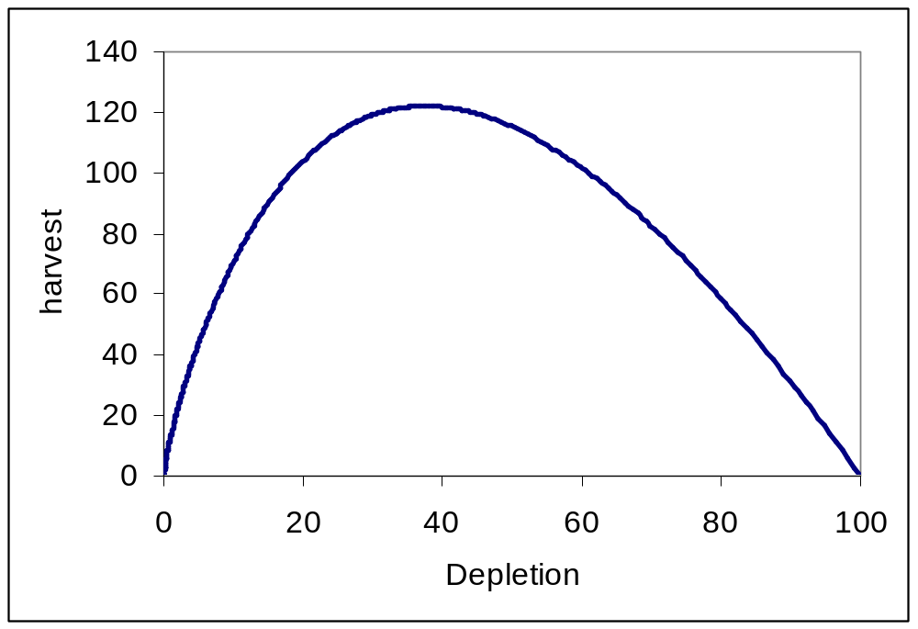
Application to Cape Hake-I
σ_{R}=0.6 (recruitment variability)
Steepness = 0.55
Current depletion = 0.35
MSY = 122 000 t
“Optimal” exploitation rate = 0.214

Slide 17
Application to Cape Hake-II
Objectives:
  Maximize catch (long-term)
  Keep the stock above 0.4 B₀. (roughly Bmsy)
Performance measures:
  Median (over simulations) of the average catch from 2003-2012.
  Lower 95th percentile (over simulations) of the average catch from 2003-2012. – basically guaranteed catch
  Probability that the spawning biomass in 2013 exceeds 0.4 B₀.
  Probability that the spawning biomass in 2013 is less than 0.1 B₀.
Notes:
Ideally last performance measure would be rewritten that prob is large

Slide 18




Constant Catches
TAC
100 | 100 | 100 | 0.60 | 0.03
122 | 122 | 70 | 0.26 | 0.36
130 | 130 | 45 | 0.18 | 0.55
150 | 69 | 20 | 0.02 | 0.90
Notes:
Cbar = median catch
Note: when we fish at Bmsy (TAC = 122), our Clow drops (due to recruitment probability)
TAC = 130 represents implementation uncertainty (can’t fish exactly at Bmsy)

Slide 19
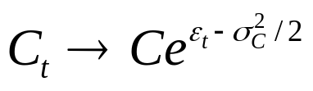
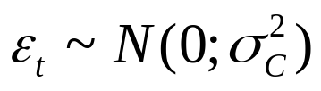

Introducing Implementation Uncertainty
Catches are implemented with uncertainty:
TAC
100 | 100 | 95 | 0.60 | 0.03
122 | 120 | 64 | 0.30 | 0.36
130 | 125 | 45 | 0.20 | 0.53
150 | 65 | 20 | 0.02 | 0.83
Notes:
Errors are always positive

Slide 20


Introducing Implementation Uncertainty
Catches are implemented with uncertainty:
TAC
100 | 105 | 103 | 0.51 | 0.06
122 | 126 | 51 | 0.22 | 0.50
130 | 107 | 35 | 0.14 | 0.62
150 | 43 | 16 | 0.01 | 0.92

Slide 21

Fixed Proportion Strategies
The quota is a fixed proportion of the current stock size:
F
0.15 | 107 | 77 | 0.72 | 0
0.2 | 116 | 82 | 0.40 | 0
0.214 | 117 | 83 | 0.30 | 0
0.25 | 118 | 82 | 0.11 | 0
Notes:
Generally we don’t set fixed quotas because of all of the uncertainty – more likely to set based on a proportion
Fixed proportion almost always beats at performance – called a dominating strategy
Usually you would get rid of non-dominating strategies (since it isn’t really a choice for most decision makers) and look at strategies with competing trade-offs, however need to remember how decision makers usually have other strategies in mind

Slide 22
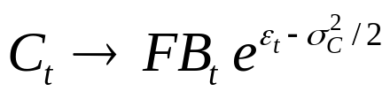
Introducing Implementation Uncertainty
Let us introduce error when estimating biomass:
F
0.15 | 106 | 77 | 0.72 | 0
0.2 | 116 | 82 | 0.36 | 0
0.214 | 117 | 82 | 0.28 | 0
0.25 | 117 | 81 | 0.12 | 0

Slide 23

Introducing Implementation Uncertainty
Let us introduce a minimum catch level:
F
0.15 | 106 | 100 | 0.56 | 0.03
0.2 | 116 | 100 | 0.34 | 0.05
0.214 | 117 | 100 | 0.27 | 0.06
0.25 | 118 | 95 | 0.10 | 0.14

Slide 24
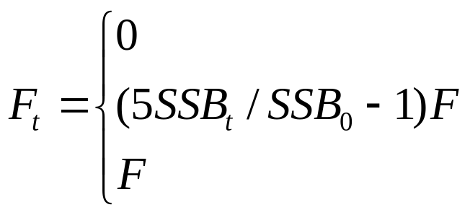
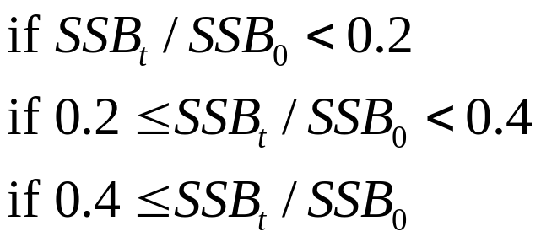

Hybrid Strategies
The quota is a fixed proportion of the current stock size,
except when the biomass is below 40% of B₀.
F
0.15 | 108 | 68 | 0.76 | 0
0.2 | 116 | 70 | 0.51 | 0
0.214 | 116 | 70 | 0.47 | 0
0.25 | 119 | 70 | 0.31 | 0
Notes:
Hybrid strategies are usually optimal – has become the default approach in the majority of US fisheries

Slide 25
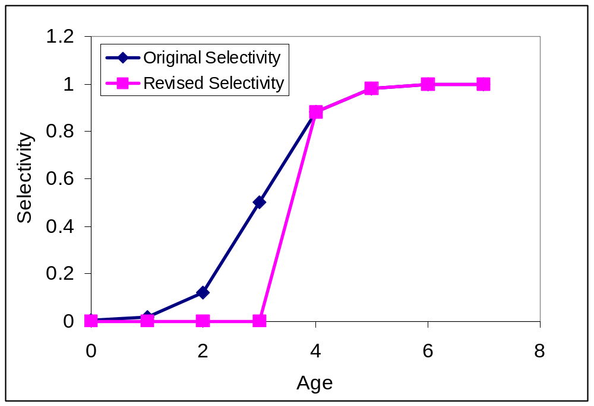
Minimum Sizes
Strategy:
reduce catch of small fish and
increase catch to 130,000t.
Notes:
Selectivity ogive – logistic equation

Slide 26
Minimum Sizes
Var
100 / O | 100 | 100 | 0.60 | 0.03
100 / N | 100 | 100 | 0.79 | 0.02
130 / O | 130 | 45 | 0.18 | 0.55
130 / N | 130 | 93 | 0.38 | 0.18
We can conclude from these projections that the current
selection pattern leads to growth overfishing.

Slide 27
Closed Areas-I
Closed Area; x%
Open Area; 1-x%
Spawn
Spawn
Density-
dependence
Recruitment
Recruitment
Notes:
The more complicated your system is, the more explicit you need to be about your assumptions

Slide 28
Closed Areas-II
We will assume:
  Spawning biomass is the sum of the spawning biomass by area.
  There is no density-dependent growth, mortality, etc.
  Recruitment is allocated to the open and closed areas in proportion to their areas.
  Density-dependence depends on the size of the (total) spawning biomass.
What other assumptions could we have made?

Slide 29
Closed Areas III
Let us try a range of closed areas: 0, 10, 20, 50%
and keep the quota at 130,000t.
%closed
0 | 130 | 45 | 0.18 | 0.55
10 | 99 | 47 | 0.15 | 0.60
20 | 77 | 46 | 0.08 | 0.30
50 | 65 | 44 | 0.43 | 0
Notes:
Small MPAs almost have no affect UNDER THESE ASSUMPTIONS
Would have to take decision makers through each of these to determine how much they weight each of the performance measures

Slide 30
Effort-based Management-I
We can manage by controlling effort (e.g. days at sea, trawl hours, etc.). The idea is that F=qE, so by setting E we can determine F. This approach does not require information on biomass.
However,
  The link between fishing effort and fishing mortality is often very weak.
  Ignore “effort creep” at your peril – fishers modify their behavior to maximize their returns. Even reducing the number of fishers is expected to increase the average fishing power of the fleet!
  Enforcement of fishing effort controls is almost as difficult as enforcement of catch limits!
Notes:
Input controls – vessels, effort, gear, etc.
Reasons to like input controls – don’t need good estimates of biomass/recruits etc.
Reasons not to like – people get more efficient over time (effort creep), you always lose the least efficient people when you input these restrictions

Slide 31
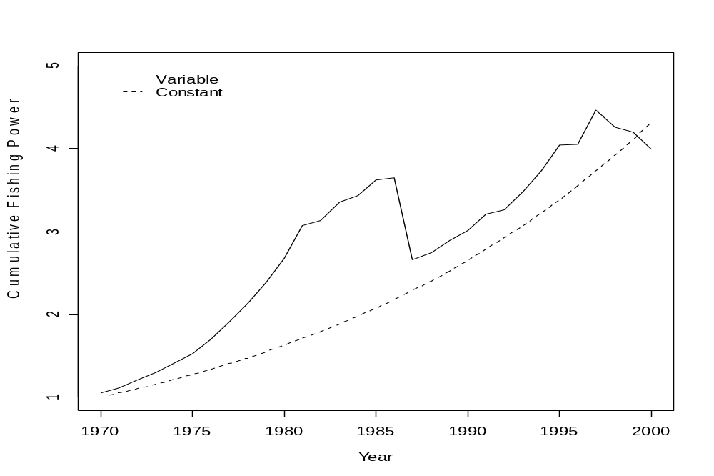
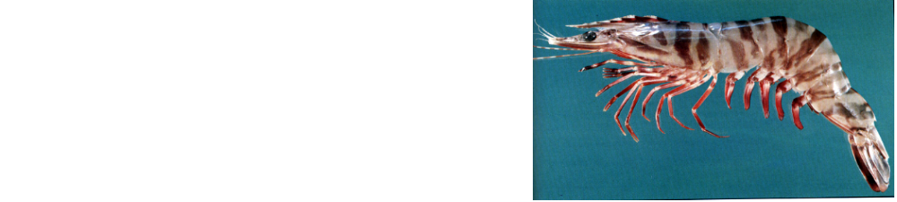
Fishing efficiency in Australia’s Northern prawn fishery!
1993 - the reference year
5% per annum

Slide 32
Effort-based Management -II
Let us fish at an exploitation rate of 0.2, but experience effort
creep of 0, 1%, 2% and 5% per year
Creep
0 | 116 | 82 | 0.40 | 0
1% | 122 | 87 | 0.22 | 0
2% | 128 | 90 | 0.06 | 0
5% | 135 | 93 | 0 | 0.30

