Slide 1

OBSERVABLES
Emily Tan
28th October 2020

Slide 2
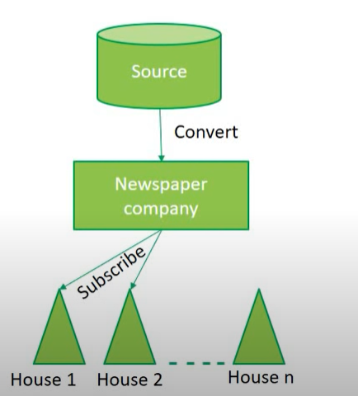
A sequence of items that arrive asynchronously over time.
Notes:
Newpaper company need convert the source information into something readable and appealing; into a specific format like header, body.
Hands newspaper to houses that only subscribes to the company.
After newspaper had been hand over to the house, it is up to the house what they want to do with the news.

Slide 3
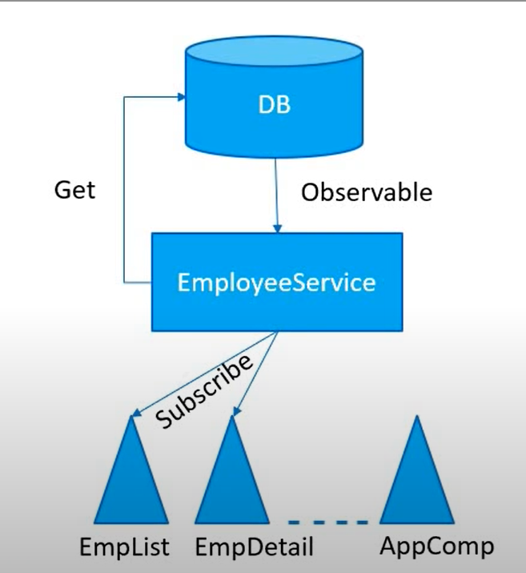
A sequence of items that arrive asynchronously over time.
Notes:
Employee Service makes a request to the DB using http get call.
As a response, we get back an Observable, which we then convert it into employee array, ready to be provided to the component.
We only provide the data to the component that have subscribed to the Employee Service.
Components then decide what they can do with the data.

Slide 4
Exercise

