Slide 1
Screenshots of PUPPET
BY SHANNON AND EMILY WANG

Slide 2
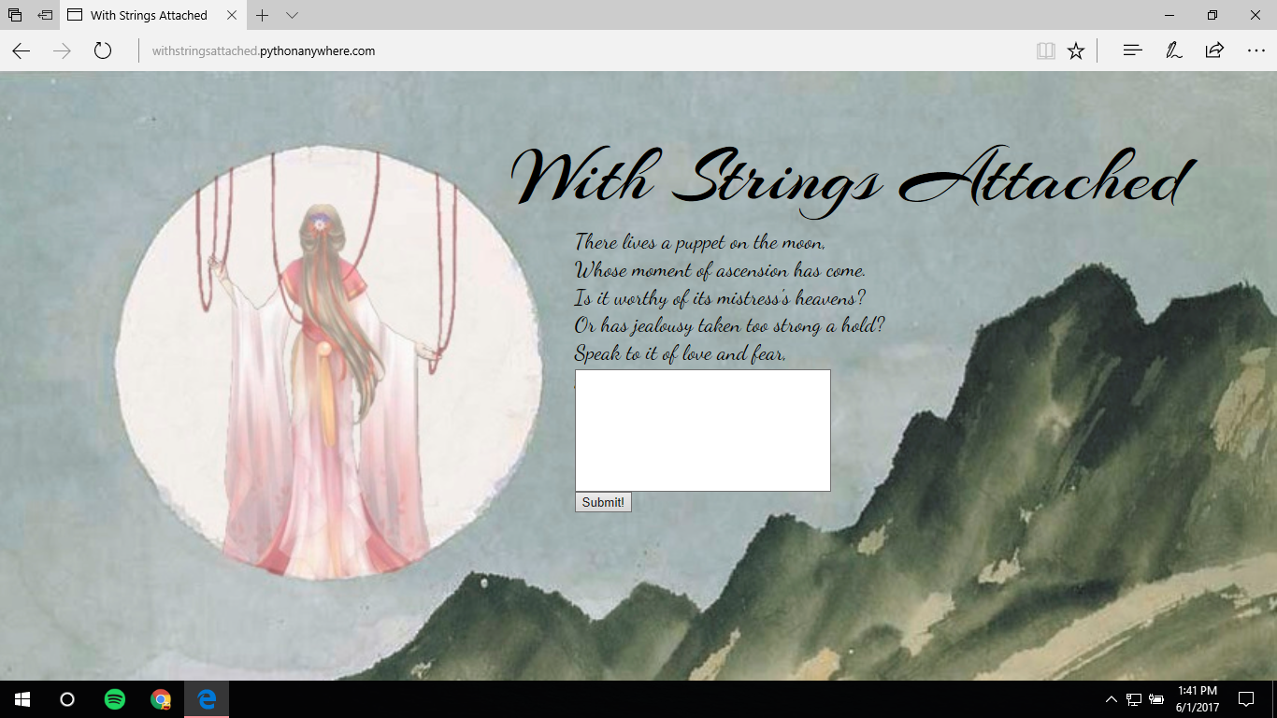
Homepage

Slide 3
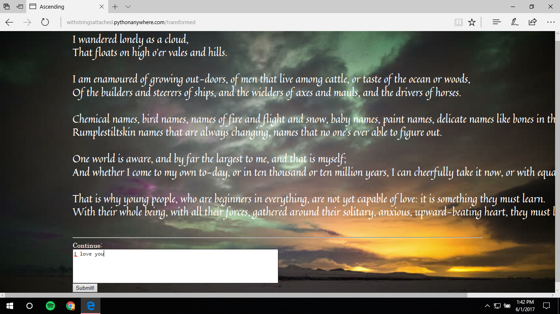
Positive Story

Slide 4
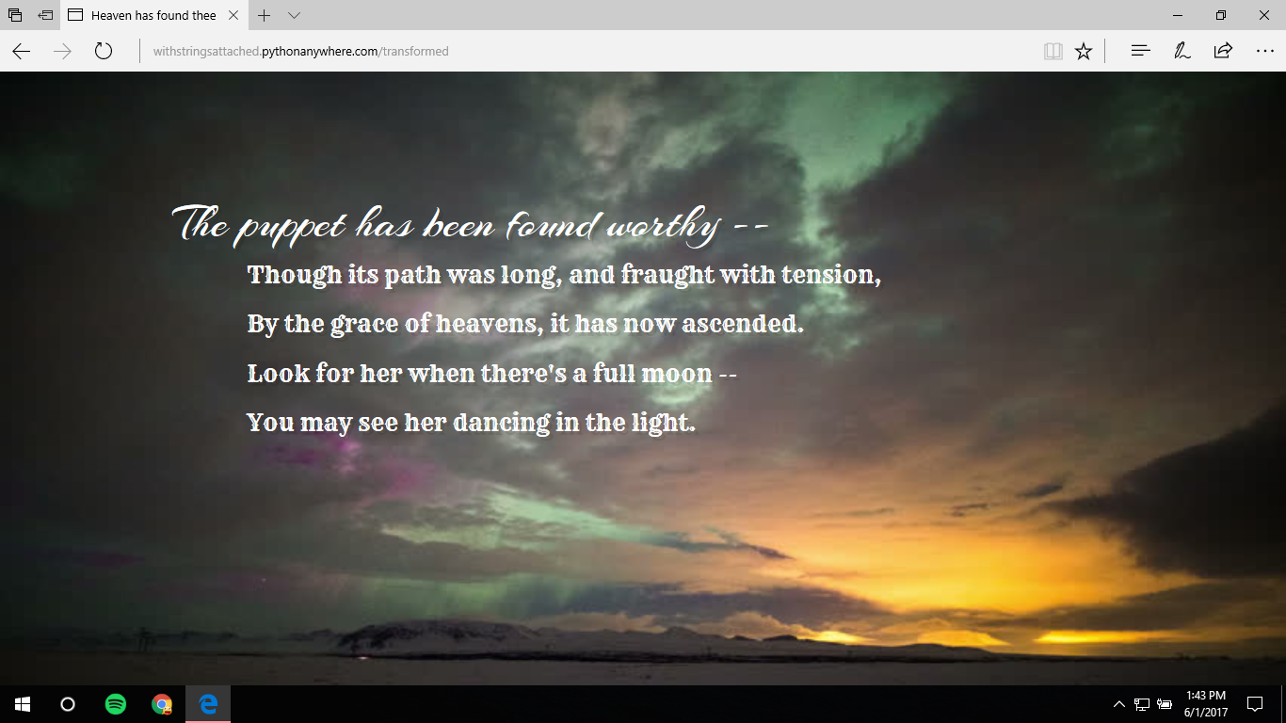
Positive Ending

Slide 5
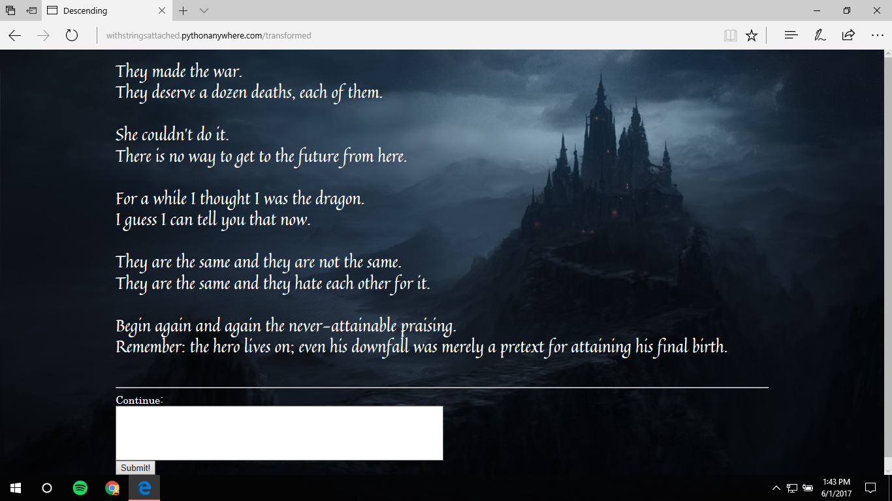
Negative Story

Slide 6
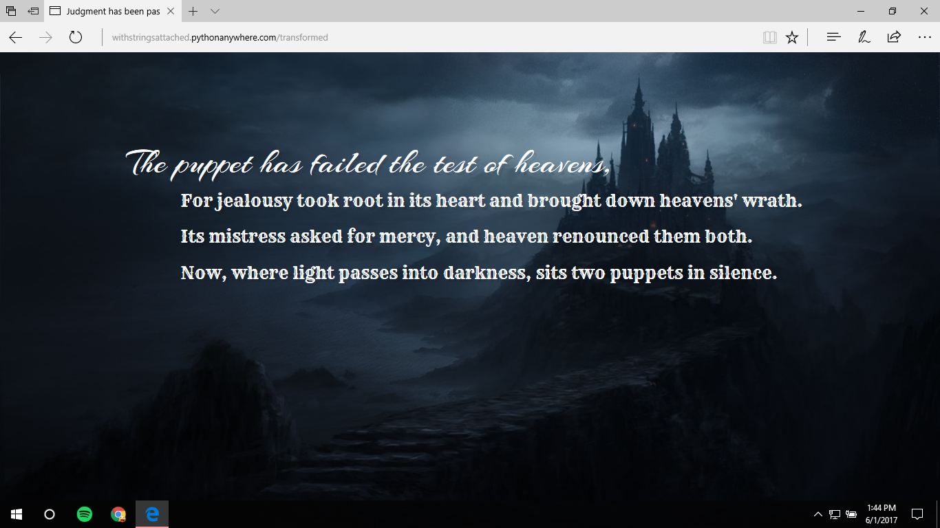
Negative Ending

