Slide 1
Impact of Player Metrics and Team Strategies on Match Wins
By Emily Val Tuliao

Slide 2
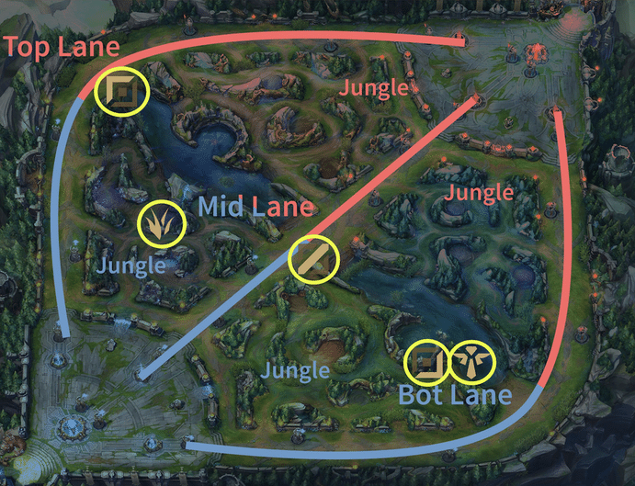
League of Legends
League of Legends is a popular multiplayer online battle arena (MOBA) game developed and published by Riot Games.
Two teams of five players each compete to destroy the enemy stronghold.
Five Roles: Support (Sup), Bottom Lane (Bot), Middle Lane (Mid), Top Lane (Top), Jungle (Jng)
Associated with where you are expected to play on the map

Slide 3
What are the specific player performance metrics and team strategies that significantly impact match outcomes in League of Legends, and how do these factors contribute to determining winning teams?
Research Question

Slide 4
Information on the Dataset
A collection of all competitive games played on League of Legends during 2020, data available from API Developer Riot.
Original: 5149 entries of matches with 408 columns
Cleaned: 10298 entries of teams with 213 columns
Fixed NA’s in data with equivalents or just removed the row if it couldn’t be fixed
Additions: player KDA ratio, total player CS, total structure objectives, total monster objectives
Split the data in half -> train_data & test_data
2020 League of Legends Competitive Games (kaggle.com)

Slide 5
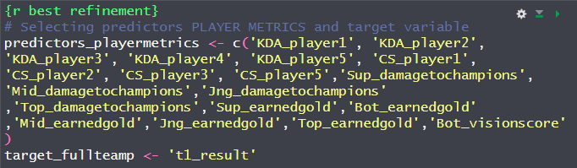
Player Metrics
KDA ratio(per player)
CS (per player)
Vision Score (per player)
Earned Gold (per player)
Damage to Enemy Champion (per player)

Slide 6
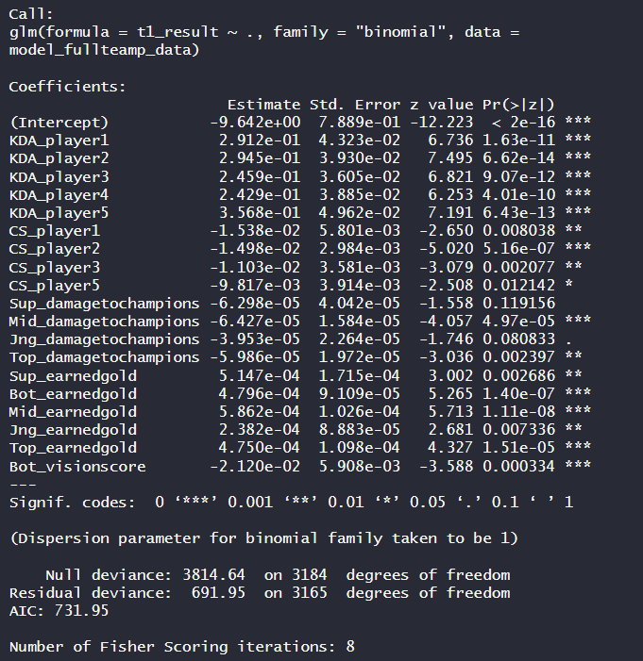
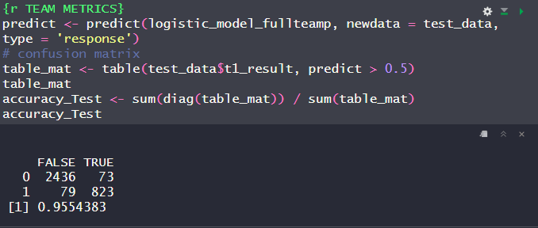
Player Metrics
Player 1 = Sup
Player 2 = Bot
Player 3 = Mid
Player 4 = Jng
Player 5 = Top
Good KDA for all players
CS for everyone except Jng
Negative coefficient
Damage only for Mid, Top, and Jng
Negative coefficient
Gold for all players

Slide 7
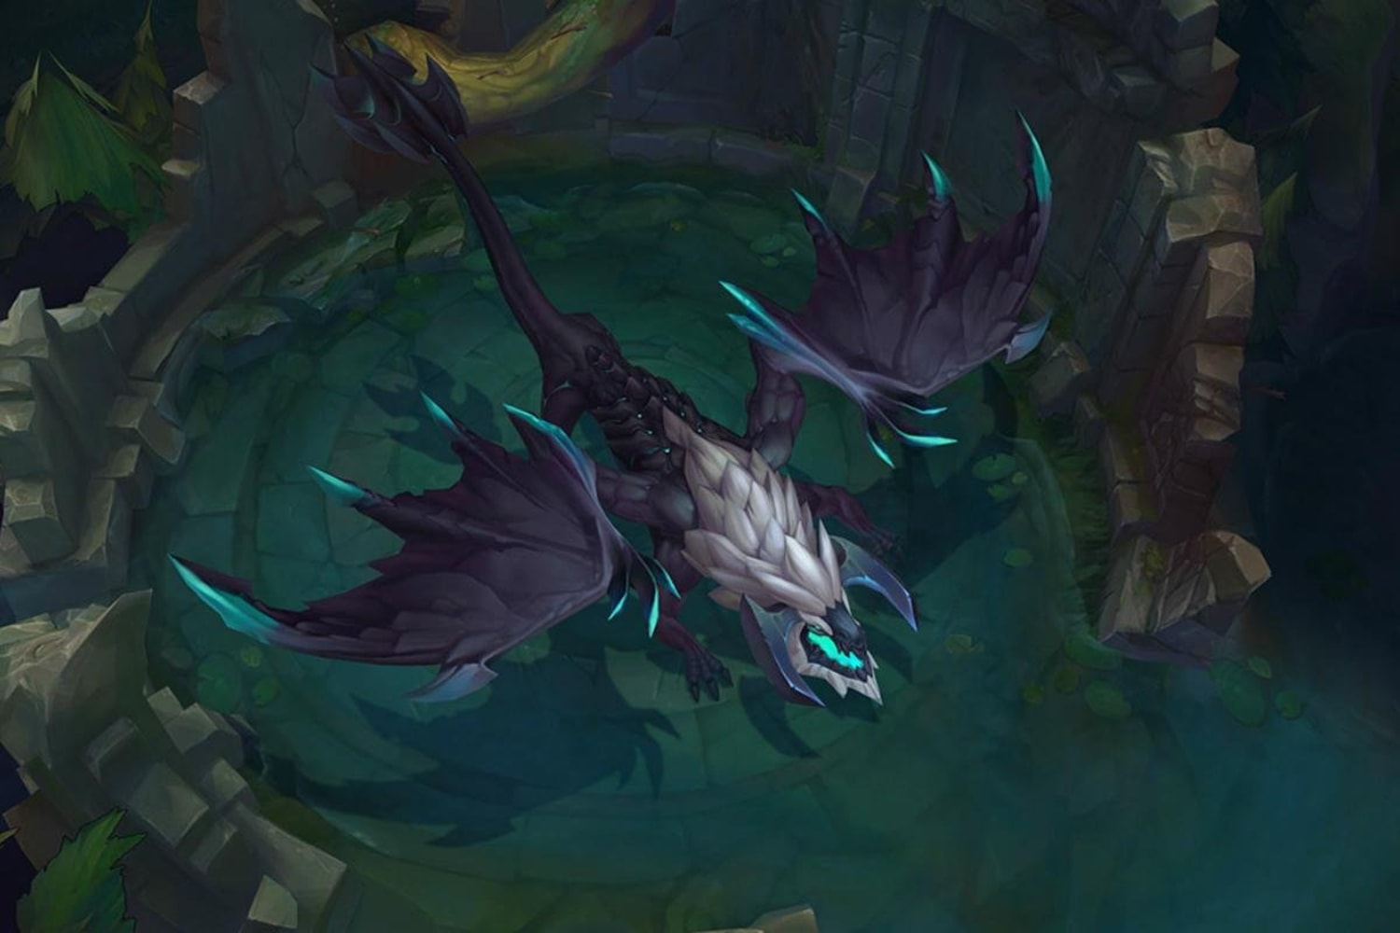
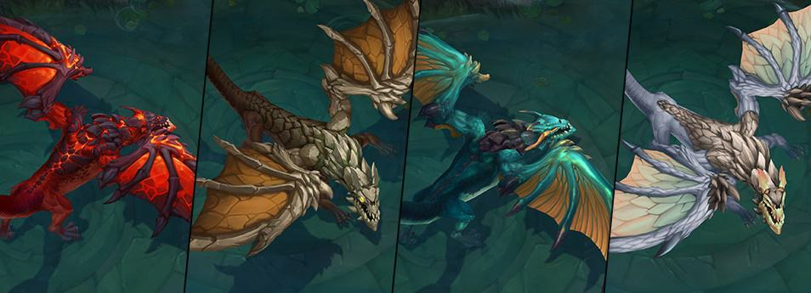
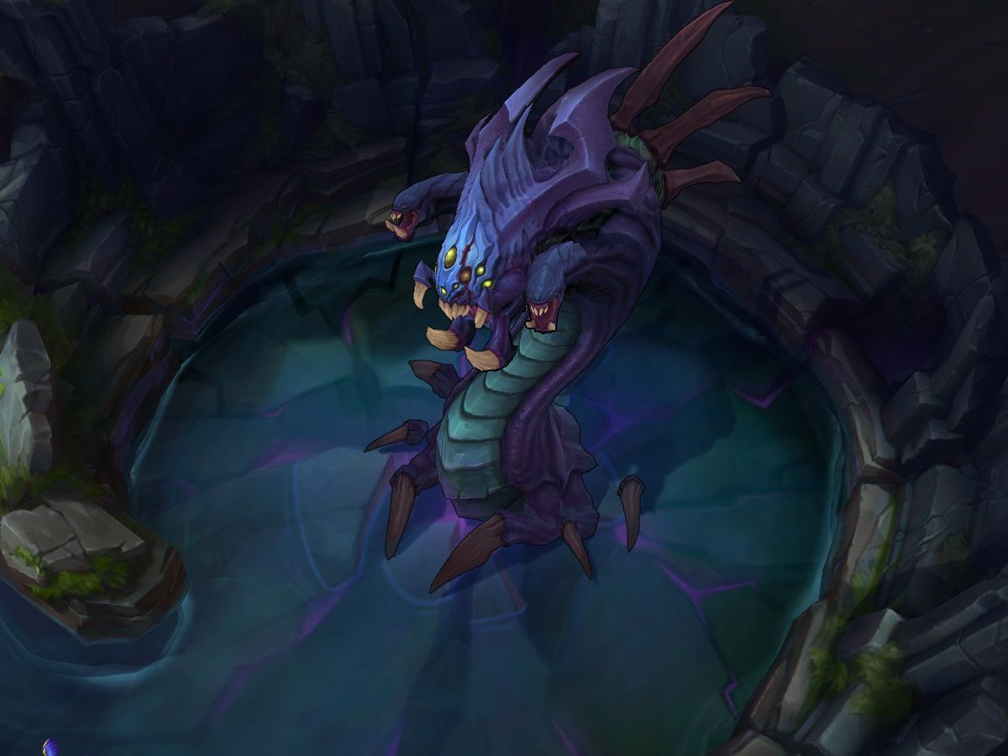
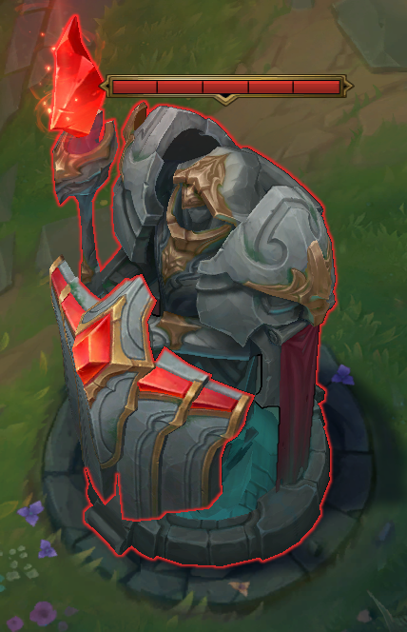
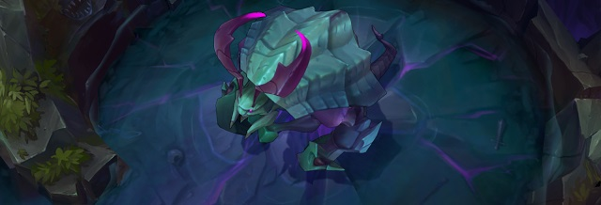
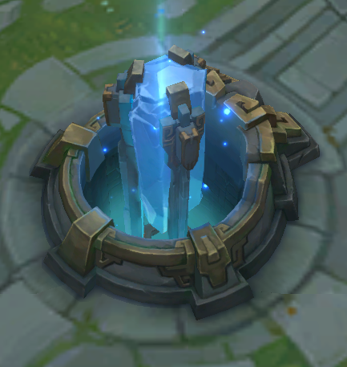
Strategy
Dragons
First dragon
Elemental Drakes
Infernals
Mountains
Clouds
Oceans
Elders
Structure Objectives
Monster Objectives
Structure Objectives
First tower
First Mid Tower
First to Three Towers
Towers
Inhibitors
Rift Monsters
First Herald
Heralds
First Baron
Barons

Slide 8
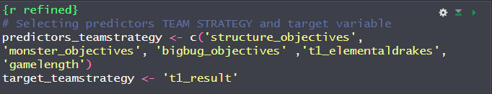
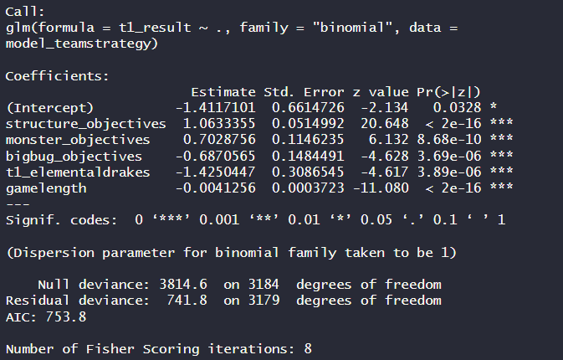

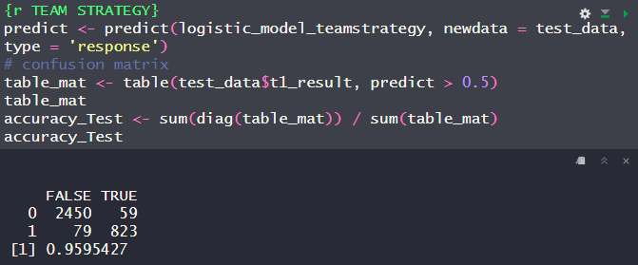
Strategy
Structure Objectives appear to be most important

Slide 9
Conclusions
Team Performance Metrics:
KDA (per player)
CS for everyone except Jng
Damage only for Mid, Top, and Jng
Team Objective Metrics
Structure Objectives appear to be most important
Monster Objectives
Rift Herald Objectives
Elemental Drakes
Game length

Slide 10
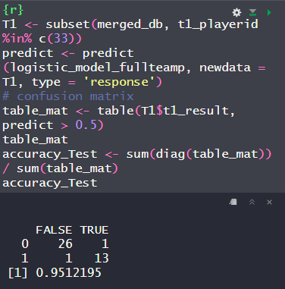
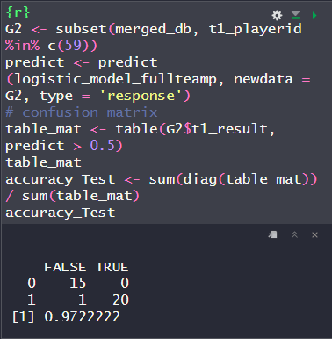
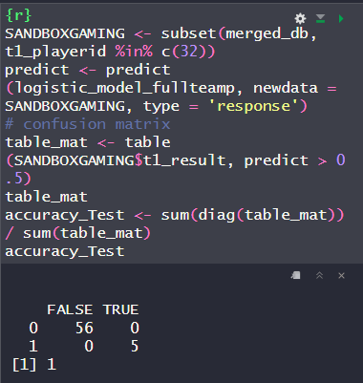



For Fun: Team Metrics

Slide 11
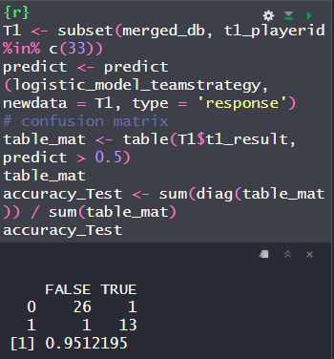
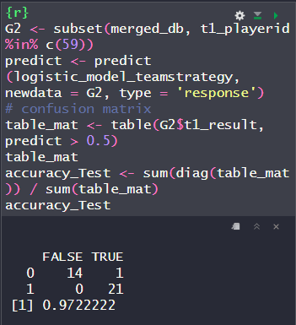
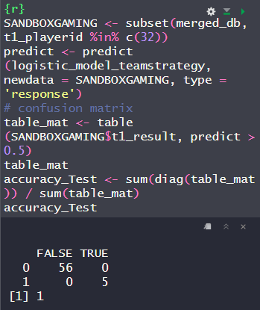
For Fun: Team Strategy

Slide 12
References
Fernando Rubén García. (2020). 2020 League of Legends Competitive Games. Kaggle. https://www.kaggle.com/datasets/fernandorubiogarcia/2020-league-of-legends-competitive-games
Riot Games. (n.d.). League of Legends. https://www.leagueoflegends.com/

