Slide 1



Before 2017
⛌ Size
⛌ Productive Capacity
Central Government
Local Government
Economic Growth
Land Regulation
Urbanization
Cropland Protection
“Red Line” Cropland Policy in China:
China’s total arable land shall be no less than 120 million hectares
Food security

Slide 2

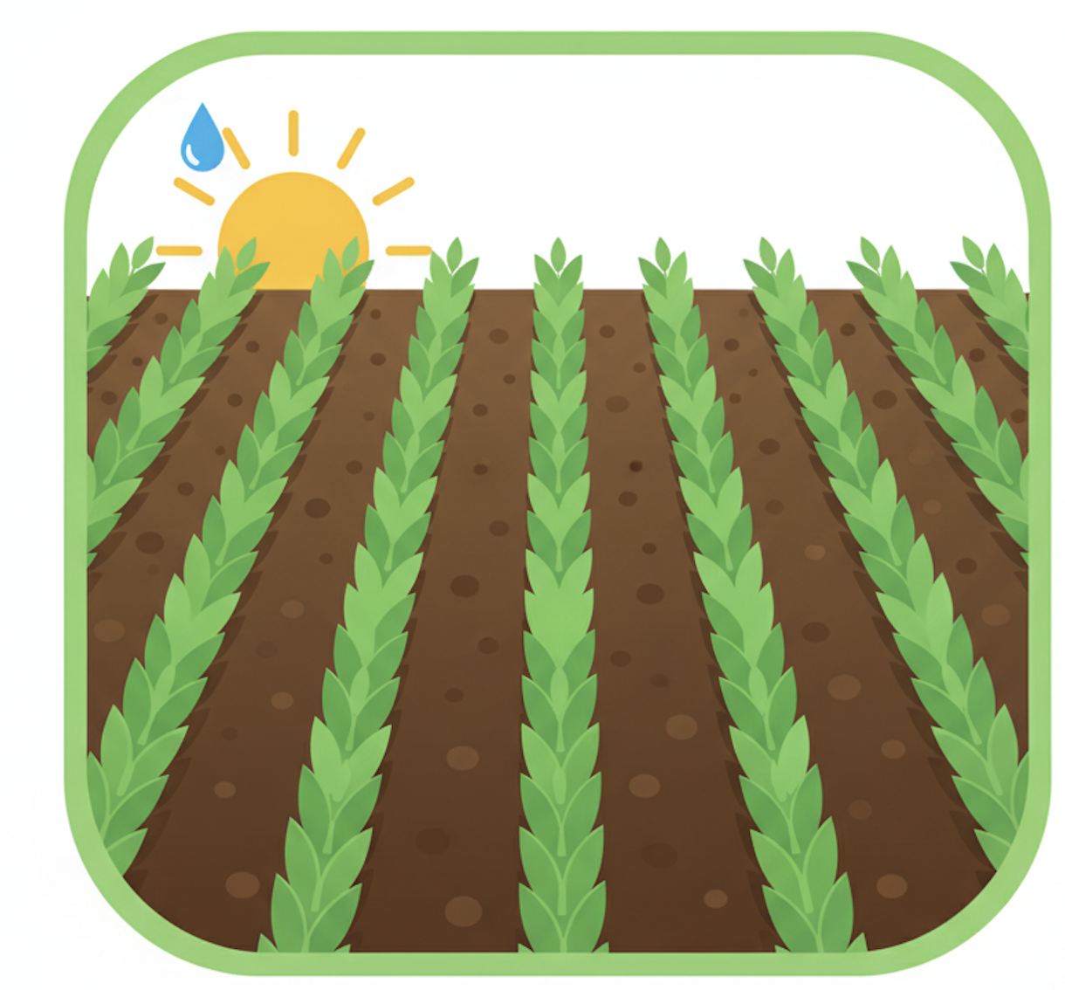
After 2017
✓ Size
⛌ Productive Capacity
Central Government
Local Government
Economic Growth
Land Regulation
Urbanization
Cropland Protection

Slide 3

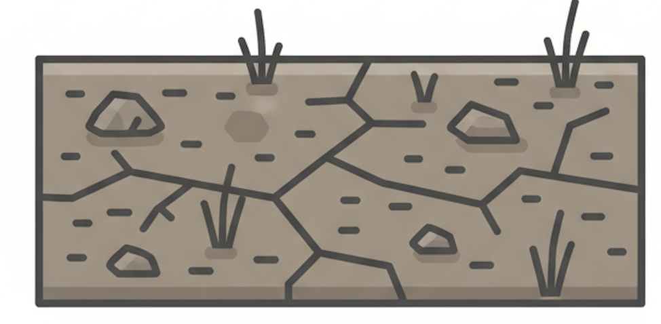
After 2017
✓ Size
⛌ Productive Capacity
Central Government
Local Government
Economic Growth
Land Regulation
Urbanization
Cropland Protection

