Slide 1
GMM & Disagreement Distance
CS 506

Slide 2
Soft Clustering/Gaussian Mixture Modeling (GMM)

Slide 3
Recall: Soft Clustering
Points are not hard-assigned to clusters!

Slide 4
Recall: Soft Clustering
Points are not hard-assigned to clusters!
Instead, points are assigned to each cluster with a probability
$ℙ\left(S_{j} | X_{i}\right)$ = probability of data point $i$ being assigned to cluster $j$

Slide 5
Recall: Soft Clustering
Points are not hard-assigned to clusters!
Instead, points are assigned to each cluster with a probability
$ℙ\left(S_{j} | X_{i}\right)$ = probability of data point $i$ being assigned to cluster $j$
E.g., a point halfway between two species might get probability 0.55 for one species and 0.45 for the other

Slide 6
Recall: Bayes’ Theorem
$$ℙ\left(S_{j} | X_{i}\right)=\frac{ℙ\left(X_{i} | S_{j}\right)ℙ\left(S_{j}\right)}{ℙ\left(X_{i}\right)}$$

Slide 7
Recall: Bayes’ Theorem
$$ℙ\left(S_{j} | X_{i}\right)=\frac{ℙ\left(X_{i} | S_{j}\right)ℙ\left(S_{j}\right)}{ℙ\left(X_{i}\right)}$$
Bayes’ theorem!

Slide 8
Recall: Bayes’ Theorem
$$ℙ\left(S_{j} | X_{i}\right)=\frac{ℙ\left(X_{i} | S_{j}\right)ℙ\left(S_{j}\right)}{ℙ\left(X_{i}\right)}$$
Likelihood $ℙ\left(X_{i} | S_{j}\right)$: probability of randomly sampling from cluster $j$ and drawing data point $i$

Slide 9
Recall: Bayes’ Theorem
$$ℙ\left(S_{j} | X_{i}\right)=\frac{ℙ\left(X_{i} | S_{j}\right)ℙ\left(S_{j}\right)}{ℙ\left(X_{i}\right)}$$
Likelihood $ℙ\left(X_{i} | S_{j}\right)$: probability of randomly sampling from cluster $j$ and drawing data point $i$
Prior $ℙ\left(S_{j}\right)$: probability of any data point being a member of cluster $j$

Slide 10
Recall: Bayes’ Theorem
$$ℙ\left(S_{j} | X_{i}\right)=\frac{ℙ\left(X_{i} | S_{j}\right)ℙ\left(S_{j}\right)}{ℙ\left(X_{i}\right)}$$
Likelihood $ℙ\left(X_{i} | S_{j}\right)$: probability of randomly sampling from cluster $j$ and drawing data point $i$
Prior $ℙ\left(S_{j}\right)$: probability of any data point being a member of cluster $j$
Evidence $ℙ\left(X_{i}\right)$: probability of drawing data point $i$

Slide 11
Recall: Bayes’ Theorem
$$ℙ\left(S_{j} | X_{i}\right)=\frac{ℙ\left(X_{i} | S_{j}\right)ℙ\left(S_{j}\right)}{ℙ\left(X_{i}\right)}$$
Requirement: the probabilities for a data point must sum to 1 over all clusters
$$\sum_{j=1}^{k}{ℙ\left(S_{j} | X_{i}\right)}=1$$

Slide 12
Mixture Model
$$ℙ\left(S_{j} | X_{i}\right)=\frac{ℙ\left(X_{i} | S_{j}\right)ℙ\left(S_{j}\right)}{ℙ\left(X_{i}\right)}$$
We say $X$ comes from a mixture model if
$$ℙ\left(X_{i}\right)=\sum_{j∈Ω}{ℙ\left(S_{j}\right)ℙ\left(X_{i} | S_{j}\right)},Ω=\{1, 2, …, k\}$$

Slide 13
Mixture Model
$$ℙ\left(S_{j} | X_{i}\right)=\frac{ℙ\left(X_{i} | S_{j}\right)ℙ\left(S_{j}\right)}{ℙ\left(X_{i}\right)}$$
We say $X$ comes from a mixture model if
$$ℙ\left(X_{i}\right)=\sum_{j∈Ω}{ℙ\left(S_{j}\right)ℙ\left(X_{i} | S_{j}\right)},Ω=\{1, 2, …, k\}$$
Law of total probability!

Slide 14
Gaussian Mixture Model
The data points in each cluster follow a normal distribution parameterized w.r.t. that cluster
$$N\left(x_{i} | μ_{j},σ_{j}^{2}\right)=\frac{1}{\sqrt{2πσ_{j}^{2}}}·exp\left(\frac{−{\left(x_{i}−μ_{j}\right)}^{2}}{2σ_{j}^{2}}\right)$$
$μ_{j}$ is the mean (center) of cluster $j$; $σ_{j}^{2}$ is its variance (spread)
$π_{j}$ = $ℙ\left(S_{j}\right)$ is the mixture weight of cluster $j$, and the weights sum to 1

Slide 15
Recall: MLE
Goal: find parameters that maximize the probability of having seen the data we got
Assume the data points were sampled independently
Then the probability of the whole dataset is the product of the probabilities of each data point
This product is called the likelihood

Slide 16
GMM Clustering
Goal: find the GMM clustering that maximizes the probability of seeing the data we have
$$L\left(θ\right)=\prod_{i=1}^{N}{ℙ\left(X_{i}\right)}=\prod_{i=1}^{N}{\sum_{j=1}^{k}{π_{j}N\left(x_{i} | μ_{j},σ_{j}^{2}\right)}}$$
Find the parameters $θ$ = ($π_{j}$, $μ_{j}$, $σ_{j}^{2}$) that maximize this likelihood!

Slide 17
GMM Clustering
Taking the log turns the product into a sum, which is easier to differentiate
$$logL\left(θ\right)=\sum_{i=1}^{N}{log\left(\sum_{j=1}^{k}{π_{j}N\left(x_{i} | μ_{j},σ_{j}^{2}\right)}\right)}$$
Problem: the log sits outside the inner sum, so the derivatives do not give a closed-form answer
We need an iterative method

Slide 18
Maximum Likelihood for GMM
How do we typically find the maximum of functions? Hmm…
Critical points!!! Derivatives
Setting the derivatives to 0 gives parameters that depend on the soft assignments $γ$
But the soft assignments depend on the parameters, so the equations are circular
Solution: alternate between the two (Expectation Maximization)

Slide 19
Expectation Maximization (EM)
We use this algorithm to iteratively estimate the parameters for our GMM
Initialize the means, variances, and weights (e.g., with K-means)
E-step: compute the soft assignment of every point to every cluster
M-step: update the parameters using those soft assignments
Repeat until the log-likelihood stops improving

Slide 20
E-step
Compute the soft assignments (responsibilities) with the current parameters
$$γ_{ij}=ℙ\left(S_{j} | X_{i}\right)=\frac{π_{j}N\left(x_{i} | μ_{j},σ_{j}^{2}\right)}{\sum_{l=1}^{k}{π_{l}N\left(x_{i} | μ_{l},σ_{l}^{2}\right)}}$$
This is Bayes’ theorem: prior × likelihood, divided by the evidence
Each point’s responsibilities sum to 1 across clusters

Slide 21
M-step: Updating Parameters
Let $N_{j}$ = $\sum_{i}{γ_{ij}}$ be the effective number of points in cluster $j$
$$π_{j}=\frac{N_{j}}{N}$$
$$μ_{j}=\frac{1}{N_{j}}\sum_{i}{γ_{ij}x_{i}}$$
$$σ_{j}^{2}=\frac{1}{N_{j}}\sum_{i}{γ_{ij}{\left(x_{i}−μ_{j}\right)}^{2}}$$

Slide 22
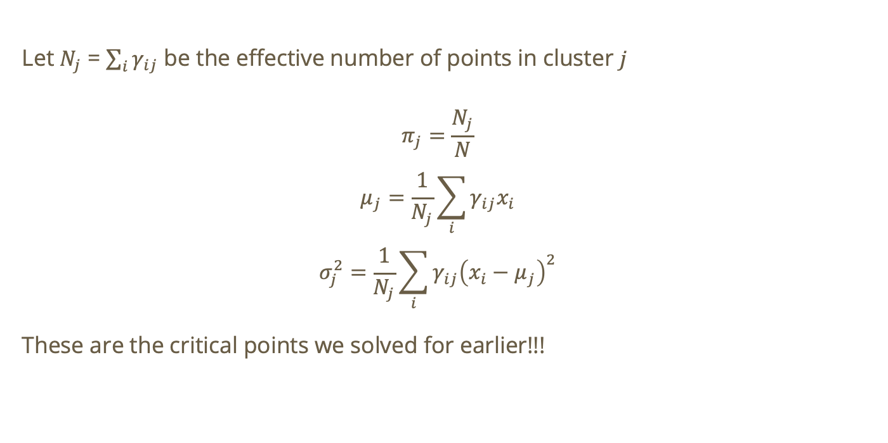
M-step: Updating Parameters
Let $N_{j}$ = $\sum_{i}{γ_{ij}}$ be the effective number of points in cluster $j$
$$π_{j}=\frac{N_{j}}{N}$$
$$μ_{j}=\frac{1}{N_{j}}\sum_{i}{γ_{ij}x_{i}}$$
$$σ_{j}^{2}=\frac{1}{N_{j}}\sum_{i}{γ_{ij}{\left(x_{i}−μ_{j}\right)}^{2}}$$
These are the critical points we solved for earlier!!!

Slide 23
Measuring Convergence
Track the log-likelihood after every M-step and stop when it barely changes
$$|logL\left(θ^{new}\right)−logL\left(θ^{old}\right)|<ε$$
EM never decreases the likelihood, so it converges
It converges to a local optimum, not necessarily the global one
So initialization matters: K-means is a common starting point, or restart EM several times

Slide 24
Do not edit
How to change the design
How many parameters does a GMM need to estimate for k clusters and 1D data?
The Slido app must be installed on every computer you’re presenting from

Slide 25
Solution
k means: $μ_{j}$
k variances: $σ_{j}^{2}$
k − 1 weights: the last weight is determined since the weights sum to 1
Total: 3k − 1
In d dimensions each variance becomes a covariance matrix with d(d+1)/2 parameters

Slide 26
Do not edit
How to change the design
Since outliers most likely don’t belong to any cluster, the probabilities of belonging to each cluster assigned by a GMM will all be small. True or false?
The Slido app must be installed on every computer you’re presenting from

Slide 27
Solution
False!
$ℙ\left(S_{j} | X_{i}\right)$ must sum to 1 over all clusters $j$
So they cannot all be small. Some cluster is always the most likely, even for an outlier

Slide 28
Do not edit
How to change the design
In a GMM, what is the likelihood of the data (with N data points) when k = N?
The Slido app must be installed on every computer you’re presenting from

Slide 29
Solution – qualitative approach!
If k = N, each cluster can sit exactly on one data point with variance 0
→ the normal density is unbounded at its mean
→ “infinite” density height at the mean
→ the likelihood is unbounded (infinite)

Slide 30
Disagreement Distance: Comparing Clusterings

Slide 31
Why compare clusterings?
We often have two clusterings of the same points: K-means vs. GMM, two random initializations, or a prediction vs. ground truth
How different are they?
Cluster names are arbitrary, so comparing labels point by point does not work
Instead, compare how each clustering treats pairs of points

Slide 32
Recall: pairs of points
For every pair of points, a clustering says one of two things
Together: both points are in the same cluster
Apart: the points are in different clusters
The two clusterings disagree on a pair if one says together and the other says apart

Slide 33
Disagreement Distance
Consider clusterings A and B of the same n points. Look at all $\frac{n\left(n−1\right)}{2}$ pairs:
a = pairs together in A and together in B
b = pairs together in A but apart in B
c = pairs apart in A but together in B
d = pairs apart in A and apart in B

Slide 34
Disagreement Distance
The disagreement distance counts the pairs on which A and B disagree
$$d\left(A,B\right)=b+c$$
Also called the Mirkin distance
Normalized: $d\left(A,B\right)/\frac{n\left(n−1\right)}{2}$ lies between 0 and 1

Slide 35
Example
A = {1, 2, 3}, {4, 5, 6} and B = {1, 2}, {3, 4}, {5, 6}. What is d(A, B)?
Clustering A
Clustering B
2
2
1
4
1
4
5
5
3
3
6
6

Slide 36
Solution
Together in A: 12, 13, 23, 45, 46, 56 (6 pairs)
Together in B: 12, 34, 56 (3 pairs)
Together in both: 12, 56 (so a = 2)
All pairs: $n$ = 6, so $6·5/2$ = 15

Slide 37
Solution (cont.)
b = together in A only = 6 − 2 = 4
c = together in B only = 3 − 2 = 1
$$d\left(A,B\right)=b+c=4 + 1 = 5$$
Normalized: 5 / 15 = 1/3

Slide 38
A Counting Shortcut
We can avoid listing pairs by using cluster sizes and overlaps $n_{kl}$ = |$A_{k}$ ∩ $B_{l}$|
$$d\left(A,B\right)=\frac{1}{2}\left[\sum_{k}{{\left(|A_{k}|\right)}^{2}}+\sum_{l}{{\left(|B_{l}|\right)}^{2}}−2\sum_{k,l}{{n_{kl}}^{2}}\right]$$
Example: $Σ|A_k|² = 9 + 9 = 18$, $Σ|B_l|² = 4 + 4 + 4 = 12$
Overlaps: 2, 1, 1, 2, so $Σ n² = 10$
d = ½(18 + 12 − 20) = 5

Slide 39
Properties
It is a metric: $d$ ≥ 0, equal to 0 only when the clusterings are identical, symmetric, and it satisfies the triangle inequality
It ignores cluster names and ordering
Range: 0 to the number of pairs
Relation to the Rand index (fraction of pairs on which A and B agree)
$$RI=\frac{a+d}{\frac{n\left(n−1\right)}{2}}=1−\frac{d\left(A,B\right)}{\frac{n\left(n−1\right)}{2}}$$

Slide 40
Disagreement Distance and GMM
GMM vs. K-means: take the most likely cluster for each point under the GMM, then compute d(GMM, K-means)
Stability: run EM from several initializations; small pairwise distances mean a stable clustering
Ground truth: compute d(prediction, truth); no label matching is needed

Slide 41
Do not edit
How to change the design
Consider A = {1, 2}, {3, 4} and B = {3, 4}, {1, 2}, which has the same clusters with their names swapped. What is d(A, B)?
The Slido app must be installed on every computer you’re presenting from

Slide 42
Solution
0
The pairs together and apart are identical in A and B
So b = c = 0: the distance ignores cluster names

Slide 43
Key Takeaways
A GMM is a mixture of Gaussians that gives soft assignments $ℙ\left(S_{j} | X_{i}\right)$ summing to 1
Fit it by maximizing the likelihood with EM: E-step (responsibilities), M-step (weights, means, variances)
EM converges to a local optimum, so initialization matters
Disagreement distance d(A, B) = b + c counts the pairs that two clusterings treat differently
It ignores cluster names and relates to the Rand index

