Slide 1
The Limits of Audio-Only Popularity Prediction
An AutoResearch Investigation of Spotify Track Popularity
Emily Yoo · AutoResearch Program · Weeks 2–6
~114,000
16
22.06 → 15.72
Spotify tracks
experiments over 5 weeks
RMSE baseline → final
Notes:
My project asked whether numeric audio features — things like energy, danceability, and tempo — can predict how popular a song becomes on Spotify. The short answer is: better than a linear model, but with a hard ceiling that no amount of modeling can break through. That ceiling is the real finding.

Slide 2
The AutoResearch Contract
Topic → how the research loop was structured
Research Question
The Keep / Discard / Crash Loop
Can Spotify track popularity be predicted
from numeric audio features alone?
13 numeric features:
danceability · energy · loudness · tempo
speechiness · acousticness · instrumentalness
liveness · valence · key · mode
time_signature · duration_ms
Target: popularity (0–100 integer)
Dataset: 114,000 tracks
Evaluation: validation RMSE
Random seed: 42 (frozen throughout)
Run experiment → measure validation RMSE
✓ Keep — RMSE improves → retain change
✗ Discard — RMSE worsens → revert
⚡ Crash — code fails → revert + log
Constraints:
• Frozen train/validation/test split (60/20/20)
• Fixed random_state = 42 throughout
• No external data, no neural architectures
• Test set untouched during all 16 experiments
• Evaluation logic in run.py is frozen
16 experiments · 5 active weeks · 0 crashes
Notes:
The AutoResearch loop had a simple rule: run an experiment, measure validation RMSE, keep it if it improves, discard it if it doesn't. The loop is fully reproducible — frozen train/validation split, fixed random seed, no external data. That discipline is what makes the 16 RMSE numbers comparable to each other.

Slide 3
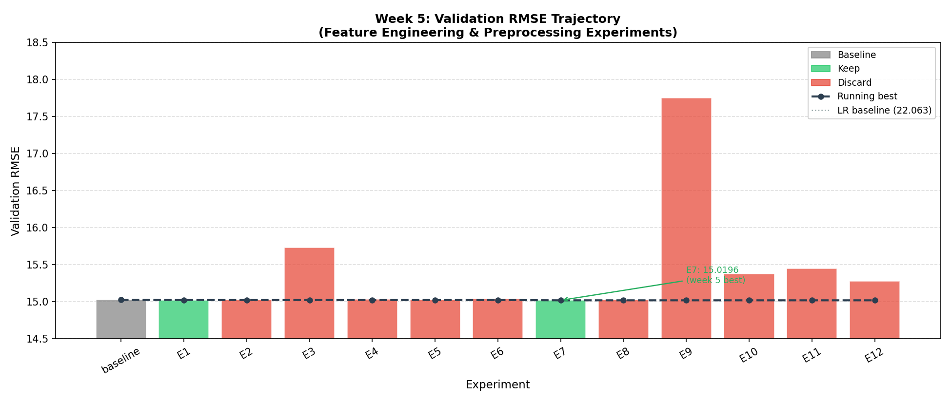
Directions Explored
What the loop tried across 16 experiments
Direction
Outcome
RF adoption
Major gain
Hyperparameter tuning
Diminishing
Feature engineering
Minimal gain
Alt. model families
Discarded
Popularity bucket
Key insight
Feature bucket
Key insight
Index artifact
Key insight
Notes:
The trajectory chart on the right shows this cleanly. There is one large step down — the switch to Random Forest — and then the curve flattens. Everything after that first drop produced combined improvement of 0.06 RMSE units across 12 experiments. The loop explored the right directions; it just ran out of signal to exploit.

Slide 4
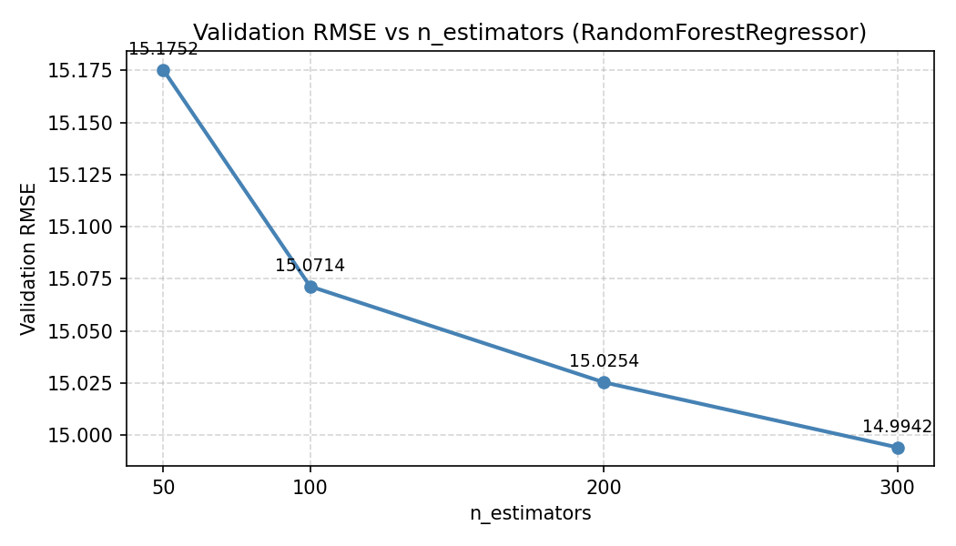
Stable Value
What produced real, reproducible improvement
31.9% RMSE reduction
One architectural decision
Linear Regression (baseline)
RMSE 22.06
Random Forest (final model)
RMSE 15.72
99% of total gain
from the model-family switch alone
0.06 RMSE units
from all 12 post-RF experiments combined
n_estimators 100→300
6× runtime for 0.5% additional gain
Notes:
The single most important decision in the entire project was switching from Linear Regression to Random Forest. That one change accounts for 99% of the total improvement. Everything else — transforms, hyperparameter tuning, alternative ensembles — moved the needle by a combined 0.06 units. If the loop had stopped after Week 2, the result would have been essentially the same.

Slide 5
Noise and Failure
10 of 16 experiments were discarded — and why that matters
Discarded (10 experiments)
What This Reveals
Interaction terms ×3
Combined effect of all discarded work:
0.00 RMSE improvement
Structural limitation of a pure RMSE loop:
• Loop executes checklist instead of updating
beliefs after first failure
• Three consecutive interaction experiments ran
even after the first failure made the reason
clear: RF already handles interactions
• No self-auditing → index artifact undetected
for 5 weeks (35.8% feature importance!)
Fix: differentiate evidence by replaceability
of hypothesis, not flat keep/discard rule
+0.004–+0.019
RF discovers interactions natively
HistGradientBoosting (×2)
+2.73 / +3.38
Worse than RF even when tuned
ExtraTreesRegressor
+0.43
Random splits < RF best-split
RF max_features / min_samples
+0.26–+0.36
Regularization not the bottleneck
Log transforms (bounded feats)
+0.003–+0.007
Bounded features — log adds noise
Feature dropping
+0.71
key, mode, time_sig still contribute
Notes:
Documenting failure is as important as documenting success. Three consecutive interaction-term experiments all failed for the same reason — RF already discovers interactions through splits — but the loop ran all three before moving on. That's a structural weakness: the loop executes its checklist rather than updating its beliefs after the first failure.

Slide 6
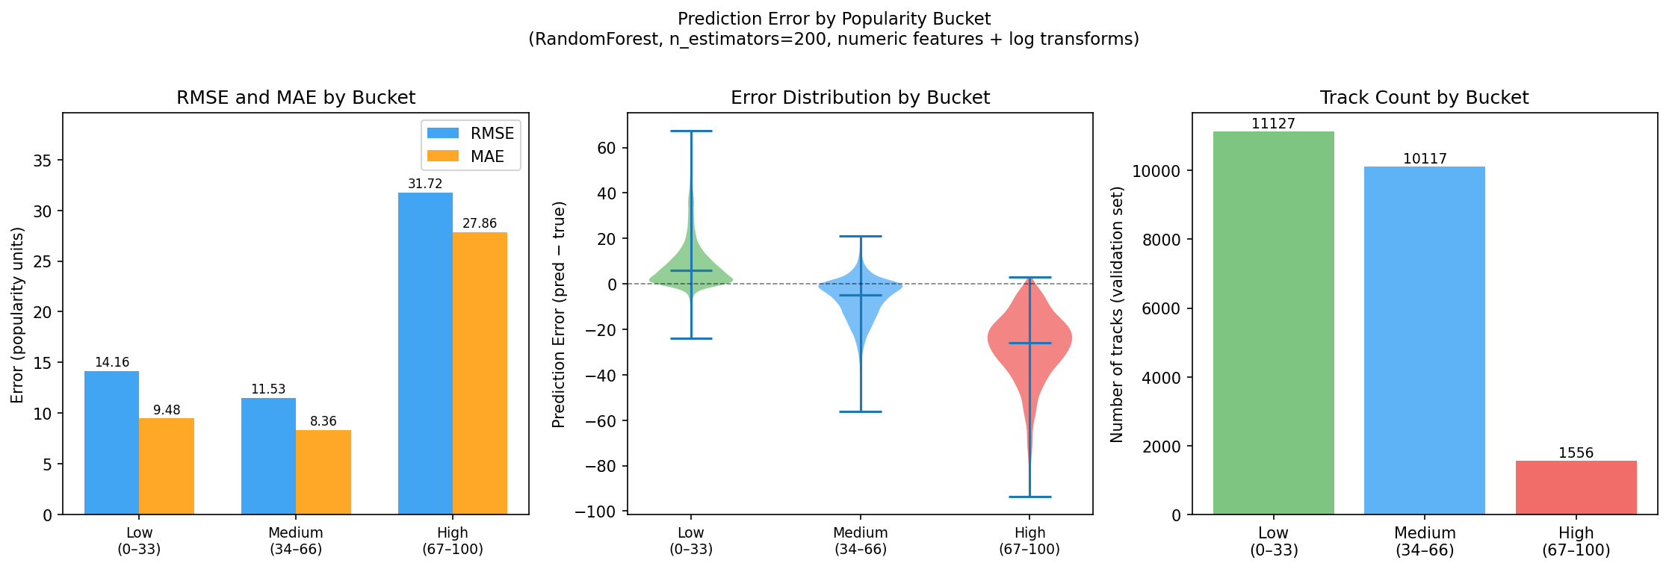
The Model Fails Where It Matters Most
Popularity bucket analysis — the central result
Low (0–33)
RMSE 15.22
Bias +10.67 · overpredicts
Medium (34–66)
RMSE 13.31
Bias −8.79 · near-balanced
High (67–100)
RMSE 28.48
Bias −23.26 · severe underpredict
2.1× higher RMSE on high-popularity tracks
Audio features identify what a song sounds like.
They cannot identify which good-sounding songs
become hits.
Missing signal:
artist reputation · playlist placement
label support · release timing
Notes:
This is the central result. The model performs reasonably on the average track but fails dramatically on breakout popular tracks. That's a 2.1× RMSE difference between the medium and high buckets. The high-popularity bucket is where all the interesting prediction happens — and that's exactly where the audio features run out of signal. The missing information is artist reputation, playlist placement, and release context. None of that is in the dataset.

Slide 7
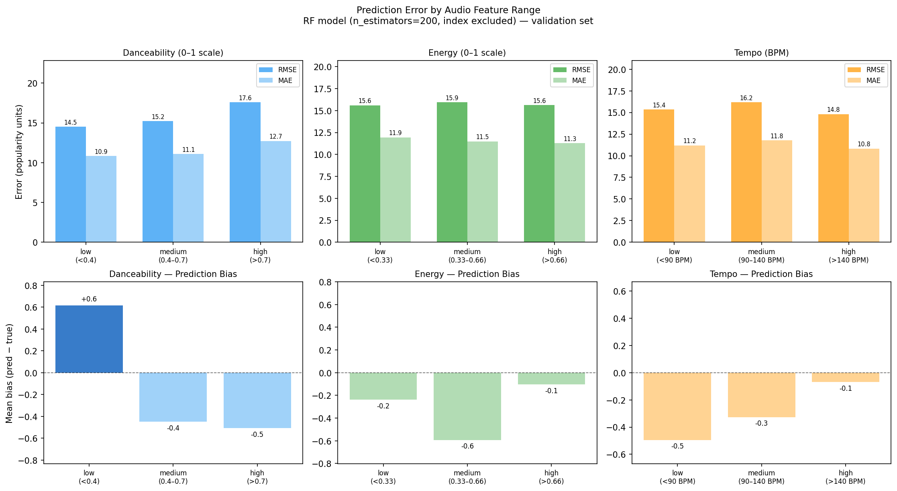
Limits of the Loop
Feature-bucket analysis: the failure is not in audio space
Error structure by slicing dimension:
Sliced by
RMSE span
Bias span
Popularity buckets
15.2 units
33.9 units
Danceability
3.1 units
1.1 units
Energy
0.3 units
0.4 units
Tempo
1.4 units
0.4 units
15-unit RMSE gap in popularity space.
3-unit gap in audio space.
The loop cannot fix what the data
does not contain.
Notes:
This analysis rules out the alternative explanation — that the model fails because it misreads certain audio profiles. Slicing by any audio feature produces at most 3 units of RMSE variation and near-zero bias. Slicing by popularity produces 15 units of RMSE variation and 34 units of bias swing. The failure is in the popularity dimension, not the audio dimension. No model change, transform, or hyperparameter could have addressed this. The loop hit the ceiling of its own data.

Slide 8
What the Loop Can and Cannot Do
Reflection · takeaways · future work
Loop Strengths
Loop Limits
Future Work
Zero crashes across 16 experiments
Index artifact undetected 5 weeks (35.8% importance — no self-audit)
Artist-level features (follower count, prior release history)
Correct rollbacks on every revert
Ran 3 identical interaction experiments instead of stopping after first fail
Playlist placement signals (editorial vs. algorithmic)
Identified diminishing returns accurately
Analysis started in Week 6 — should have been Week 3
Release context (label, timing, cultural moment)
Applied log transforms correctly (zero-inflated features only)
Flat keep/discard rule doesn't weight evidence by hypothesis replaceability
Social engagement signals
Reproducible RMSE comparisons
Feature audit checkpoint after first model fit
Improving prediction required understanding the limits of the data, not building more complex models.
Notes:
The loop is good at mechanical discipline and bad at knowing when to stop or what to look at. The index artifact — a CSV row number that acted as a genre proxy — was the highest-importance feature for five weeks because the loop had no self-auditing component. It was only caught when the interpretability analysis ran in Week 6. The fix is procedural: inspect feature importances after the first model fit, run a bucket analysis after Week 3, and build diminishing-returns checkpoints into the loop. The bigger lesson is that the most valuable output of this project was not the RMSE number — it was characterizing exactly why the number cannot get lower.

