Slide 1
Slide 1 / 8
Predicting Spotify Popularity with Audio Features
An AutoResearch Investigation of What Audio Can—and Cannot—Predict
Claim: Audio features reduce prediction error by 28.7%—but a hard ceiling remains because hit-making depends on factors no audio feature can capture.
~114,000
16
22.06 → 15.72
28.7%
Spotify tracks
experiments run
RMSE improvement
error reduction
Emily Yoo · AutoResearch Program · Weeks 2–6

Slide 2
Slide 2 / 8
Topic → AutoResearch Formulation
Research Question
"Can Spotify track popularity be predicted from numeric audio features, and what are the practical limits of audio-only prediction?"
THE TOPIC
THE AUTORESEARCH CONTRACT
Spotify exposes 13 numeric audio features per track:
danceability · energy · loudness · tempo · speechiness ·
acousticness · instrumentalness · liveness · valence ·
key · mode · time signature · duration
Target variable: popularity (0–100 integer)
The intuition: a song's sonic character should predict how popular it becomes.
The harder question: how well, and where does prediction break down?
Metric
Validation RMSE — one number, frozen split
Decision rule
KEEP if RMSE improves · DISCARD if it doesn't
Scope
Numeric audio features only, no external data
Reproducibility
Fixed random_state=42 across all 16 experiments
Accountability
Every experiment logged with decision + RMSE
The topic became a contract the moment the research question was operationalized as a reproducible keep/discard loop with a single measurable objective.

Slide 3
Slide 3 / 8
Data & Baseline
DATASET
BASELINE MODEL
~114,000
Spotify tracks
Linear Regression
13
numeric audio features
22.06
0–100
popularity target (integer)
Baseline RMSE (validation set)
60 / 20 / 20
train / val / test split
R² = 0.026:
near-zero — no meaningful linear signal
Ridge α=1.0:
identical RMSE — not an overfitting problem
random_state=42
frozen — all 16 RMSEs comparable
Evaluation metric:
RMSE used across all 16 experiments
Interpretation:
audio & popularity have no linear relationship
Features: danceability · energy · loudness · tempo · speechiness · acousticness · instrumentalness · liveness · valence · key · mode · time_signature · duration_ms
The baseline was frozen on Day 1. All 16 experiment RMSE values are directly comparable.

Slide 4
Slide 4 / 8
Loop Design
1
2
3
RUN EXPERIMENT
EVALUATE RMSE
KEEP / DISCARD
→
→
Modify model.py Run python3 run.py
Compare to current best
Retain if RMSE ↓ Revert if RMSE ↑
↩ repeat for next experiment
16
0
3
10
100%
experiments run
crashes
directions retained
directions discarded
reproducible evaluations
Fixed random_state=42 · frozen train/val/test split · no external data

Slide 5
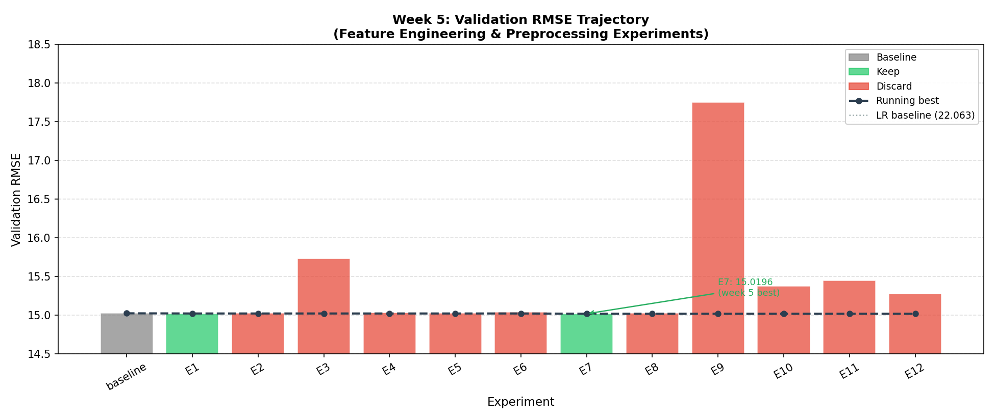
Slide 5 / 8
Experiment Trace: What Directions Did the Agent Explore?
Wk 2
Linear Regression (baseline)
RMSE 22.06 → start
Wk 2
Random Forest adoption
RMSE 15.07 ▼ 31.7%
Wk 3
HistGradientBoosting (default)
RMSE 18.45 ✗ discarded
Wk 4
n_estimators scaling (50→300)
RMSE 15.18→14.99 small gains
Wk 5
Log transforms (×5 experiments)
2 kept, 3 discarded
Wk 5
Interaction terms (×3 expts)
All 3 discarded ✗
Wk 5
ExtraTrees / HistGBR (tuned)
Both discarded ✗
Wk 6
Popularity bucket analysis
Key insight ★
Wk 6
Index artifact validation
Key insight ★
Wk 6
Feature-bucket error analysis
Key insight ★
One large early drop, then diminishing returns — the trajectory tells the story.

Slide 6
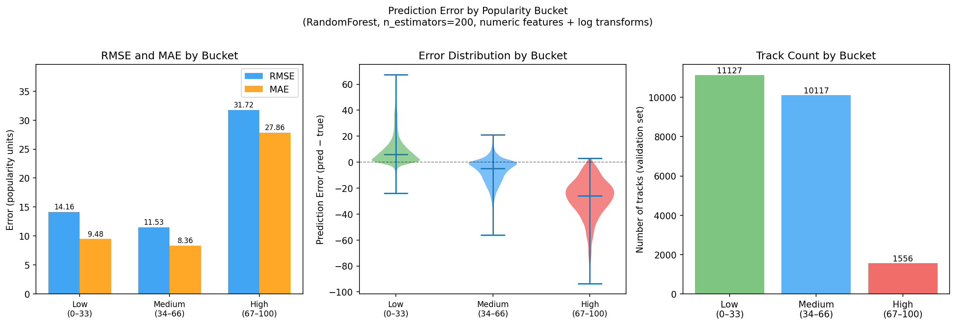
Slide 6 / 8
Final Result
22.06 → 15.72 | 28.7% reduction in prediction error
Popularity Bucket Analysis
Bucket
RMSE
Bias
Low (0–33)
15.22
+10.67
Overpredicts obscure tracks
Medium (34–66)
13.31
−8.79
Best performance
High (67–100)
28.48
−23.26
Severe underprediction
KEY FINDING
The model works on average tracks. It fails on breakout hits — a 2.1× RMSE gap between medium and high popularity. Missing signal: artist reputation, playlist placement, release context — absent from all 13 audio features.
Audio features describe what a song sounds like. They cannot identify which songs the world hears.

Slide 7
Slide 7 / 8
What Worked vs. What Failed
WHAT WORKED
WHAT FAILED
Random Forest adoption
HistGradientBoosting (default)
RMSE 22.06 → 15.07 · 31.7% gain · single biggest decision
RMSE 18.45 · sequential boosting underperforms RF here
n_estimators scaling to 200
Interaction terms (×3 experiments)
RMSE −0.04 · clearly identified diminishing returns
RF finds interactions natively · all 3 added collinear noise
log1p(duration_ms)
Log transforms on bounded features
RMSE −0.002 · right-skew compression improved split criterion
loudness, speechiness, acousticness · added noise, not structure
log1p(instrumentalness)
ExtraTreesRegressor
RMSE −0.004 · zero-inflated distribution benefited from log
RMSE 15.45 · random splits inferior to RF best-split search
Popularity bucket analysis
RF max_features / min_samples_leaf tuning
Revealed 2.1× RMSE gap · central finding of the project
RMSE 15.28–15.38 · regularization not the bottleneck
Index artifact detection
Tuned HistGBR (500 iterations)
Caught misleading feature at 35.8% importance · removed for honest results
RMSE 17.75 · even tuned, could not match RF
3 of 16 experiments produced stable value. 10 were discarded. Combined post-RF gain: 0.06 RMSE units.

Slide 8
Slide 8 / 8
Reflection
What the Loop Did Well
What Required Human Judgment
Limits of the Loop
Zero crashes
The scope lock
Index artifact undetected 5 weeks
16 experiments, zero failures. Every rollback correctly restored the prior baseline.
Deciding to stop modeling and start explaining required judgment about project framing.
No self-auditing step. A feature at 35.8% importance went unquestioned until Week 6.
Correct keep/discard logic
Index artifact evaluation
Redundant failed experiments
RMSE monotonically controlled. No regression went undetected.
Whether removing the artifact invalidated prior results required scientific judgment.
3 consecutive interaction-term failures. The loop executed its checklist instead of updating its beliefs.
Identified diminishing returns
Program constraints
Analysis started too late
6× runtime for 0.5% gain → correctly concluded the bottleneck was the feature set, not capacity.
Frozen seed, fixed split, no external data — these constraints are what make 16 RMSEs comparable.
Bucket analysis (Week 6) should have run after Week 3. Would have redirected wasted effort.
Correct log-transform criterion
Flat decision rule
Applied log1p only to zero-inflated features; left bounded features unchanged.
A third failed experiment should carry more weight than a first. The loop treats them equally.
Takeaway: Improving prediction accuracy required understanding the limits of the data — not building more complex models.

