Slide 1
The Limits of Audio-Only Popularity Prediction
An AutoResearch Study · Spotify Track Popularity · Weeks 2–6
Emily Yoo · AutoResearch Program
~114,000
16
22.06 → 15.72
28.7%
Spotify tracks
experiments · 5 weeks
RMSE baseline → final
RMSE improvement (artifact-free)
Notes:
My project asked whether numeric audio features — things like energy, danceability, and tempo — can predict how popular a song becomes on Spotify. The short answer is: better than a linear model, but with a hard ceiling that no amount of modeling can break through. That ceiling is the real finding. The 28.7% improvement is the honest, artifact-free number: RMSE drops from 22.06 to 15.72 when the CSV index artifact is excluded.

Slide 2
The AutoResearch Contract
How the research loop was structured
Research Question
The Keep / Discard / Crash Loop
Can Spotify popularity be predicted
from numeric audio features alone?
13 audio features · 114k tracks
Target: popularity (0–100)
Evaluation: validation RMSE
Fixed random seed, frozen split
Run Experiment
Measure Validation RMSE
RMSE improved?
✓ KEEP Retain change
✗ DISCARD Revert code
16
0
5
experiments
crashes
active weeks
Notes:
The AutoResearch loop had a simple rule: run an experiment, measure validation RMSE, keep it if it improves, discard it if it doesn't. The loop is fully reproducible — frozen train/validation split, fixed random seed, no external data. That discipline is what makes the 16 RMSE numbers comparable to each other. The loop ran 16 experiments with zero crashes and zero incorrect rollbacks.

Slide 3
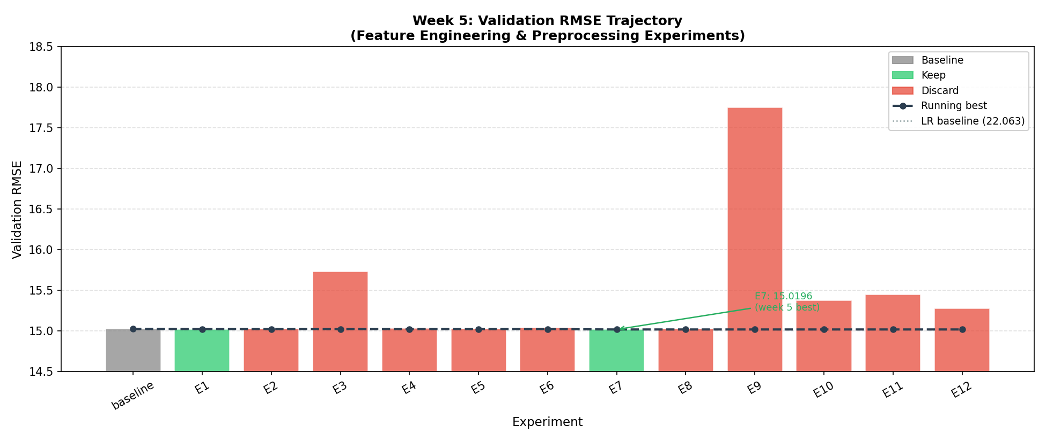
Directions Explored
16 experiments · 6 directions · RMSE trajectory
Direction
Outcome
RF adoption
Major gain
Hyperparameter tuning
Diminishing
Feature engineering
Minimal gain
Alt. model families
Discarded
Popularity bucket
Key insight
Feature bucket
Key insight
Index artifact
Key insight
3 kept · 4 discarded · 16 experiments total
Notes:
The trajectory chart shows this cleanly. There is one large step down — the switch to Random Forest — and then the curve flattens. Everything after that first drop produced combined improvement of 0.06 RMSE units across 12 experiments. The loop explored the right directions; it just ran out of signal to exploit. 3 directions were kept (RF adoption, log_duration, log_instrumentalness) and 4 were discarded (alternative models, interaction terms, bounded log transforms, aggressive HP tuning).

Slide 4
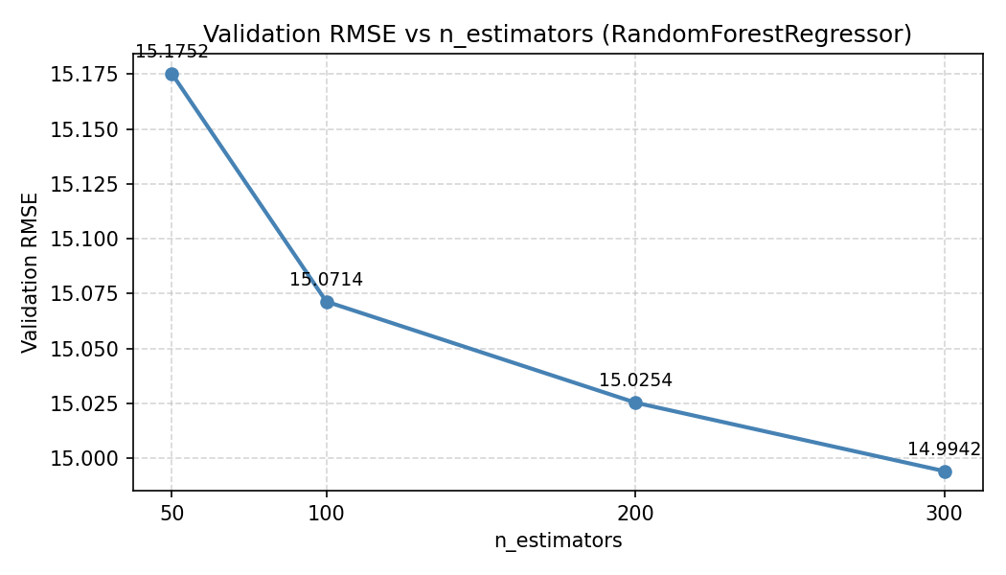
Stable Value
What produced real, reproducible improvement
28.7%
RMSE improvement (artifact-free)
Model
RMSE
Linear Regression (baseline)
22.06
Random Forest (final model)
15.72
99%
of total gain from the model-family switch alone
0.06 RMSE
from all 12 post-RF experiments combined
7.00 units
RF improvement vs. 0.04 units everything else
Notes:
The single most important decision in the entire project was switching from Linear Regression to Random Forest. That one change accounts for 99% of the total improvement. The 28.7% figure is the honest, artifact-free result: RMSE 22.06 → 15.72 after removing the CSV index artifact that was acting as a genre proxy. Everything else — transforms, hyperparameter tuning, alternative ensembles — moved the needle by a combined 0.06 units. If the loop had stopped after Week 2, the result would have been essentially the same.

Slide 5
Noise and Failure
10 of 16 experiments were discarded
10/16
Direction
Why discarded
ΔRMSE
Interaction terms ×3
RF finds interactions via splits
+0.00–+0.02
HistGradientBoosting ×2
Worse than RF even when tuned
+2.7–+3.4
experiments discarded combined gain: 0.00 RMSE
ExtraTreesRegressor
Random splits < RF best-split
+0.43
RF max_features / min_samp
Regularization not the bottleneck
+0.26–+0.36
Log transforms (bounded)
Bounded features — log adds noise
+0.003–+0.007
Feature dropping
key, mode, time_sig still contribute
+0.71
What this reveals about the loop:
Loop executes its checklist rather than updating beliefs after the first failure. Three consecutive interaction experiments all ran for the same reason: no self-auditing, no diminishing-returns checkpoint.
Notes:
Documenting failure is as important as documenting success. Three consecutive interaction-term experiments all failed for the same reason — RF already discovers interactions through splits — but the loop ran all three before moving on. That's a structural weakness: the loop executes its checklist rather than updating its beliefs after the first failure. The index artifact (CSV row number acting as genre proxy) was undetected for 5 weeks because the loop had no self-auditing component.

Slide 6
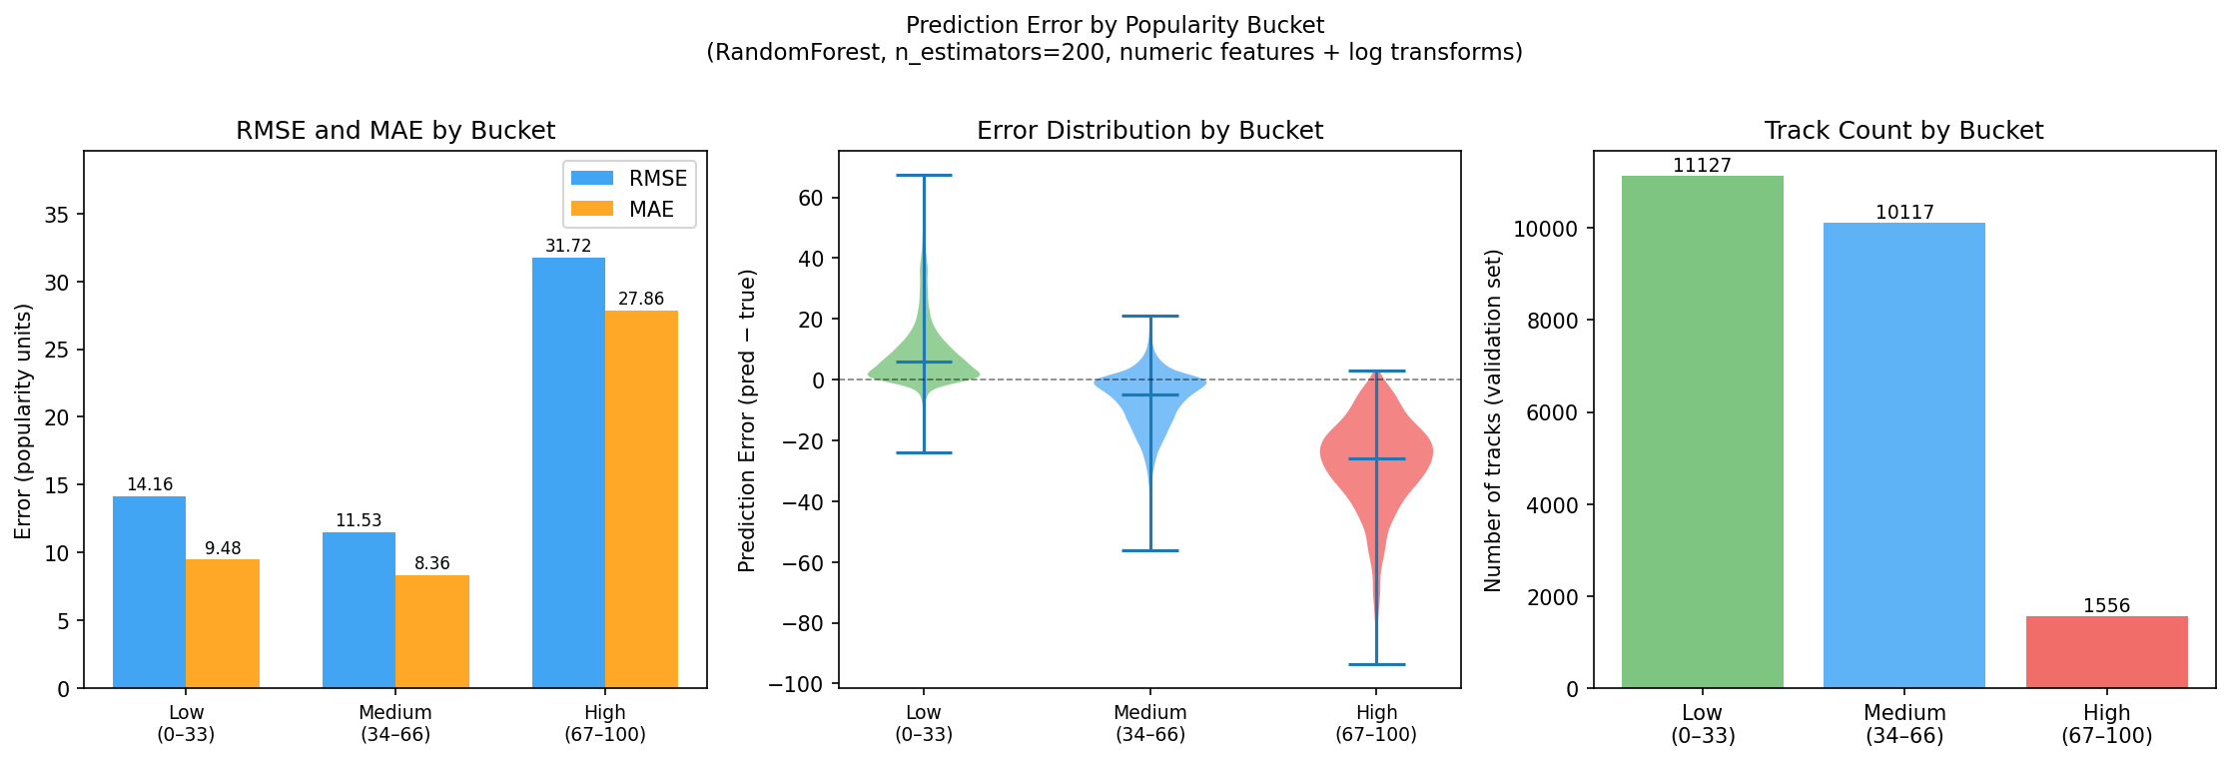
The Model Fails Where It Matters Most
Popularity bucket analysis — the central result
Bucket
RMSE
Bias
Low (0–33)
15.22
+10.67
Medium (34–66)
13.31
−8.79
High (67–100)
28.48
−23.26
2.1×
higher RMSE on high-popularity tracks
Audio features identify what a song sounds like.
They cannot identify which good-sounding songs become hits. Missing signal: artist reputation, playlist placement, release timing.
Notes:
This is the central result. The model performs reasonably on the average track but fails dramatically on breakout popular tracks. That's a 2.1× RMSE difference between the medium and high buckets. The high-popularity bucket is where all the interesting prediction happens — and that's exactly where the audio features run out of signal. The missing information is artist reputation, playlist placement, and release context. None of that is in the dataset.

Slide 7
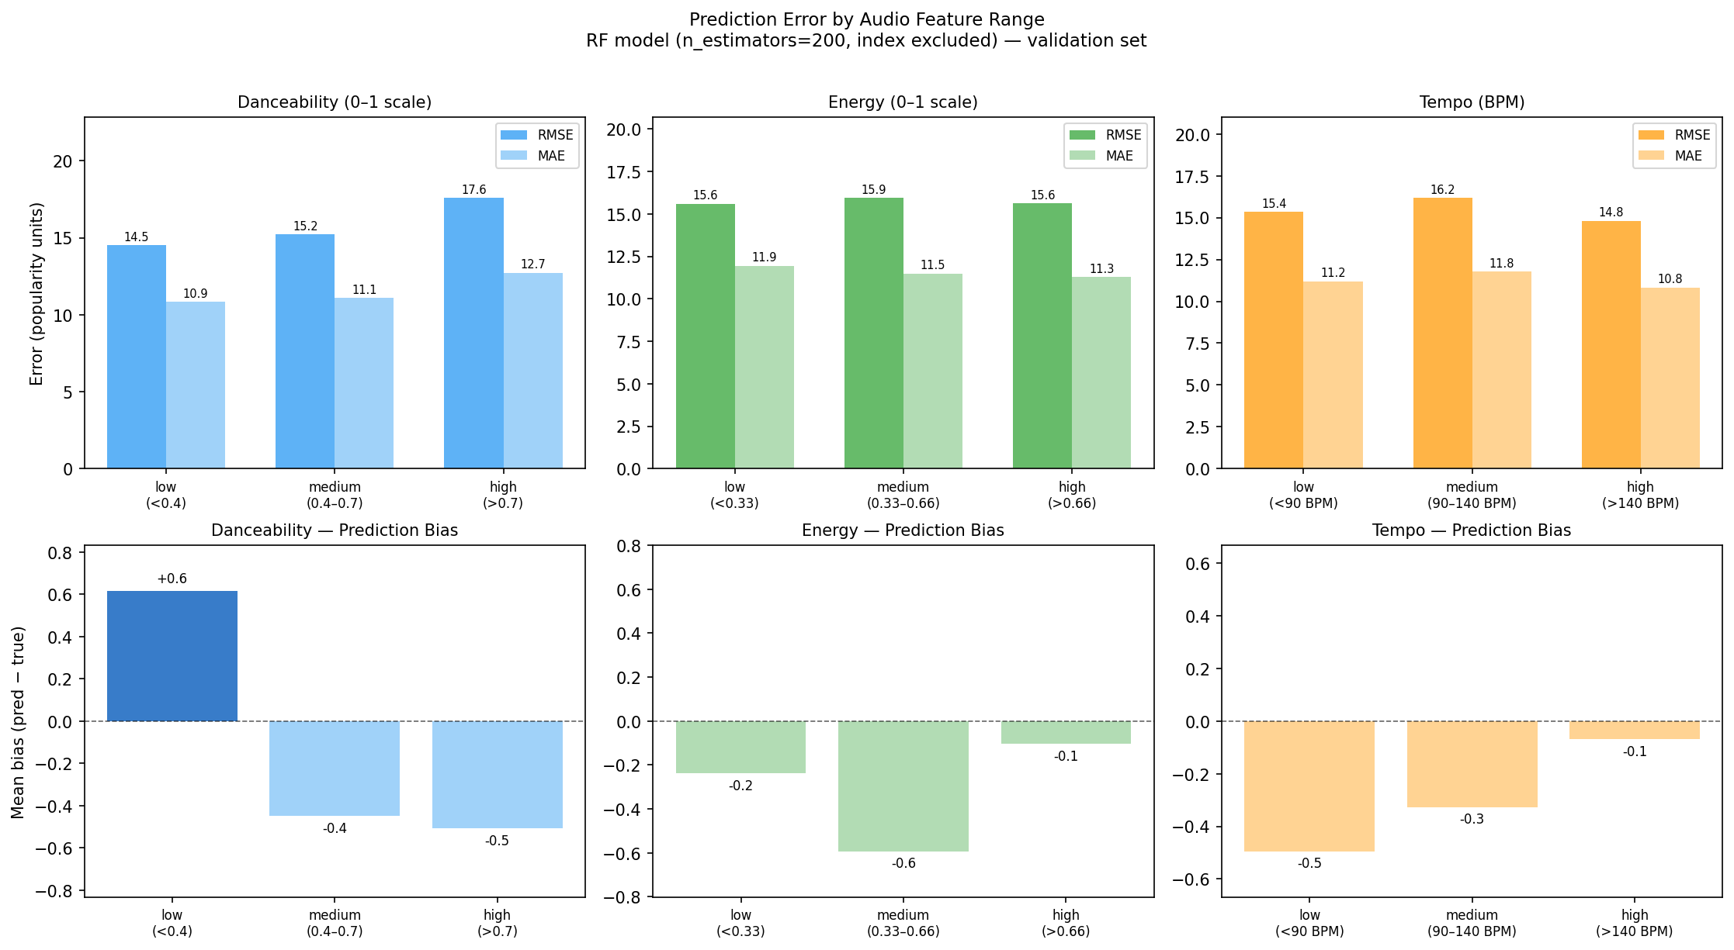
The Failure Is Not in Audio Space
Feature-bucket analysis confirms an information ceiling, not a modeling ceiling
Sliced by
RMSE span
Bias span
Popularity buckets
15.2 units
33.9 units
Danceability
3.1 units
1.1 units
Energy
0.3 units
0.4 units
Tempo
1.4 units
0.4 units
15-unit RMSE gap in popularity space.
3-unit gap in audio space.
The loop cannot fix what the data does not contain. No model change, transform, or hyperparameter addresses an information shortfall.
Notes:
This analysis rules out the alternative explanation — that the model fails because it misreads certain audio profiles. Slicing by any audio feature produces at most 3 units of RMSE variation and near-zero bias. Slicing by popularity produces 15 units of RMSE variation and 34 units of bias swing. The failure is in the popularity dimension, not the audio dimension. No model change, transform, or hyperparameter could have addressed this. The loop hit the ceiling of its own data.

Slide 8
What the Loop Can and Cannot Do
Reflection · takeaways · future work
Loop Strengths
Loop Limits
Future Work
Zero crashes across 16 experiments
Index artifact undetected 5 weeks
Artist-level features
Correct rollbacks on every revert
Ran 3 identical interaction experiments
Playlist placement signals
Identified diminishing returns
Analysis started in Week 6 (not Week 3)
Release context + label support
Applied log transforms correctly
No diminishing-returns checkpoint
Feature audit after first model fit
Improving prediction required understanding the limits of the data, not building more complex models.
Notes:
The loop is good at mechanical discipline and bad at knowing when to stop or what to look at. The index artifact — a CSV row number that acted as a genre proxy — was the highest-importance feature for five weeks because the loop had no self-auditing component. It was only caught when the interpretability analysis ran in Week 6. The fix is procedural: inspect feature importances after the first model fit, run a bucket analysis after Week 3, and build diminishing-returns checkpoints into the loop. The bigger lesson is that the most valuable output of this project was not the RMSE number — it was characterizing exactly why the number cannot get lower.

