Slide 1
Decoding Robustness: How Perturbations Propagate Through LMs
A representation-metric confound — and a cross-family (absolute vs RoPE) finding
GPT-2 (124M) · OPT-6.7B · Llama-3.1-8B · Qwen2.5-7B | WikiText-2, 100 passages × 128 tokens

Slide 2
Setup: three perturbations, four models
Each clean passage run twice — clean vs perturbed — and compared
• Perturbations, each isolating one interface:
– Char substitution → tokenizer disruption
– Token substitution → lexical / semantic corruption
– Token shuffling → positional corruption
• Metrics:
– Behavioral: perplexity, output divergence, logit-KL
– Representation: per-layer stripped cosine (content) + stripped CKA (geometry)
Model | Params | Pos. encoding
GPT-2 | 124M | learned absolute
OPT-6.7B | 6.7B | learned absolute
Llama-3.1-8B | 8B | RoPE
Qwen2.5-7B | 7B | RoPE
Absolute vs RoPE at matched scale (~7–8B) is the controlled comparison.

Slide 3
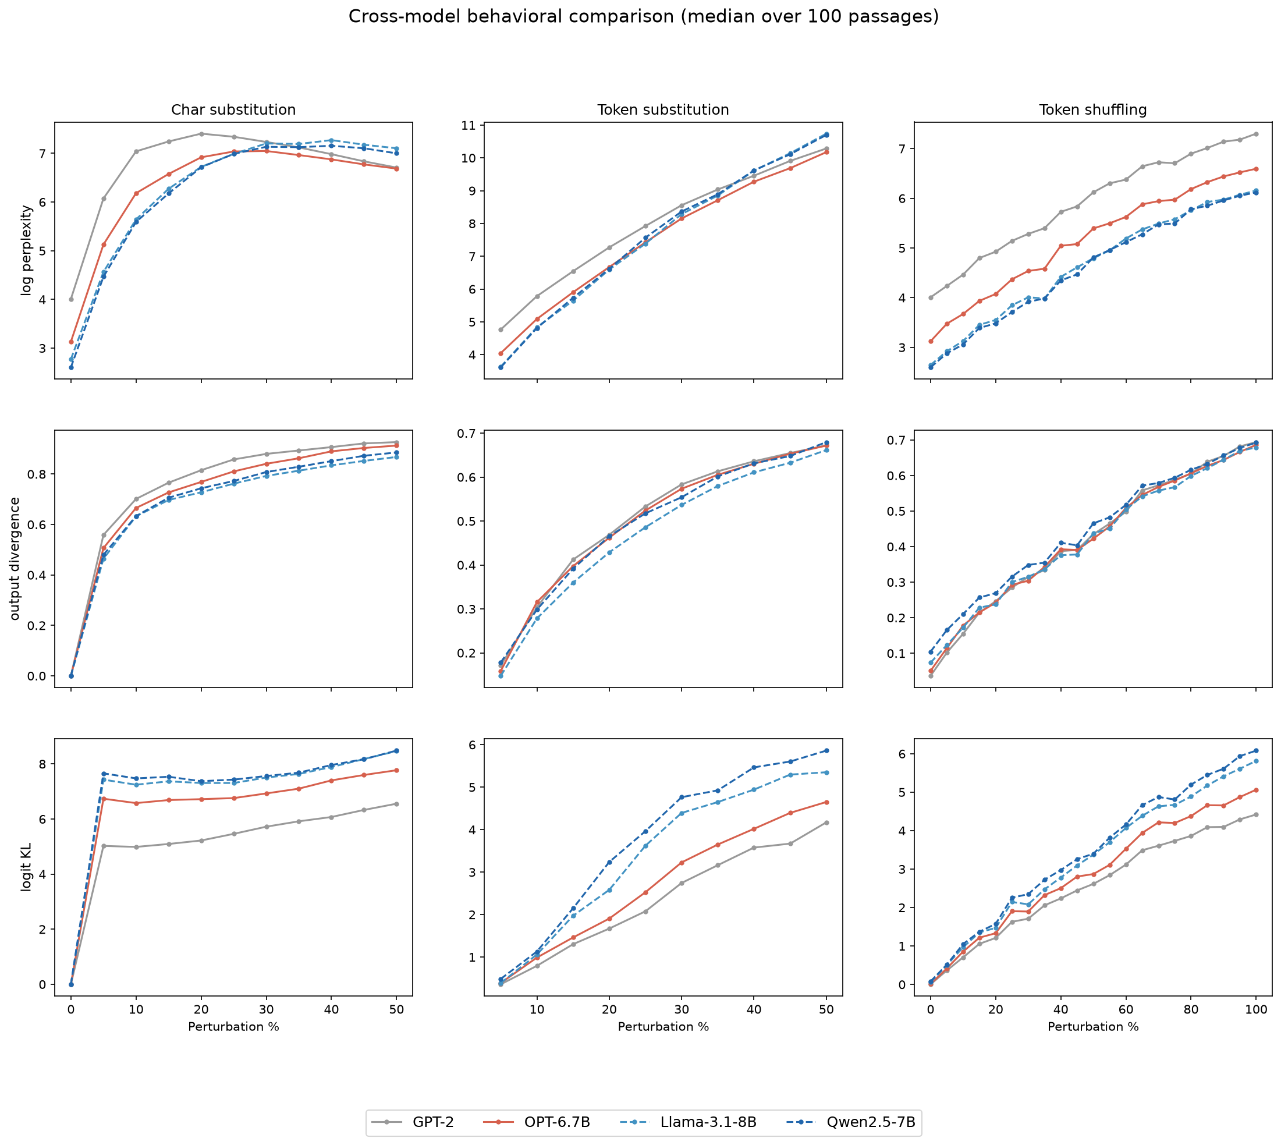
Behavioral signatures differ by corruption type
• Char: front-loaded — 5% already flips half the output
• Token: explosive perplexity (valid-but-wrong = max surprise)
• Shuffle: gentlest — models robust to local word-order
• Severity char < shuffle < token holds across all models

Slide 4
The representation metric was confounded
Raw cosine 'recovered' to ~0.95 at the final layer even when outputs were totally different
• Cause: massive activations (few 'rogue' dims implementing attention sinks)
– Near-constant, huge magnitude → survive perturbation → fake 'similarity'
• Every off-the-shelf metric is fooled — differently:
Metric | Weights dims by | Fooled by | Result
Raw cosine | magnitude (+offset) | the huge offset | falsely HIGH (0.95)
Z-scored cosine | 1 / std | flat dims' noise | falsely LOW (0.04)
Plain CKA | variance | preserved positional variance | falsely HIGH (0.999)
• Fix: drop the top-k highest-variance dims per layer, THEN measure

Slide 5
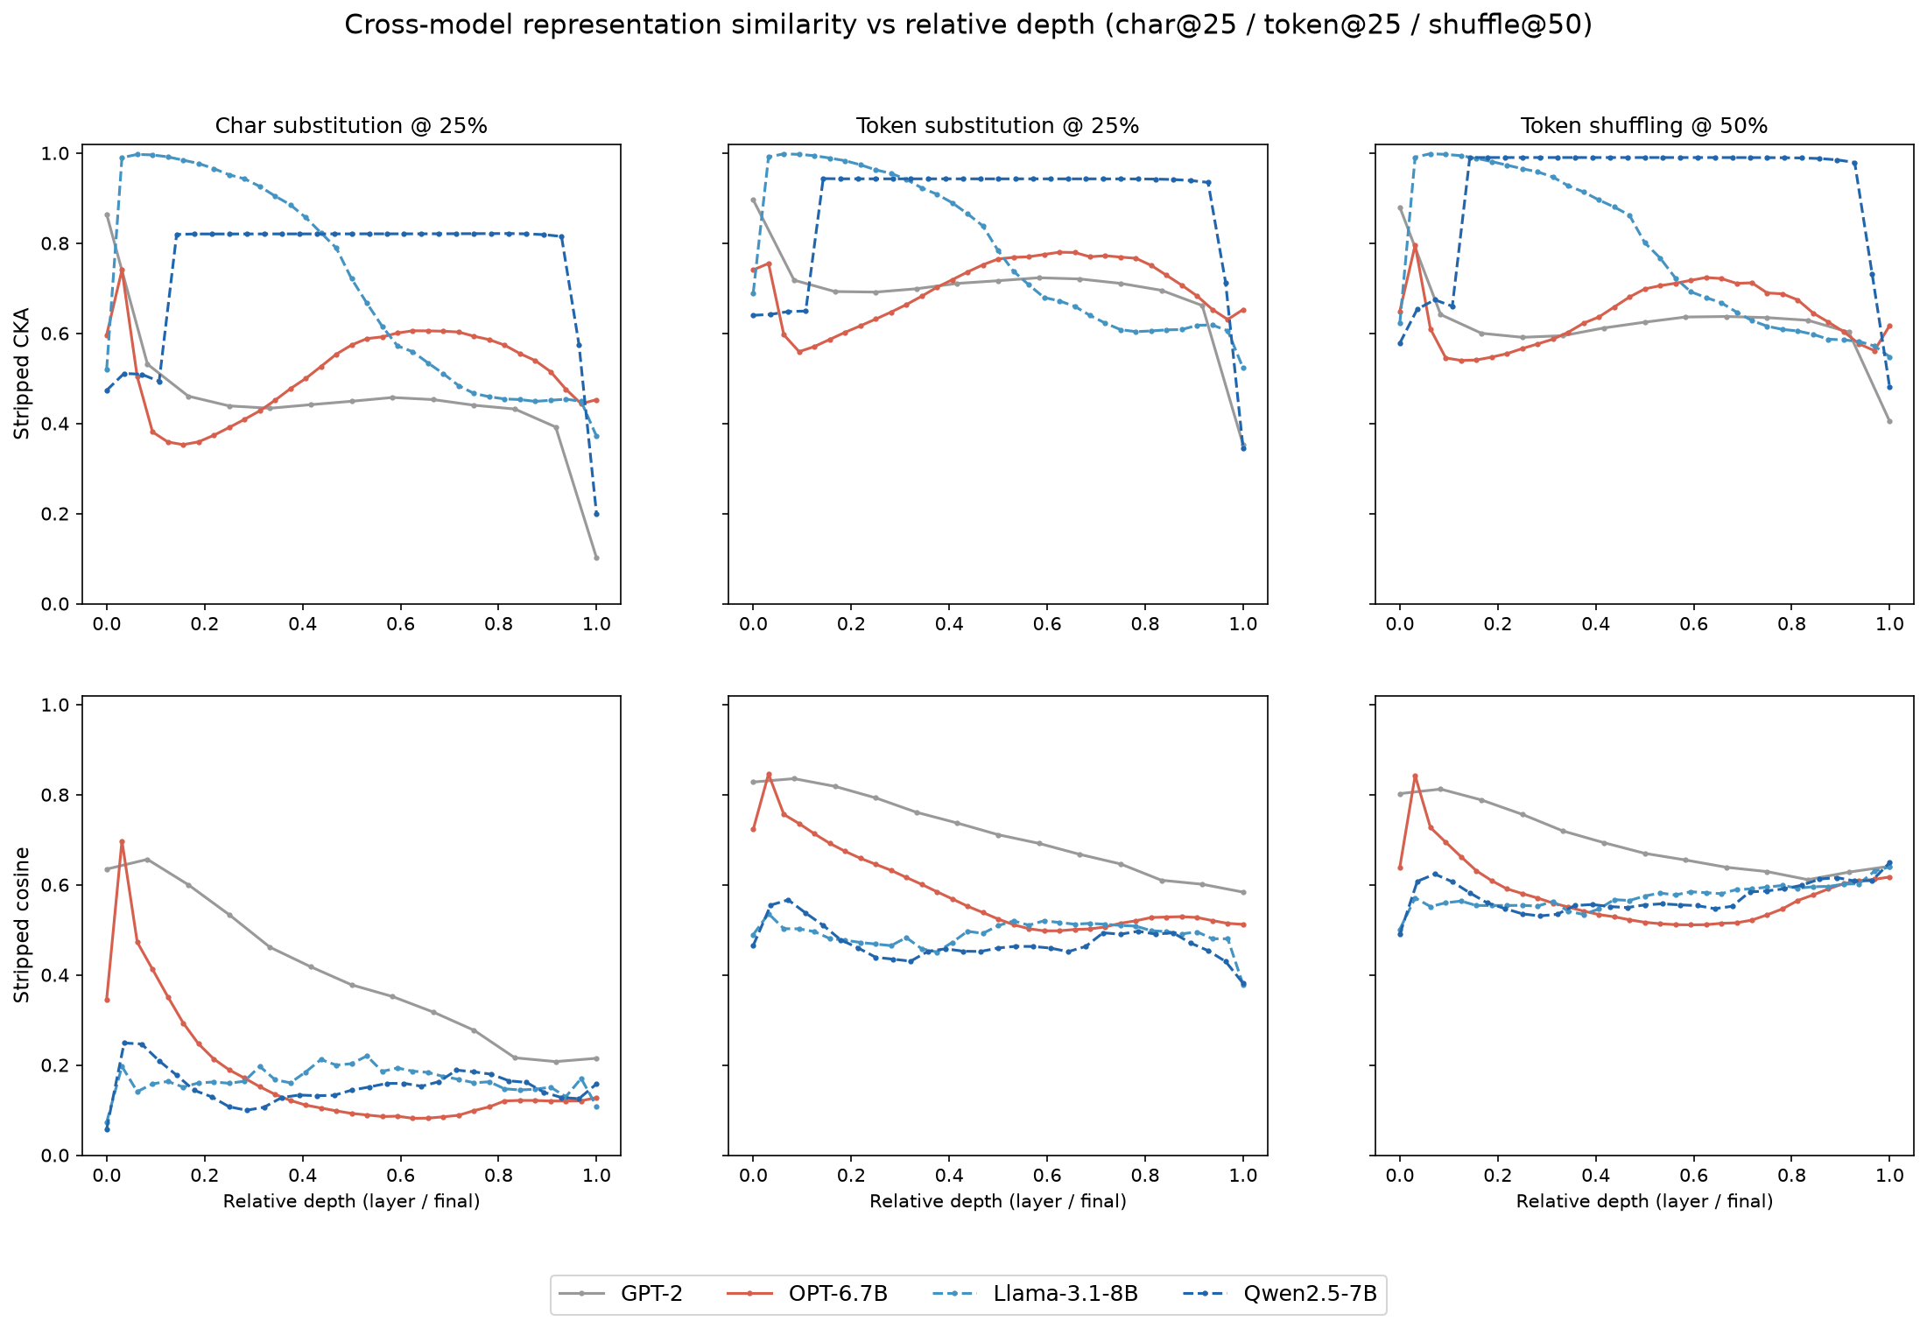
RoPE keeps a similarity that absolute models lose
• Top (CKA): RoPE (dashed) high plateau; absolute (solid) low
• Bottom (cosine): inverts — absolute higher
• RoPE's high CKA = pure positional geometry — the confound itself

Slide 6
Two separable effects: positional encoding × depth
After stripping the outlier dims, do the two metrics agree? (cosine = content, CKA = geometry)
Model | Pos. encoding | Early layers | Late layers
GPT-2 (124M) | absolute | cosine ≈ CKA | cosine ≈ CKA
OPT-6.7B | absolute | cosine ≈ CKA | cosine ≪ CKA
Llama-3.1-8B | RoPE | cosine ≪ CKA | cosine ≪ CKA
Qwen2.5-7B | RoPE | cosine ≪ CKA | cosine ≪ CKA
cosine ≈ CKA → metrics converge (confound gone) cosine ≪ CKA → gap persists (confound remains)
• Read DOWN ‘Early layers’ ↓ — absolute (OPT) converge; RoPE (Llama, Qwen) don’t
– → positional encoding controls whether the metrics converge early
• Read ACROSS each row → — the gap re-opens with depth, even for absolute OPT
– → a depth effect, independent of positional encoding
• So a persistent gap is NOT unique to RoPE — OPT (no RoPE) shows it late

Slide 7
Why does this happen?
Char corruption changes the tokens — but keeps their POSITIONS fixed.
So the positional signal is identical in clean vs perturbed. A metric reading geometry (CKA) latches onto that shared signal → looks ‘similar’; a metric reading direction/content (cosine) sees the changed tokens → looks ‘different’.
Absolute position (GPT-2, OPT)
Position is stored in a FEW dimensions.
Drop those dims → the shared positional signal is gone
→ CKA falls to meet cosine.
Result: cosine and CKA CONVERGE (early layers)
RoPE (Llama, Qwen)
Position is spread across ALL dimensions (rotations).
There is no small set of dims to drop
→ CKA stays pinned high (~0.8).
Result: the cosine–CKA GAP PERSISTS
With depth, position spreads out even in absolute models → the gap re-opens in their late layers too.

Slide 8
Takeaways & open questions
• Takeaways
– Off-the-shelf representation-similarity metrics are confounded by massive
– activations — always strip outlier dims before interpreting
– The strip budget k is model-specific (k=5 for GPT-2; wide models need more,
– or never converge under RoPE)
– Absolute vs RoPE produce qualitatively different geometry under perturbation
• Open questions
– Disentangle depth vs positional encoding at matched depth
– Phase 2: attention / head-ablation (GQA complicates single-head study)
– Char-perplexity non-monotonicity; k-sensitivity sweep for publication

