Slide 1


Gender Discrimination Lawsuit: Analytics consultant for female doctors
BC2406 Semester 1 Team 5
Mepurath Sriraman Karthik (U2223211J)
Kalepu Sai Sri Akshath (U2421041F)
Tan Yong Yan (U2310497D)
Amber Yong Yu Jie (U2410976J)
Zhang Han Rui Emily (U2421417A)
Ng Zi En Chloe (U2340186C)

Slide 2
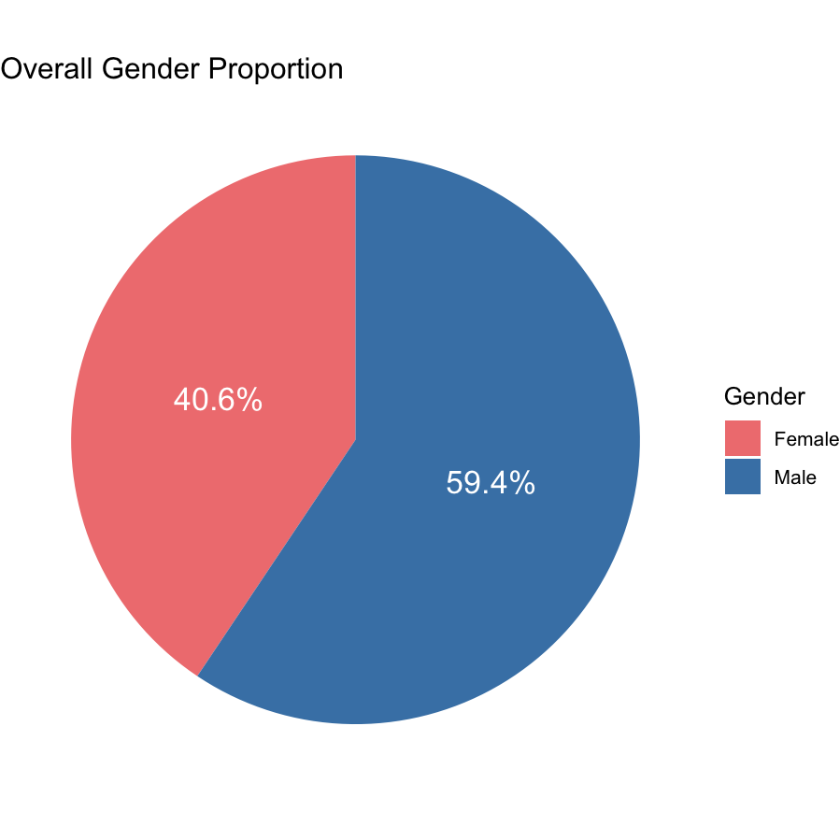
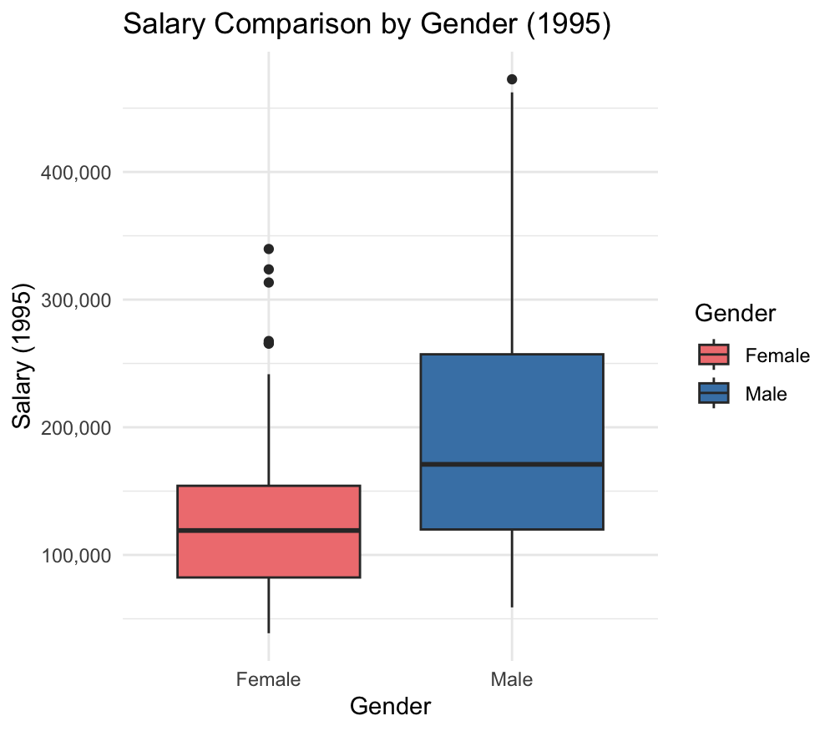
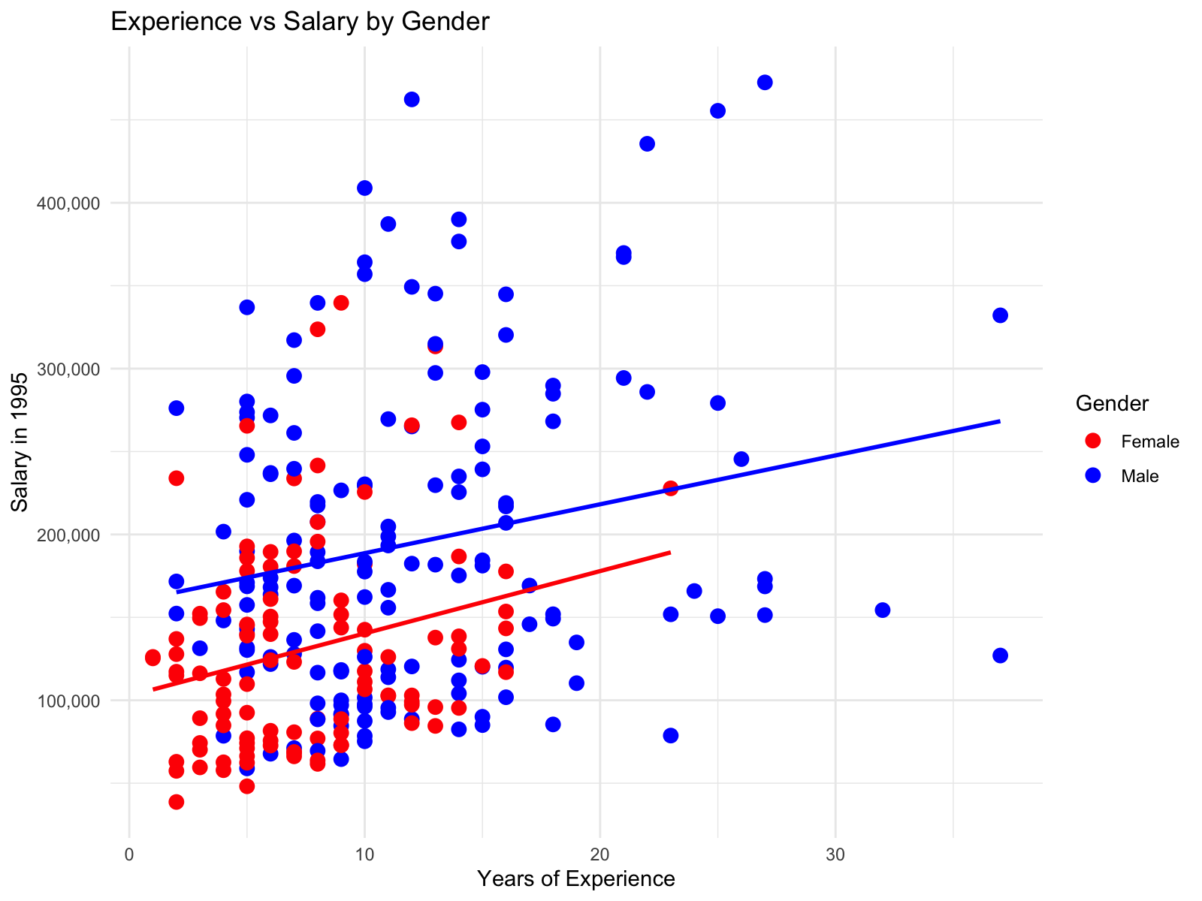
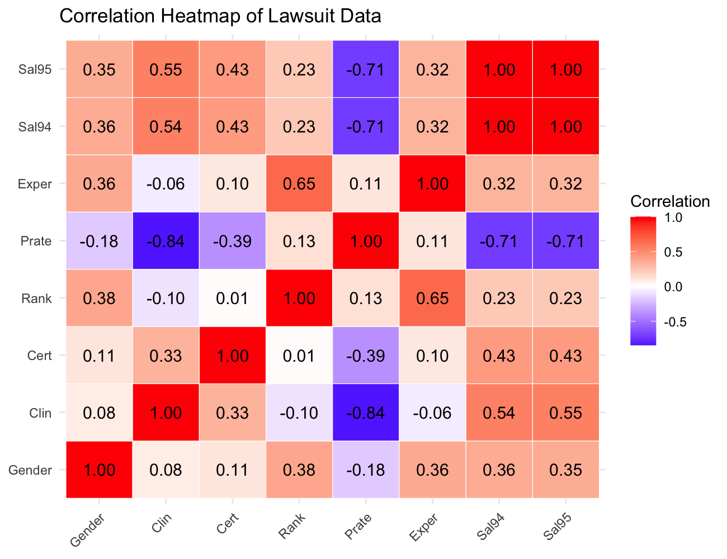
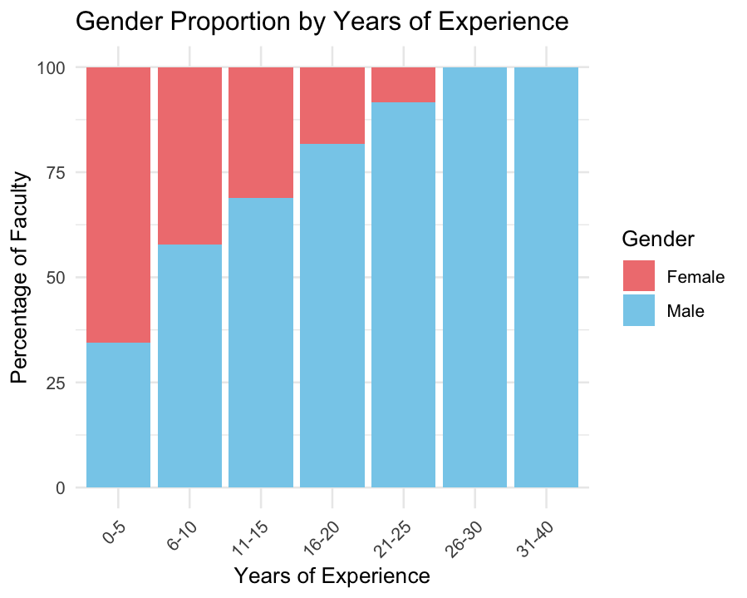

Do female academics earn less?
Mepurath Sriraman Karthik
Ng Zi En Chloe
Gender distribution: 60% are male, 40% are female.
Average salary: Female academics earn $130,877, while Male academics earn $194,914, nearly 50% more than their female counterparts
Utilising a correlation matrix, we identify that Department, Emphasis (Clin), and Certification have high correlation with respect to Salary, while Gender, Experience, and Rank have mild correlation with respect to salary
Despite a higher proportion of women in the 0-5 experience bin, they start approximately $60,000 lower than that of men, per regression intercepts
Moreover, proportion of women decrease with increasing experience, suggesting barriers to career progression and retention

Slide 3
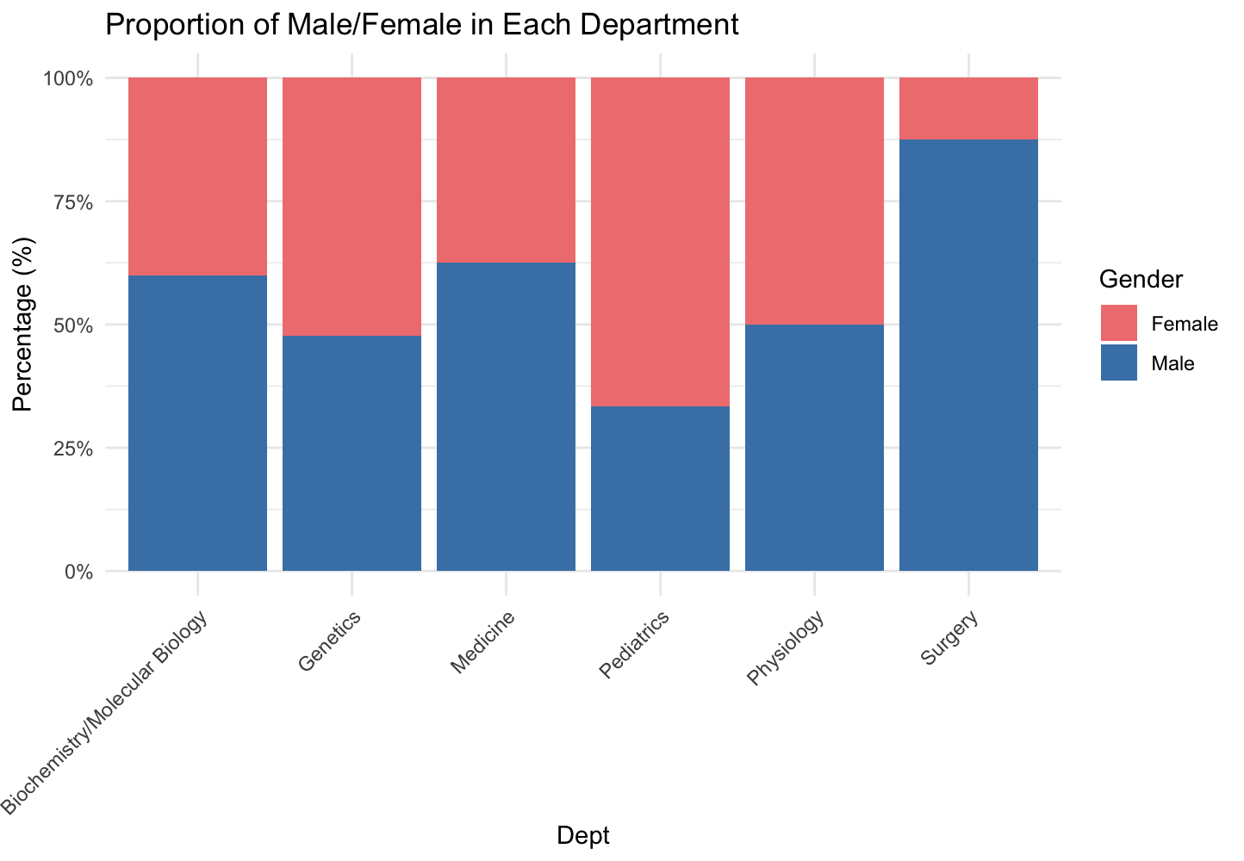
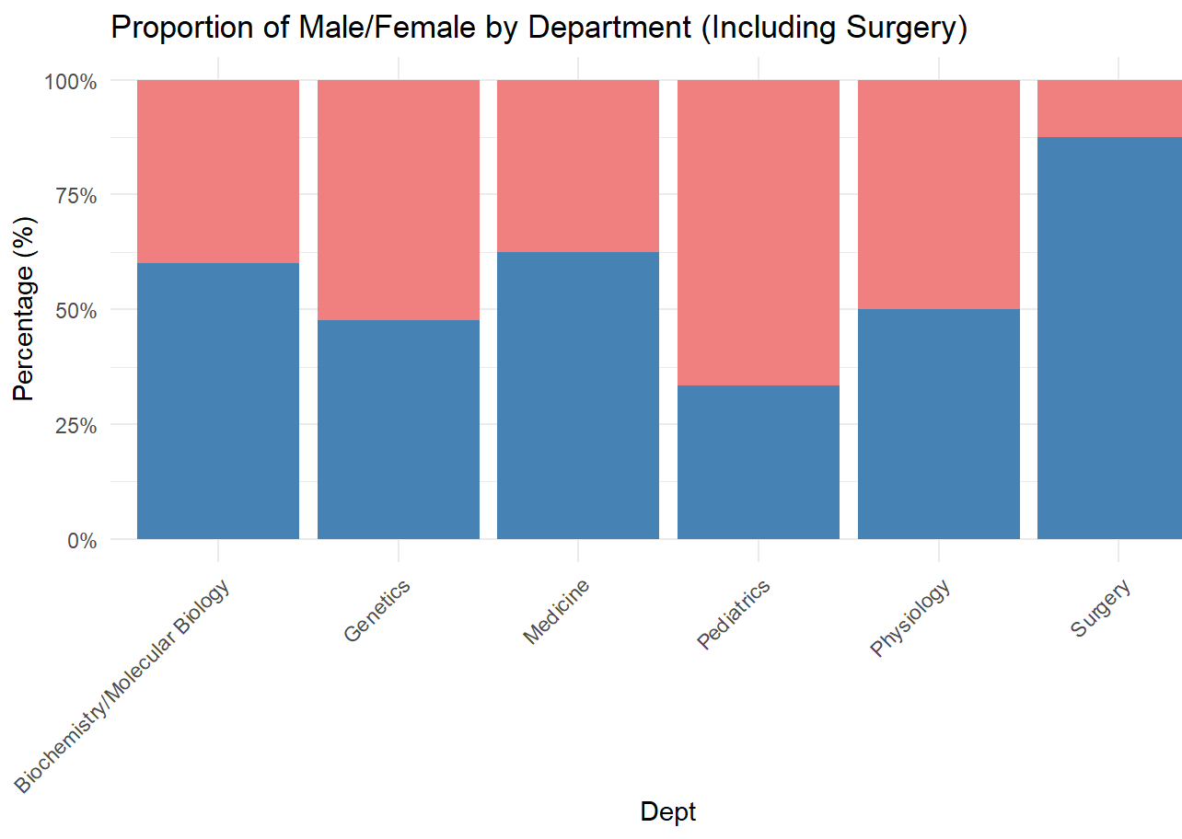
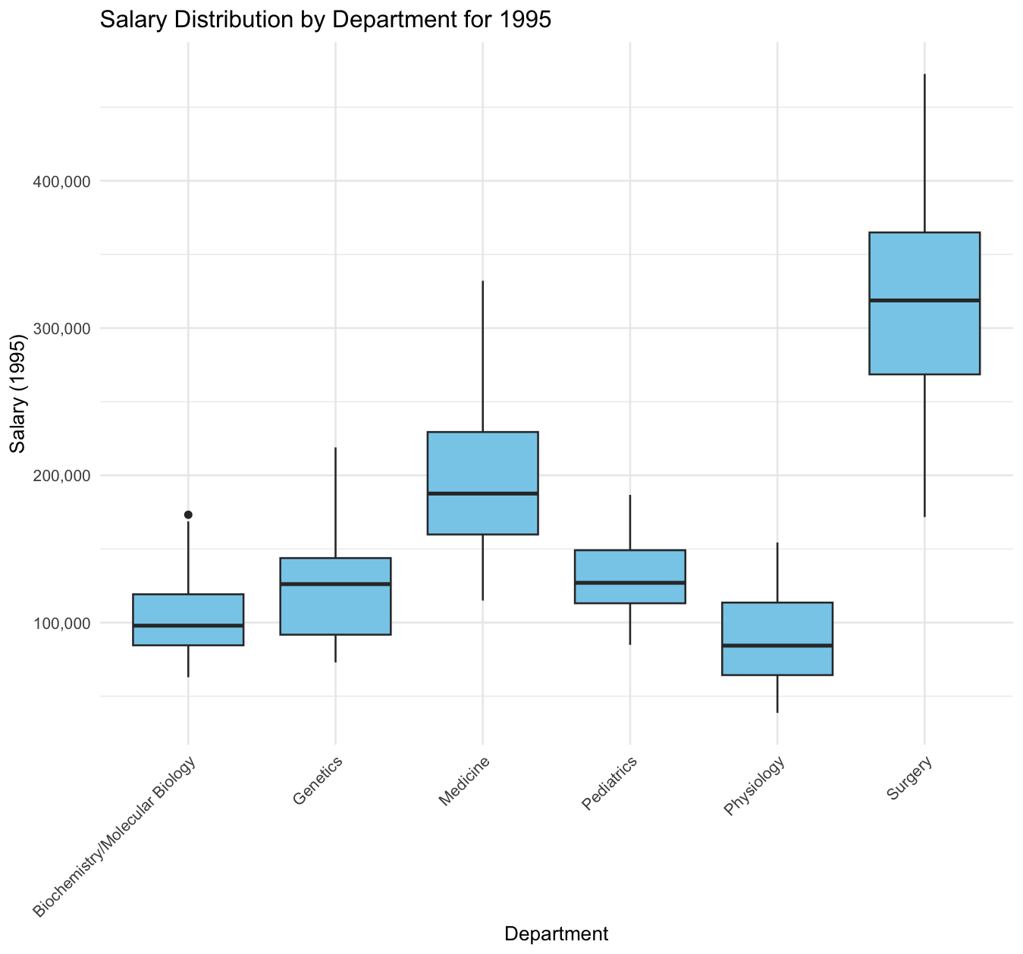
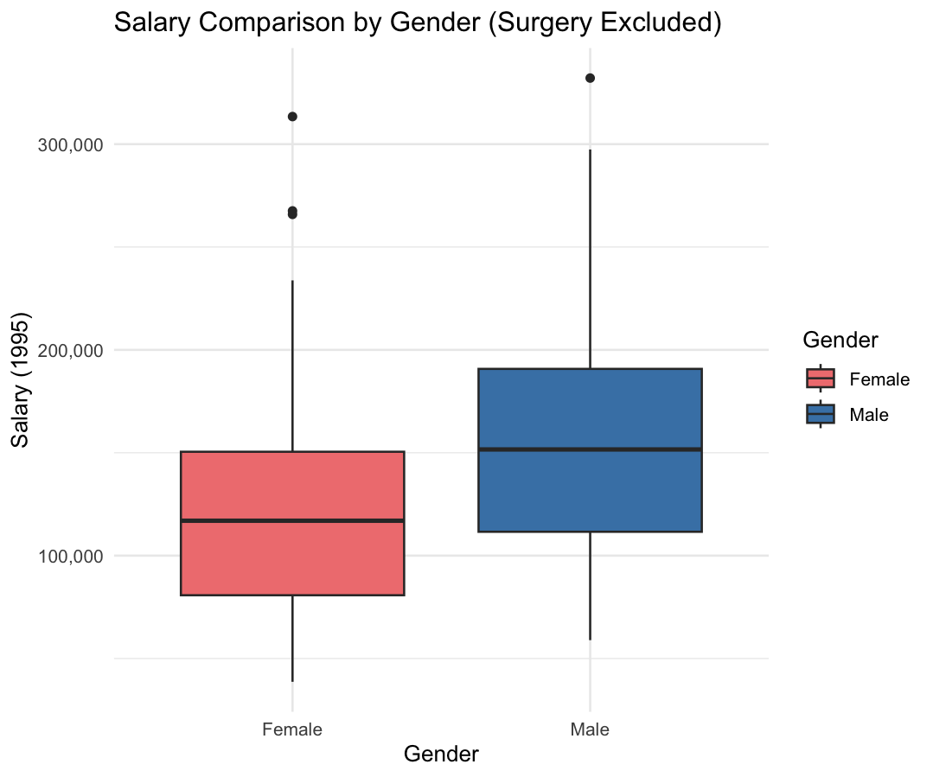

Surgery department: an outlier
Mepurath Sriraman Karthik
Ng Zi En Chloe
Additionally, males dominate the surgery department (87.5%)
This over representation inflates average male salaries, masking true gender disparity
Hence, surgery is excluded from the salary analysis to assess the gap accurately
~$100,000
Excluding surgery brings the gender proportions in the dataset closer to parity, however a significant median salary gap remains, indicating pay disparity.
There is a high departmental variation in salary, surgery has the highest median salary, and physiology has the lowest median salary
However, even compared to the 2nd-highest paying department (Medicine), surgery salaries are significantly higher: the 25th percentile of academics in surgery significantly out earn the 75th percentile of academics in medicine, highlighting extreme variation

Slide 4
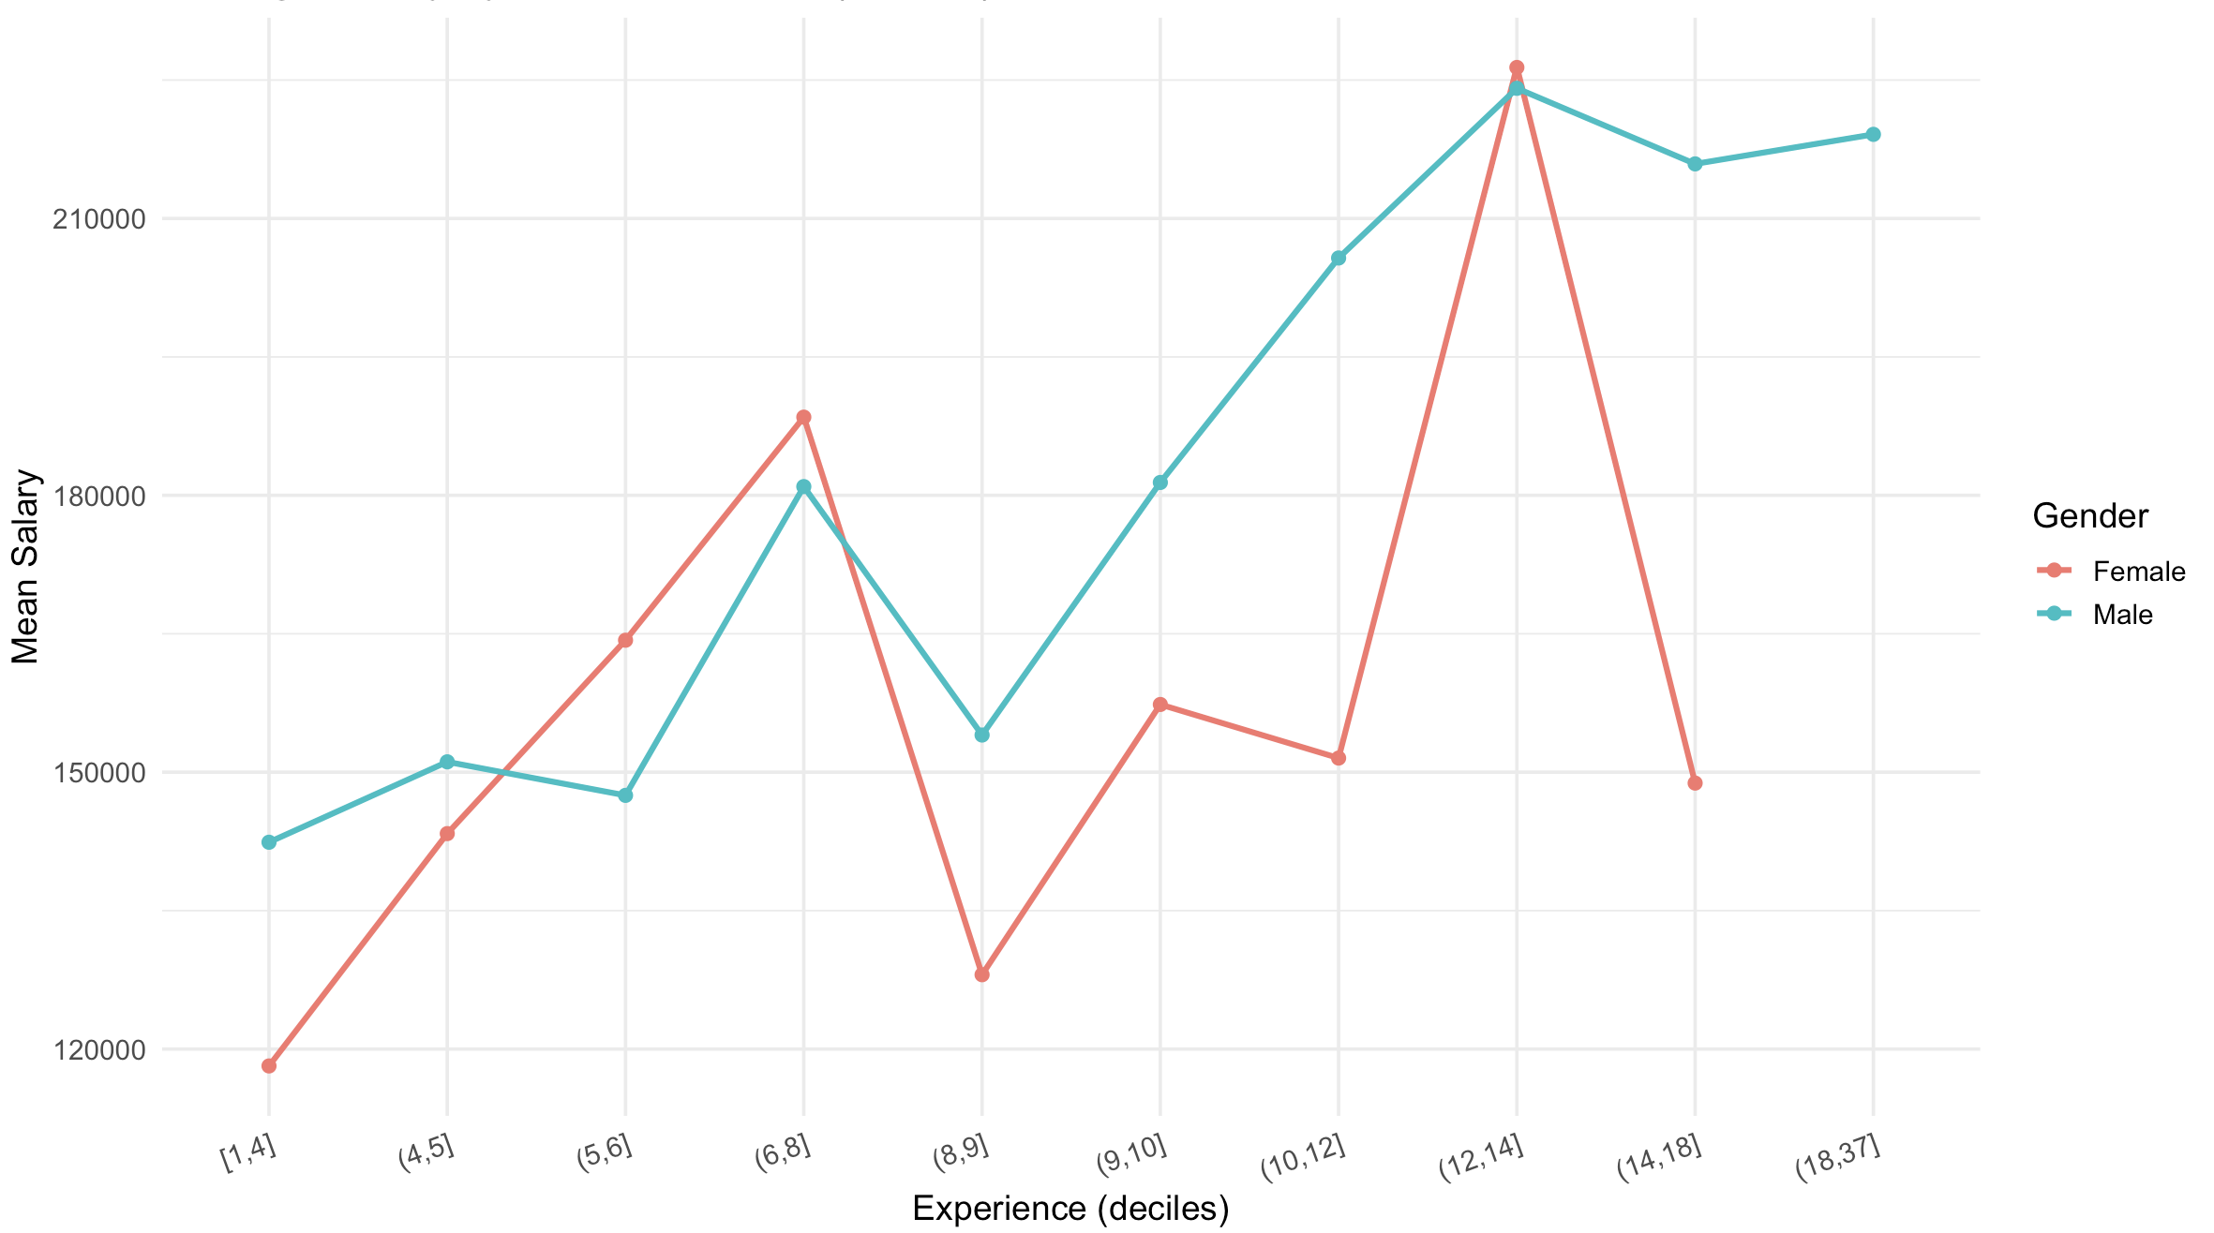
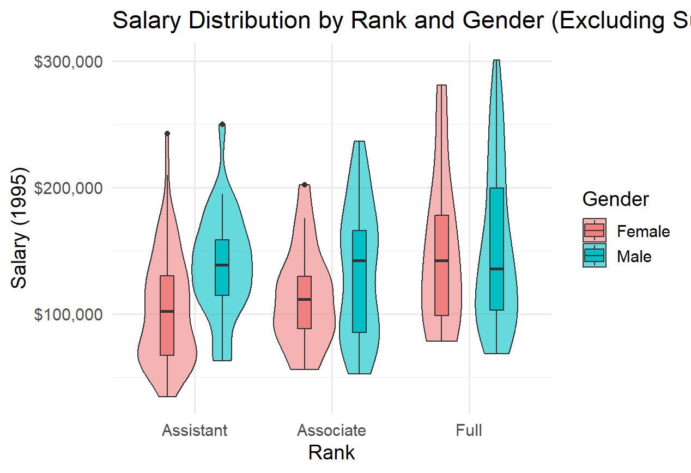
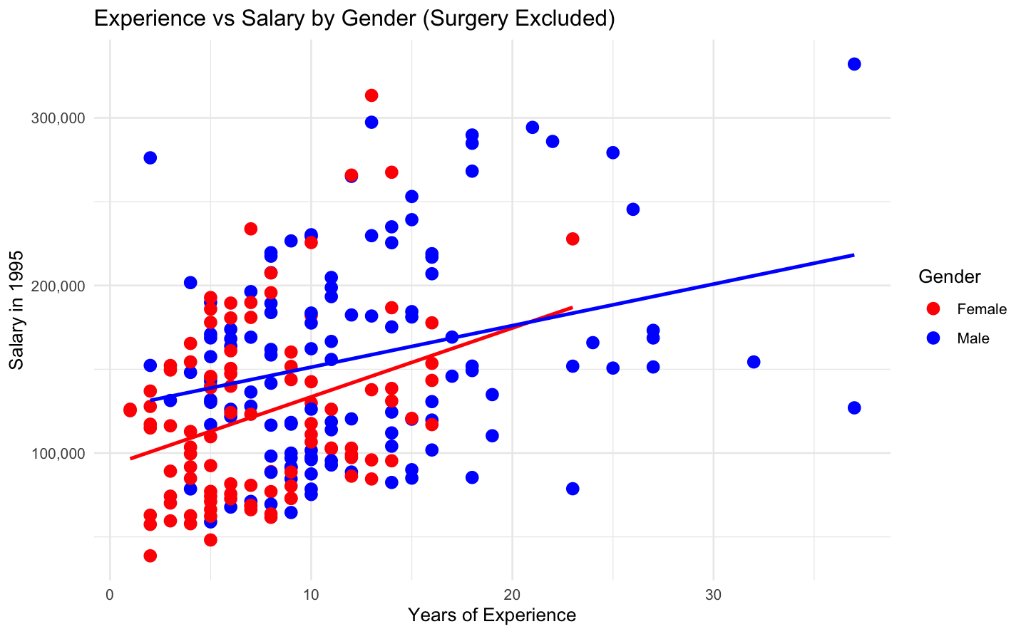

Experience and Rank do not close the gender pay gap
Kalepu Sai
Experience v Salary
Experience and salary are positively correlated
Generally, males earn more than the females in the same experience bins, especially within the top experience brackets.
Women starting salaries are much lower. Despite continuous salary progression with experience, it drops sharply once it a certain threshold, more so than the men.
This shows a “glass ceiling” effect; invisible systemic barriers for women.
Rank v Salary
In all 3 roles, the male counterparts earn much more than the female counterparts, despite equal growth in salary across ranks.
Male distributions are wider and higher → men earn more on average and dominate the higher salary ranges at each rank.
Female distributions are narrower → fewer women are represented in the upper end of pay within the same rank.
Men start with higher salaries and continue to pull ahead over time. By later career stages, the pay gap has widened substantially.
Women not only start with a pay disadvantage but also suffer it at every subsequent rank.
Notes:
Replace with the 2 slides
Redo box plots to remove the outline. And change to base on 1995 salary

Slide 5
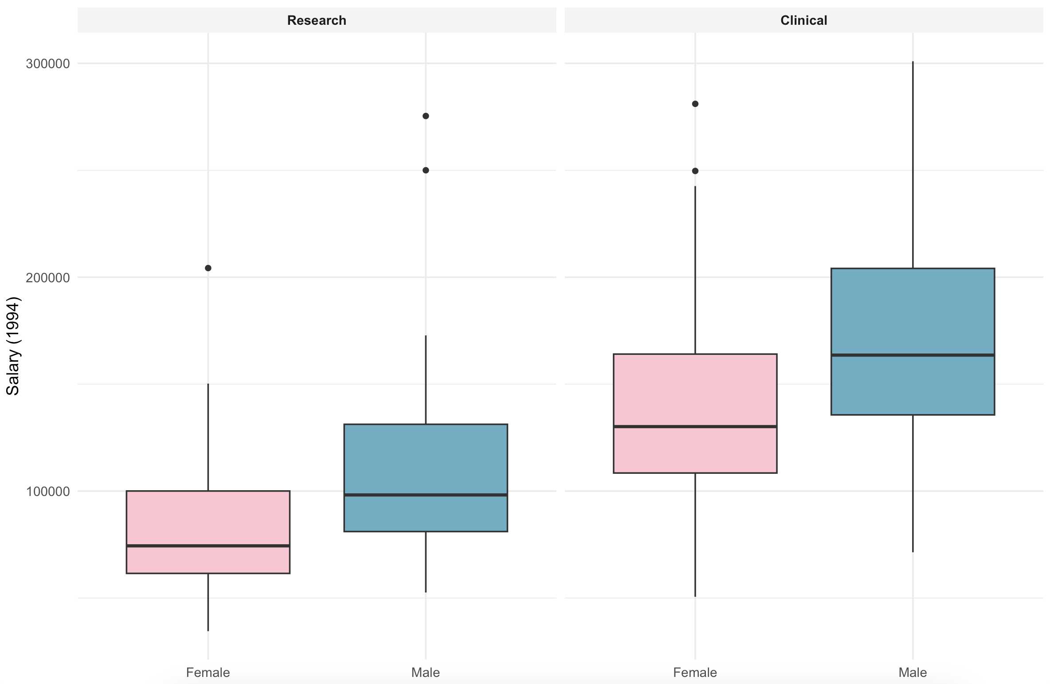
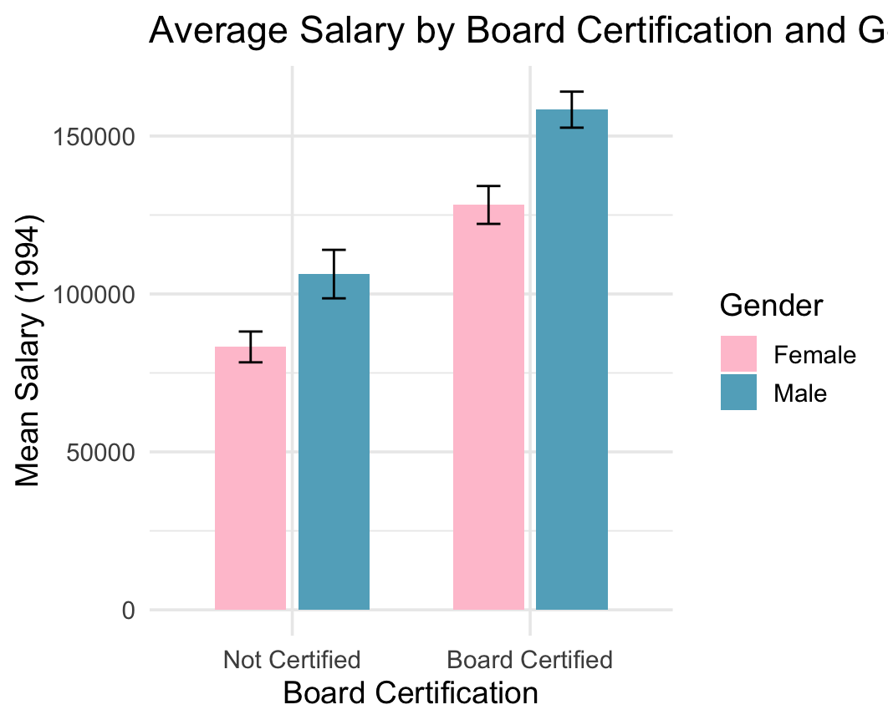
Even with board certification, women in clinical roles earn less than men
Kalepu Sai
For Research and Clinical, the median salary is higher for males than females.
Clinical: the spread (IQR) of male salaries is much wider than for females, suggesting not only higher salaries but also greater variability/opportunity at the top end.
Research: both genders’ spreads are narrower, but men still edge higher consistently.
Males on average earn more than females, even if they are board certified or not.
Both males and females see a salary increase when board certified.
But men’s salary boost is significantly larger — the certification widened the gender gap instead of closing it.
Clear and consistent gender pay gap in both research and clinical roles. Male faculty earn more than female faculty at every salary level, especially in clinical roles.
Board certification increases salaries for both men and women, but men not only start from a higher baseline, but they also receive a larger financial reward from certification.

Slide 6
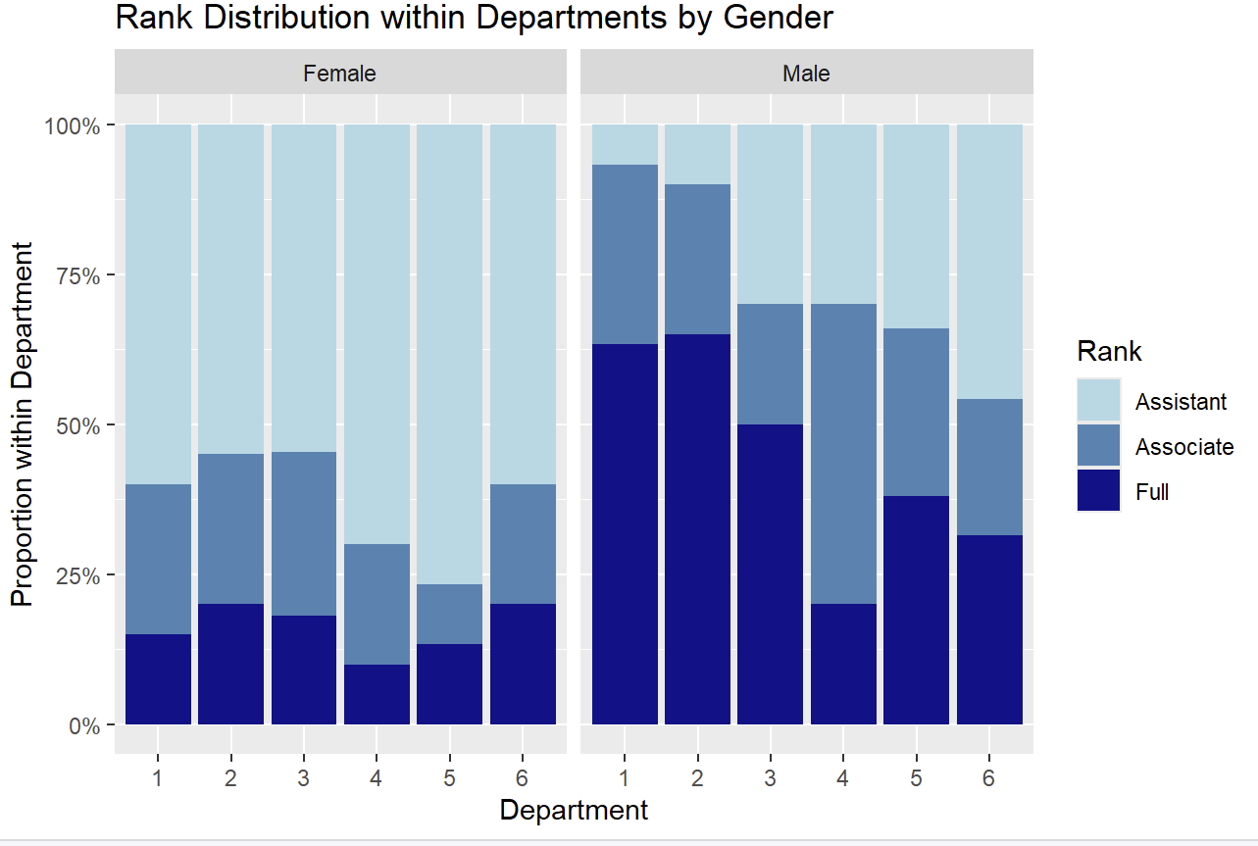
Tan Yong Yan
Women are overrepresented in Assistant roles, while underrepresented in Professor roles
 | Female | Male | Portion of Female
Assistant | 69 | 43 | 62%
Associate | 21 | 43 | 33%
Professor | 16 | 69 | 19%
Total | 106 | 155 | 100%
Most women are concentrated at the Assistant rank (69 /106), while very few attain the rank of Full Professor (16 /106).
Overall, 62% of female academics are Assistant Professors, and their representation drops sharply with higher rank, with only 19% of Full Professors being female.
This trend is consistent within departments as well:
Over 50% of women are concentrated at the Assistant Professor rank.
Men are more likely to be Full Professors in their departments.
Women are underrepresented at the Full Professor level, while being overrepresented at the Assistant Professor level. Men are more likely to be Full Professors.

Slide 7
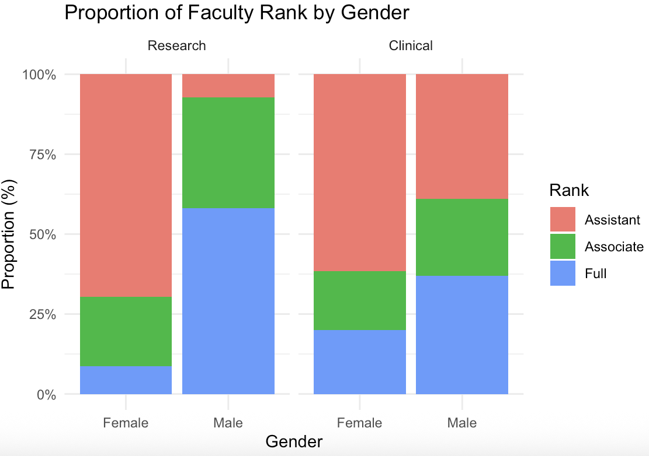
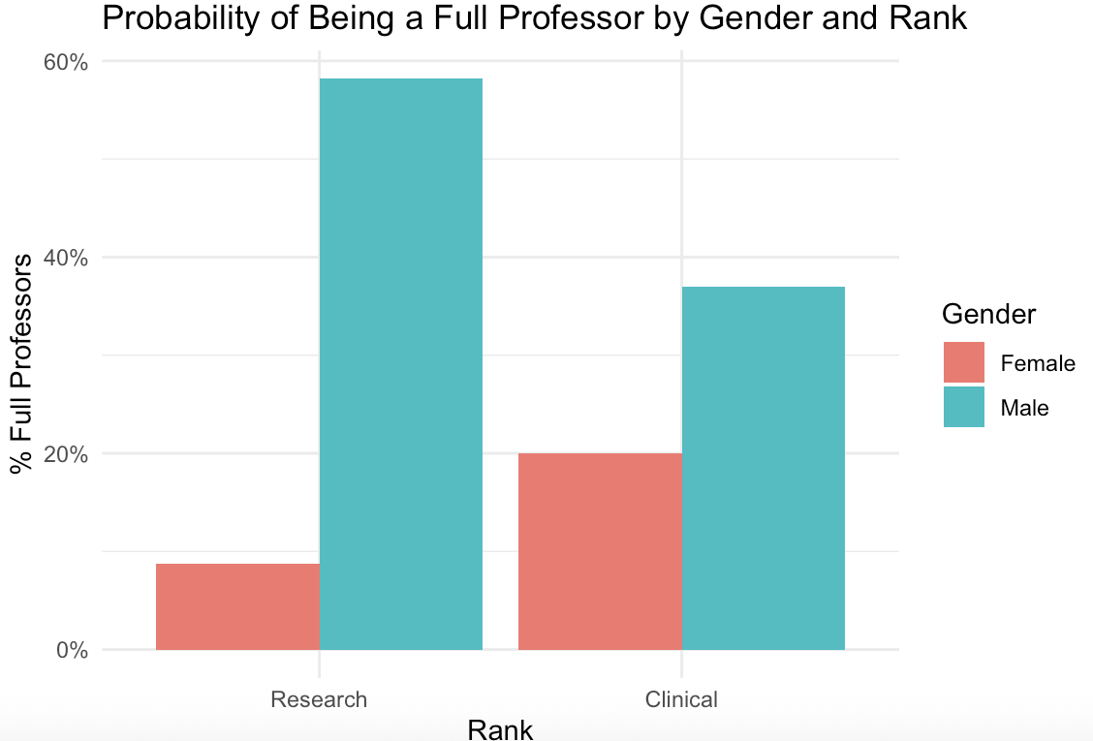
Amber Yong
Women are less likely to become full professors, Research shows the sharpest disparity
Clinical
About 20% of female academics are Full Professors, compared to about 38% of male academics.
Research
Only about 9% of female academics are Full Professors, compared to about 58% of male academics.
Women are about 50% less likely than men to hold Full Professor positions, showing significant underrepresentation in both clinical and research faculties, with the disparity being more pronounced in research.

Slide 8
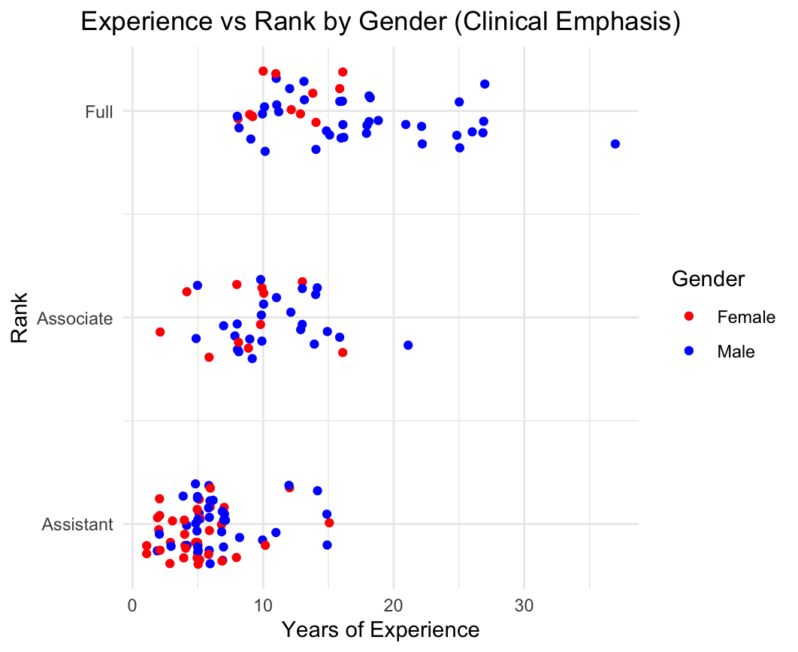
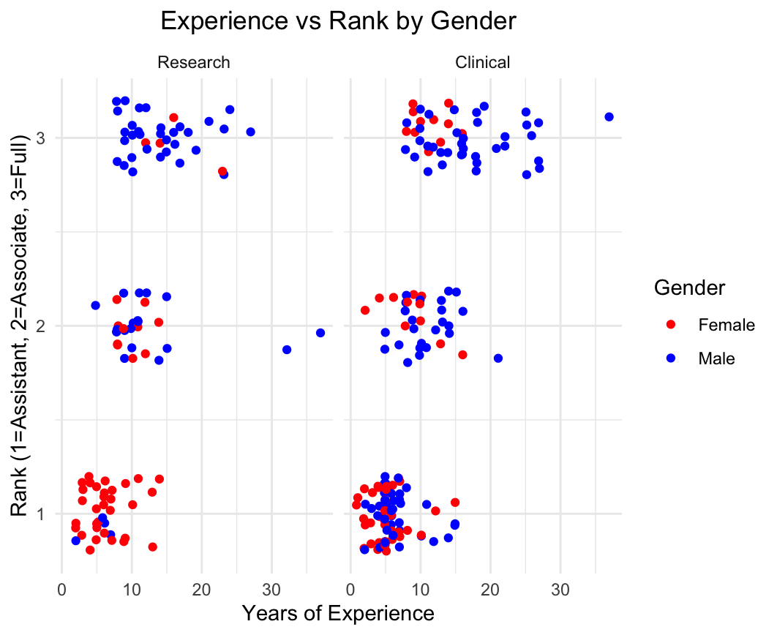
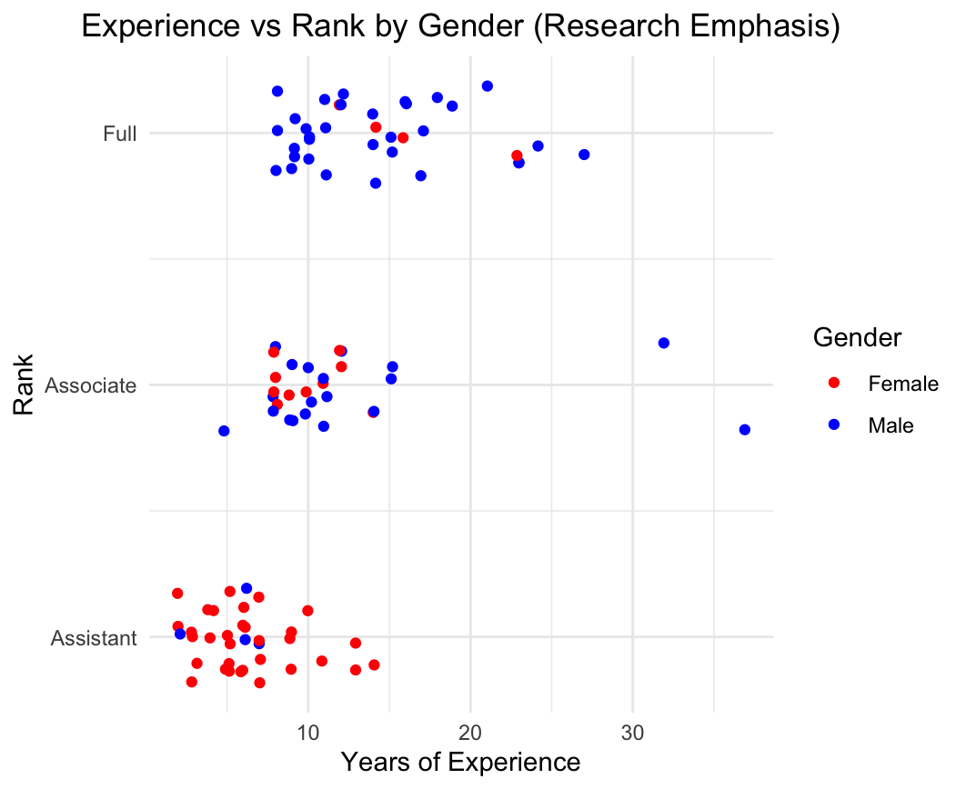
Given similar years of experience, women hold more positions in the lower ranks
Emily Zhang
At the same experience levels, men are more likely to be Full Professors.
Female clinical faculty are clustered at lower ranks, especially in the case for Assistant professor.
Proportion of women decrease with increasing experience, suggesting barriers to career progression and retention.
At the same experience levels, men are disproportionately more likely to be Full Professors.
Female research faculty are clustered at lower ranks, especially in the case for Assistant professor.
This is particularly noticeable at 10-15 years of experience where men have higher rank than women.
Proportion of women decrease with increasing experience, more so for research than clinical emphasis.
Despite comparable experience, women remain concentrated disproportionately in lower ranks while men dominate senior positions, highlighting a gender bias in promotions.

Slide 9
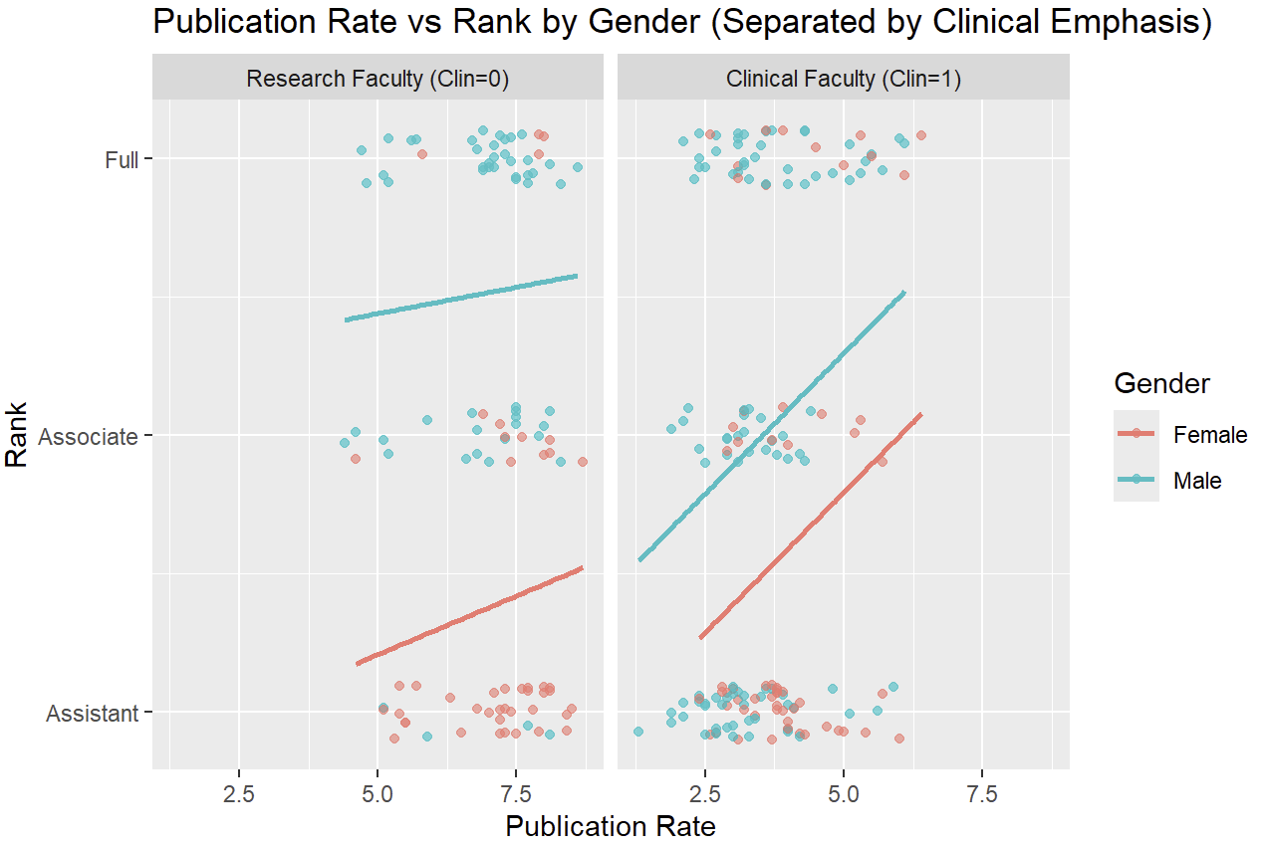
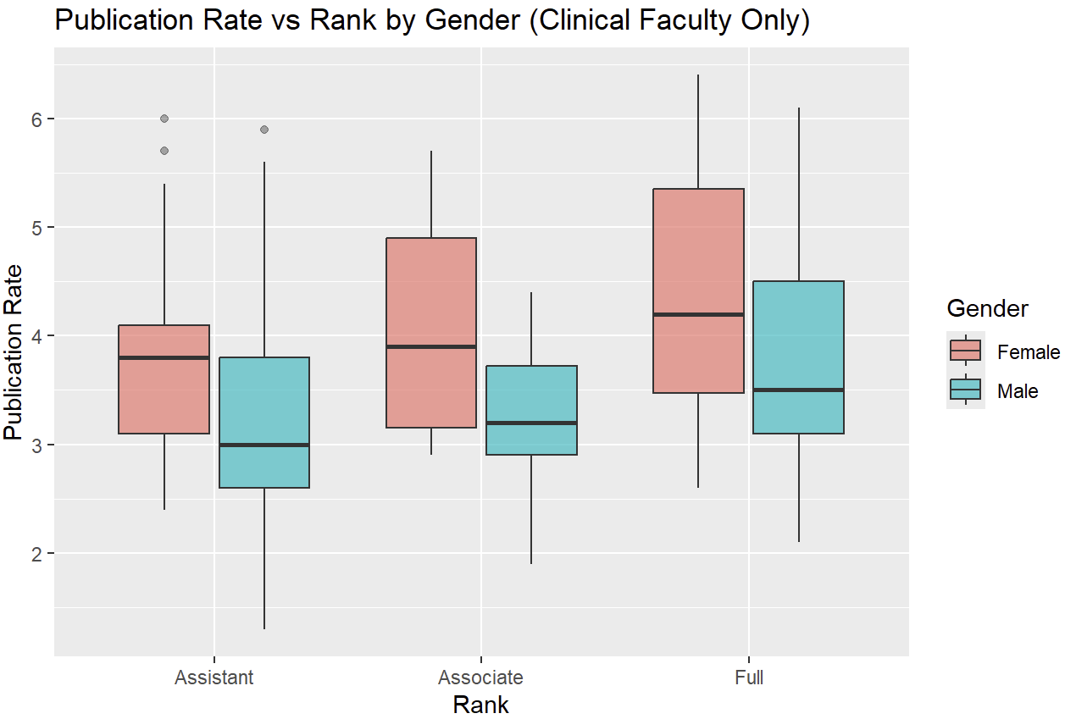
Despite higher publication rates, Women are still underpromoted
Tan Yong Yan
In Clinical faculty, women generally have a higher publication rate than men.
The publication gap widens at higher ranks, with female professors significantly publishing more than their male counterparts on average.
This indicates women face stricter publication requirements for promotion, while men benefit from a comparatively easier promotion pathway.
Publication rate has a strong positive correlation with rank for Clinical faculty.
Male academics in this faculty have steeper correlations with publication rate, meaning that they see greater increase in rank for the same increase in publication rate.
Several women remain in the Assistant Professor rank despite having similar or higher publication rates than their male counterparts, suggesting an inherent bias against female faculty.
Female academics have higher publication rates on average as compared to their male counterparts, however they face greater barriers in carrier progression, suggesting systemic bias in promotion.

Slide 10
Tan Yong Yan
Conclusion
Houston College of Medicine underpays their Female faculty as compared to Male faculty
** As surgery is an outlier, that masks the true gender disparity due to its high salary, it has been removed
On average, women earn approximately 50% less than men, with men consistently out earning equally qualified women.
Even after accounting for departmental variations and additional factors such as board certification, experience, rank etc. pay disparities exist, especially at higher experience levels.
Women have lower starting salaries as compared to their male counterparts at a similar experience level.
Pay gaps persist in both clinical and research faculties, with the disparity being more pronounced in the clinical faculty.
Men start with higher salaries irrespective of certification status, with certification yielding greater financial benefit for men.
Despite salary progression, women are discriminated against and face a “glass ceiling”, never collectively reaching the earnings of men even with equivalent qualifications.
Women are less likely to become full professors, while more likely to become assistant professors
Women hold only 20% of the Full Professor positions, while holding 62% of the Assistant Professor positions,
Despite similar experience levels and equal, if not better, rates of publication, women are disproportionately concentrated at the Assistant Professor level, particularly in research faculties where only about 9% of female academics are Full Professors, while it is 58% for male academics.
Female academics have higher publication rates on average as compared to their male counterparts, however they face greater barriers in carrier progression, indicating higher promotion requirements and systemic bias against female academics

Slide 11
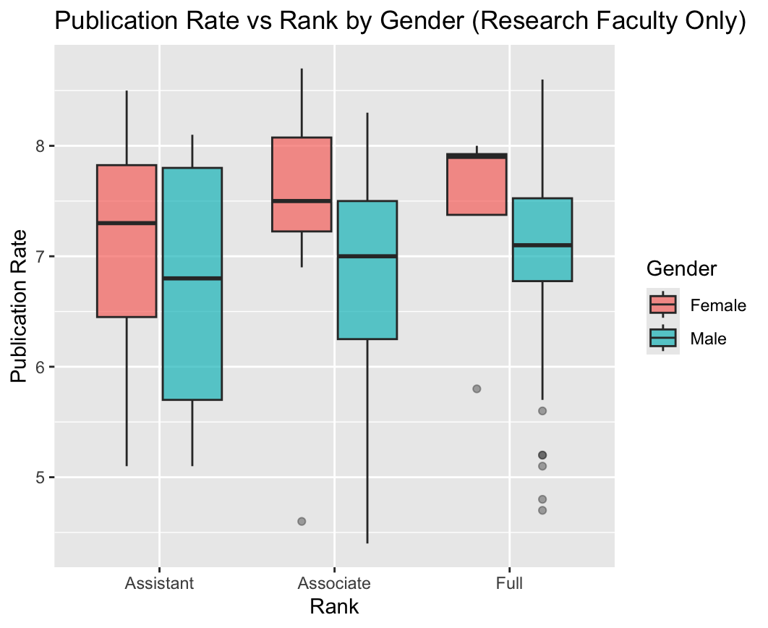
Appendix

