Slide 1


Slide 2

Lecture #6 – Racism and Sexism in Football
What seems to be a problem?
A First Hand Account – Guest Speaker Sonja Misso

Slide 3

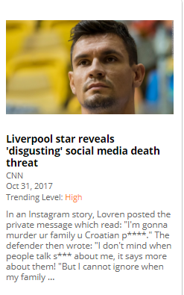
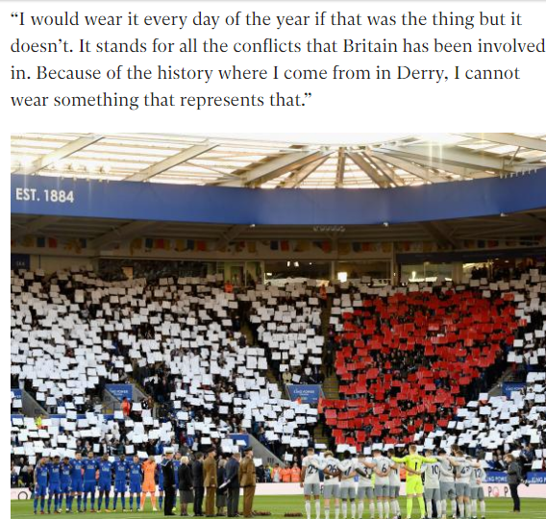
Last Week Today
$302 million
9 straight wins
23 unbeaten
52 goals in 11
10 in 11 against
1960 Spurs last better start
James McClean
Dejan Lovren reveals vile threat to his family following Liverpool defeat by Tottenham

Slide 4
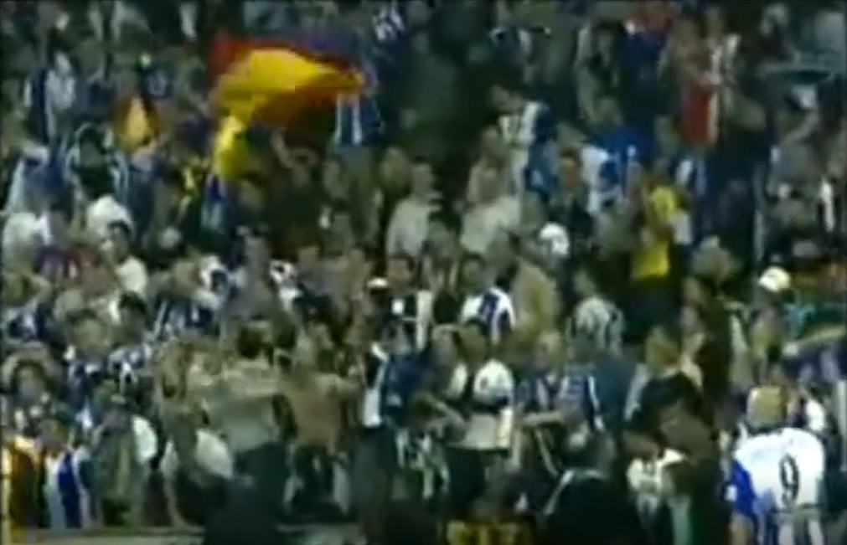
RACISM IN FOOTBALL

Slide 5
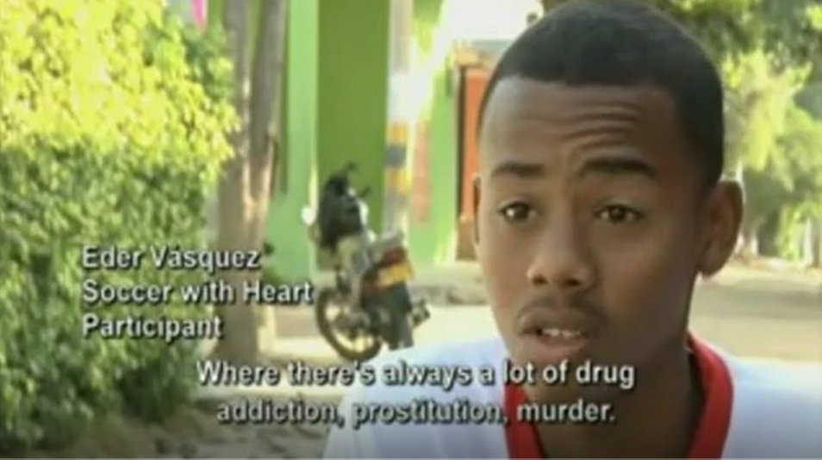
The Social impact of Soccer

Slide 6
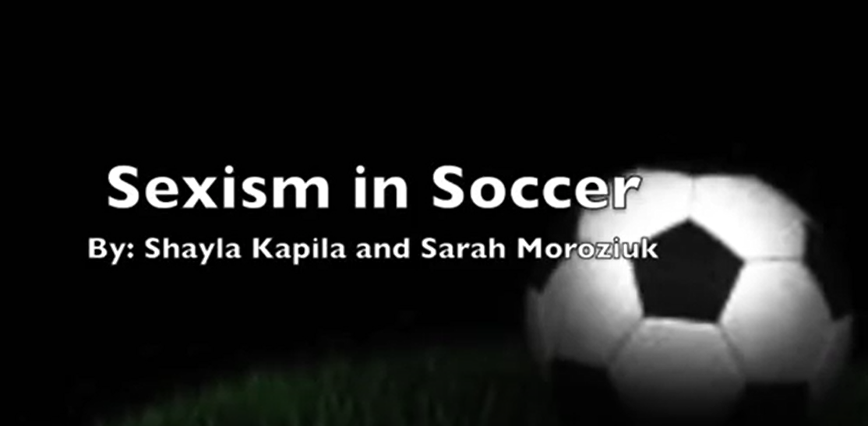
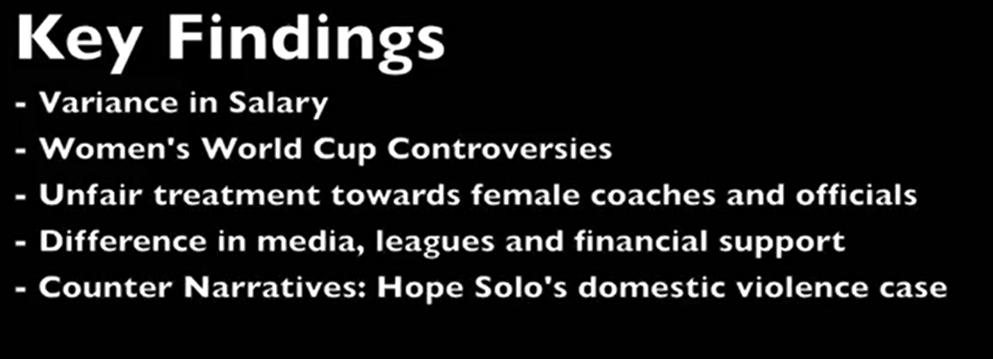

Slide 7
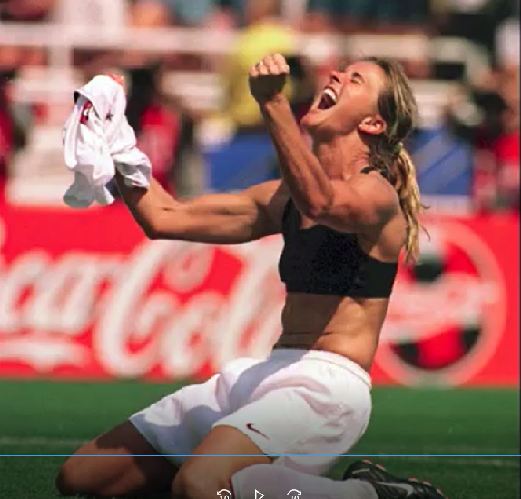
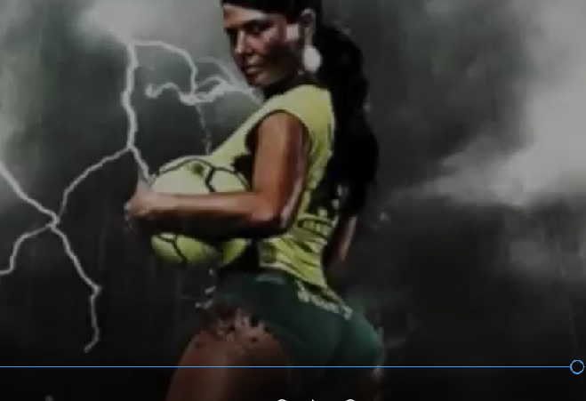
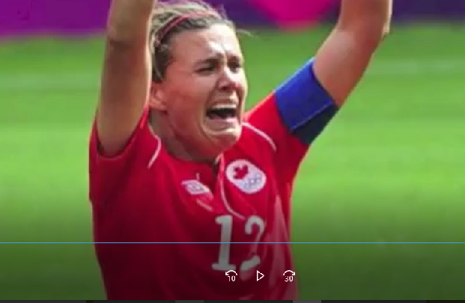
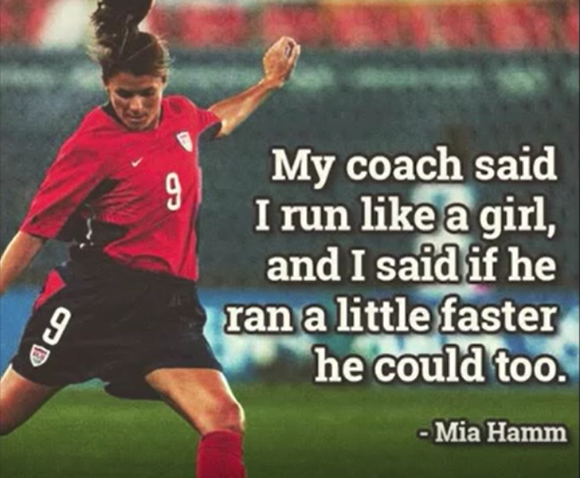

Slide 8

S
O
N
J
A
M
I
S
S
O

Slide 9
Next Week
The History of Soccer in Africa
Africa and Football (documentary)

