Slide 1


Slide 2

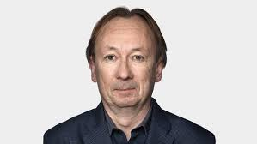
The Beautiful Game
The Joy of Soccer
Soccer & Entertainment

Slide 3










Last Week Today
World Cup Shockers

Slide 4
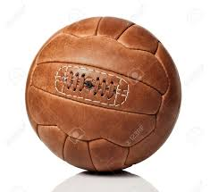
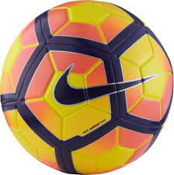
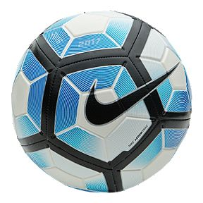

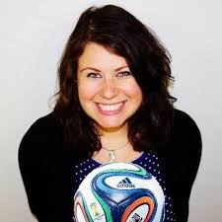
HISTORY- ORIGINS
STYLES - STARS
FOOTBALL HEROES & VILAINS
PELE, MARADONA, ZIDANE
1
5
AESTETICS
“THE BEAUTIFUL GAME”
GENDER, SEXISM,RACISM
2
6
FOOTBALL & POLITICS
HISTORICAL EVENTS
FOOTBALL IN AFRICA
7
3
FOOTBALL & ENTERTAINMENT
GOVERNANCE, FIFA
CORRUPTION & REFORMS
8
4

Slide 5
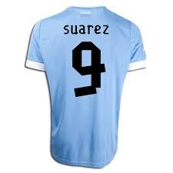
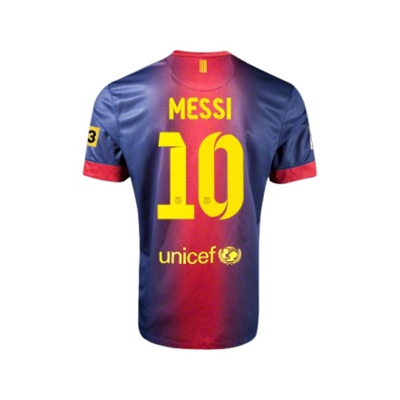

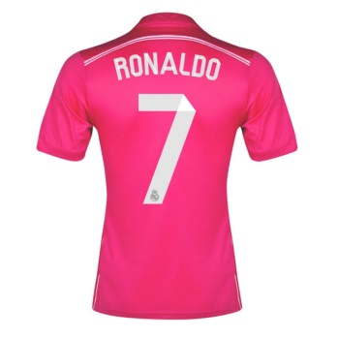
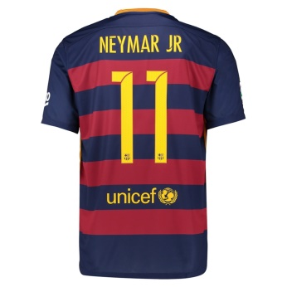
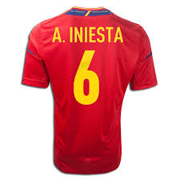
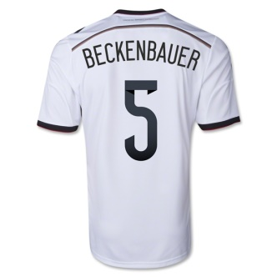
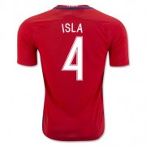
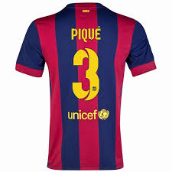
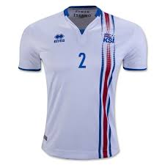

International
Diversity
Year Round
Jogo Bonito
Technical Skills
Fluid Play
Normalcy of Physic
Safety
Affordability
Easy-2-Learn
Accessibility

Slide 6
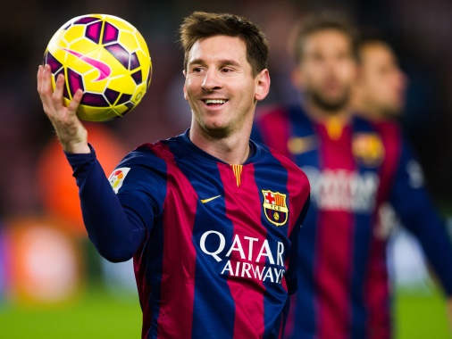
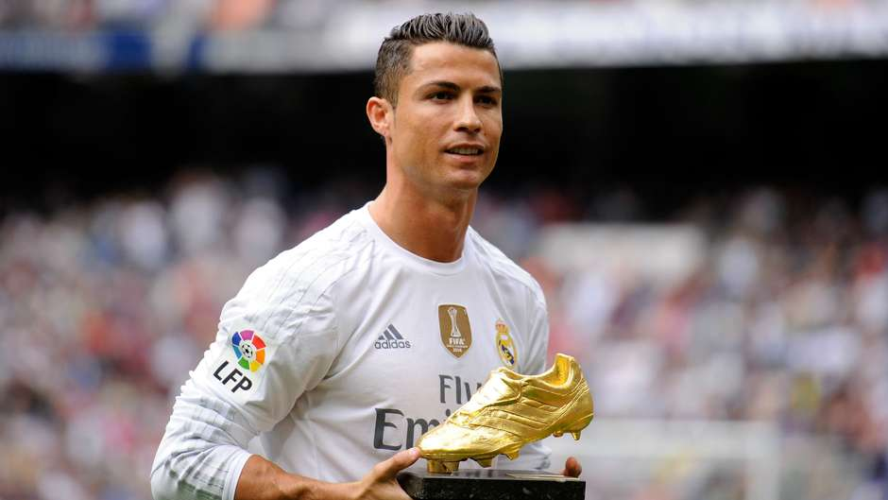
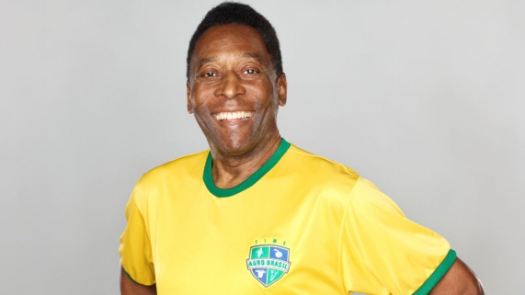
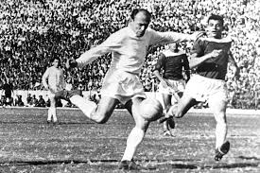
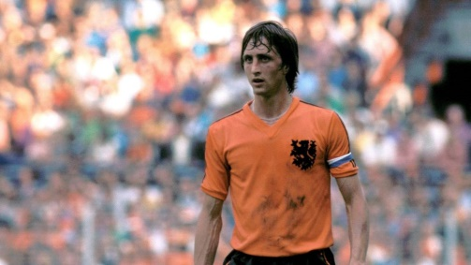
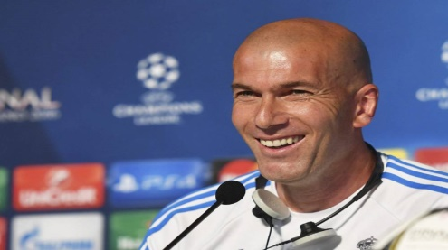
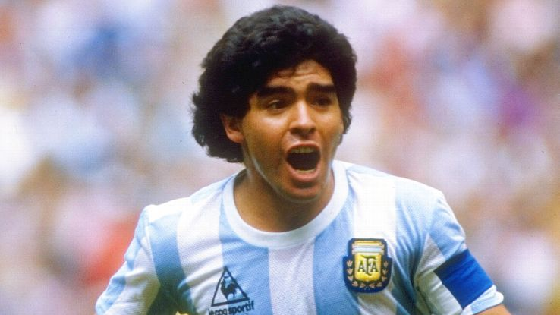
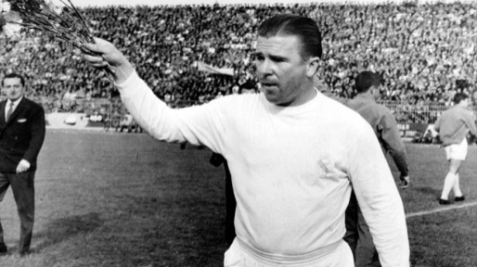
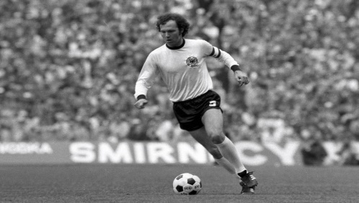
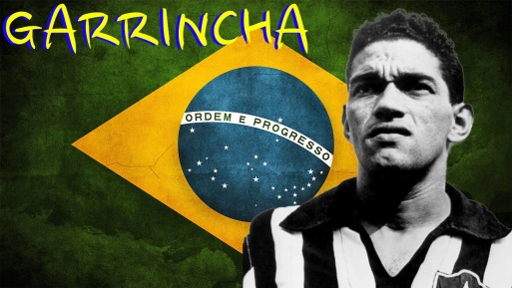
Top 10 Ever
3
7
4
8
1
9
5
6
2
10

Slide 7
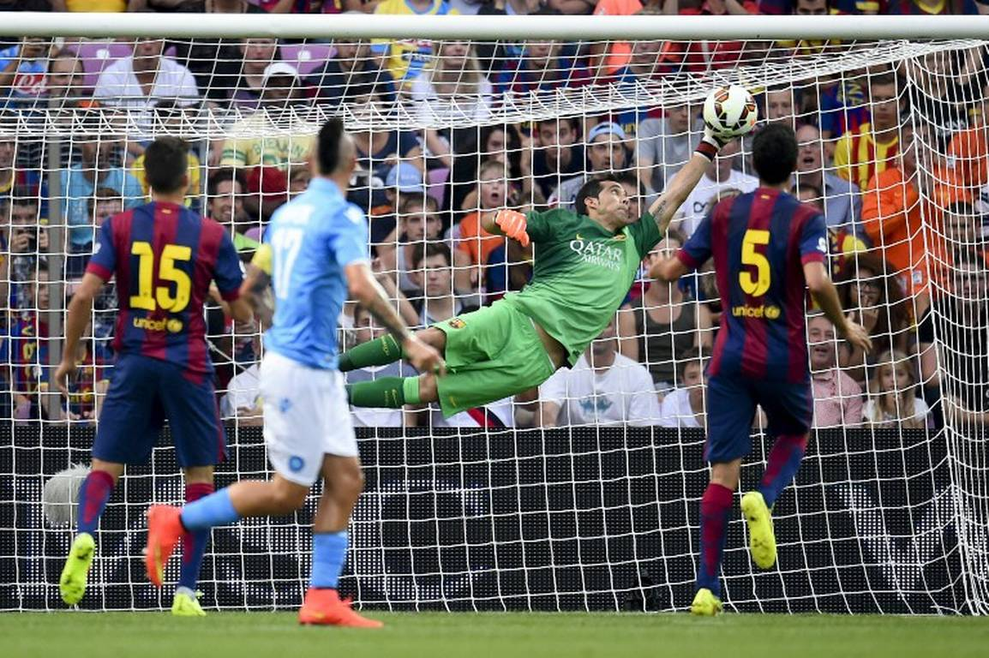

Slide 8
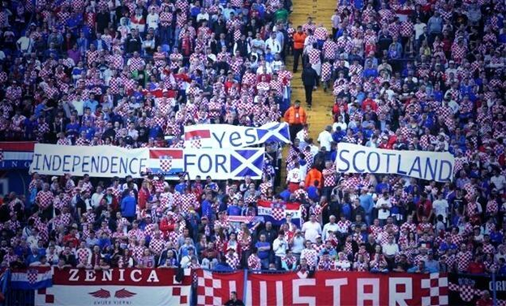
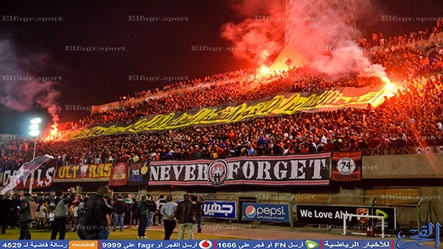
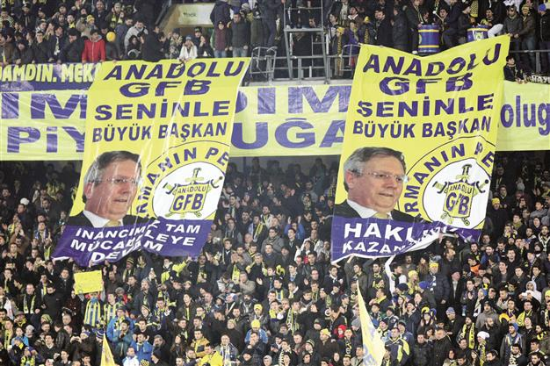
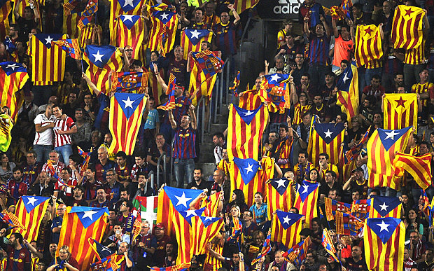
FOOTBALL & POLITICS

Slide 9
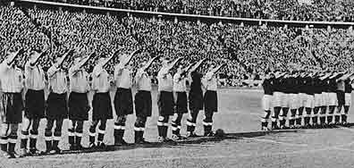
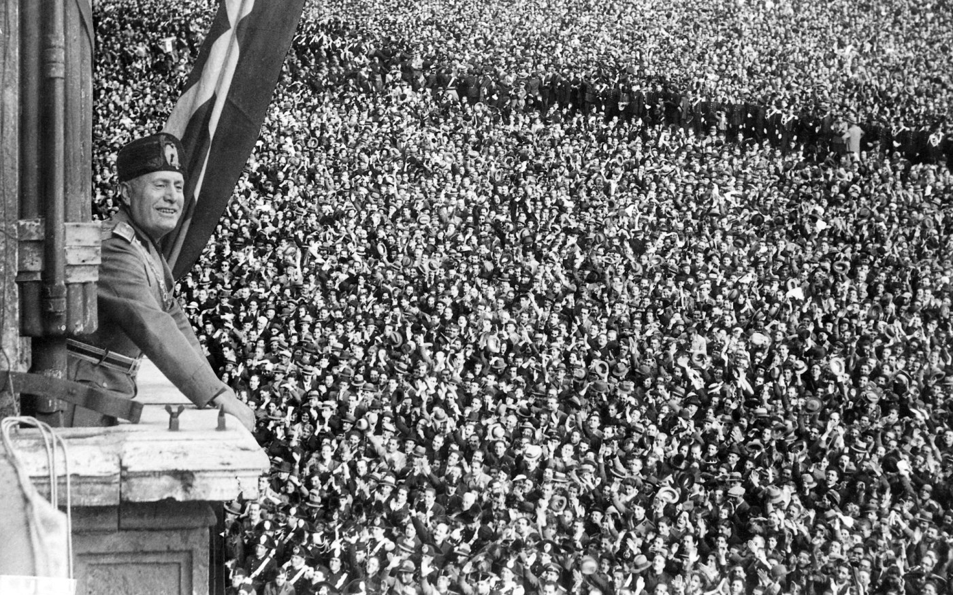
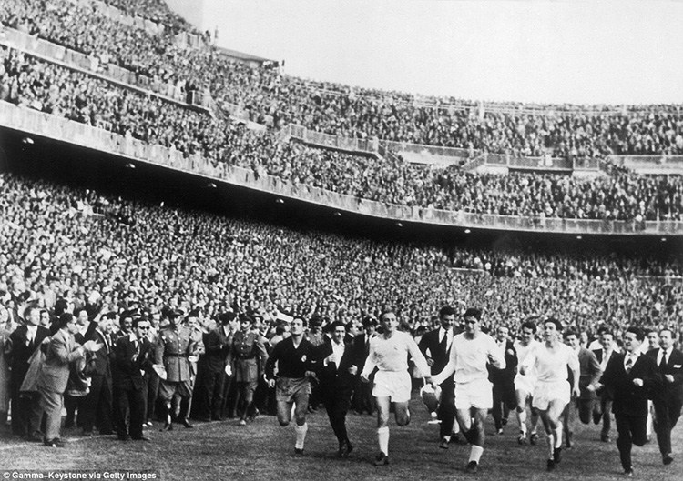
1938
FORCE FOR EVIL - IDEOLOGY
.

Slide 10
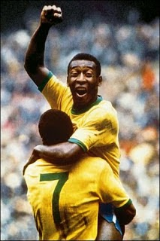

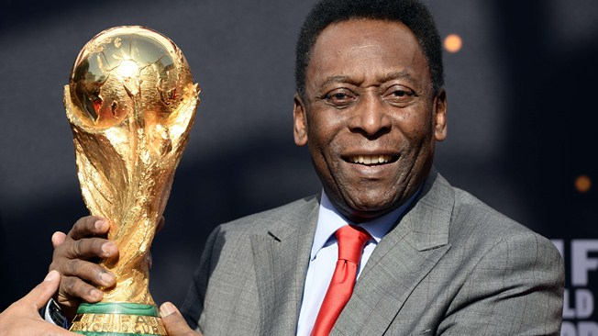
My Inspirational Hero – PELE’

Slide 11
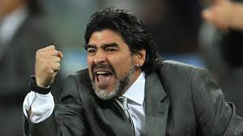
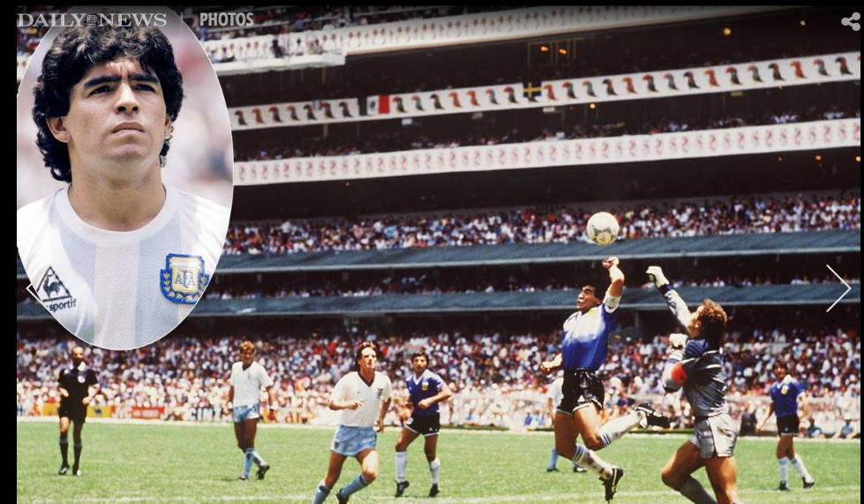
Diego Maradona
Argentine retired professional footballer. He has served as a manager and coach at other clubs as well as the national team of Argentina. Many in the sport, including football writers, players, and fans, regard Maradona as the greatest football player of all time. He was joint FIFA Player of the 20th Century with Pelé
.

Slide 12
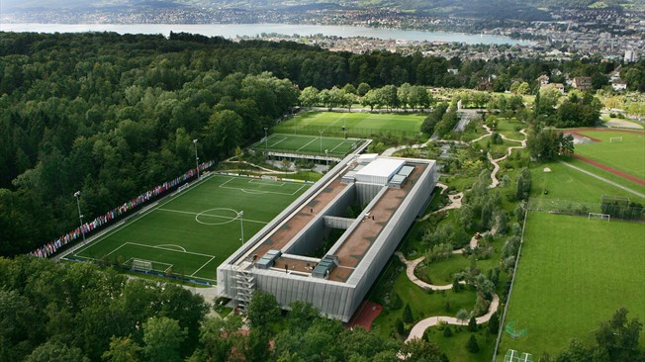
FIFA
∑(M+P) (#a+#t) =∞C
Money + Power multiplied by lack of Accountability plus lack of Transparency = Infinite Corruption

Slide 13




What is it like
being a woman
in the sport
journalism
industry?
Notes:
I will speak to this and use the WMC 2014 media report.

Slide 14
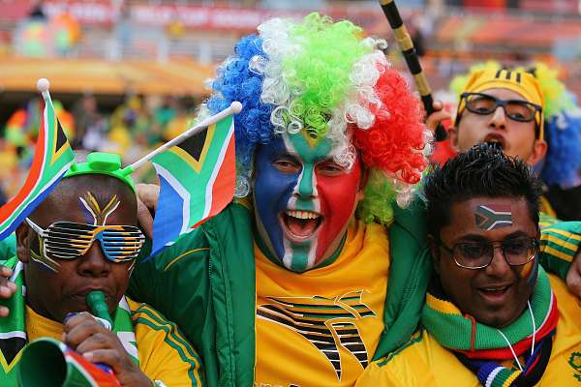
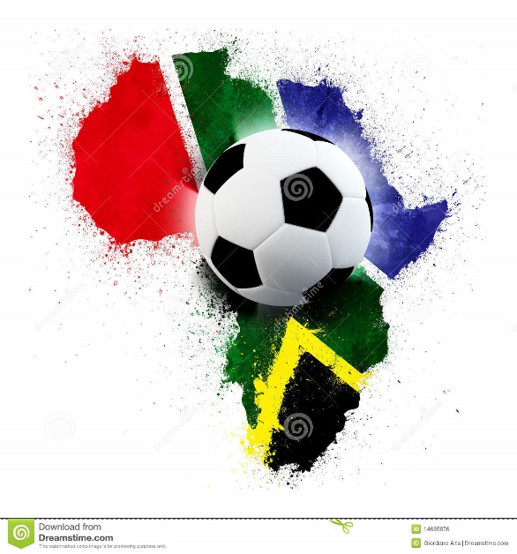
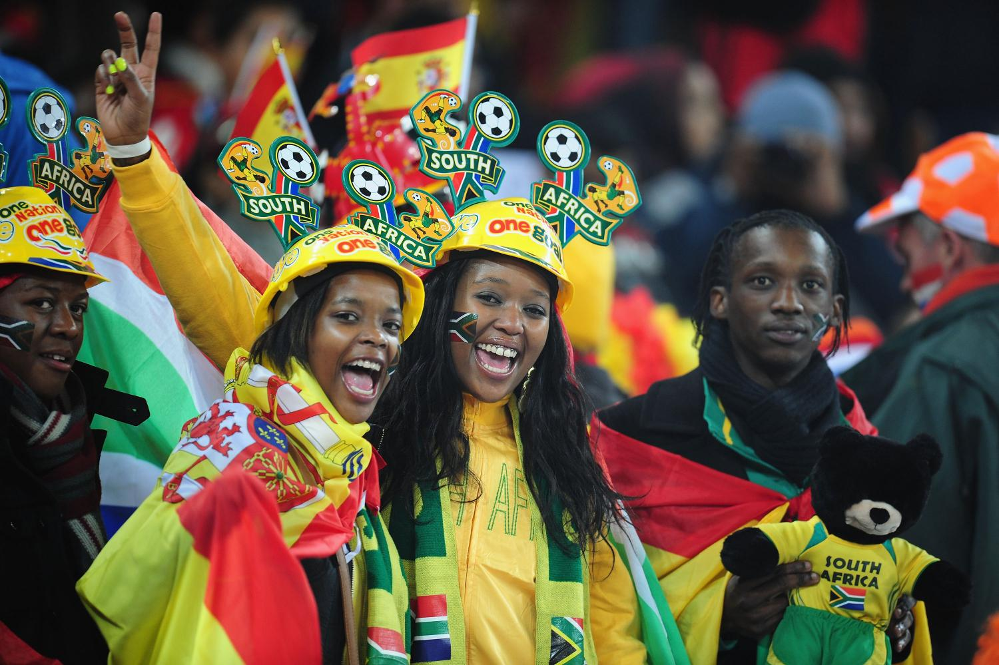
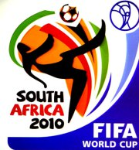
Soccer History in Africa

Slide 15
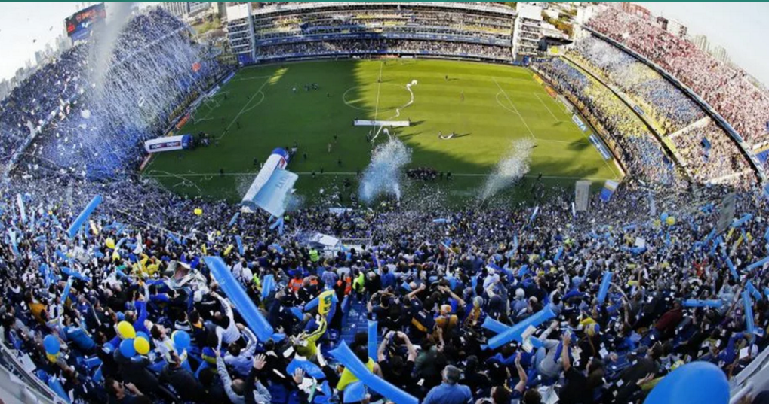

Slide 16
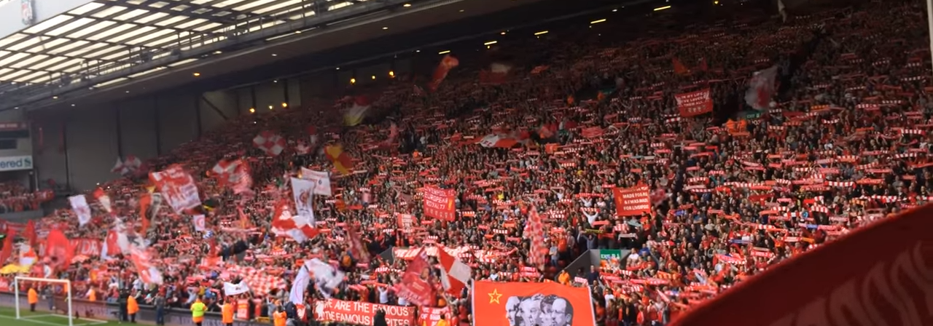

Slide 17
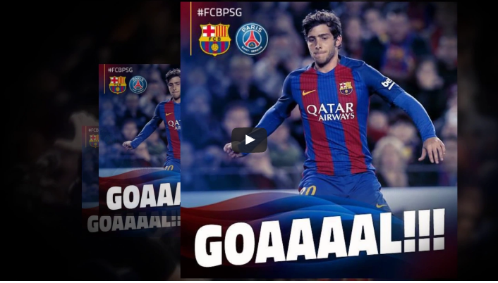

Slide 18
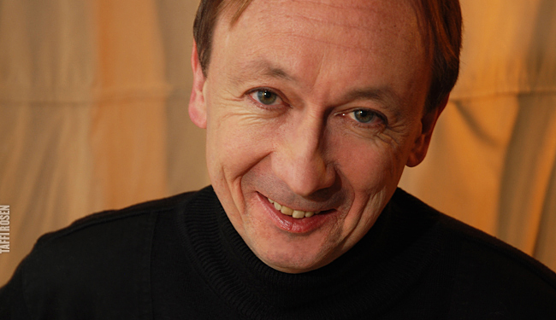

John Doyle is here in his capacity as a Soccer Fanatic. He is also the television critic for The Globe and Mail . He also covers major football (soccer) events for the paper. His writing on soccer has also appeared in The New York Times and The Guardian. His book The World is a Ball is a soccer fan’s must read.

Slide 19


