Slide 1

EE 464 POWER CONVERSION II
TERM PROJECT SIMULATION PRESENTATION
PL Electronics
Emin ÜN / 2167476
Emre KARABAKLA / 2540706
Görkem GÜLLETUTAN / 2166544

Slide 2
OUTLINE
Topology Selection
Analytical Calculations
Component Selection
Cost Analysis
Magnetic Design
Controller
Detailed Simulation
PCB Design

Slide 3
Topology Selection

Slide 4
Analytical Calculations
Battery Current and Voltage Waveforms From the Simulation Report
Simulations of Three Phase Diode Rectifiers
Circuit Schematic
Input and Output Voltage Waveforms
Simulations of Buck Converter
Circuit Schematic
Input and Output Voltage Waveforms
Simulations of Battery Part
Schematic of Controller Part
Corrected Battery Current and Voltage Waveforms

Slide 5


Analytical Calculations
Maximum Duty Cycle and Turns Ratio
$D_{max}=0.40$
$V_{D}=0.8$
$V_{Rds(on)}=0.2$
$N=\frac{N_{1}}{N_{2}}=11.45 \overset{→}{}$ $N=\frac{36}{3}=12$

Slide 6
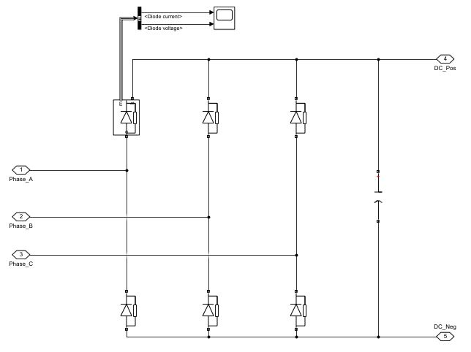
Simulation Results
Simulations of Three Phase Diode Rectifiers
Circuit Schematic
After corrections, capacitor is changed to 0.1mF from 1mF.
Decreased cost and size.

Slide 7
Up Next: …….
Name / Surname

Slide 9
Thank you
for
listening!

