Slide 1





Hand Gesture Recognition and Communication Software
Group-12

Slide 2
Abstract
The study aims at analyzing and recognizing single hand gestures that can be converted to text in order to facilitate communication with differently abled people.
we propose to recognize hand gestures using "Background Subtraction" and "Convolution Neural Network (CNN) " for Classification of Images into Text. Our method provides "98.28 %" accuracy for 28 classes of characters with the assumption that the background has no lines and edges and is smooth.

Slide 3
Introduction
The communication with and between differently-abled people, specifically deaf and dumb, has been a problem ever since. They need to learn different techniques for expressing their thoughts to other people.
Sign language is a visual language and consists of 3 major components[1]:
“Finger Spelling” : used to spell words letter by letter.
“Word Level Sign Vocabulary” : used for the majority of communication.
“Non-manual Features” : facial expression and tongue, mouth and body position.

Slide 4
In our project we basically focus on producing a model which can recognize Fingerspelling based hand gestures in order to form a complete word by combining each gesture which is custom for every user. This eliminates the problem of lack of communication with and between differently-abled people as this system overcomes the problem of sign language dependency.

Slide 5
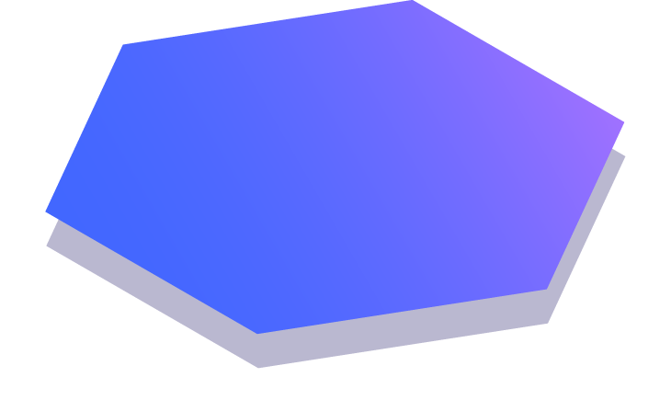
Literature Review
We studied the existing project related to the topic and the system behaviour.

Slide 6
We studied the existing project related to the topic and the system behavior. A group of researchers have worked upon a robust technique to generate background by taking weighted averages.
This is quite robust and works for most of the lighting conditions. Background subtraction was the most common way to extract the gestures out , after the background is generated. Several other methods such as, depth map for hand segmentation, hue saturation color model have been used for hand tracking and hand segmentation.
Another method which was used by another group of people was based on canny edge detection after skin color segmentation, for edge detection for edge detection, Principal Component Analysis (PCA) for feature extraction and then Support Vector Machine (SVM) for classification.
In one of the papers, they have proposed a method in which the angle and peak calculation approach is used to extract the features of hand gestures by using MATLAB and then they convert the recognized gesture into speech using MATLAB inbuilt command.

Slide 7

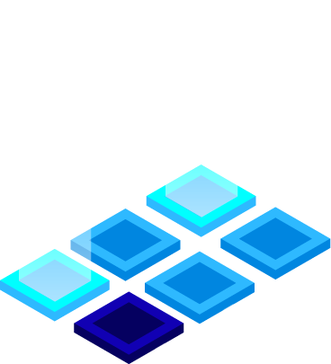
Problem Definition
The crux of the problem is given an image of hand gesture we have to tell the character to which it is mapped. The images are stored in the database So, we can formally define the problem to be the prediction of the contextual meaning of a particular hand gesture, via learning of an appropriate system of related data.

Slide 8
Proposed Methodology
Dataset Collection
Data Pre-processing
Training phase
Testing Phase
Output generation

Slide 9
Database Collection
The dataset is custom generated. We used Open computer
vision(OpenCV) library in order to produce our dataset. Firstly we captured around 1000 images of each of the symbol in English alphabet for training purposes and around 100 images per symbol for the testing purpose.
Data Pre-processing
The grayscale image recorded is passed through a Guassian blur filter of 7x7. After that Background subtraction is applied onto them to extract out the hand. The obtained image is then resized to 100x89 which is then stored into the system.

Slide 10
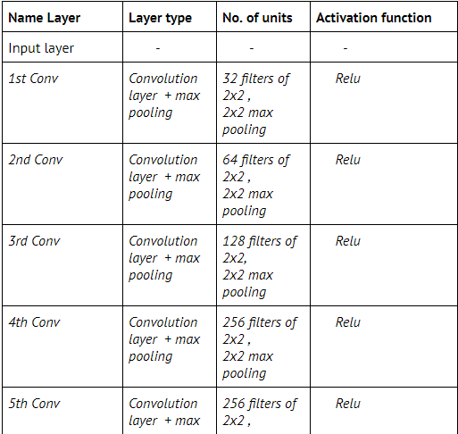
Training phase
For the training phase we had 28000 images of 100x89 fed into CNN.

Slide 11
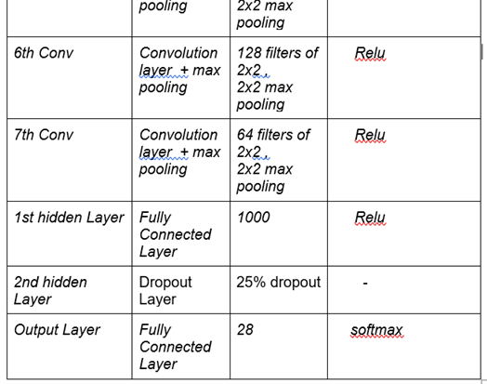
Training phase
For the training phase we had 28000 images of 100x89 fed into CNN.

Slide 12
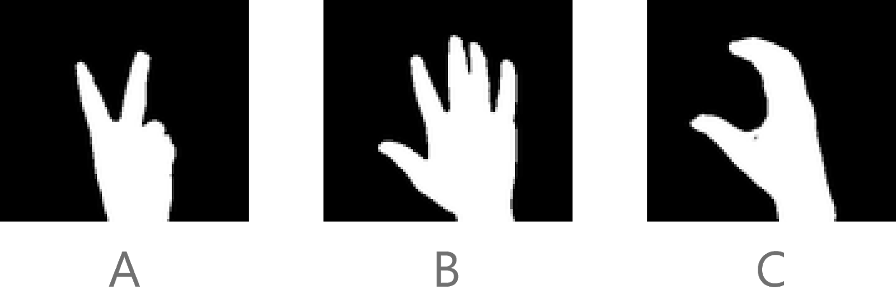
Output Generation
When the application starts , running average of 30 frames is taken to learn the background .
Now when user shows the gesture , it is converted into Grayscale image and passed through Background subtractor , then resized and passed into the model for prediction.
The predicted class is passed through a function to get the corresponding character of that class which is displayed onto the screen along with its confidence.

Slide 13
What’s new in our approach ?
We’ve defined gesture for all 26 english alphabets, for space and backspace as well, which leads to a total of 28 gestures.
CNN is used in training model instead of traditional ways because of their ability to develop the image, for eg. , a 2-D image to corresponding 1-D representation without losing its characteristics.Loss function will be calculated, weights and biases updated accordingly which will be faster than the traditional method.

Slide 14
Continued..
We have implemented a functionality to form sentences from the gestures detected. We can form both words and append it to form a sentence. A backspace functionality is added for correction of wrong letters.
In the base paper, the authors used angle and peak calculation for gesture detection, but we have used a weighted average background generation and background subtraction for detection of gestures, which proved to be more robust to lighting conditions.

Slide 15

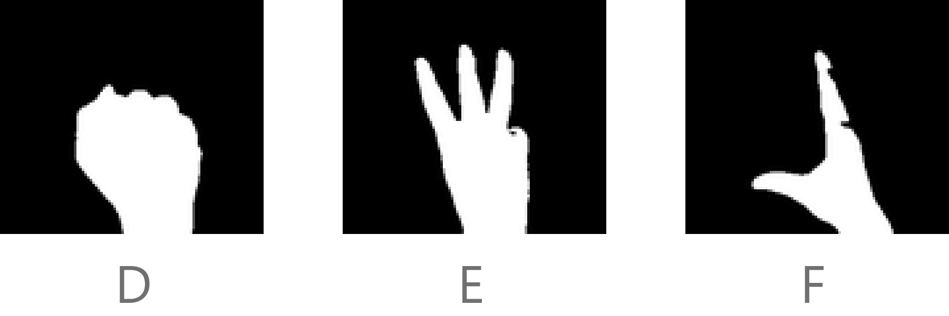
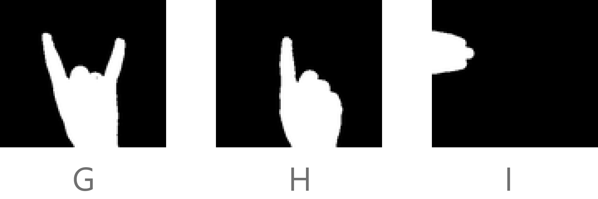
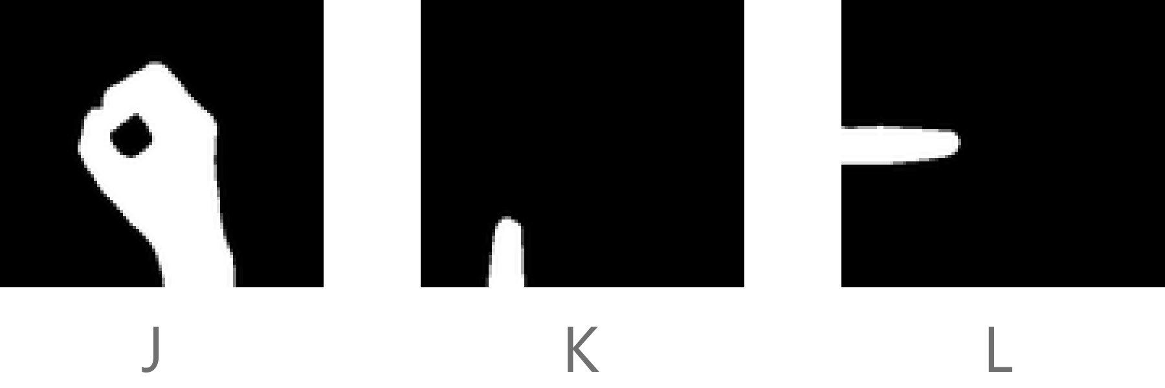
Our Input Gestures

Slide 16
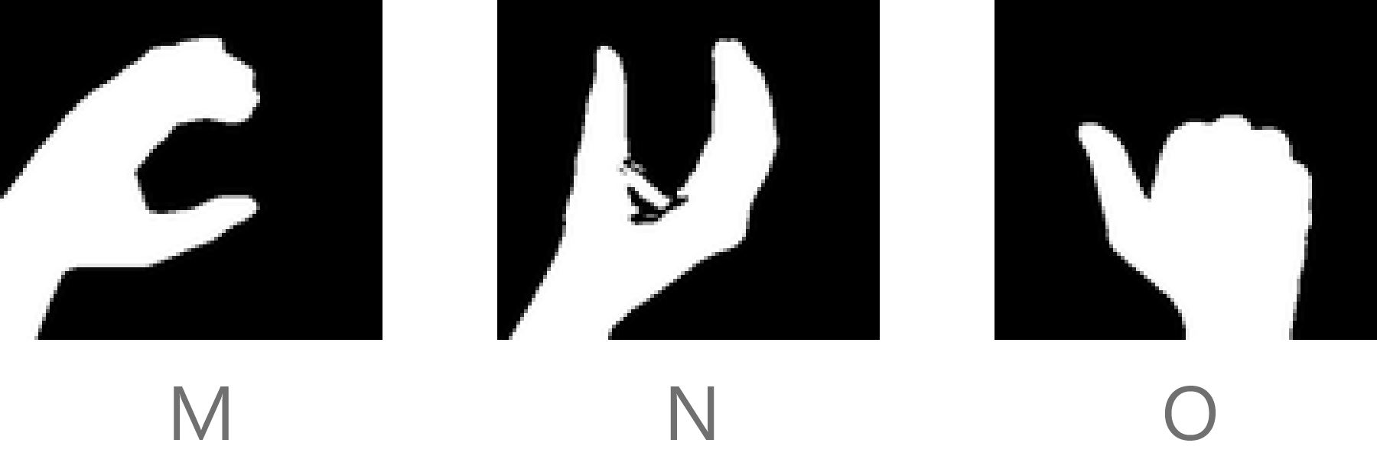
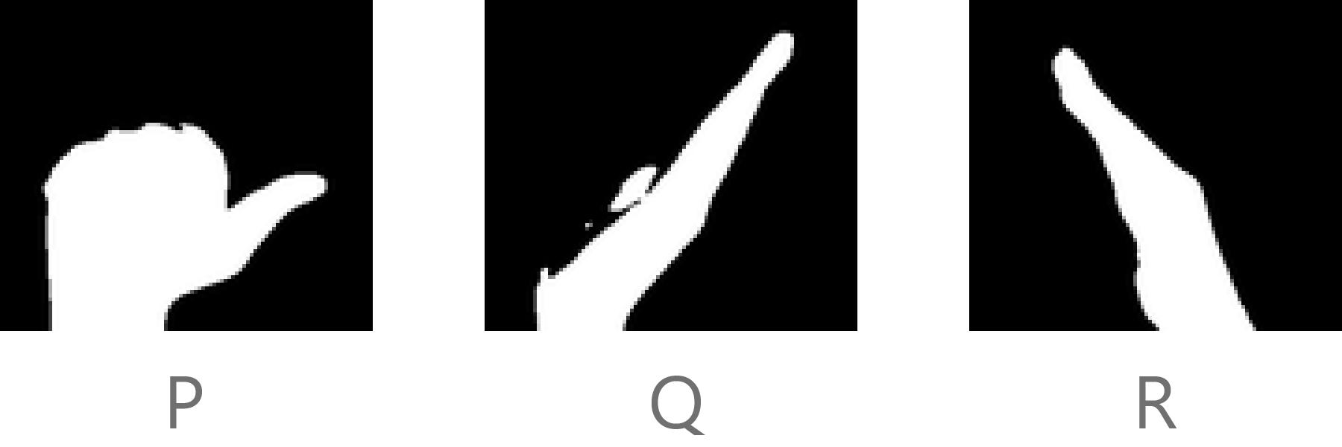
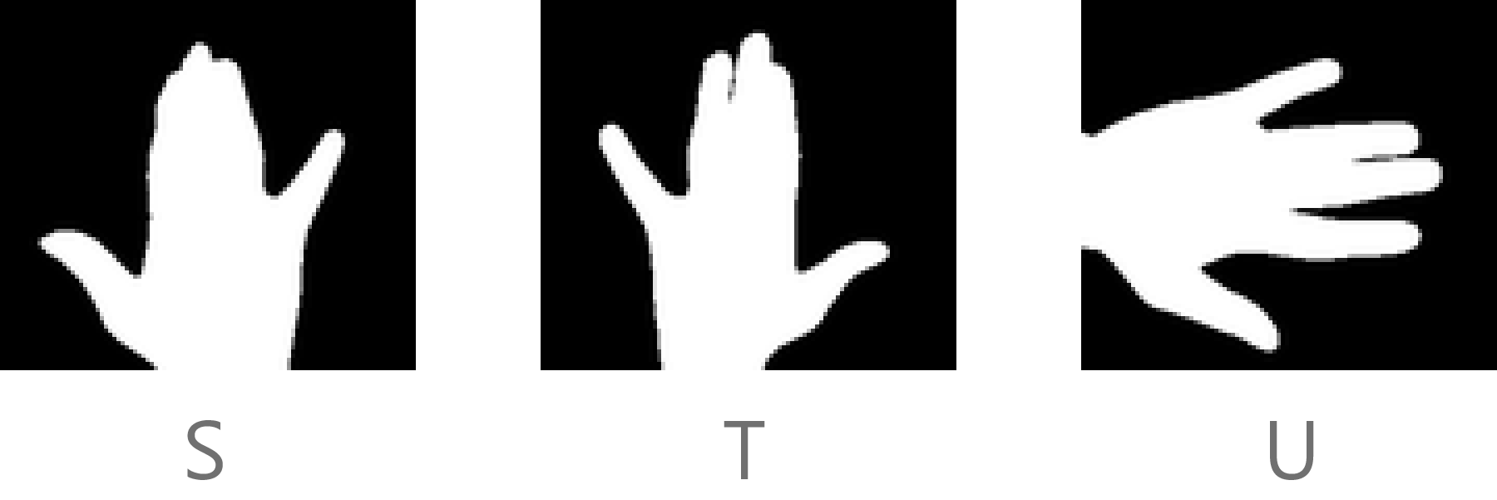
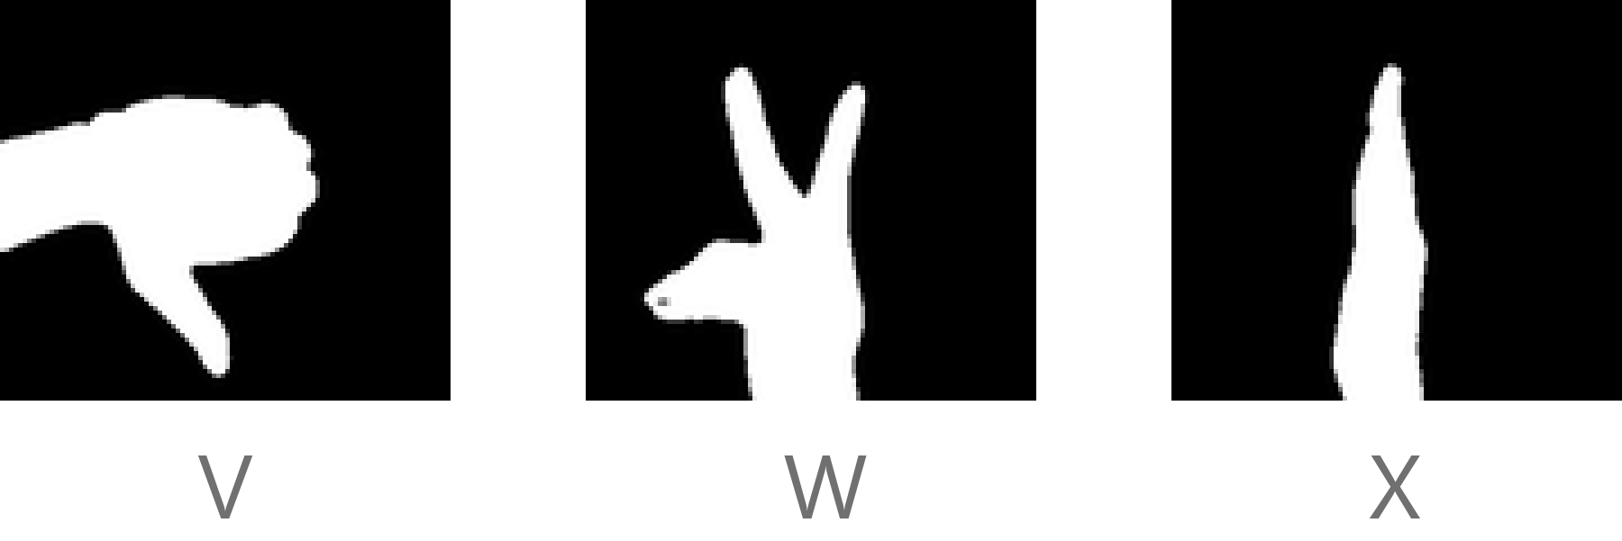
Our Input Gestures

Slide 17
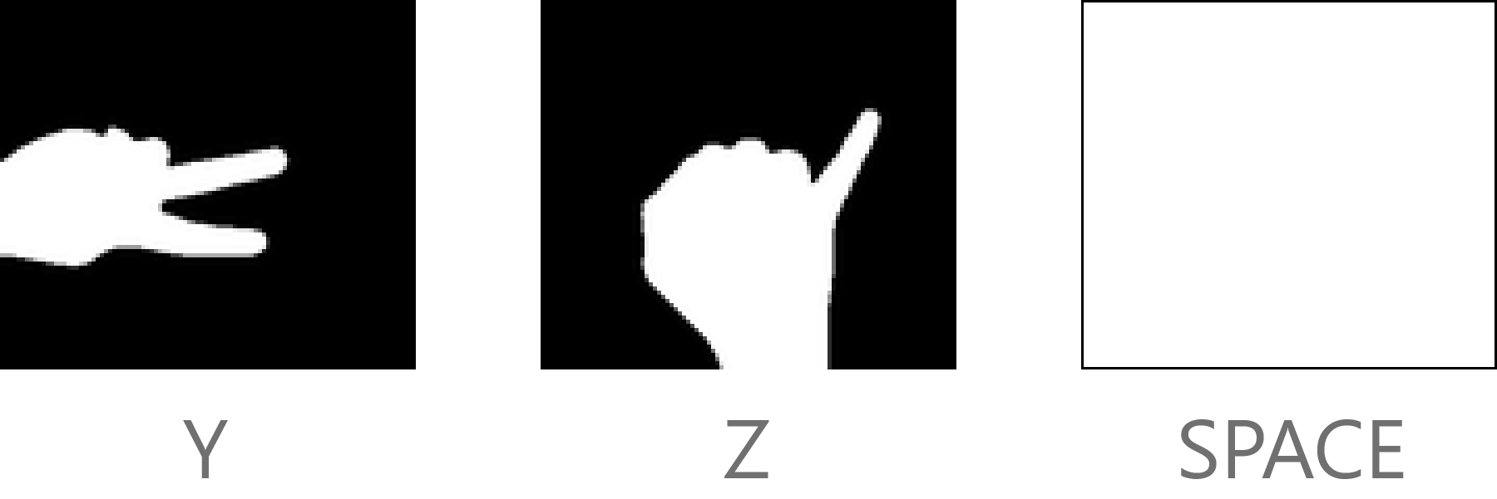

Our input Gestures
BACKSPACE

Slide 18
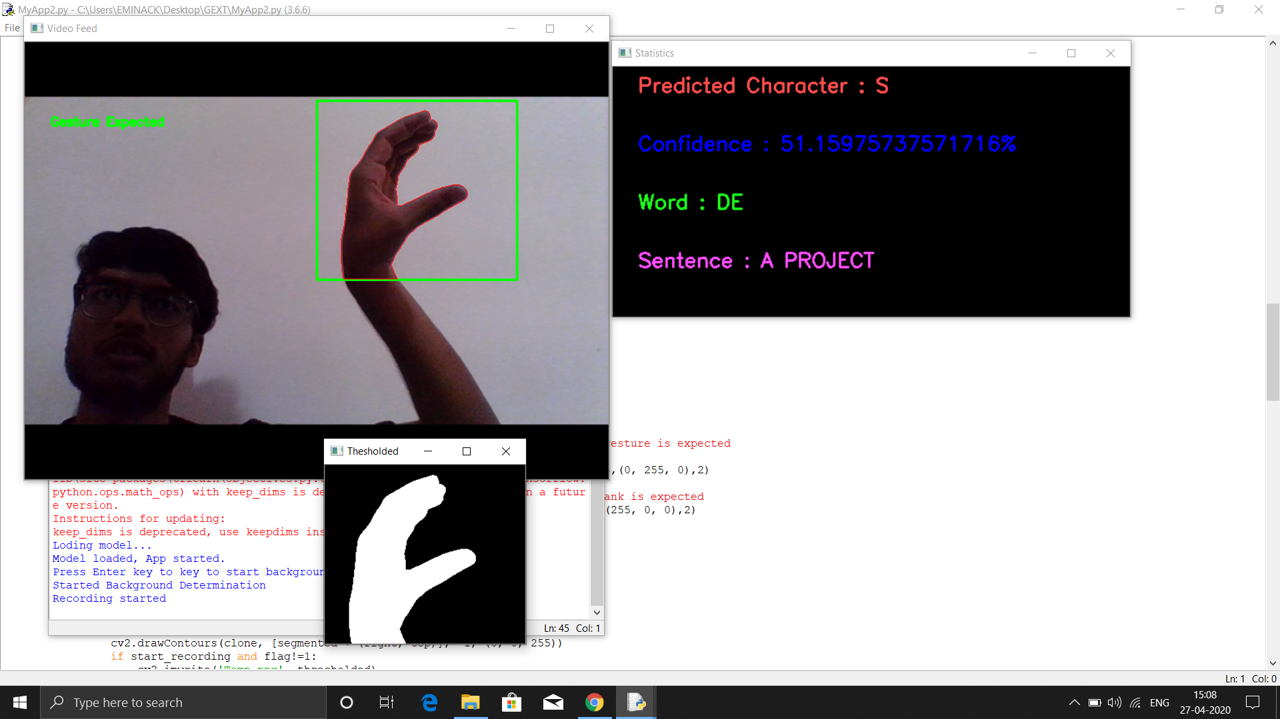
RESULTS OF OUR PROJECT

Slide 19
Advantages of this approach
Eliminates the dependency of sign language between the users using it, since each person can customize the actions according to his/her needs.
User can also create a custom database which can give the flexibility to :
Use words
Use custom templates

Slide 20
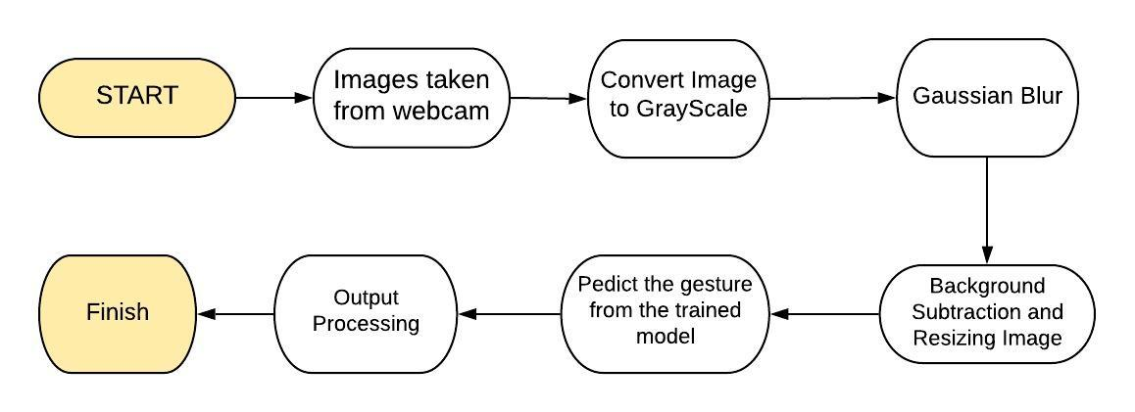
System Architecture

Slide 21
Tools
Python
Scikit learn
Tensorflow
OpenCv
Keras
Numpy

Slide 22
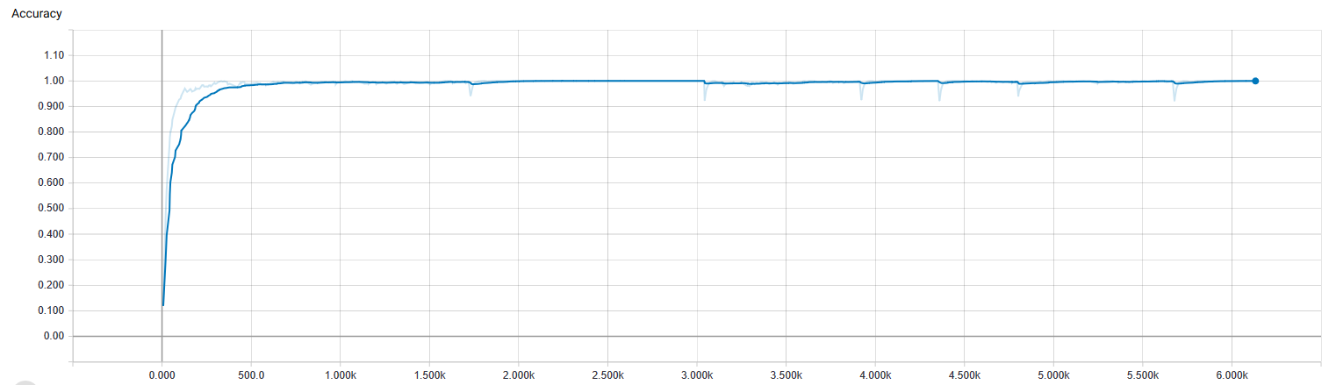
RESULTS
No of steps
Training - Accuracy

Slide 23
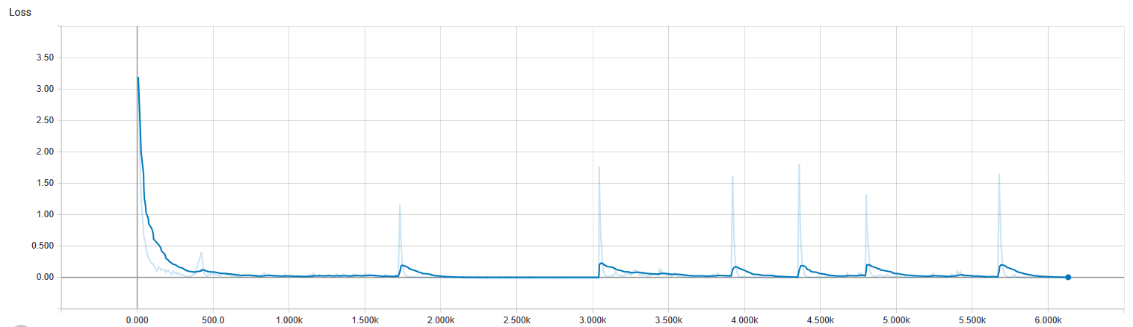
No of steps
Training - Loss

Slide 24
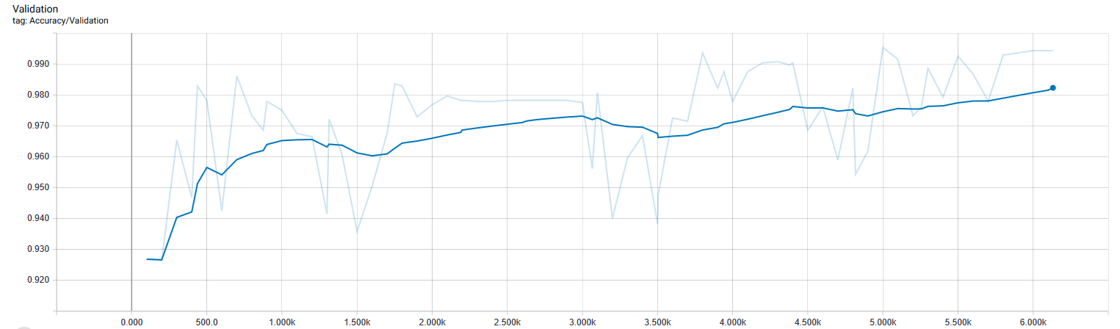
No of steps
Validation - Accuracy

Slide 25
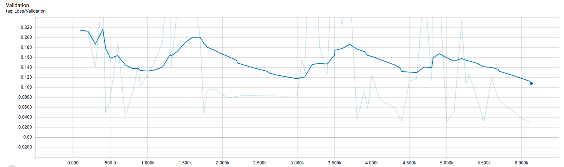
No of steps
Validation - Loss

Slide 26
Bibliography
https://gogul.dev/software/hand-gesture-recognition-p1
We have used referred to this blog for background subtractor and have used the same in our code.
https://papers.nips.cc/paper/4824-imagenet-classification-with-deep-convolutional-neural-networks.pdf --- AlexNet brought a breakthrough in Image classification tasks in machine learning and provided better results than most of the pre-existing models. We have used this architecture in our project.

Slide 27
References
[1] Hazem Khaled , Samir G. Sayed El Sayed M. Saad and Hossam Ali. “Hand Gesture Recognition Using Modified 1$ and Background Subtraction Algorithms”. 2015 Hindawi, Mathematical Problems in Engineering, 2015.
[2] Byeongkeun Kang, Subarna Tripathi and Truong Q. Nguyen. “ Real-time sign language fingerspelling recognition using convolutional neural networks from depth map “. 2015 3rd IAPR Asian Conference on Pattern Recognition (ACPR).
[3] Shinde, Shweta S., Rajesh M. Autee, and Vitthal K. Bhosale. "Real-time two-way communication approach for hearing impaired and dumb person based on image processing." Computational Intelligence and Computing Research (ICCIC), 2016 IEEE International Conference on. IEEE, 2016 (BASE PAPER)

Slide 28
Thanks!
Aditya Raj
IIT2017005
Sameer Kathal
IIT2017020
Aman Saxena
IIT2017021
Nishant Kumar
IIT2017023
Sneh Sameer
IIT2017028

