Slide 1
HAND GESTURE RECOGNITION AND COMMUNICATION SOFTWARE
Literature review
Group 12
Aditya Raj
Sameer Kathal
Aman Saxena
Nishant Kumar
Sneh Sameer
IIT2017005
IIT2017010
IIT2017021
IIT2017023
IIT2017028

Slide 2
Reference Papers
Ref. [1], “Real-time Sign Language Fingerspelling Recognition using Convolutional Neural Networks from Depth map” - Byeongkeun Kang Subarna Tripathi Truong Q. Nguyen. 2015 3rd IAPR Asian Conference on Pattern Recognition (ACPR).
Ref.[2], “SSVM Classifier and Hand Gesture based Sign Language Recognition” H.P Singh, Gaurav Yadav, Dr. H.P Singh , Sanal Malhohtra, Mr. Ashutosh Gupta, Amity University Uttar Pradesh, Noida, India, Tata Consultancy Services Ltd., New Delhi, India. 2018 International Conference on Intelligent Circuits and Systems
Ref.[3], “Real-Time Two Way Communication Approach for Hearing Impaired and Dumb Person Based on Image Processing”, Shweta S. Shinde, Rajesh M. Autee, Vitthal K. Bhosale, Deogiri Institute of Engineering and Management Studies, Aurangabad, Maharashtra, India.Computational Intelligence and Computing Research (ICCIC), 2016 IEEE International Conference on. IEEE, 2016 (BASE PAPER)

Slide 3
“Real-time Sign Language Fingerspelling Recognition using Convolutional Neural Networks from Depth map” - Byeongkeun Kang Subarna Tripathi Truong Q. Nguyen
Methodology
Dataset Collection : They have collected 31,000 depth maps using a depth sensor, Creative Senz3D camera of the resolution of 320 × 240. The dataset consists of 1,000 images for each of the 31 different hand signs from five subjects. 31 hand signs include all the finger-spellings of both alphabets and numbers.

Slide 4
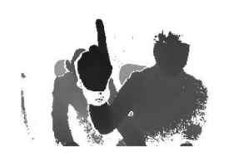
Fig 1: Captured image before pre-processing.

Slide 5
Cont.
Hand Segmentation : that the closest object from the camera is the user’s hand. This assumption is valid in fingerspelling and hand gesture tasks. They used a black wristband to get depth voids around the wrist, since the depth sensor cannot capture depth from black objects well. As a part of hand is the closest to the camera and there is depth void on the wrist part due to the black band, hence the process of hand segmentation is essentially finding the connected components from this nearest part. A bounding box was made around the extracted gesture to form an image of size 256x256.

Slide 6
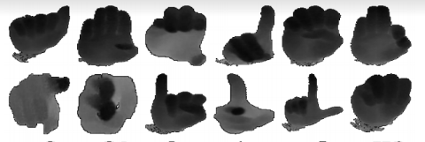
Fig 2: Processed image for training ( Background is set to zero)

Slide 7
Cont.
Classification :
Architecture : We use Caffe [4] implementation (Caf-feNet) of the CNNs which is almost equivalent to AlexNet. The architecture consists of five convolution layers, three max-pooling layers, and three fully connected layers. After each convolution layer or fully connected layer except the last one, rectified linear unit layer is followed.
Feature Extraction : A 4096-dimensional feature (final fully connected layer feature) vector was extracted from each pre-processed depth image using the aforementioned architecture.
Training : They categorized the pre-training process into two operational modes, namely re-training and fine-tuning. For re-training, the model is re-trained from randomly generated weights using the collected fingerspelling data.

Slide 8
Cont.
Classification :
Training cont.: In fine-tuning, we pre-train the CNNs using a large ILSVRC2012 classification dataset [11]; then we fine-tune the network weights for fingerspelling classification with the same architecture except the last layer which is replaced by 31 output classes. From the subjects’ data separation perspective, in one case, they did not separate the subjects in training, validation, and testing and in the second scenario, they used data from different subjects for training, validation and testing.

Slide 9
“SSVM Classifier and Hand Gesture based Sign Language Recognition” H.P Singh, Gaurav Yadav, Dr. H.P Singh , Sanal Malhohtra, Mr. Ashutosh Gupta, Amity University Uttar Pradesh, Noida, India, Tata Consultancy Services Ltd., New Delhi, India
The important point of this research paper is to recognize skin color and filter-out skin color from the RGB image. RGB color image converted into gray scale image and then it again converted into binary image. Then using skin color based segmentation, it filters out the skin color from the image and then it extracts the region of interest from the image. After extracting ROI (Region of Interest), the background of the image subtracted from the image by the background subtraction method. Hand gesture from the binary image extracted by Principal Component Analysis features of fifteen different hand gestures with 100 samples extracted. We are using SVM classifier to train the entire image and hand gesture so all the 15 hand gesture of 100 samples is trained using it. The SVM classifier is giving 95.4% efficiency after training it.

Slide 10
Cont.
Methodology
Image Acquisition: The acquired image size is set on 640x480. A complete set of 100 images is taken from the web camera of the laptop with 15 different gestures. The entire images are taken with different light conditions to keep the system efficient. The dataset prepared by the 200 images taken from the web camera
Skin color segmentation: The upper range of values of RGB in the image with respect to skin color is [240 230 220] and lower RGB values in the skin color is [120 110 105]. The color image converted into binary image using the skin color values of RGB. The values upper than the RGB value consider as 1 and remaining considered as 0 in the image. From this consideration all the pixels of the image converted into 0 and 1. The unwanted objects except the area of hand region is eliminated from the binary Image with the help of connected components.

Slide 11
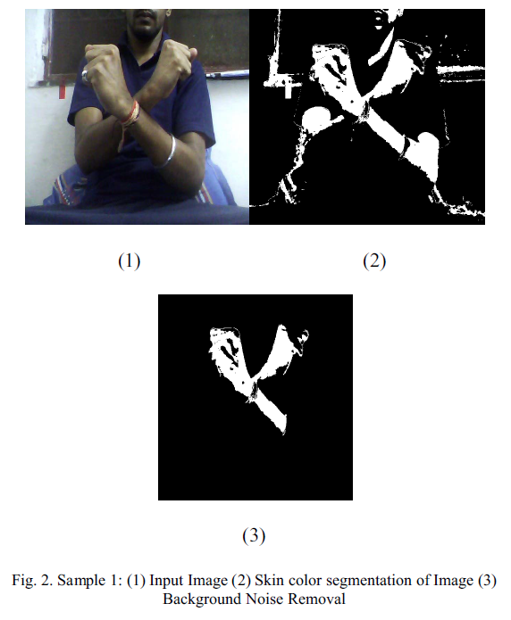
Fig 3: (1) Input Image (2) Skin Color Segmentation (3) Background Noise Removal

Slide 12
Cont.
Feature Extraction And Classification: PCA is used to extract out the features from the image. The seven PCA features are as follow: Mean; Entropy; Energy; Homogeneity; Correlation; Contrast;and standard deviation. In these PCA features, only best two features are selected for the training and testing purpose. Due to consideration of only two features, the matrix resolve in 100x2 matrix and this matrix will be used for the training and testing of next step.
Training & Testing: The system is trained for the 15 hand gesture it is recognizing the hand gesture with accuracy rate of 95.4 %. All the 15 hand gesture is identified or recognize by SVM classifier. The gesture which has been recognized for security purpose is keeping in Category A and all other hand gesture is keeping in category B. The category B hand gesture further Trained and tested by the SVM classifier. Using SVM all the 15 different gestures is recognized.

Slide 13
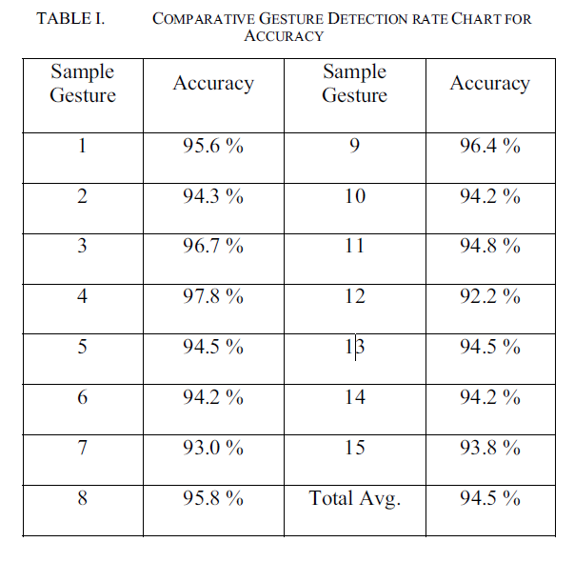
Table 1: Comparative Gesture Detection accuracy chart

Slide 14
“Real-Time Two Way Communication Approach for Hearing Impaired and Dumb Person Based on Image Processing”, Shweta S. Shinde, Rajesh M. Autee, Vitthal K. Bhosale, Deogiri Institute of Engineering and Management Studies, Aurangabad, Maharashtra, India.
This research paper project is actually based on vision-based Hand Recognition. It performs operations like background segmentation of hand from the obtained data and after that, unique gestures are assigned to different signs on which this project is working on. This paper involves methods like feature extraction and it is being calculated using peak calculation and angle calculation of hand gestures, and in the final stage, the gestures are recognized and since this paper is converting the text output into speech format, the output is converted to speech.
The proposed system is based on MATLAB.

Slide 15
Cont.
Methodology
Image Acquisition: The dataset collected for training and testing purposes in the form of images using a webcam, the same mentioned in the reference paper.
Image Preprocessing: Images have been converted from RGB to grayscale for training and testing purposes. Grayscale images are passed through a gaussian blur filter for Noise Reduction and Background Subtraction will be done, as mentioned in the base paper, to extract out the hand

Slide 16
Cont.
Feature Extraction: It involves two steps -
Angle and Peak Calculation: This approach takes the number of folded and not folded fingers into consideration and zero, positive and negative are used to differentiate among gestures.
Classification Bit Generation: A 12-bit binary sequence is generated for the classification purpose for each of the hand gestures, which classifies the different hand gestures. Then finally, the gesture is recognized and converted into the required output format.
Output Format: Since in the reference paper, the output format is required into speech, so the text received from the gesture is converted to speech format and this reference paper has also discussed some steps on getting the gestures from the speech format as well, and since this research paper has worked for alphabets from A-I, one result of the same is attached:

Slide 17
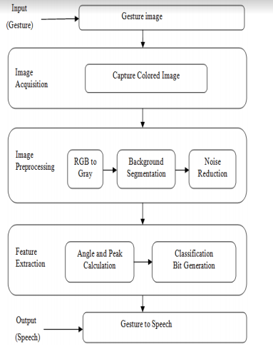
Fig 4: Flow Diagram

Slide 18
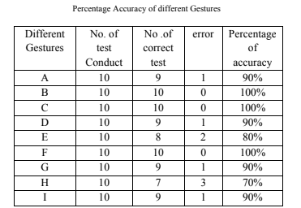
Table 2: Percentage Accuracy of different Gestures

Slide 19
THANK YOU

