Slide 1

Aegis
A lightweight syscall monitoring and sandboxing solution
Dominik M. Weber, Emina Sljivic, Hanna Körkel

Slide 2
Motivation
Black-box apps without source code -> security concerns
Best security: Spin up VM (boring)
Solution: Lightweight sandbox with monitoring capabilities

Slide 3
Monitoring

Slide 4
with ptrace we can read out the syscall nr. register
(e.g. rax on x64)
on every syscall entry
report syscalls back via stdout
Aegis
C++
Helper
Traced app
path, args
fork & ptrace
dup2 -> named pipes for stdout & stderr

Slide 5
System Call Filters

Slide 6

Userspace App
Userspace App
read
getpid
Userspace apps do almost everything through syscalls
open
socket
Syscall Filter - seccomp
write
Kernel

Slide 7
Temporally-Specialized System Call Filters

Slide 8
Problem
most seccomp users apply the filter once, often at application startup, and never change it afterwards [1]
all required syscalls are included in a single, overly permissive filter!
Solution
We already trace the syscalls… why not monitor them as well?
It’s a bit more expensive, but we can just check every syscall and kill the child if it does not behave!
Sleep deprivation hit right about then….
[1] Transparent Temporally-Specialized System Call Filters. In ACM Asia Conference on Computer and Communications Security (ASIA CCS ’25), August 25–29, 2025

Slide 9
Desktop JVM
Android Native
Kotlin Multi-Platform
Common Code
Linux JVM
Android Native
C++ Helper
C++ Helper

Slide 10
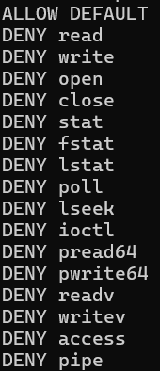
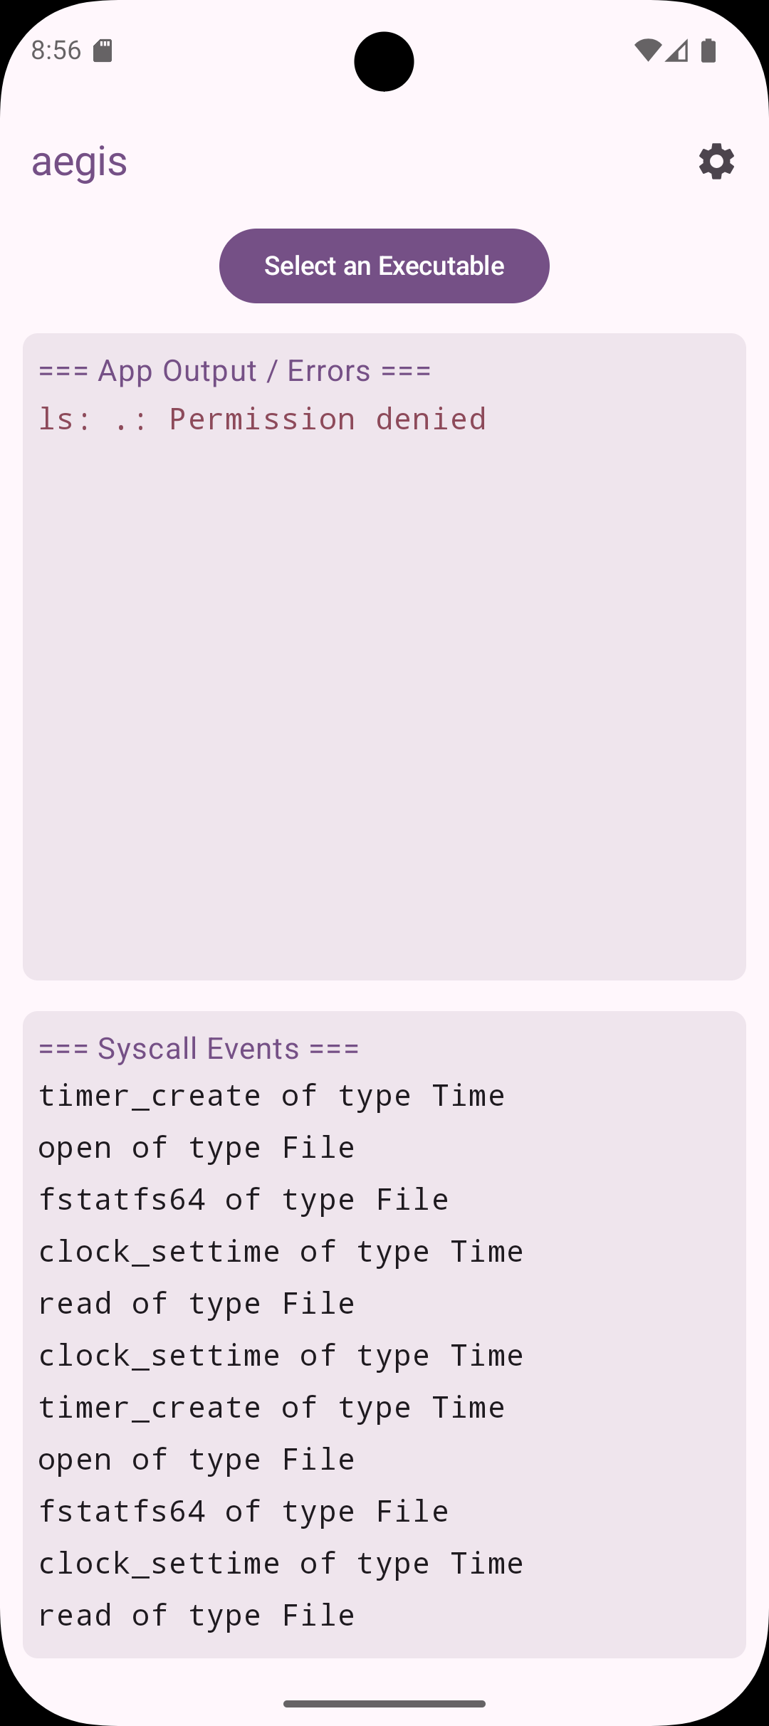
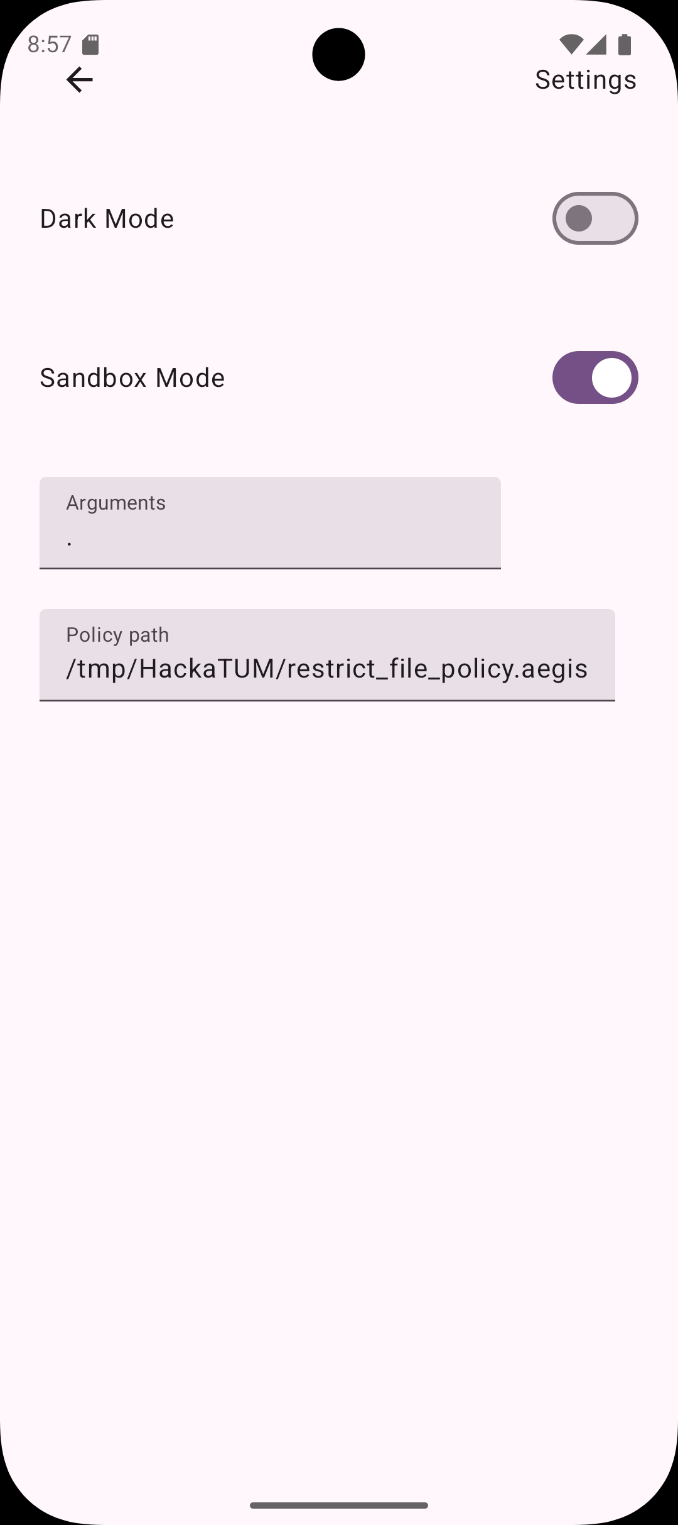

Slide 11
